Slide 1

Balancing Weather Risk and Crop Yield for Soybean Variety Selection
Bhupesh Shetty
Ling Tong
Samuel Burer

Slide 2
Thank you!

Slide 3
Outline
Decision Model
Results
Coefficient Estimation
Conclusion

Slide 4
Decision Model

Slide 5
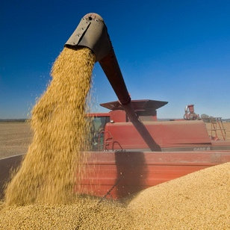
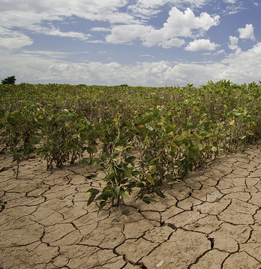
Competing Objectives
Minimizing weather risk /
Maximizing guaranteed yield
Maximizing expected yield

Slide 6


Sets
varieties
season types

Slide 7

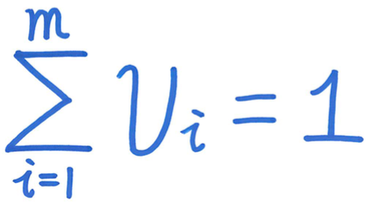
Variables and Constraints
percentage to allocate
100% allocation

Slide 8
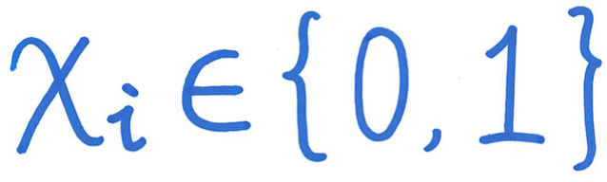

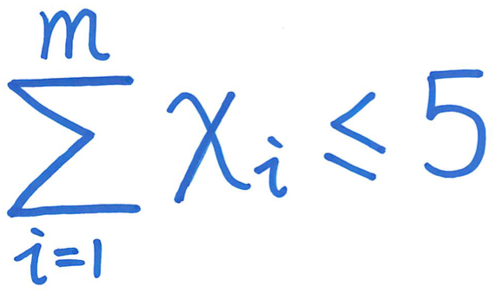
Variables and Constraints
indicator
bounds
limit on number
of varieties

Slide 9

Objectives
maximize expected yield
expected yield of variety
during season type
probability of season type

Slide 10

Objectives
maximize guaranteed yield
expected yield of variety
during season type

Slide 11
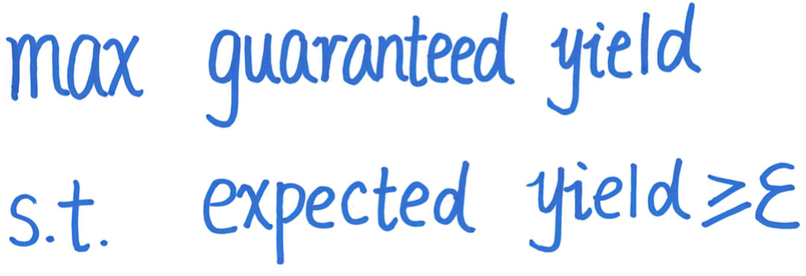
Frontier

Slide 12
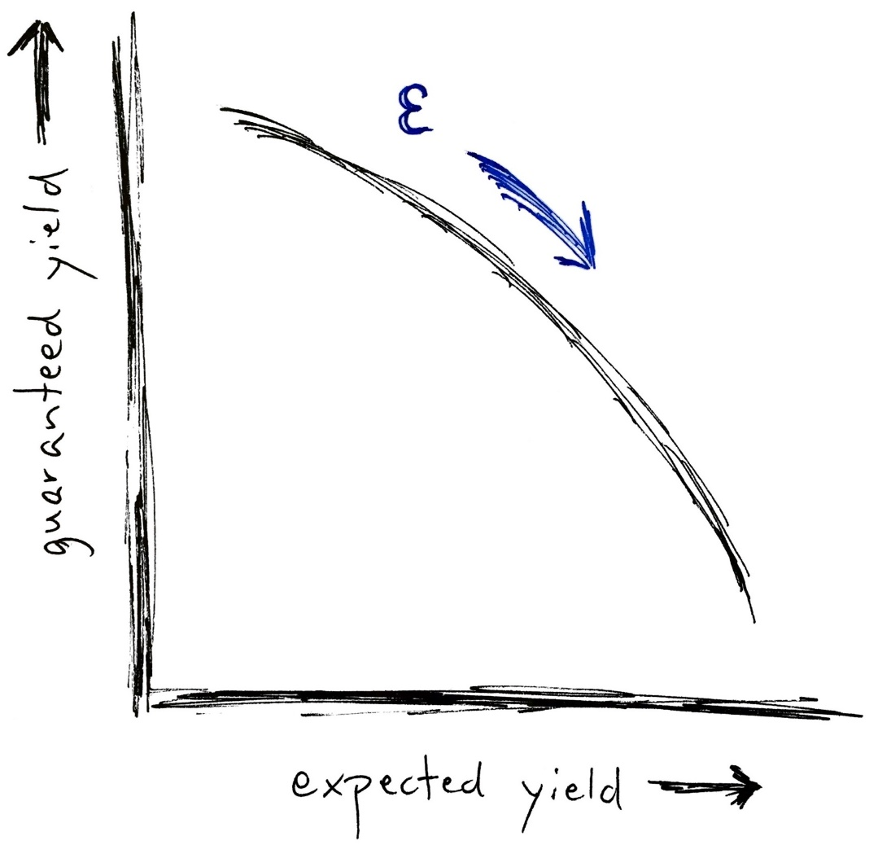
Frontier

Slide 13
Results

Slide 14
Implementation
Data handling | R
Optimization | Julia + JuMP + Cbc
Time | < 3 min on typical laptop

Slide 15
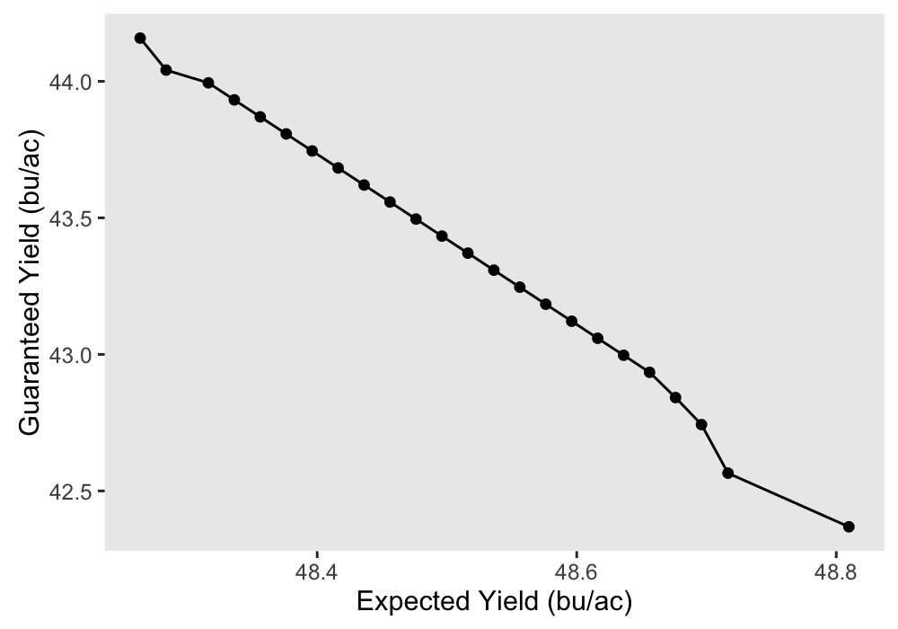
Frontier

Slide 16
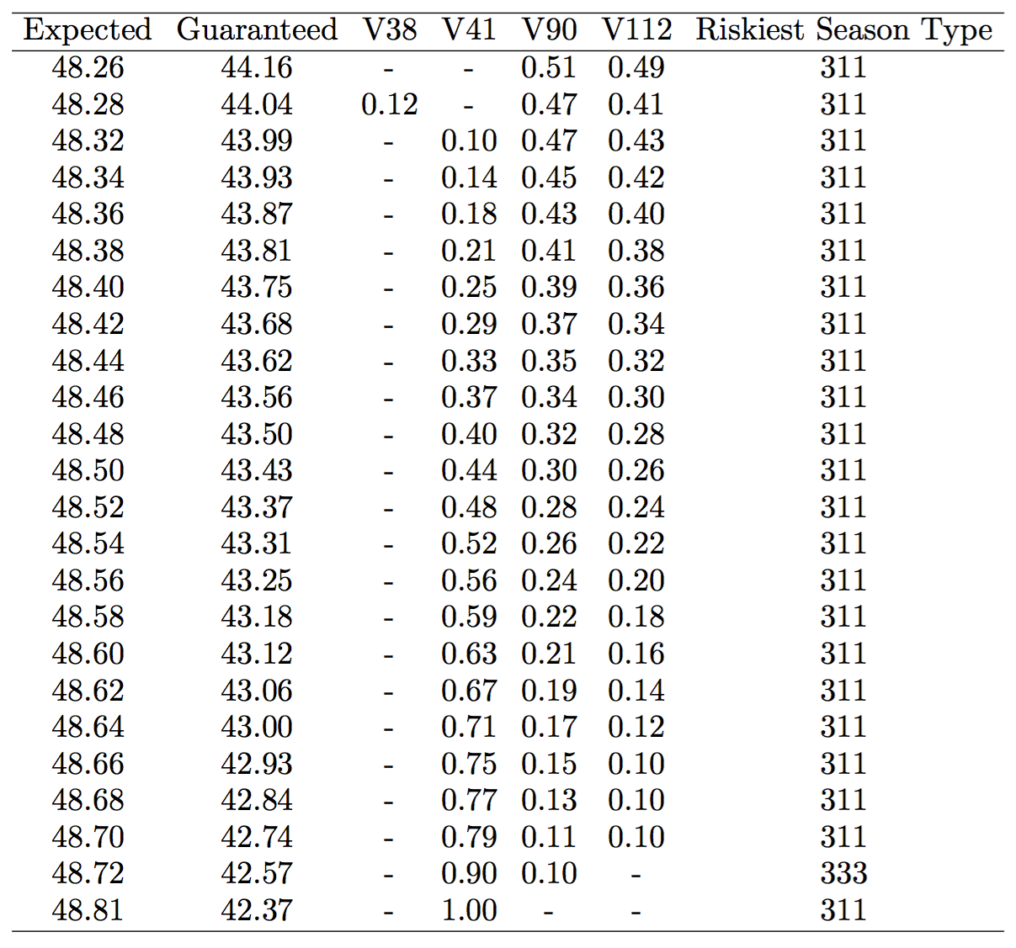
Frontier

Slide 17
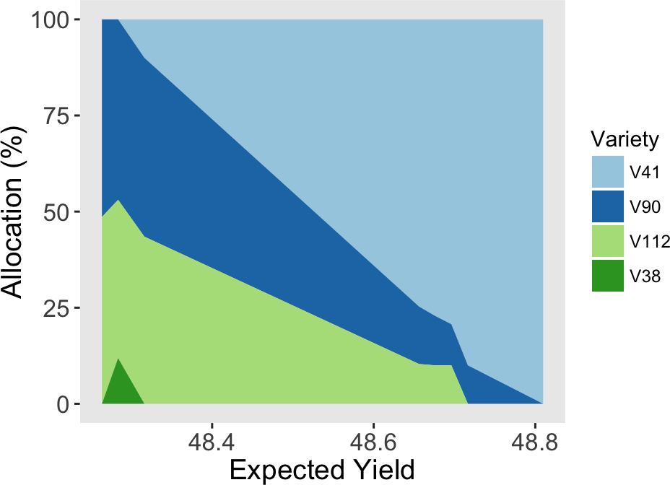
Optimal Solutions

Slide 18
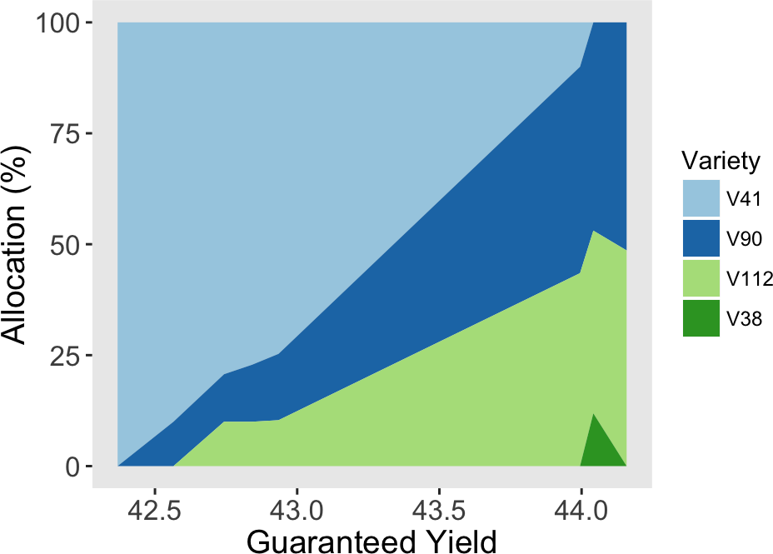
Optimal Solutions

Slide 19
Coefficient Estimation

Slide 20
Data Cleaning
Followed Challenge FAQ
Imputed missing data
Identified data-unique site locations

Slide 21
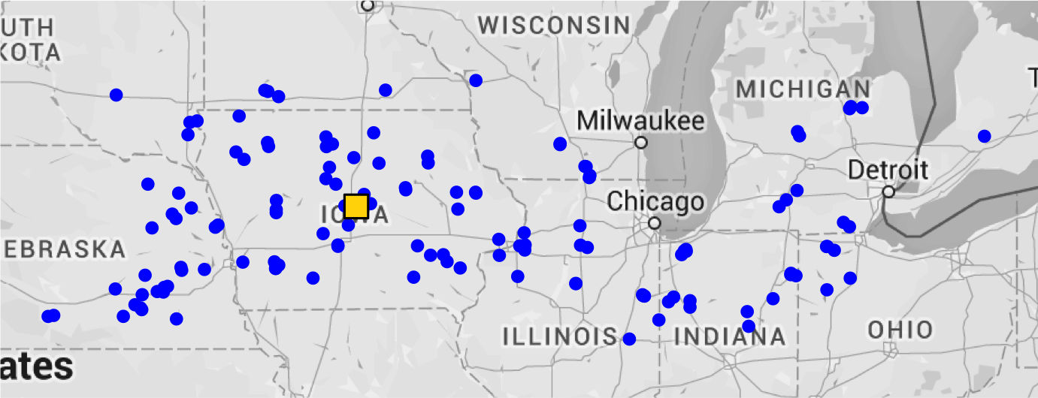
Data Cleaning

Slide 22

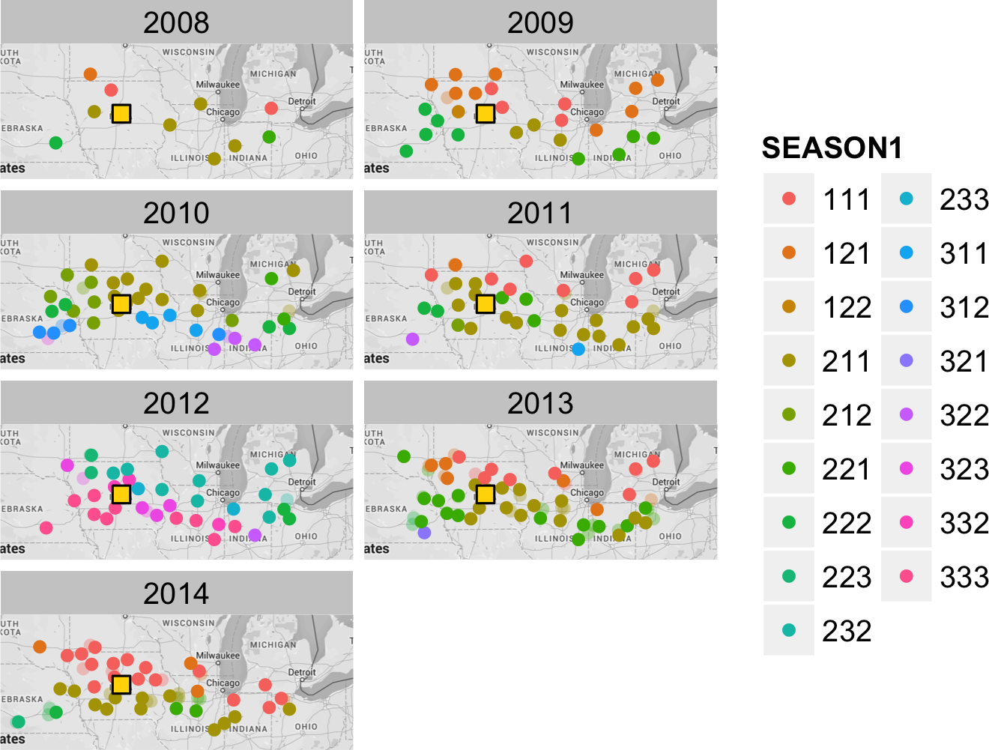
Probability Coefficients

Slide 23
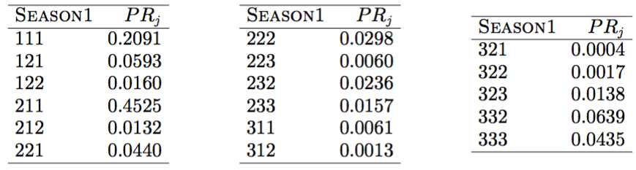
Probability Coefficients

Slide 24

Yield Coefficients
“Check Yield”
via regression
(variety independent)
“Yield Diff” via Bayesian updating
(variety dependent)

Slide 25

Yield Coefficients
Regression
Used linear model with verified assumptions
Restricted model to “non-variety” variables
Removed duplicate observations and clear outliers

Slide 26
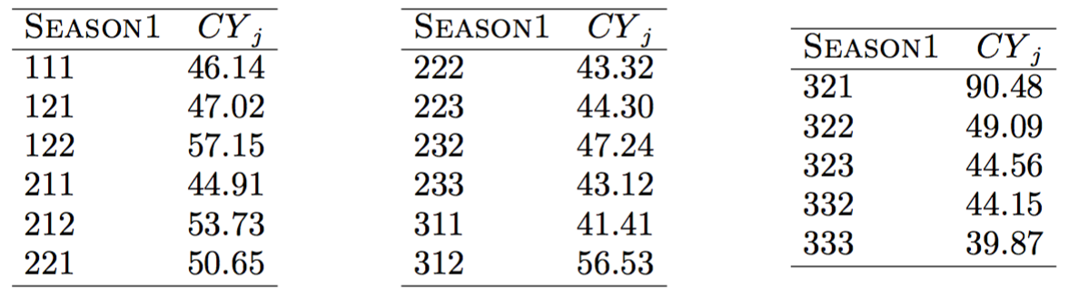
Yield Coefficients
low probability (0.0004)

Slide 27

Yield Coefficients
Bayesian Updating
Standard approach with verified assumptions
Allowed the sensible use of all variety data
Strong varieties “bubble to the top”

Slide 28
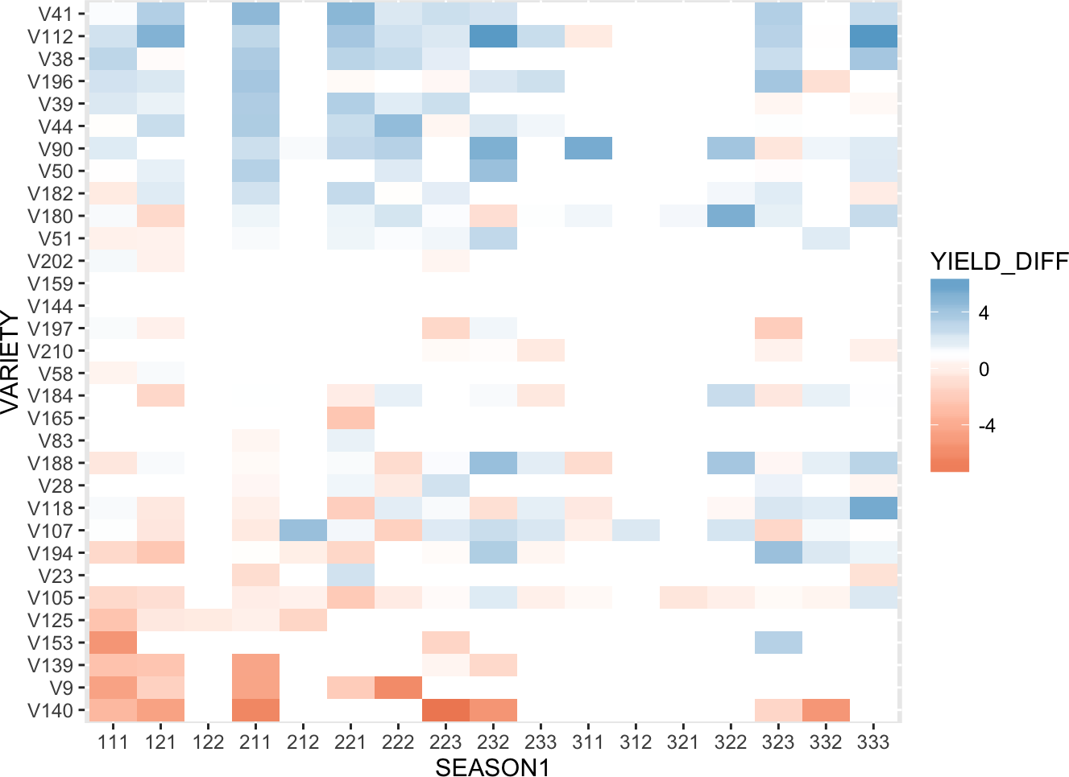
Yield Coefficients

Slide 29
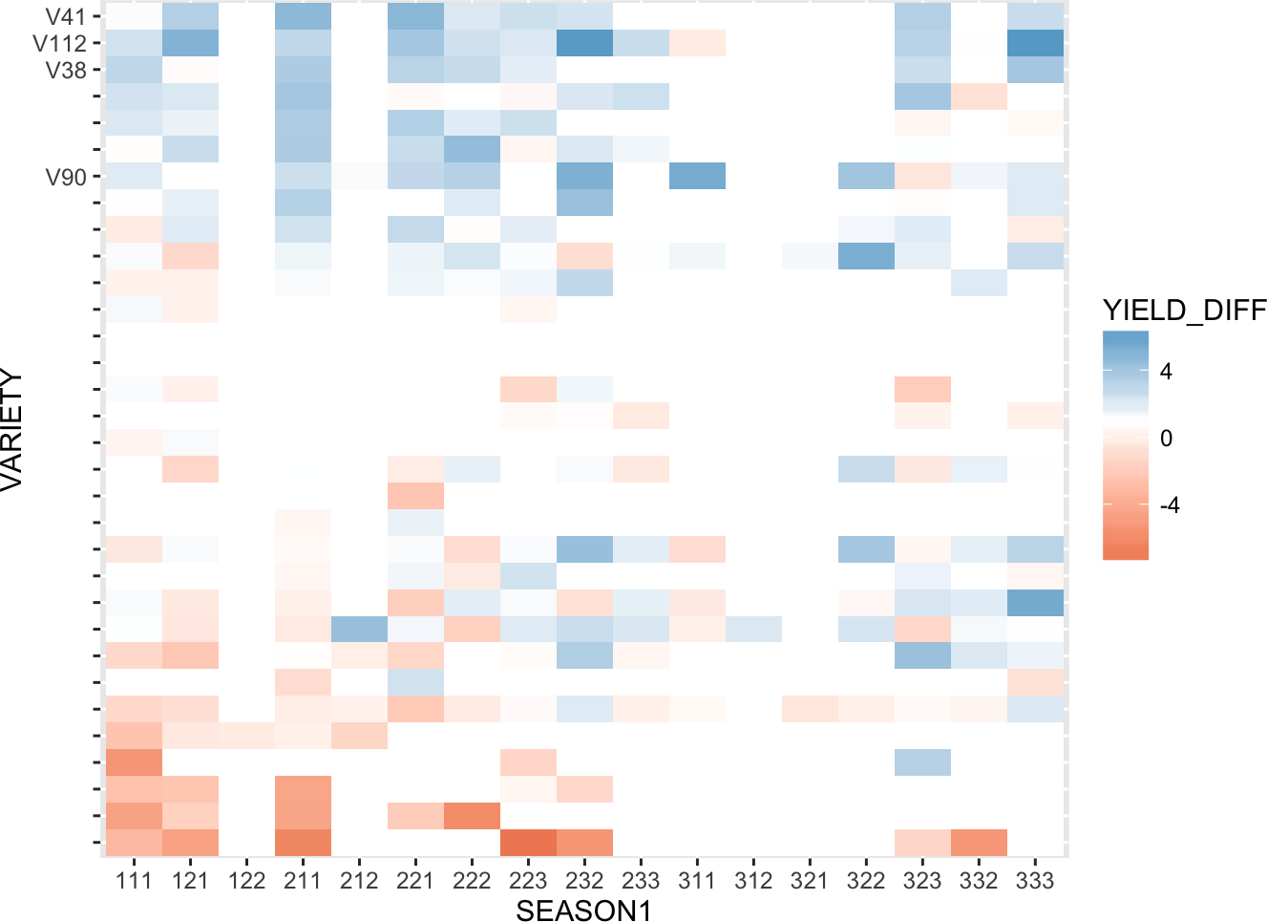
Yield Coefficients

Slide 30
Conclusions

Slide 31
Limitations and Opportunities
Expected values for simplicity
Worst-case approach for risk
Robustness

Slide 32

Final Thoughts
Optimization-based approach balancing competing objectives
Coefficients estimated directly from data using relatively simple, standard analytical tools
Make use of all variety data, even for “rare” varieties

