Slide 1
Poetry Generation using RNN & GAN Networks
Sam Burtch

Slide 2
Poem Data
Kaggle Dataset 570+ poems
Renaissance and Modern era poets such as Shakespeare, Queen Elizabeth I
Topics include Love, Nature and Mythology & Folklore
“Green groweth the holly, So doth the ivy. Though winter blasts blow never so high, Green groweth the holly.”
-HENRY VIII, KING OF ENGLAND

Slide 3
Tools & Libraries
Preprocessing:
Numpy
Pandas
Re
Keras.preprocessing
Tokenizer
Pad_sequences
GloVe
Neural Network Architecture:
Keras.models
Sequential
Model
Keras.layers
LSTM
Dense

Slide 4
Hygiene
For standardizing poem length, only poems with character length between 100 and 1000 were kept
Each word in entire poem dataset mapped to integer
Poems converted to vector of 177 (longest poem) integers using mapping with 0s for padding so each is 177 in length
Example:
[‘The’,’quick’,’brown’,’fox’,’jumps’,’over’,’the’,’lazy’,’dog’]
--->
[1,14,56,929,123,52,1,202,89,0,0,....0,0]
len(poem) = 177

Slide 5
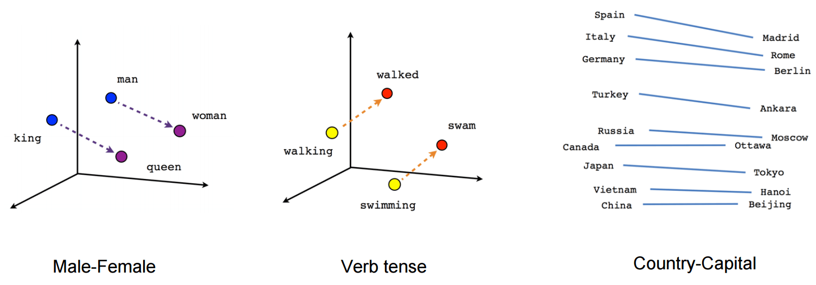
Feature Engineering
Each integer value in mapping converted to 50-dimensional vector of floats
Stanford GloVe dictionary converts words to vectors with similar words having similar vector spaces
Creates embedding matrix with each row vector of 50 features for each word
1 = [1.245, -3.343,...1,892]
Photo cred: https://nlp.stanford.edu/projects/glove/

Slide 6
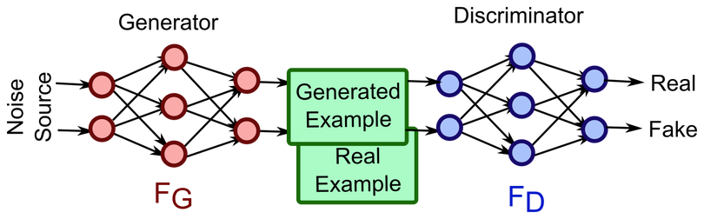
GAN Framework
Generated (fake) poems are used with real poems to create training set
Second network tries to predict real vs fake poems
GAN = Generative Adversarial Network
2 Networks - Generator & Discriminator
Photo cred: https://akshaynathr.wordpress.com/2018/01/02/gan-generative-adversarial-network/

Slide 7
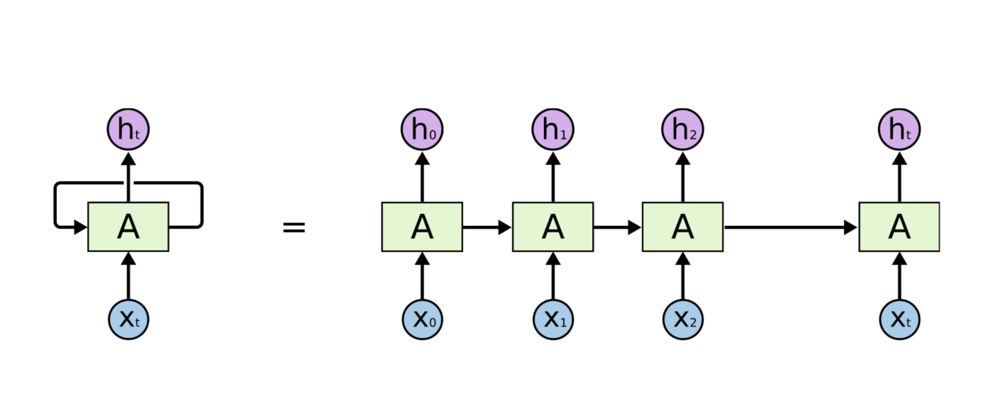
RNN Framework
RNN = Recurrent Neural Network
Generative model used for sequential data
Especially helpful with time-series predictions
Previous outputs are used as future inputs
Photo cred: https://colah.github.io/posts/2015-08-Understanding-LSTMs/

Slide 8
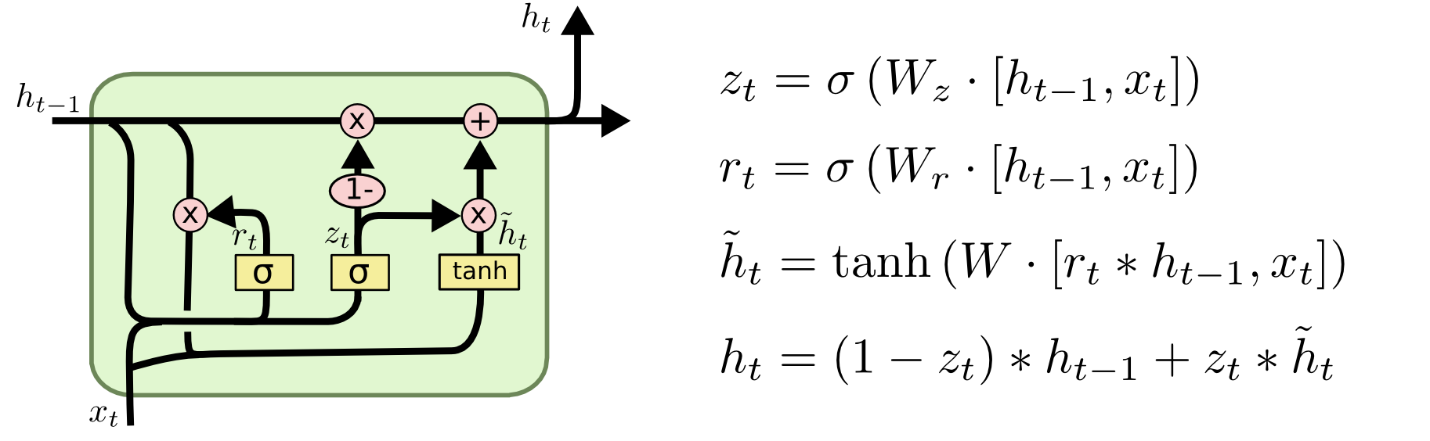
LSTM Cells
Type of RNN framework
3 different weight matrices to determine what to forget, remember, and output
Cell state is recurrent memory of prior inputs
Along with input, cell state acts as input at each step
Photo cred: https://colah.github.io/posts/2015-08-Understanding-LSTMs/

Slide 9
Generator
Input - Noise vector from Gaussian distribution
LSTM layer - 350 unique cells
Return_sequences=True - concatenates hidden state/output at each step for a full poem prediction of 177 words
Output - predicted poem from noise vector + label = 0 (fake)

Slide 10
Discriminator
Inputs - Samples from real poems from dataset and generated fake poems from generator
LSTM Layer - 350 cells
Dense Layer - sigmoid activation of one cell to predict binary outcome (1/0; real/fake)
[1,52,33,125,692,1265,43,1,0...0]
---> LSTM Layer ---->
---> Dense Layer ---->
0 = Fake = y_hat

Slide 11
Loss Function
Attempt to convert loss to game theory approach
Cross-entropy: Generator and Discriminator are playing against each other (hence the min(g)max(d))
Train discriminator when incorrectly classifying poem, else train generator
D = Discriminator | G = Generator
x = real poem | z = noise vector

Slide 12
End Game
We now have a network that can effectively train poems based on random noise
Discriminator is not used in real-world generation
Detach discriminator and only use generator

