Slide 1

Linear elastodynamics
ME-473
Dynamic finite element analysis of structures
Stefano Burzio
(Credit: Getty Images)

Slide 2
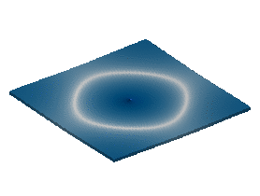
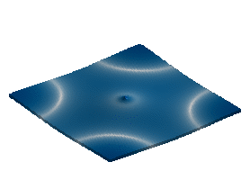
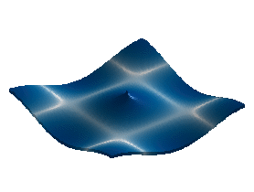
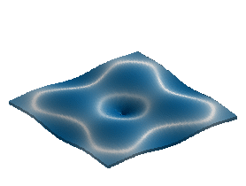
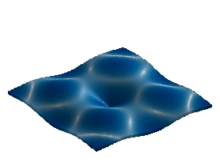
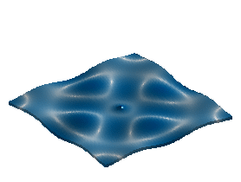
Linear : infinitesimally small deformations
Elasticity : material return to its original shape and size when the forces causing the deformation are removed.
Dynamics : The formulation given here generalizes the formulation of ME-372, which was restricted to steady state problems, to time dependent
(Credit: Noé Jiménez)

Slide 3
Summary
Underlying hypothesis
Notations and conventions
Equilibrium equations of motion
Strong formulation of equilibrium equations
Example: longitudinal vibration of bars
Weak formulation of equilibrium equations
Recommended readings
[GM] Gmür, Dynamique des structures (§2.1 and §2.2)
[N] Neto, et al., Engineering Computation of Structures (Chap. 1)

Slide 4
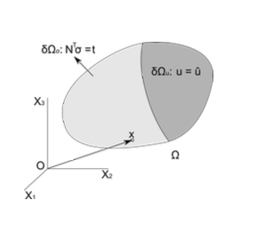
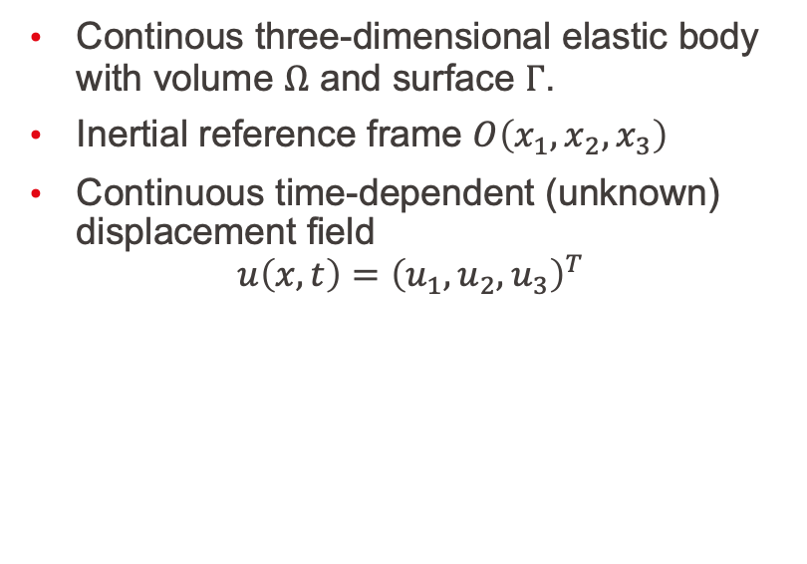
Hypothesis
Continous three-dimensional elastic body with volume $Ω$ and surface $Γ$.
Inertial reference frame $O\left(x_{1},x_{2},x_{3}\right)$
Continuous time-dependent (unknown) displacement field
$$u\left(x,t\right)={\left(u_{1},u_{2},u_{3}\right)}^{T}$$

Slide 5
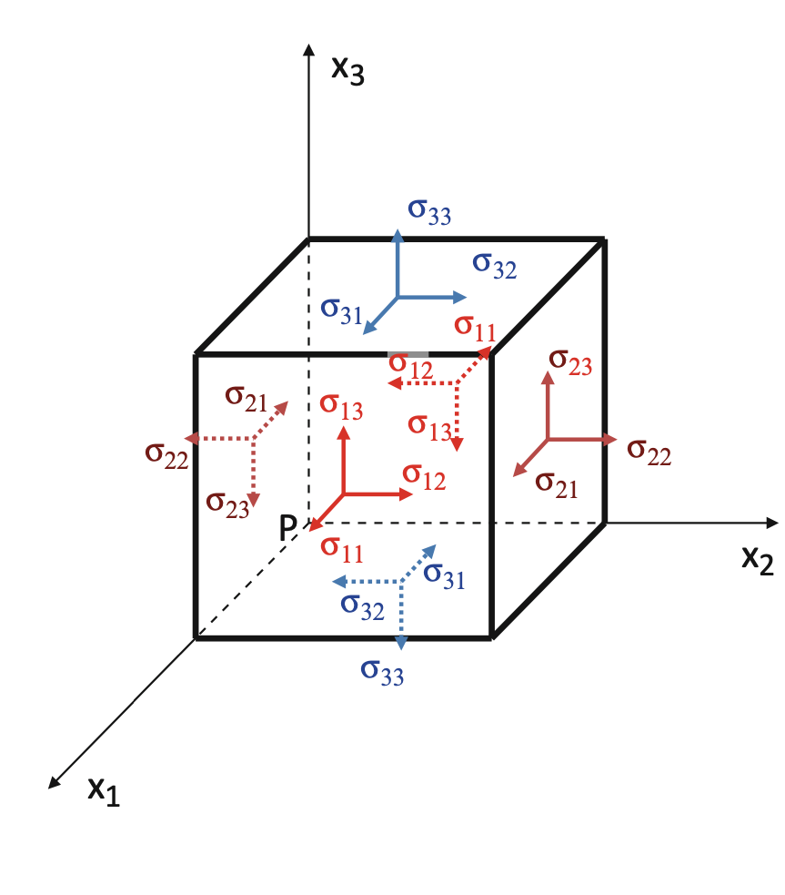

Stress and strain tensors
Stress tensor:
$$σ\left(x,t\right)={\left(σ_{11},σ_{22},σ_{33},σ_{23},σ_{31},σ_{12}\right)}^{T}$$
Strain tensor:
$$ε\left(x,t\right)={\left(\right)}^{T}$$
(Credit: [N])

Slide 6
Generalized Hooke’s law

Slide 7
Stress–strain relationship

Slide 8
Differential equations of movement
Newton’s 2nd law
Conservation principle (balance of forces)

Slide 9
Boundary conditions
The surface is divided into two types:

Slide 10
Initial conditions

Slide 11
Remarks

Slide 12
Example: longitudinal vibration of a bar

Slide 13
Weak formulation

Slide 15
Summary
Underlying hypothesis
Notations
Equilibirum equations
Strong formulation of equilibirum equations
Example: longitudinal vibration of bars
Weak formulation of equilibirum equations

