Slide 1
Grow Hubway: Where should Hubway expand next?
Notes:
Note the health benefits of increased availability of bikes: more physical activity, positive public opinion in favor of cycling

Slide 2
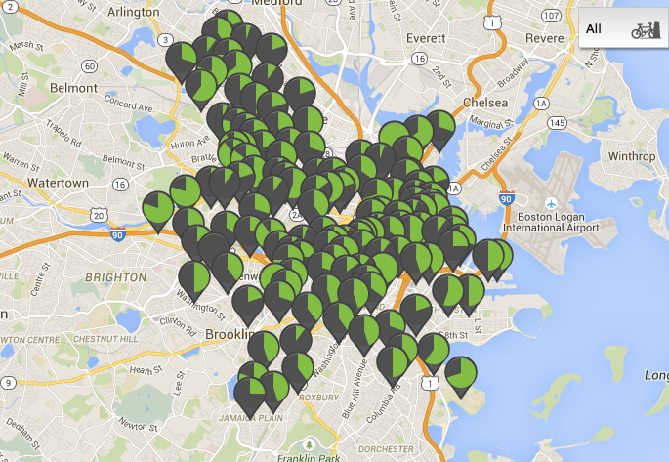
Grow Hubway: Where should Hubway expand next?
Notes:
Note the health benefits of increased availability of bikes: more physical activity, positive public opinion in favor of cycling

Slide 3
Data
Hubway Data
Publicly available: July 2011 through November 2013
Timestamp, start & end station, and duration for each trip
~140 stations
Ancillary Data
US Census data by zip code
Population size from 2010
Employee size from 2012
MBTA rider data from 2013
PDF scraping
http://erikdemaine.org/maps/mbta/mbta.yaml
Mask for Charles river from OpenStreetMap data

Slide 4
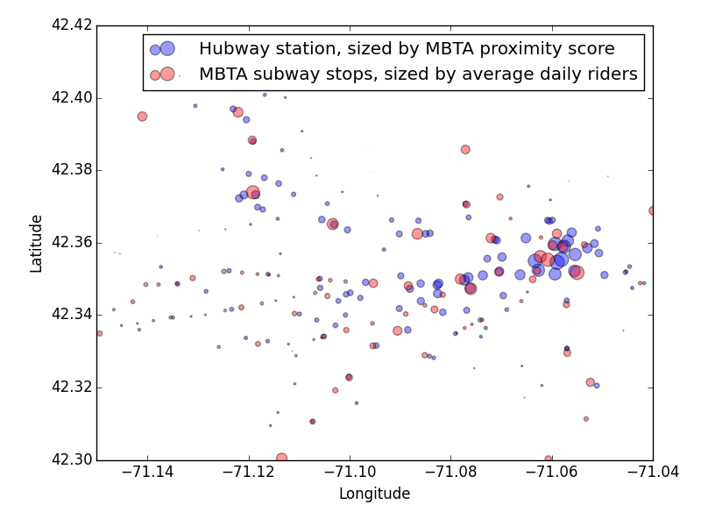
Alewife
Harvard
Central
Kendall

Slide 5
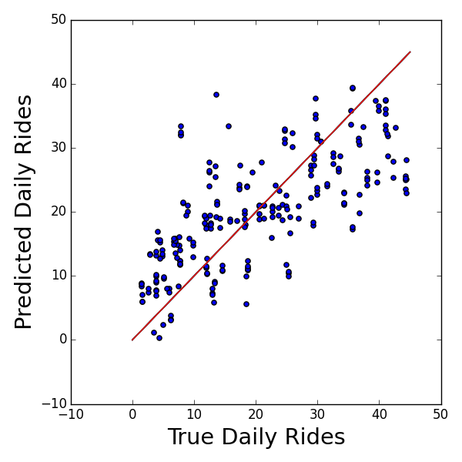
Algorithmic Approach
Features
Population score
Employee score
MBTA subway score
“origin” score and “destination” score for each of the above features
Label: average daily rides
Mean absolute error: -7.4
Machine Learning approach
Linear regression
5-fold cross-validation
prescription for cannibalism

Slide 6
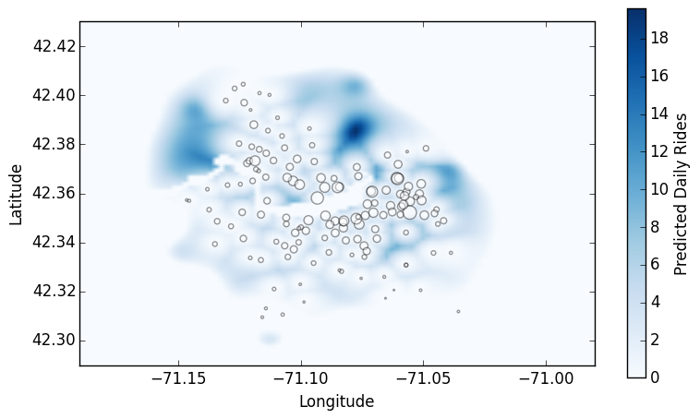
Alewife
Harvard
Kendall/MIT
Downtown
Boston

Slide 7



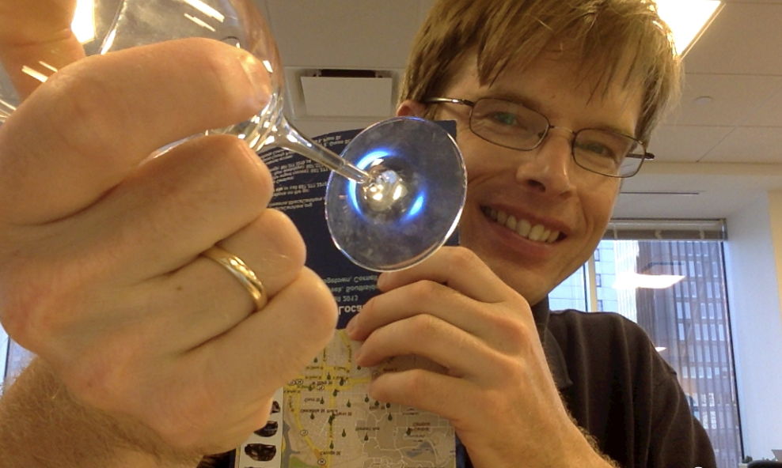
About Me
PhD, Astronomy, University of Arizona, 2010
Postdoc at Harvard-Smithsonian Center for Astrophysics
Postdoc at Cornell University
Research topic: understand how stars form in distant galaxies by studying gravitationally lensed galaxies

