Slide 1


Spin evolution of supermassive black holes in a cosmological context
Sebastián Bustamante
HITS
Supervisor:
Volker Springel
Group Meeting
October, 2016

Slide 2
Overview
Motivation
Model
Numerical implementation
Results (tests)
Conclusions
Ongoing and future work
References
Notes:
Acá debo hablar de la introducción general del tema

Slide 3
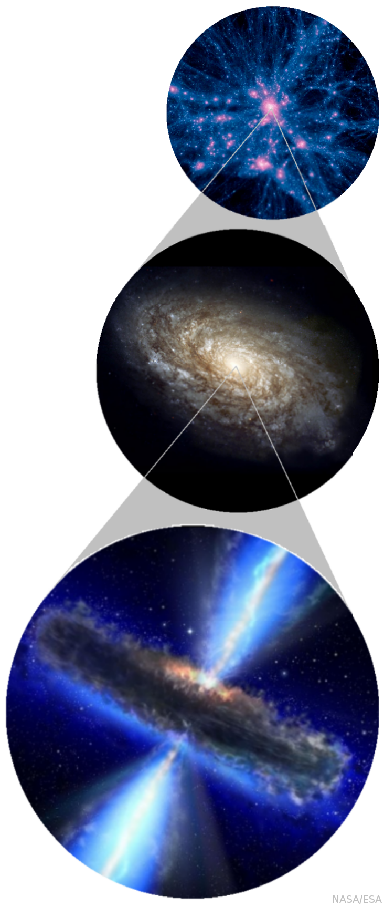
Spin of Supermassive Black Holes
Angular momentum is an intrinsec property of all astrophysic objects.
For the mass and energy range exhibited by BHs, spin should play an important role.
It has been proposed as the defining parameter of the bimodal distribution on the radio-optical plane.
Radio jet power seems to depend strongly on the spin. (Blandford-Znajek mechanism).
Gravitational wave emission in BH-BH binary mergers depends strongly on the spin.

Slide 4
Modelling Spin Evolution

Slide 5
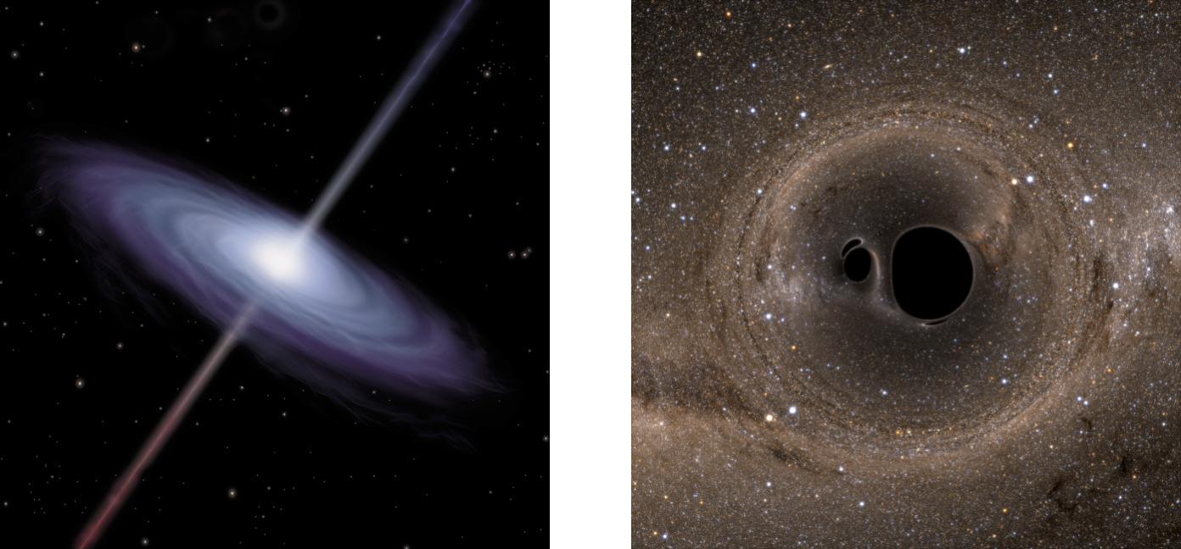
Modelling Spin Evolution
Rotating BHs follow a Kerr metric.
The spin is defined as:
Two main processes can spin up or down a BH:
Gas accretion
BH-BH binary coalescence

Slide 6
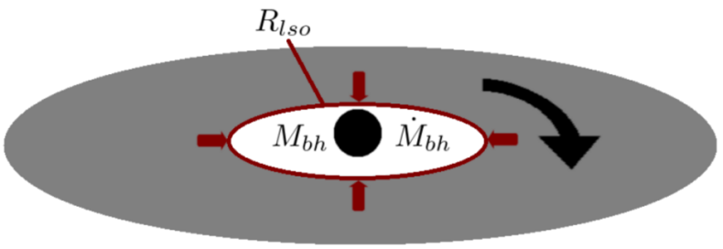
Gas Accretion
Gas accretion is driven by an equatorial accretion disk around the BH (Shakura-Sunyaev -disk ) [Shakura & Sunyaev, 1973].
Angular momentum is transported outwards by viscous torques. Gas parcels sink into BH potential and are accreted.
Only accretion rates above 1% of the Eddington accretion are considered. Below this, other models have to be used (ADAFs).

Slide 7
Gas Accretion: spin magnitude evolution
Once a mass parcel is accreted, the next equations describe the change in the BH mass and spin:
Leading to the spin evolution equation:
whose solution is given by: [Bardeen, 1970]
[Thorne, 1974]

Slide 8
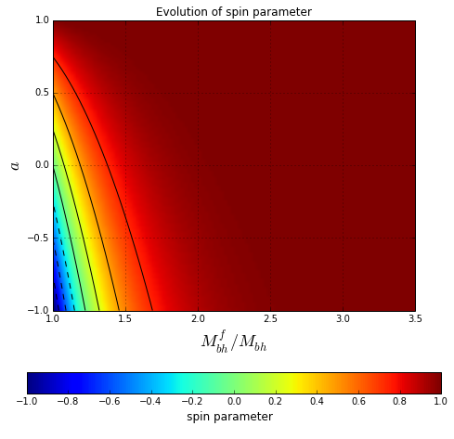
Gas Accretion: spin magnitude evolution
Any solution leads to an increase in the BH spin.
The lower the spin, the higher the required mass increase to spin up the BH.
A mass ratio above 2.0 would completely spin up the BH to its maximum value.

Slide 9
Gas Accretion: spin magnitude evolution
The previous scheme allows us to evolve the spin by knowing the mass accretion history of the BH.
Different mass intervals would lead to different spin histories.
Accretion timescale has to be estimated.
No information about spin orientation evolution.

Slide 10
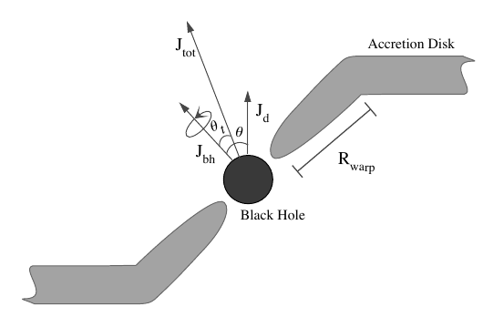
Gas Accretion: misaligned disks
Misaligned accretion disks are a more general scenario.
The Lense-Thirring (LT) effect generates a torque in the innermost part of the disk, and due to strong viscosity gradients, this region gets warped.
Total angular momentum is conserved in every accretion episode:
with
[Fanidakis, et. al., 2011]

Slide 11
Gas Accretion: characteristic timescales
Different timescales characterize the spin evolution process:
    : precession timescale.
    : viscous accretion tms (radial viscosity).
    : warp propagation tms (vertical viscosity).
    : alignment timescale.
The warp region is defined through [Natarajan & Armitage, 1999]:
The next relations are satisfied at the warp radius:

Slide 12
Gas Accretion: accreted mass
Mass per accretion episode:

Slide 13
Gas Accretion: spin orientation
The LT effect aligns or anti-aligns the BH spin in the alignment timescale . The condition for anti-alignment is given by [King, et. al., 2005]:
After every accretion episode, the BH is assumed to succesfully aligns or anti-aligns with the total angular momentum.
The orientation of angular momentum of the infalling gas parcel is assumed either as random or following angular momentum of neighbouring gas cells.

Slide 14
Gas Accretion: self-gravity disks
Self-gravity can limit the mass of the disk, constraining as well the growth of the BH. [King, et. al., 2008]
This causes several random small accretion episodes instead of a prolonged accretion as discussed before.
Alignment and anti-alignment
The mass per episode is given by: [Pringle, 1981]

Slide 15
Gas Accretion
The previous two prescription of the accreted mass lead to the two spin evolution modes: prolonged mode and chaotic mode.
Prolonged mode is used in low-accretion regimes, where the mass of the disk is small to exhibit self-gravity effects. This is consistent with the radio mode of the BH.
Chaotic mode is used in high-accretion regimes, where the disk is massive enough to develop considerable self-gravity. This is consistent with the quasar mode.

Slide 16
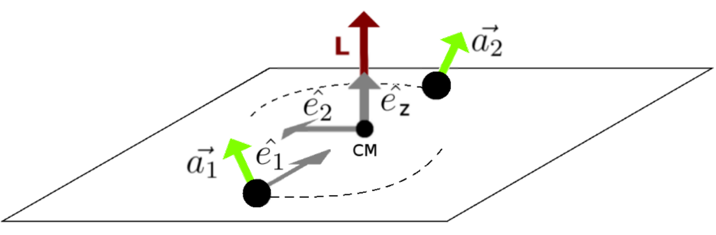
BH-BH binary coalescence
This is another important channel of spin evolution, especially in the hierarchical structure formation scenario.
Spin is a key property in this process as the momentum carried by gravitational waves has a strong dependence on it.
Relativistic simulations of BH-BH mergers have provided fitting formulas for predicting remnant recoil speed and spin. [Rezolla, et. al., 2008].

Slide 17
Numerical Implementation

Slide 18
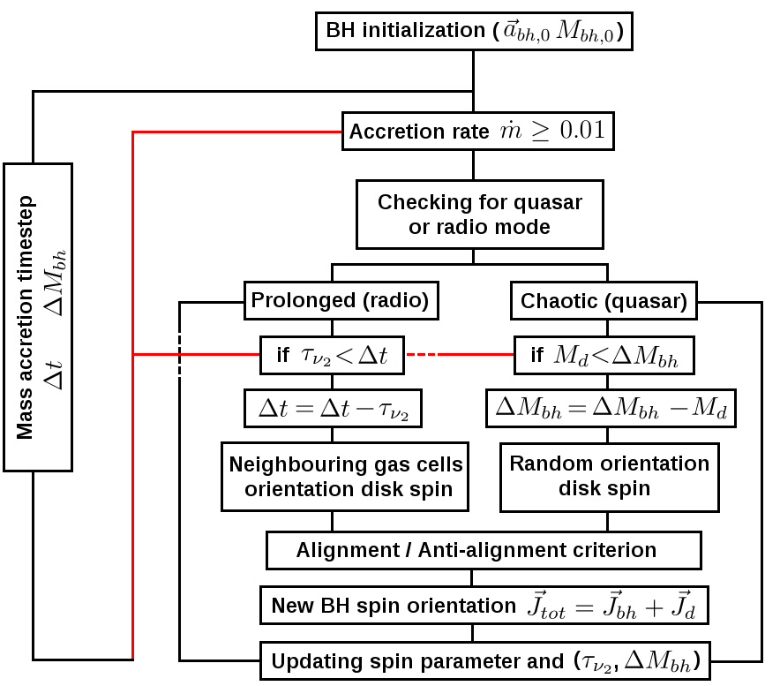

Slide 19
Results (test)

Slide 20
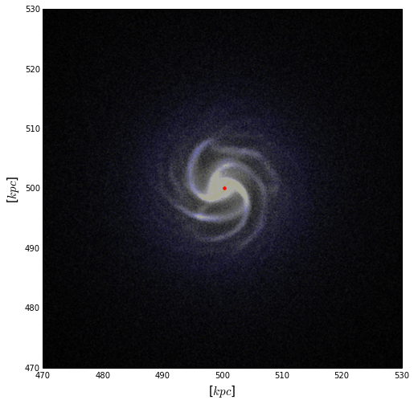
Test simulation: isolated galaxy
Parameters:
100000 particles.
Thermal BH feedback
Start formation.
Massive halo ( ).
Gas fraction 0.2.

Slide 21
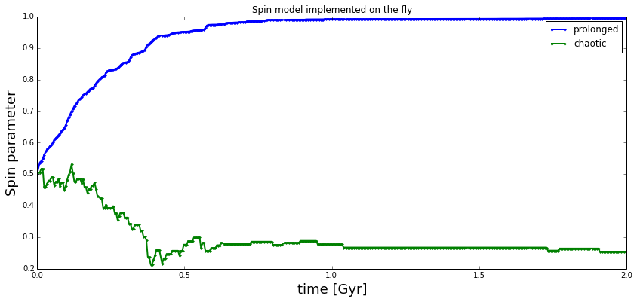
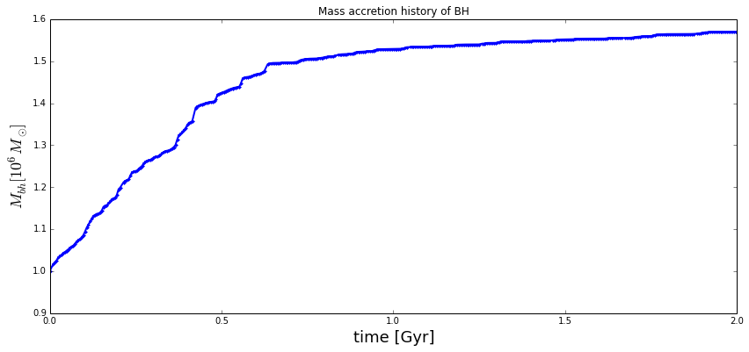

Slide 22
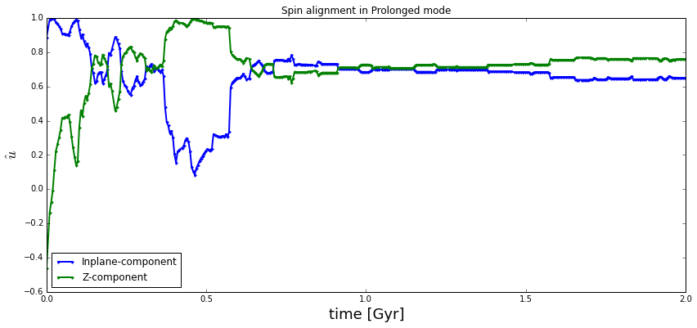
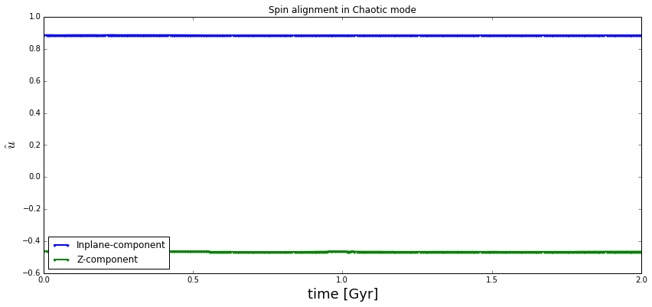

Slide 23
Ongoing and future work
Currently, cosmological simulations are being run, so a statistic analysis of spin evolution can be carried out.
Currently, the BH-BH binary merger channel is being written.
Comparison with previous results in literature.
Study of effects of recoil kicks, fraction of escaping BHs and returning timescales.
Spin-dependent radiative efficiency in AGN feedback.
Any other possible effect of spin.

Slide 24

http://blog-assets.rosettastone.com/wp-content/uploads/2014/11/thank-you-languages-post.png

