Slide 1


Spin evolution of supermassive black holes in a cosmological context
Sebastian Bustamante
HITS
Virgo Meeting
December, 2016

Slide 2
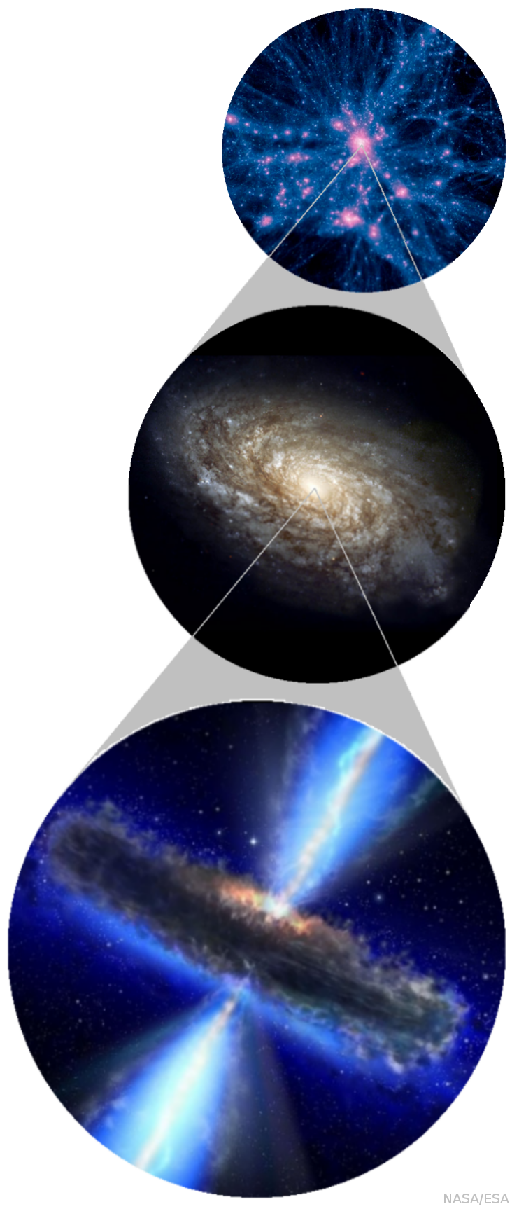
Spin of Supermassive Black Holes
Angular momentum is an intrinsec property of all astrophysic objects, including SMBHs!
Radiative efficiency is spin-dependent.
It might play a role in the bimodal distribution on the radio-optical plane.
Radio jet power seems to depend on the spin. (Blandford-Znajek mechanism).
Gravitational wave emission in BH-BH binary mergers depends strongly on the spin (including recoils!).

Slide 3
Spin of Supermassive Black Holes
Angular momentum is an intrinsec property of all astrophysic objects, including SMBHs!
Radiative efficiency is spin-dependent.
It might play a role in the bimodal distribution on the radio-optical plane.
Radio jet power seems to depend on the spin. (Blandford-Znajek mechanism).
Gravitational wave emission in BH-BH binary mergers depends strongly on the spin (including recoils!).

Slide 4
Spin of Supermassive Black Holes
Angular momentum is an intrinsec property of all astrophysic objects, including SMBHs!
Radiative efficiency is spin-dependent.
It might play a role in the bimodal distribution on the radio-optical plane.
Radio jet power seems to depend on the spin. (Blandford-Znajek mechanism).
Gravitational wave emission in BH-BH binary mergers depends strongly on the spin (including recoils!).

Slide 5
Modelling Spin Evolution
(in AREPO)

Slide 6
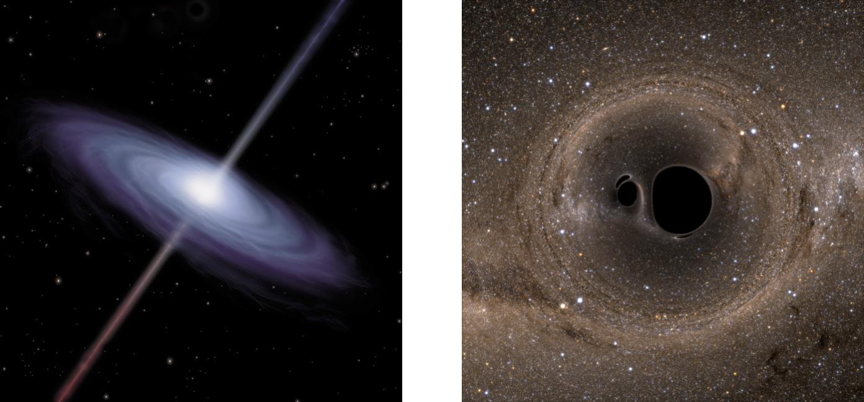
Modelling Spin Evolution
The spin is defined as:
A subgrid model is implemented.
Mass accretion is numerically coupled from the code. (Bondi-Hoyle-Lyttleton).
Two evolution channels:
Gas accretion
BH-BH coalescence
Nasa
Nasa

Slide 7
Gas Accretion
Shakura-Sunyaev -disk model. [Shakura & Sunyaev, 1973]
Only radiative efficient disks are modelled (> 1% Eddington rate).
Evolution of spin parameter: [Bardeen, 1970]
[Thorne, 1974]

Slide 8
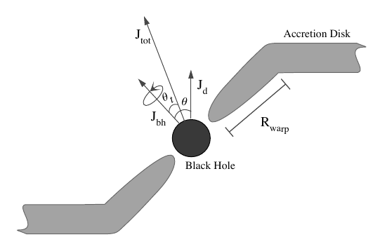
Gas Accretion: misaligned disks
Misaligned accretion disks are a more general scenario.
The Lense-Thirring (LT) effect generates a torque in the innermost part of the disk, and due to strong viscosity gradients, this region gets warped.
Total angular momentum is conserved in every accretion episode:
with
[Fanidakis, et. al., 2011]

Slide 9
Gas Accretion: characteristic timescales
Different timescales characterize the spin evolution process:
    : precession timescale.
    : viscous accretion tms (radial viscosity).
    : warp propagation tms (vertical viscosity).
    : alignment timescale.
The warp region is defined through [Natarajan & Armitage, 1999]:
The next relations are satisfied at the warp radius:

Slide 10
Gas Accretion: spin orientation
The LT effect aligns or anti-aligns the BH spin in the alignment timescale . The condition for anti-alignment is given by [King, et. al., 2005]:
After every accretion episode, the BH is assumed to succesfully aligns or anti-aligns with the total angular momentum.
The orientation of angular momentum of the infalling gas parcel is assumed either as random or following angular momentum of neighbouring gas cells.

Slide 11
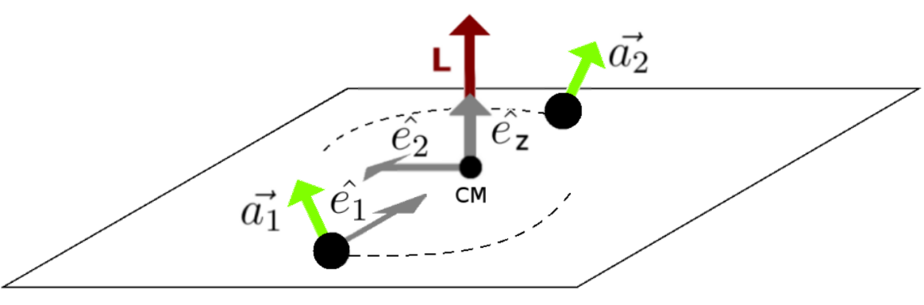
BH-BH binary coalescence
This is another important channel of spin evolution, especially in the hierarchical structure formation scenario.
Spin is a key property in this process as the momentum carried by gravitational waves has a strong dependence on it.
Relativistic simulations of BH-BH mergers have provided fitting formulas for predicting remnant recoil speed and spin. [Rezolla, et. al., 2008].

Slide 12
Ongoing and future work
Currently, cosmological simulations are being run, so a statistic analysis of spin evolution can be carried out.
Currently, the BH-BH binary merger channel is being written.
Comparison with previous results in literature.
Study of effects of recoil kicks, fraction of escaping BHs and returning timescales.
Spin-dependent radiative efficiency in AGN feedback.
Any other possible effect of spin.

Slide 13

http://blog-assets.rosettastone.com/wp-content/uploads/2014/11/thank-you-languages-post.png

