Slide 1
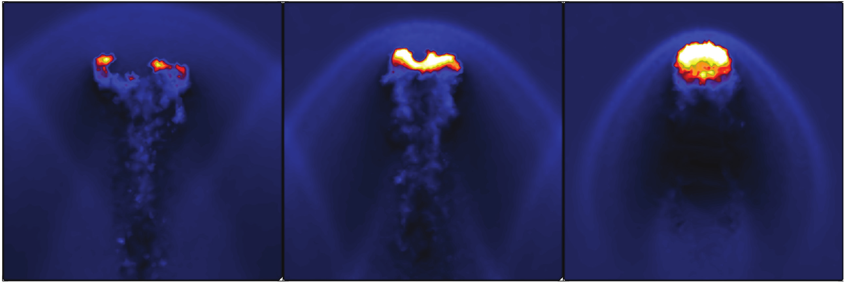
Verifying the Voronoi-Particle Hydrodynamics (VPH) scheme in Galaxy Formation
Sebastian Bustamante
Universidad de Antioquia
Medellín, Colombia

Slide 2
Motivation
Understanding and simulating hydrodynamics processes with good accuracy in astrophysics is a very important task as many phenomena are modeled as fluid systems.
Provided the complexity of the hydrodynamic equations, numerical solutions are usually the only feasible approach.

Slide 3
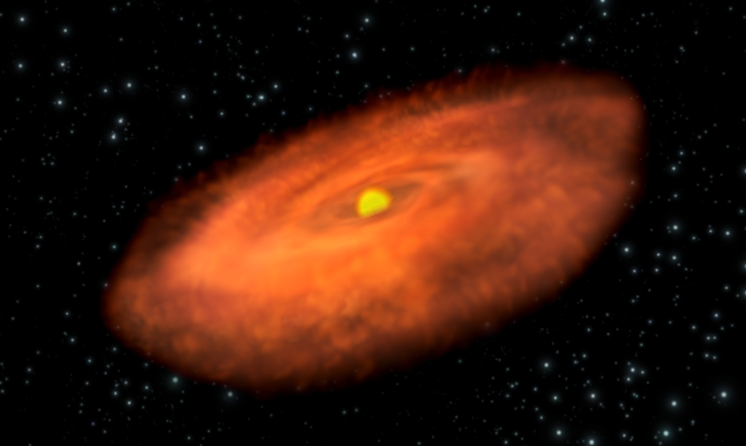
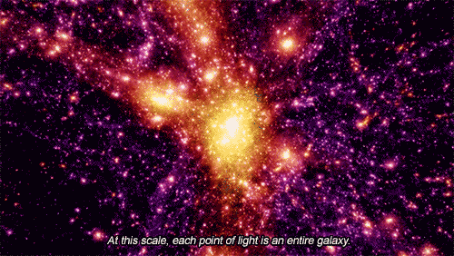
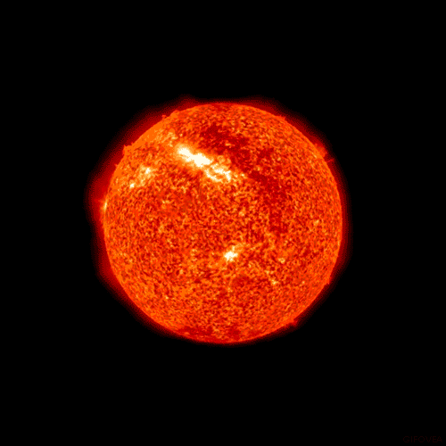
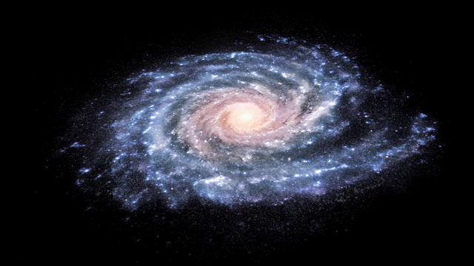
Motivation

Slide 4
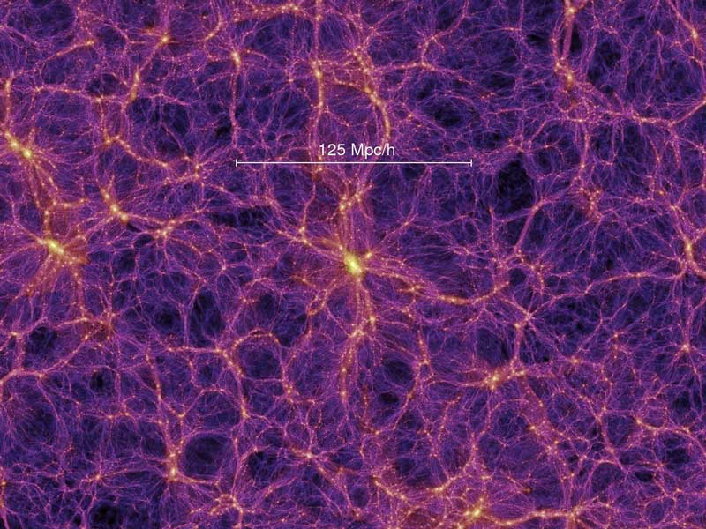
Motivation
The large-scale Universe is a very rich scenario where a plethora of hydrodynamical processes occur. In this fashion, cosmological setups are excellent systems for comparing hydrodynamic solvers.

Slide 5
Objectives
Quantifying the computational performance of the VPH technique in terms of its physical accuracy for a cosmological setup.
Compare the improved accuracy of VPH with the Lagrangian scheme SPH.

Slide 6
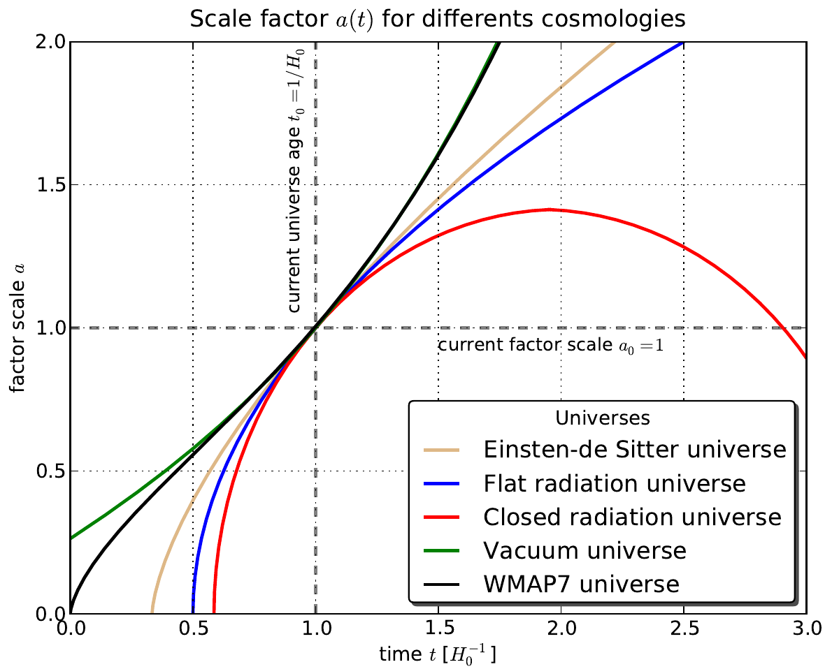
The cosmological setup
The Universe at very large scales can be modeled as a homogeneous and isotropic fluid.

Slide 7
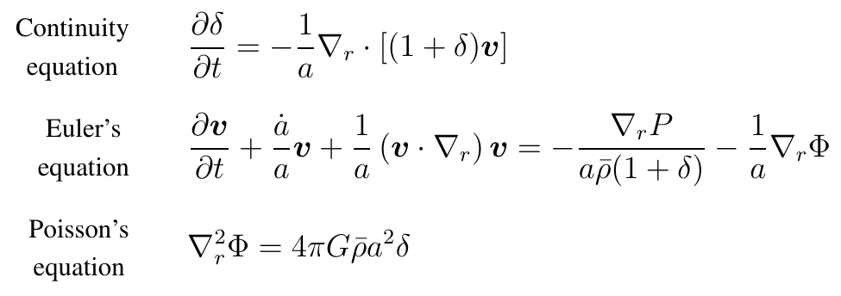

The cosmological setup
However, a homogeneous and isotropic Universe can not account for complex structures like galaxies, stars, planets and us!

Slide 8


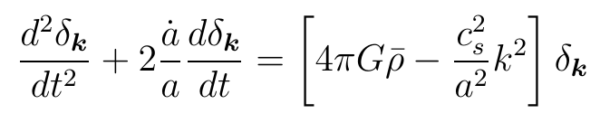

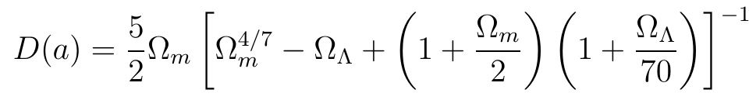
The cosmological setup
When modes of the density field are small enough ( ), it is possible to decouple them, obtaining the next equation:
Obtaining the analytical solution for the lineal regime:

Slide 9
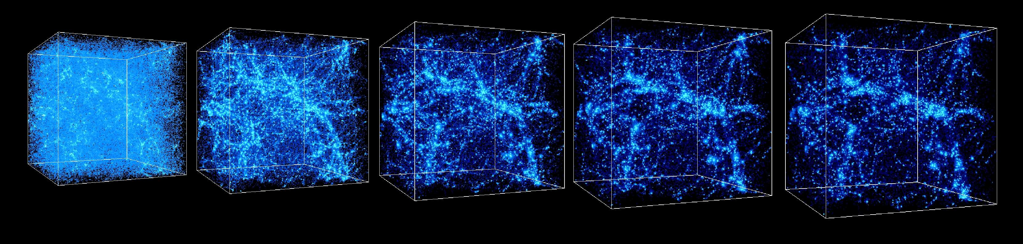
The cosmological setup
For the non-linear regime, the Fourier modes of the density are not longer coupled. Numerical evolution is necessary henceforth. However, quasi-linear solutions provide initial conditions for numerical schemes.
http://www.lsw.uni-heidelberg.de/users/mcamenzi/

Slide 10
Hydrodynamic solvers
Once clarified the importance of the hydrodynamics in Galaxy formation (for evolving the non-linear regime), two families of numerical approaches has been adopted throughout the literature:
Lagrangian schemes: the fluid is evolved following the dynamics of fluid parcels.
Eulerian schemes: the evolution performed over a fixed coordinate system, namely a mesh.

Slide 11
Lagrangian schemes
The most representative Lagrangian scheme is SPH (Smoothed-Particle Hydrodynamic).
Other schemes, normally modifications of the original SPH, have been also implemented.
Among the most interesting proposals is the VPH (Voronoi-Particle Hydrodynamic) scheme. This scheme greatly improves the accuracy of SPH.

Slide 12
Smoothed-Particle Hydrodynamic
Although a fluid is a continuous medium, numerical solutions always requires some kind of discretization.
SPH reaches this by sampling the fluid through particles that represent a parcel.
The equations of motion are then integrated over each of moving particles.
Continuous properties are then recovered through interpolation techniques.

Slide 13
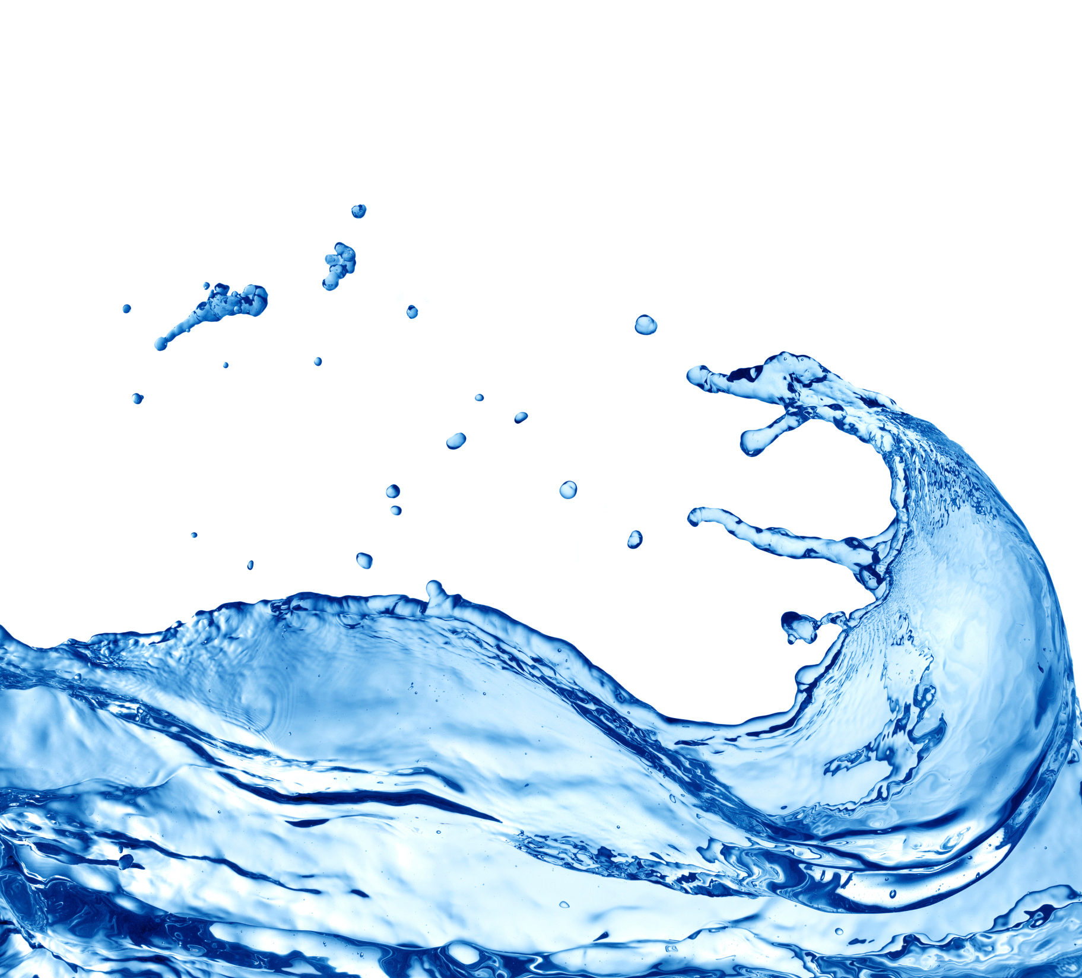
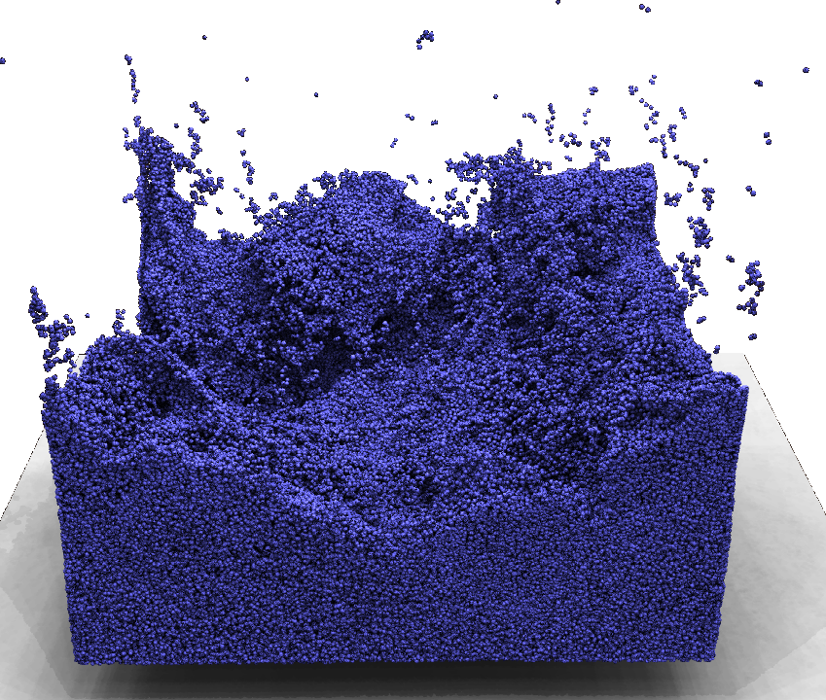
Smoothed-Particle Hydrodynamic
http://rnd-zimmer.de/

Slide 14
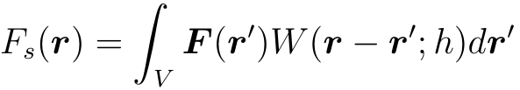

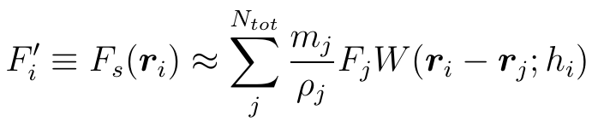

Smoothed-Particle Hydrodynamic
The heart of SPH is the kernel interpolant formalism:
Discretization can be reached approximating , yielding:
Where is the smoothing length and is associated to the volume of the fluid parcel.

Slide 15
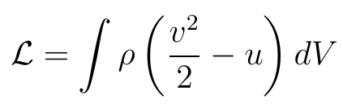
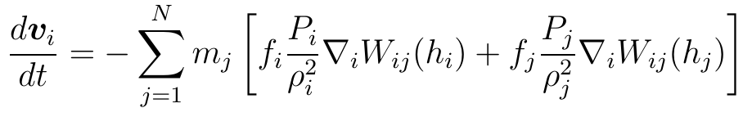
Smoothed-Particle Hydrodynamic
The equations of motions may be derived from the Lagrangian
Using the equation of state of inviscid gas and discretizing, we obtain

Slide 16
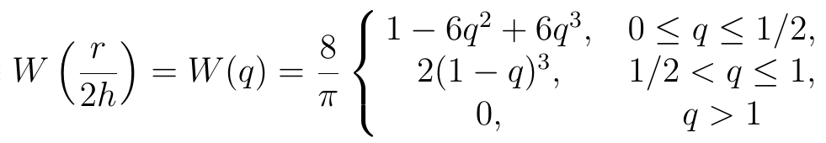
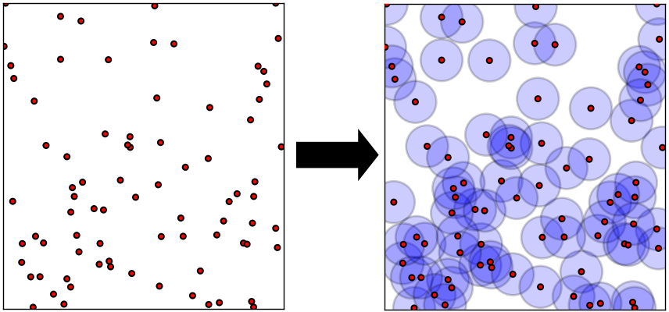
Smoothed-Particle Hydrodynamic
Computational performance is greatly improved if we use a compact kernel:

Slide 17
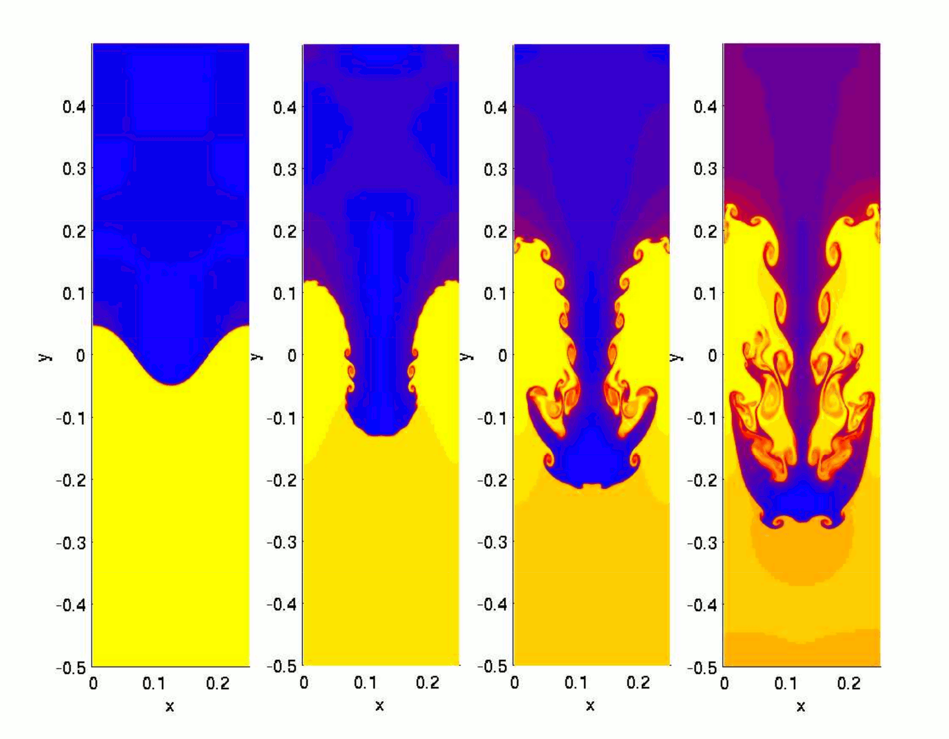
Smoothed-Particle Hydrodynamic
Due to the interpolant formalism, SPH produces suppressions in fluid instabilities.
http://en.wikipedia.org/wiki/Rayleigh%E2%80%93Taylor_instability

Slide 18
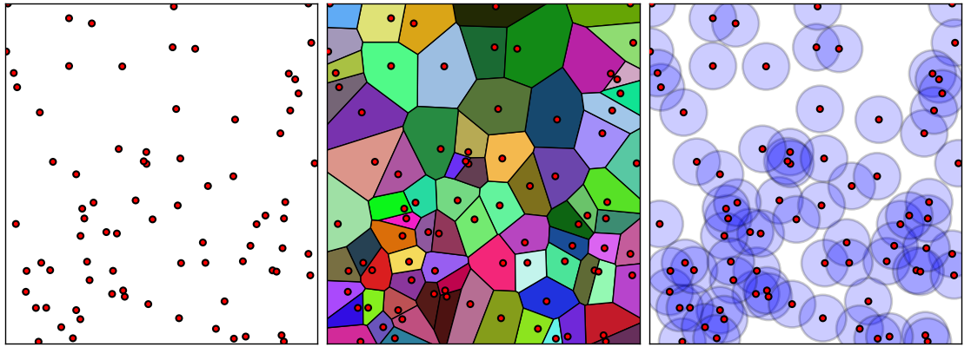
Voronoi-Particle Hydrodynamic
VPH is a modification of SPH, where the density estimation is made by means of a Voronoi Tesselation.

Slide 19
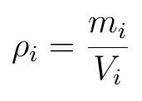
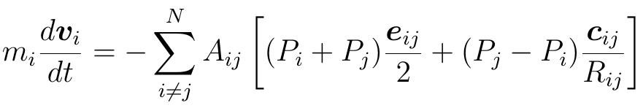
Voronoi-Particle Hydrodynamic
Using the same fluid Lagrangian
discretizing and replacing the new density estimation
It is obtained the next equation of motion

Slide 20
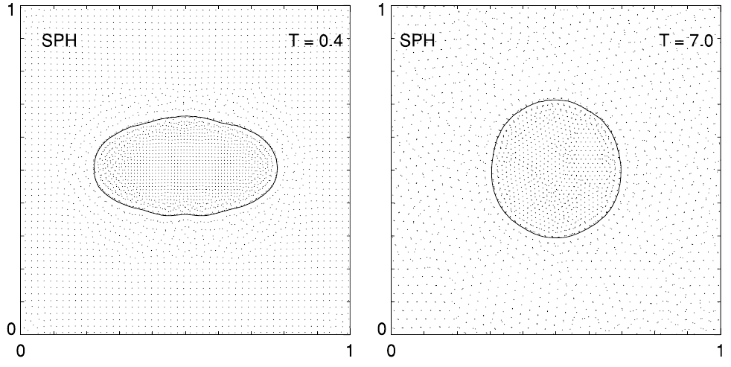
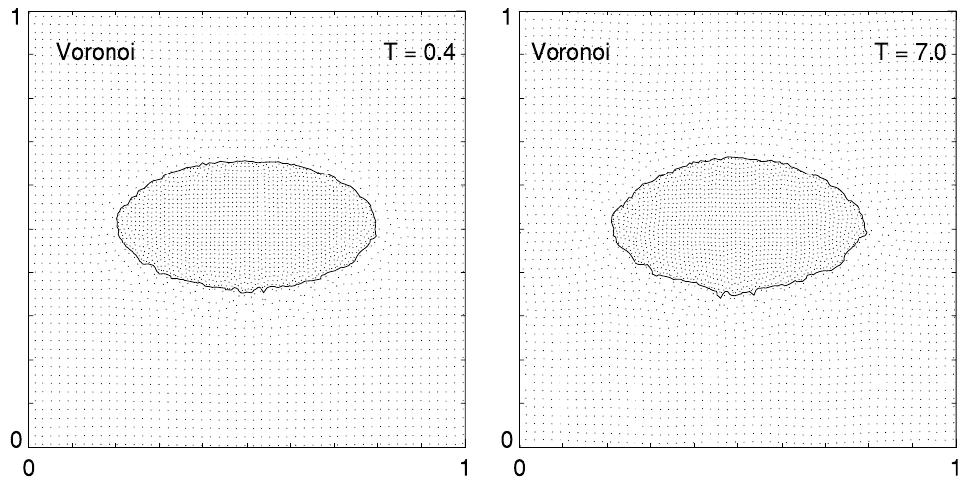
Previous results
Surface tension effects [Hess and Springel 2010]

Slide 21
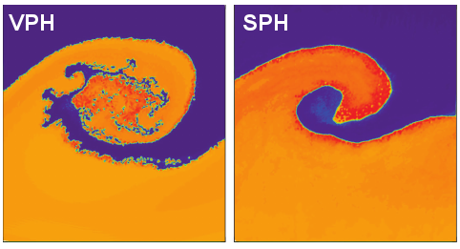
Previous results
Kelvin–Helmholtz instability for both solvers: [Hess and Springel 2010]

Slide 22
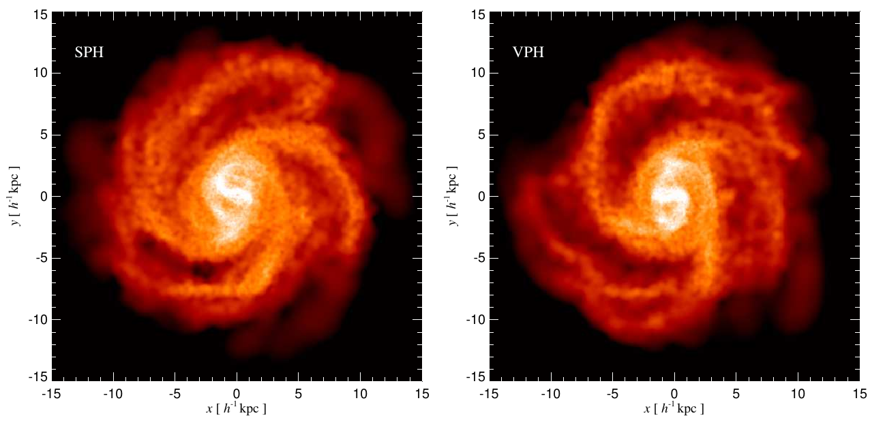
Previous results
Stars forming galaxy simulations [Hess and Springel 2012]

Slide 23
Our first results!

Slide 24
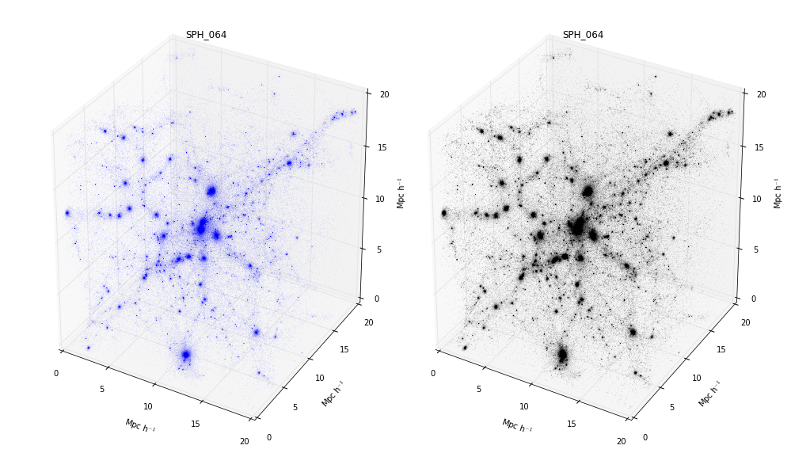
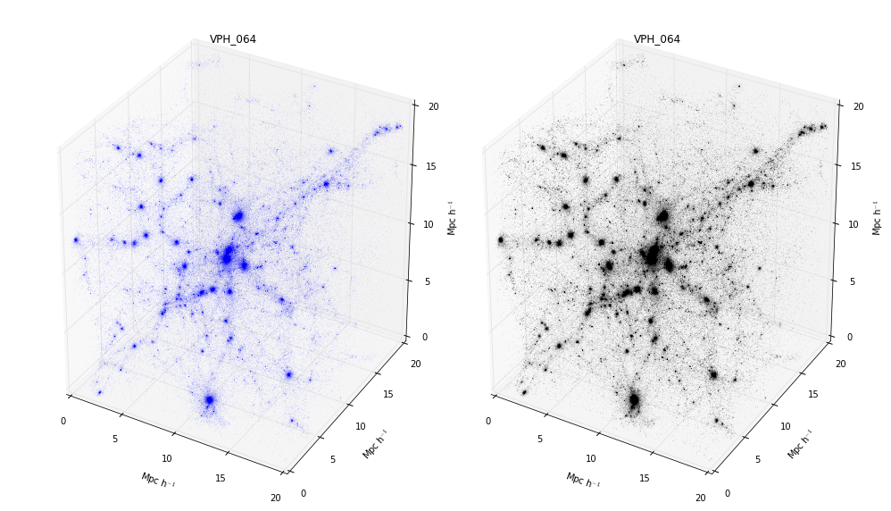
SPH
VPH

Slide 25
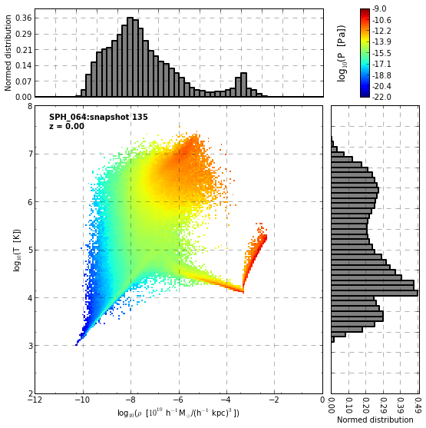
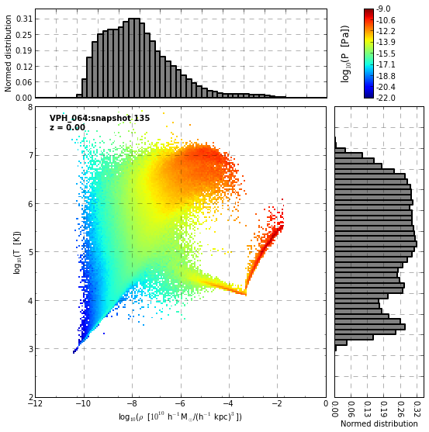
SPH
VPH

Slide 26
Conclusions
VPH reduces spurious suppressions of fluid instabilities exhibited by SPH.
Numerical effects like surface tensions are also diminished by VPH.
For our results, VPH seems to be more efficient for radiative cooling than SPH, what is an improvement as Galaxy formation is more likely to occur in such a scenario. However further analysis are required for more robust conclusions!

Slide 27
Ongoing work
Set of simulations. WMAP9 cosmology, 20Mpc
Building catalogs of dark matter halos.
Detecting virial radius and analyzing virial shocks of the gas around for both schemes.
Quantifying differences in the thermodynamics.
Scheme | Resolutions
 | 64^3 | 128^3 | 256^3
Only Dark Matter | Done | Done | --
SPH | Done | -- | --
VPH | Done | -- | --

Slide 28


