Slide 1
FINAL PROJECT / CS 6338
ThreatWeave
Evidence-grounded cybersecurity
question answering with GraphRAG
Local model. Source passages. Inspectable graph paths.
Final evaluation: October 16, 2026
Stephen Butler October 16, 2026
01
Notes:
Sources: S:/ThreatWeave/docs/ThreatWeave_evaluation_freeze_checkpoint.md and S:/ThreatWeave/work/evaluation_corpus_chunks/20261016T040604Z-bccf59fb/summary.json. Frozen source-level protocol, seed 42, no held-out tuning. MODE field and evidence format confound retrieval-only causal attribution. Actual context cap: 3,000 UTF-8 bytes.
Sources: S:/ThreatWeave/work/application_qa/20261015T074134Z-a878f56c/display.json and S:/ThreatWeave/work/application_qa/20261015T165813Z-950f9f1f/display.json, displayed through S:/ThreatWeave/demo_replay.py and the production render_result function. Browser captures show actual saved outputs; no new model/database call. Earlier live graph-only/full-hybrid checks are historical. Current replay is not a live latency measurement. Renderer may add entity display-column metadata to exports; answer/evidence remain unchanged.

Slide 2
THREATWEAVE / CS 6338
Every link needs its own source support
Advisory observations
Which actor used which software, and what technique did that report cite?
ATT&CK reference guidance
Which direct mitigation associations exist in the frozen 17.1 reference?
A citation identifies supplied evidence. Review still determines whether it supports the claim.
Stephen Butler October 16, 2026
02
Notes:
Sources: S:/ThreatWeave/docs/ThreatWeave_evaluation_freeze_checkpoint.md and S:/ThreatWeave/work/evaluation_corpus_chunks/20261016T040604Z-bccf59fb/summary.json. Frozen source-level protocol, seed 42, no held-out tuning. MODE field and evidence format confound retrieval-only causal attribution. Actual context cap: 3,000 UTF-8 bytes.
Sources: S:/ThreatWeave/work/application_qa/20261015T074134Z-a878f56c/display.json and S:/ThreatWeave/work/application_qa/20261015T165813Z-950f9f1f/display.json, displayed through S:/ThreatWeave/demo_replay.py and the production render_result function. Browser captures show actual saved outputs; no new model/database call. Earlier live graph-only/full-hybrid checks are historical. Current replay is not a live latency measurement. Renderer may add entity display-column metadata to exports; answer/evidence remain unchanged.

Slide 3
THREATWEAVE / CS 6338
The pipeline preserves source context
Stage | Result retained
Prepare and extract | Frozen spans, table context and validated candidate assertions
Resolve and review | Type-compatible identities and retained acceptance decisions
Store and index | Directed source facts plus separate text and graph vectors
Retrieve and generate | Exact evidence pack, cited claims and terminal outcomes
Inspect | Source text, graph snapshot, run metadata and export
Gold labels and reference answers enter scoring only.
Stephen Butler October 16, 2026
03
Notes:
Sources: S:/ThreatWeave/docs/ThreatWeave_evaluation_graph_index_step.md and S:/ThreatWeave/docs/ThreatWeave_final_evaluation_step.md. Shared scope 101 CISA windows and 190 ATT&CK reference parents. 510 text vectors, 212 domain graph nodes, 394 directed facts, 212 graph vectors, 2,120 walks. Integrity verification does not prove semantic accuracy.
Source: schemas.py, extraction/, resolve.py, graph/, retrieval/, application_engine.py.

Slide 4
THREATWEAVE / CS 6338
Both indexes share a frozen source scope
Evaluation asset | Count
CISA windows / ATT&CK reference parents | 101 / 190
Text chunks / embedding dimensions | 510 / 384
Domain nodes / directed facts | 212 / 394
Graph vectors / embedding dimensions | 212 / 128
Scope-level development separation, with disclosed overlap between report snapshots.
Stephen Butler October 16, 2026
04
Notes:
Sources: S:/ThreatWeave/docs/ThreatWeave_evaluation_graph_index_step.md and S:/ThreatWeave/docs/ThreatWeave_final_evaluation_step.md. Shared scope 101 CISA windows and 190 ATT&CK reference parents. 510 text vectors, 212 domain graph nodes, 394 directed facts, 212 graph vectors, 2,120 walks. Integrity verification does not prove semantic accuracy.
Sources: S:/ThreatWeave/docs/ThreatWeave_evaluation_freeze_checkpoint.md and S:/ThreatWeave/work/evaluation_corpus_chunks/20261016T040604Z-bccf59fb/summary.json. Frozen source-level protocol, seed 42, no held-out tuning. MODE field and evidence format confound retrieval-only causal attribution. Actual context cap: 3,000 UTF-8 bytes.

Slide 5
THREATWEAVE / CS 6338
Four conditions use the same evidence scope
Condition | Retrieval
Text only | MiniLM source-chunk similarity
Graph only | Accepted directed paths
Hybrid without Node2Vec | Text and structural paths
Full hybrid | Text, structural paths and graph-neighbor candidates
The MODE prompt field and evidence formats also differ. Retrieval-only causal attribution is limited.
Stephen Butler October 16, 2026
05
Notes:
Sources: S:/ThreatWeave/docs/ThreatWeave_evaluation_freeze_checkpoint.md and S:/ThreatWeave/work/evaluation_corpus_chunks/20261016T040604Z-bccf59fb/summary.json. Frozen source-level protocol, seed 42, no held-out tuning. MODE field and evidence format confound retrieval-only causal attribution. Actual context cap: 3,000 UTF-8 bytes.
Sources: S:/ThreatWeave/docs/ThreatWeave_evaluation_graph_index_step.md and S:/ThreatWeave/docs/ThreatWeave_final_evaluation_step.md. Shared scope 101 CISA windows and 190 ATT&CK reference parents. 510 text vectors, 212 domain graph nodes, 394 directed facts, 212 graph vectors, 2,120 walks. Integrity verification does not prove semantic accuracy.

Slide 6
THREATWEAVE / CS 6338
The frozen experiment contains 240 outcomes
20 questions × 4 conditions × 3 repeats
Four excluded warm-ups and seed-42 execution order
80 primary human entries from the prespecified first repeat
20 secondary entries for the author’s delayed rescore
No regeneration, favorable replacement or imputation after observing results.
Stephen Butler October 16, 2026
06
Notes:
Source: S:/ThreatWeave/work/final_evaluation_review_checks/20261016T052517Z-4778a10b and S:/ThreatWeave/docs/ThreatWeave_final_evaluation_checkpoint.md. 240 measured outcomes plus 4 excluded warm-ups. 210 valid non-abstaining answers, 15 graph-only empty-evidence abstentions, 15 generation validation failures. Valid refers to schema/citation validation, not semantic correctness. 9 repeated-citation and 6 repeated-claim failures after allowed attempts. All missing values preserved.
Sources: S:/ThreatWeave/docs/ThreatWeave_primary_completed_ratings.json and S:/ThreatWeave/evaluation/human_analysis.py. Primary: 80 prespecified repeat-one entries, partially blinded. Author entered/confirmed ratings. There was limited AI assistance for review questions. Secondary: all 20 completed entries, same-author declared delayed rescore. No independent second reviewer. Day-level dates do not verify elapsed delay. Both reviews passed validation before method unblinding. Source: work/human_scoring_analysis/20261016T174034Z-7c181a33 and work/final_completion/submission_results.json. Secondary scores remain separate from primary results.
Sources: S:/ThreatWeave/docs/ThreatWeave_evaluation_freeze_checkpoint.md and S:/ThreatWeave/work/evaluation_corpus_chunks/20261016T040604Z-bccf59fb/summary.json. Frozen source-level protocol, seed 42, no held-out tuning. MODE field and evidence format confound retrieval-only causal attribution. Actual context cap: 3,000 UTF-8 bytes.

Slide 7
THREATWEAVE / CS 6338
Availability remains part of the result
639 / 720
automatic metric slots
returned numeric values
36 judge failures
45 unavailable slots
“Valid” means schema/citation validation passed. It does not mean semantically correct.
Stephen Butler October 16, 2026
07
Notes:
Source: S:/ThreatWeave/work/final_evaluation_review_checks/20261016T052517Z-4778a10b and S:/ThreatWeave/docs/ThreatWeave_final_evaluation_checkpoint.md. 240 measured outcomes plus 4 excluded warm-ups. 210 valid non-abstaining answers, 15 graph-only empty-evidence abstentions, 15 generation validation failures. Valid refers to schema/citation validation, not semantic correctness. 9 repeated-citation and 6 repeated-claim failures after allowed attempts. All missing values preserved.
Source: S:/ThreatWeave/docs/ThreatWeave_human_answer_review_step.md. All 720 metric slots: 639 numeric, 36 evaluator output-limit failures, 45 unavailable slots from 15 generation failures. Both completed review exports passed validation before unblinding. Full-hybrid available faithfulness is 0.626 (52/60), text-only 0.568 (40/60). Available means and paired estimates use different eligibility rules. Same-model automated judging can share generator biases.

Slide 8
THREATWEAVE / CS 6338
Extraction F1 misses the proposed 0.80 target
10 TP
12 exact nonmatches
139 missed assertions
149 scoped gold assertions
22 unique predictions
Five nonmatches may expose annotation or granularity gaps. Frozen labels remain unchanged.
Stephen Butler October 16, 2026
08
Notes:
Source: S:/ThreatWeave/work/extraction_scoring_analysis/20261016T171118Z-dc75fabd/results.json, protocol.json, annotation_audit.json. 146 gold records plus 3 existing additional support assertions give 149 source-scoped assertions. 114 windows: 61 ready, 49 empty, 4 persistent validation failures. 196 pre-review occurrences, 23 inside complete scopes, 22 unique predictions. TP 10, FP 12 exact nonmatches, FN 139. Strict and duplicate-normalized sensitivity agree. Five nonmatches may expose inventory/granularity gaps. No relabeling or model rerun.

Slide 9
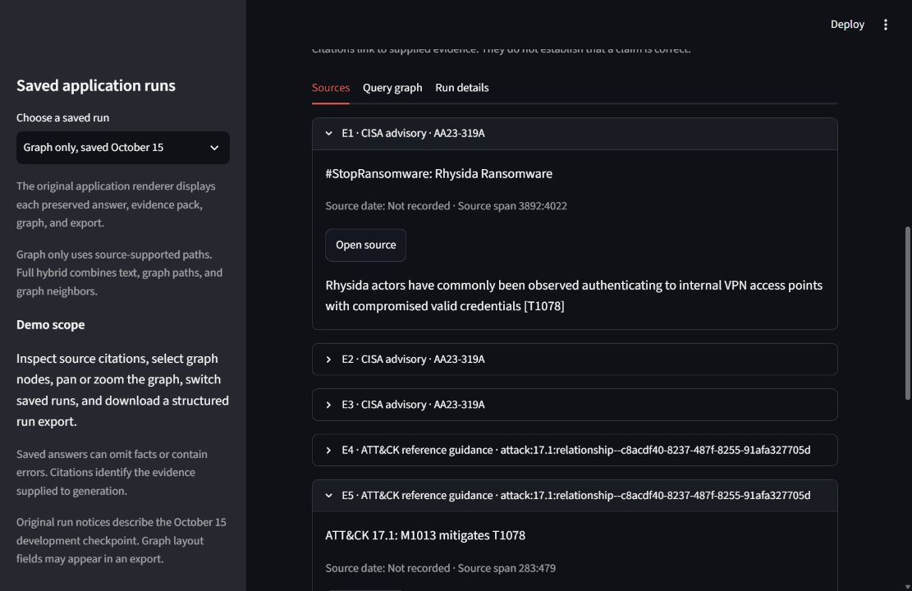
THREATWEAVE / CS 6338
The analyst can inspect the source passage
CISA evidence
The saved Rhysida answer cites the observation about compromised credentials and VPN access.
Mitigation guidance appears under a separate reference label.
Stephen Butler October 16, 2026
09
Notes:
Sources: S:/ThreatWeave/work/application_qa/20261015T074134Z-a878f56c/display.json and S:/ThreatWeave/work/application_qa/20261015T165813Z-950f9f1f/display.json, displayed through S:/ThreatWeave/demo_replay.py and the production render_result function. Browser captures show actual saved outputs; no new model/database call. Earlier live graph-only/full-hybrid checks are historical. Current replay is not a live latency measurement. Renderer may add entity display-column metadata to exports; answer/evidence remain unchanged.

Slide 10
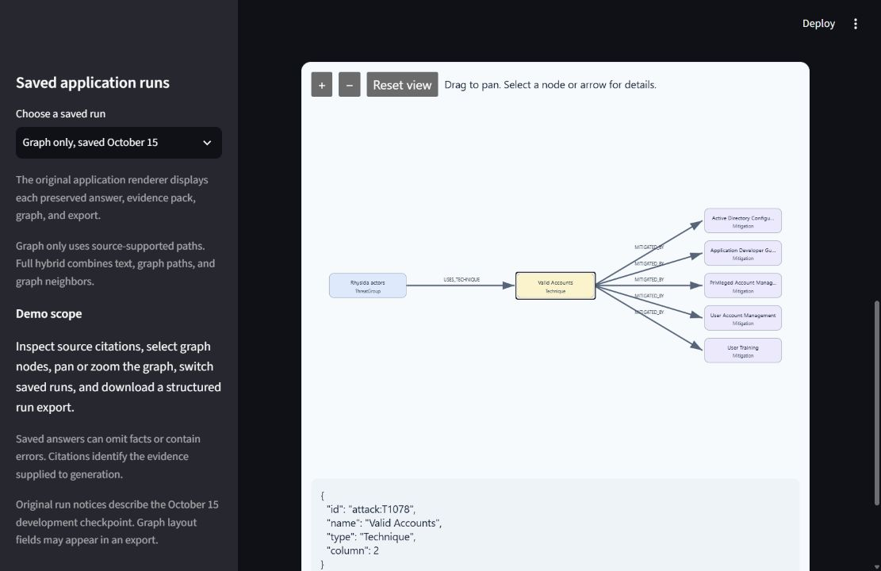
THREATWEAVE / CS 6338
The query graph exposes the returned paths
Directed evidence
Select a technique or relationship to inspect the returned graph structure.
The replay uses real saved runs and makes no new model or database call.
Stephen Butler October 16, 2026
10
Notes:
Sources: S:/ThreatWeave/work/application_qa/20261015T074134Z-a878f56c/display.json and S:/ThreatWeave/work/application_qa/20261015T165813Z-950f9f1f/display.json, displayed through S:/ThreatWeave/demo_replay.py and the production render_result function. Browser captures show actual saved outputs; no new model/database call. Earlier live graph-only/full-hybrid checks are historical. Current replay is not a live latency measurement. Renderer may add entity display-column metadata to exports; answer/evidence remain unchanged.
Vector similarity is a candidate-selection aid, not evidence that an incident relationship exists.

Slide 11
THREATWEAVE / CS 6338
Human completeness improves by only 0.11 points
Condition | Factuality | Completeness | Coherence
Text only | 2.944 (18/20) | 1.889 (18/20) | 3.833 (18/20)
Graph only | 3.500 (20/20) | 1.900 (20/20) | 4.000 (20/20)
No Node2Vec | 3.529 (17/20) | 2.000 (17/20) | 3.882 (17/20)
Full hybrid | 3.350 (20/20) | 2.000 (20/20) | 3.900 (20/20)
Primary means on a 1–5 scale. Parentheses show numeric entries out of 20.
Full hybrid misses the proposed completeness gain of 0.50 points.
Stephen Butler October 16, 2026
11
Notes:
Sources: S:/ThreatWeave/docs/ThreatWeave_primary_completed_ratings.json and S:/ThreatWeave/evaluation/human_analysis.py. Primary: 80 prespecified repeat-one entries, partially blinded. Author entered/confirmed ratings. There was limited AI assistance for review questions. Secondary: all 20 completed entries, same-author declared delayed rescore. No independent second reviewer. Day-level dates do not verify elapsed delay. Both reviews passed validation before method unblinding. Source: work/human_scoring_analysis/20261016T174034Z-7c181a33 and work/final_completion/submission_results.json. Secondary scores remain separate from primary results.

Slide 12
THREATWEAVE / CS 6338
Automatic means have unequal score availability
Condition | Faithfulness | Relevancy | Context recall
Text only | 0.568 (40/60) | 0.555 (54/60) | 0.659 (54/60)
Graph only | 0.503 (53/60) | 0.335 (60/60) | 0.610 (57/60)
No Node2Vec | 0.598 (47/60) | 0.493 (53/60) | 0.593 (53/60)
Full hybrid | 0.626 (52/60) | 0.486 (58/60) | 0.710 (58/60)
Means on a 0–1 scale. Parentheses show numeric scores out of 60.
Judge failures and generator failures limit comparisons between available means.
Stephen Butler October 16, 2026
12
Notes:
Source: S:/ThreatWeave/docs/ThreatWeave_human_answer_review_step.md. All 720 metric slots: 639 numeric, 36 evaluator output-limit failures, 45 unavailable slots from 15 generation failures. Both completed review exports passed validation before unblinding. Full-hybrid available faithfulness is 0.626 (52/60), text-only 0.568 (40/60). Available means and paired estimates use different eligibility rules. Same-model automated judging can share generator biases. The generator and judge use the same local model. Missing values stay missing.

Slide 13
THREATWEAVE / CS 6338
Paired effects do not establish a general advantage
Hybrid minus text | Paired n/20 | Difference | Exploratory 95% CI
Human factuality | 18 | +0.444 | [-0.056, 0.944]
Human completeness | 18 | +0.167 | [-0.278, 0.611]
Human coherence | 18 | +0.056 | [0.000, 0.167]
Auto faithfulness | 9 | +0.124 | [0.011, 0.240]
Human scores use 1–5. Automatic faithfulness uses 0–1.
The QA target and extraction F1 target both remain unmet.
Stephen Butler October 16, 2026
13
Notes:
Sources: S:/ThreatWeave/docs/ThreatWeave_primary_completed_ratings.json and S:/ThreatWeave/evaluation/human_analysis.py. Primary: 80 prespecified repeat-one entries, partially blinded. Author entered/confirmed ratings. There was limited AI assistance for review questions. Secondary: all 20 completed entries, same-author declared delayed rescore. No independent second reviewer. Day-level dates do not verify elapsed delay. Both reviews passed validation before method unblinding. Source: work/human_scoring_analysis/20261016T174034Z-7c181a33 and work/final_completion/submission_results.json. Secondary scores remain separate from primary results. Source: S:/ThreatWeave/docs/ThreatWeave_human_answer_review_step.md. All 720 metric slots: 639 numeric, 36 evaluator output-limit failures, 45 unavailable slots from 15 generation failures. Both completed review exports passed validation before unblinding. Full-hybrid available faithfulness is 0.626 (52/60), text-only 0.568 (40/60). Available means and paired estimates use different eligibility rules. Same-model automated judging can share generator biases. Full hybrid minus text only. Question bootstrap 10,000 draws, seed42. Human uses repeat one. Automatic requires all three numeric repeats in both conditions. Intervals are exploratory and unadjusted for multiplicity.

Slide 14
THREATWEAVE / CS 6338
Delayed scores show mixed consistency
Dimension | Pairs | Exact | Within 1 | Weighted kappa
Factuality | 19 | 21.1% | 100.0% | 0.275
Completeness | 19 | 78.9% | 100.0% | 0.823
Coherence | 19 | 36.8% | 89.5% | 0.153
There was limited AI assistance for review questions.
Secondary scores were lower on average. These results describe within-reviewer consistency.
Stephen Butler October 16, 2026
14
Notes:
Sources: S:/ThreatWeave/docs/ThreatWeave_primary_completed_ratings.json and S:/ThreatWeave/evaluation/human_analysis.py. Primary: 80 prespecified repeat-one entries, partially blinded. Author entered/confirmed ratings. There was limited AI assistance for review questions. Secondary: all 20 completed entries, same-author declared delayed rescore. No independent second reviewer. Day-level dates do not verify elapsed delay. Both reviews passed validation before method unblinding. Source: work/human_scoring_analysis/20261016T174034Z-7c181a33 and work/final_completion/submission_results.json. Secondary scores remain separate from primary results. Nineteen numeric pairs per dimension, S011 excluded as failed-response N/A. Secondary minus primary: factuality -0.789, completeness -0.211, coherence -0.737. Five question clusters, exploratory descriptive agreement.

Slide 15
THREATWEAVE / CS 6338
The result is an inspectable but limited prototype
A working local workflow
Source context and returned paths make errors easier to inspect. Citations alone do not guarantee correctness.
The strongest measured limitation is extraction coverage
Recall is 0.067 against the scoped inventory. Missing QA outcomes and annotation gaps also constrain conclusions.
General superiority and operational effectiveness remain unestablished.
Stephen Butler October 16, 2026
15
Notes:
Source: S:/ThreatWeave/work/extraction_scoring_analysis/20261016T171118Z-dc75fabd/results.json, protocol.json, annotation_audit.json. 146 gold records plus 3 existing additional support assertions give 149 source-scoped assertions. 114 windows: 61 ready, 49 empty, 4 persistent validation failures. 196 pre-review occurrences, 23 inside complete scopes, 22 unique predictions. TP 10, FP 12 exact nonmatches, FN 139. Strict and duplicate-normalized sensitivity agree. Five nonmatches may expose inventory/granularity gaps. No relabeling or model rerun.
Sources: S:/ThreatWeave/docs/ThreatWeave_evaluation_freeze_checkpoint.md and S:/ThreatWeave/work/evaluation_corpus_chunks/20261016T040604Z-bccf59fb/summary.json. Frozen source-level protocol, seed 42, no held-out tuning. MODE field and evidence format confound retrieval-only causal attribution. Actual context cap: 3,000 UTF-8 bytes.
Sources: S:/ThreatWeave/docs/ThreatWeave_primary_completed_ratings.json and S:/ThreatWeave/evaluation/human_analysis.py. Primary: 80 prespecified repeat-one entries, partially blinded. Author entered/confirmed ratings. There was limited AI assistance for review questions. Secondary: all 20 completed entries, same-author declared delayed rescore. No independent second reviewer. Day-level dates do not verify elapsed delay. Both reviews passed validation before method unblinding. Source: work/human_scoring_analysis/20261016T174034Z-7c181a33 and work/final_completion/submission_results.json. Secondary scores remain separate from primary results.

Slide 16
THREATWEAVE / CS 6338
The repository preserves the evidence trail
Record | What a reviewer can verify
Source manifest and split | Snapshot identity and question assignments
Collection/scoring receipts | Attempts, terminal failures and metric availability
Extraction analysis | Scoped predictions and annotation audit
Human review exports | Ratings, N/A reasons and reviewer consistency
Run identities and source citations appear in the speaker notes and report.
Stephen Butler October 16, 2026
16
Notes:
Sources: S:/ThreatWeave/docs/ThreatWeave_evaluation_freeze_checkpoint.md and S:/ThreatWeave/work/evaluation_corpus_chunks/20261016T040604Z-bccf59fb/summary.json. Frozen source-level protocol, seed 42, no held-out tuning. MODE field and evidence format confound retrieval-only causal attribution. Actual context cap: 3,000 UTF-8 bytes.
Sources: S:/ThreatWeave/docs/ThreatWeave_evaluation_graph_index_step.md and S:/ThreatWeave/docs/ThreatWeave_final_evaluation_step.md. Shared scope 101 CISA windows and 190 ATT&CK reference parents. 510 text vectors, 212 domain graph nodes, 394 directed facts, 212 graph vectors, 2,120 walks. Integrity verification does not prove semantic accuracy.
Source: S:/ThreatWeave/work/extraction_scoring_analysis/20261016T171118Z-dc75fabd/results.json, protocol.json, annotation_audit.json. 146 gold records plus 3 existing additional support assertions give 149 source-scoped assertions. 114 windows: 61 ready, 49 empty, 4 persistent validation failures. 196 pre-review occurrences, 23 inside complete scopes, 22 unique predictions. TP 10, FP 12 exact nonmatches, FN 139. Strict and duplicate-normalized sensitivity agree. Five nonmatches may expose inventory/granularity gaps. No relabeling or model rerun.
Source: S:/ThreatWeave/work/final_evaluation_review_checks/20261016T052517Z-4778a10b and S:/ThreatWeave/docs/ThreatWeave_final_evaluation_checkpoint.md. 240 measured outcomes plus 4 excluded warm-ups. 210 valid non-abstaining answers, 15 graph-only empty-evidence abstentions, 15 generation validation failures. Valid refers to schema/citation validation, not semantic correctness. 9 repeated-citation and 6 repeated-claim failures after allowed attempts. All missing values preserved.
Source: S:/ThreatWeave/docs/ThreatWeave_human_answer_review_step.md. All 720 metric slots: 639 numeric, 36 evaluator output-limit failures, 45 unavailable slots from 15 generation failures. Both completed review exports passed validation before unblinding. Full-hybrid available faithfulness is 0.626 (52/60), text-only 0.568 (40/60). Available means and paired estimates use different eligibility rules. Same-model automated judging can share generator biases.
Sources: S:/ThreatWeave/work/application_qa/20261015T074134Z-a878f56c/display.json and S:/ThreatWeave/work/application_qa/20261015T165813Z-950f9f1f/display.json, displayed through S:/ThreatWeave/demo_replay.py and the production render_result function. Browser captures show actual saved outputs; no new model/database call. Earlier live graph-only/full-hybrid checks are historical. Current replay is not a live latency measurement. Renderer may add entity display-column metadata to exports; answer/evidence remain unchanged.
Sources: S:/ThreatWeave/docs/ThreatWeave_primary_completed_ratings.json and S:/ThreatWeave/evaluation/human_analysis.py. Primary: 80 prespecified repeat-one entries, partially blinded. Author entered/confirmed ratings. There was limited AI assistance for review questions. Secondary: all 20 completed entries, same-author declared delayed rescore. No independent second reviewer. Day-level dates do not verify elapsed delay. Both reviews passed validation before method unblinding. Source: work/human_scoring_analysis/20261016T174034Z-7c181a33 and work/final_completion/submission_results.json. Secondary scores remain separate from primary results.
Authorship: Stephen Butler. Codex assisted code, source/score auditing, statistical tooling and deliverable preparation. Video uses synthetic narration.

