Slide 1
Applying Bayesian Analysis to COVID-19: What is helping to slow death rates?
ST 540 Final Project
Taylor Krebsbach, Jonathan McMahon, and Shantel Ward
1

Slide 2
Motivation
The COVID-19 pandemic began in Wuhan, China in December 2019. The virus has traveled the globe and drastically changed our lives. It is no surprise for us to wonder if staying at home is slowing the spread. We seek to understand if the actions taken by the U.S. states has significantly impacted the number of deaths caused by COVID-19.
For example, in Washington state, we see below that the number of deaths per 100,000 population appears to taper off around two weeks after the stay at home order and non-essential business closures.
1

Slide 3
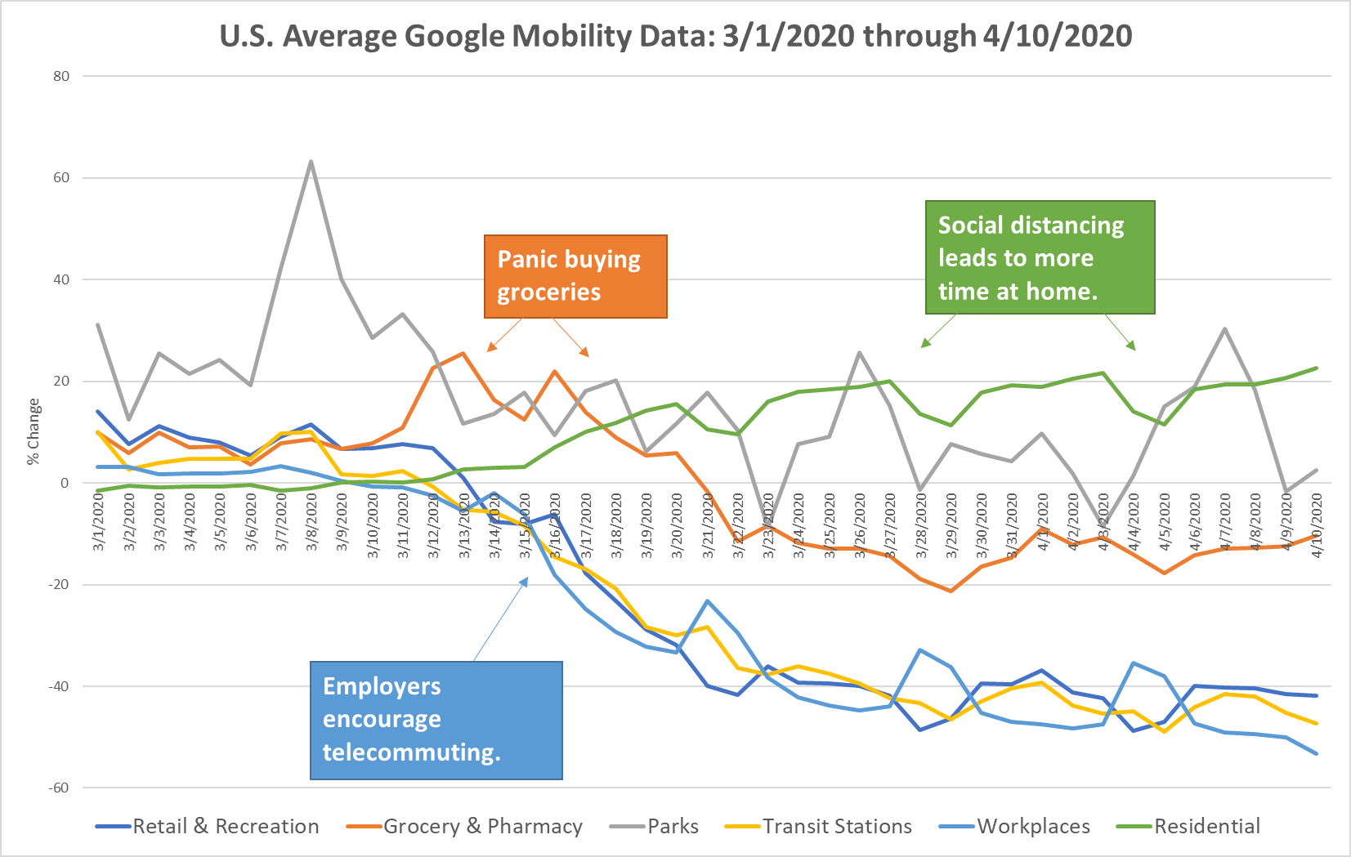
Data Analysis
We compiled data from multiple sources & aggregated them by state from 3/1-4/10/20. Our model inputs consist of daily snapshots by state of these factors combined with state-specific information (e.g. median age).
The dates for state actions e.g. school closures) were transformed into “days since effective date of action”
Deaths per 100K were normalized by the population of each state
Google collects mobility data to provide insights into how activity patterns have changed in response to policies aimed at combatting COVID-19.
Testing and Death Counts
Population and Median Age
Changes in Unemployment Rates
Google Mobility Report
Dataset
Days since Legislation went into effect
Details below
Data Sources:
covidtracking.com
google.com/covid19/mobility
worldpopulationreview.com
bls.gov
kff.org
1

Slide 4
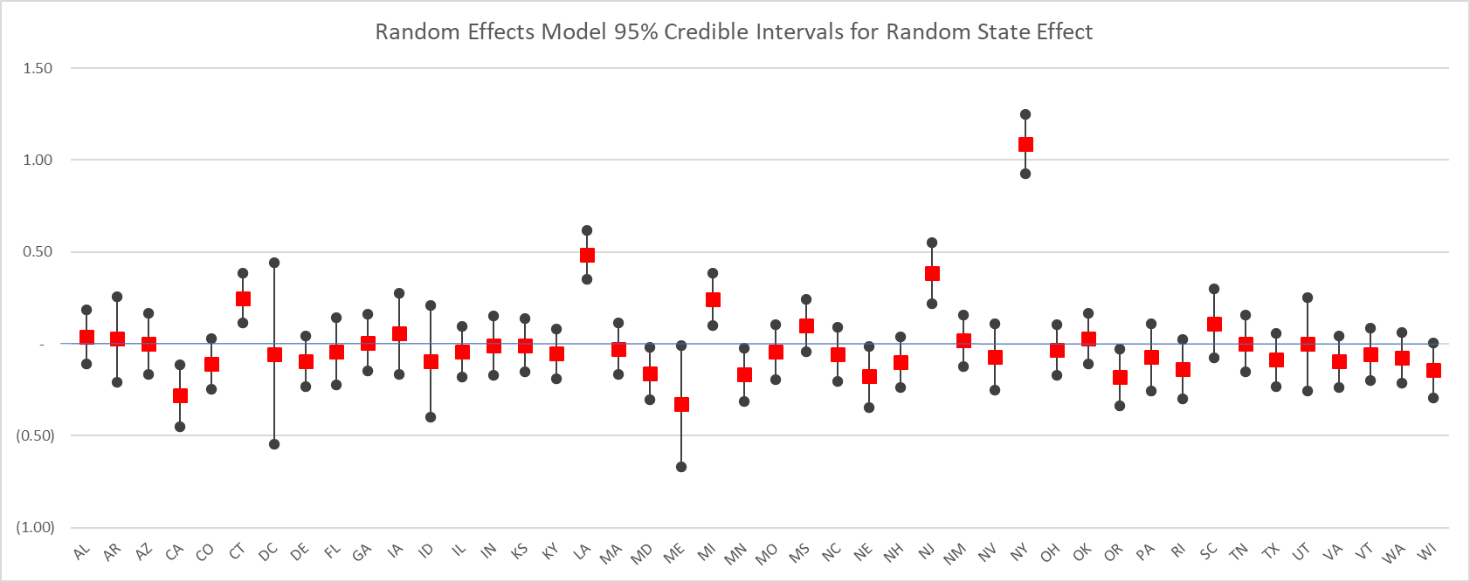
Variable Selection & Testing
Two weeks is the commonly-cited incubation period during which COVID-19 symptoms will manifest. Based on this fact, in order to explore the death rates two weeks into the future, we select variables using data from two weeks prior as our covariates.
We also removed states that had less than 10 deaths. We considered that these states are “lagging behind” the other states.
Throughout our modeling selection, we consider the fact that some of the variables in our model may mask the signal of the others.
StayAtHome variable has statistical significance in the absence of the Mobility data.
In one model we reviewed the random state effects. As seen below, the states with random effects significantly different from zero are those that were hit the hardest with COVID-19 earlier on: NY, NJ, CT, LA, CA, and MI.
1
4

Slide 5
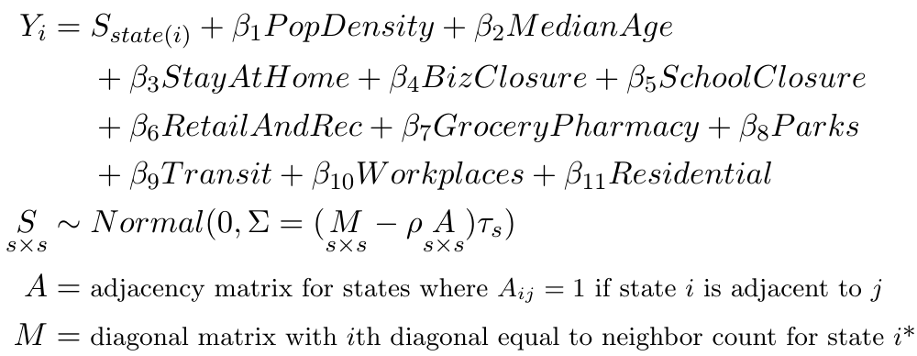
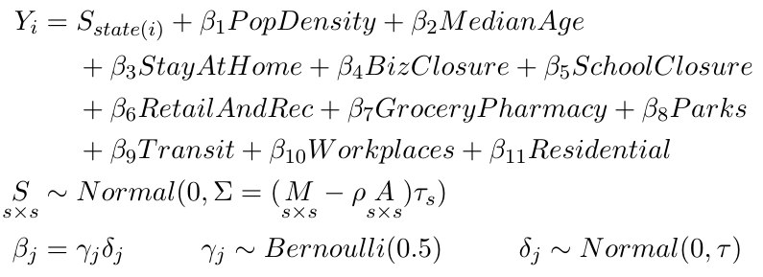
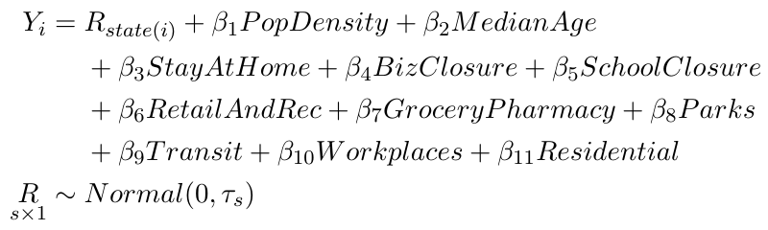
Models & Results
Spatial Model | Stochastic Search Variable Selection Spatial Model | State Random Effects Model
WAIC: 442.67 DIC: 429.1 | WAIC: 468.74 DIC: 454.6 | WAIC: 442.74 DIC: 429.1
Our Spatial Model yields a spatial dependence parameter ρ=0.61. Therefore we conclude residual spatial dependence is present in these data. We hypothesize that for smaller states this spatial dependence would be higher.
Among our final three models, the TransitPctChg and ResidentialPctChange covariates were consistently significant.
Stochastic Search Variable Selection Model exhibited that covariates SchoolClosure, TransitPctChg, and ResidentialPctChange, should be included in the model. These covariates have mean posterior inclusion probabilities of 0.17, 0.46, and 0.93, respectively.
WAIC and DIC for the Spatial Model and State Random Effects Model are the lowest. Perhaps this validates that states have a significant impact on the model.
Model burn-in was 50k iterations then 2 chains x 300k iterations (thin=3). ESS counts of >1,000 and Gelman Diagnostics of 1 revealed that the models converged for all parameters.
1
*See Page 155 of Bayesian Statistical Methods (Reich & Ghosh)

Slide 6
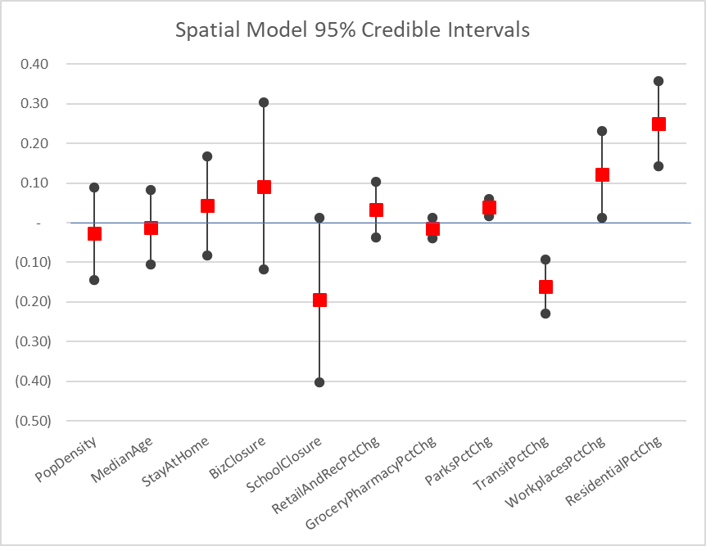
Conclusions & Further Questions
Conclusions:
There is a significant state effect for those states exposed earlier and hit the hardest.
Our Spatial Model points to a spatial dependence between states.
The Mobility Data has the most consistently significant predictive power in all our models. The ResidentialPctChange is the strongest predictor followed by TransitPctChg.
In the Spatial Model, ResidentialPctChange is positively correlated with the death rates, where TransitPctChg is negatively correlated.
The estimated mean for SchoolClosure suggests a strong negative correlation with the death rate, but due to the high level of uncertainty we cannot assign statistical significance to this covariate.
Our SSVS Spatial Model variable selection also identified this variable for inclusion.
Further Exploration:
Perform analysis by county level/separate major cities (NYC).
Configure random effects model with statistically significant state effects and “all other states”.
Our analysis was truncated at 3/27/2020 due to predicting the 4/10/2020 number of deaths. How would our models change with more data?
Explore correlations further between covariates to remove any serial correlation or autocorrelation.
Incorporate the impacts of hospital bed capacity, hospital utilization and ventilator availability/shortages as covariates to see the significance on death rates.
1
6

