Slide 1
Harnessing the full power of modern hardware accelerators using idomatic C++
Stefan Butz
Fakultät für Mathematik und Informatik
Seminar Rechnerarchitekturen
Lehrstuhl Prof. Dr. Lena Oden
Stefan Butz

Slide 2
Why should we use hardware accelerators?
Computational Power vs. Complexity
Modern applications require high-performance computing (HPC).
Hardware accelerators (GPUs, FPGAs) provide massive parallelism.
However, using them effectively requires specialized programming models.
Existing Solutions and Their Challenges
CUDA (NVIDIA) and ROCm (AMD) require vendor-specific knowledge.
Open standards like OpenCL and SYCL attempt to provide portability.
C++ standard parallelism (stdpar) aims to integrate parallel computing directly into the language.

Slide 3
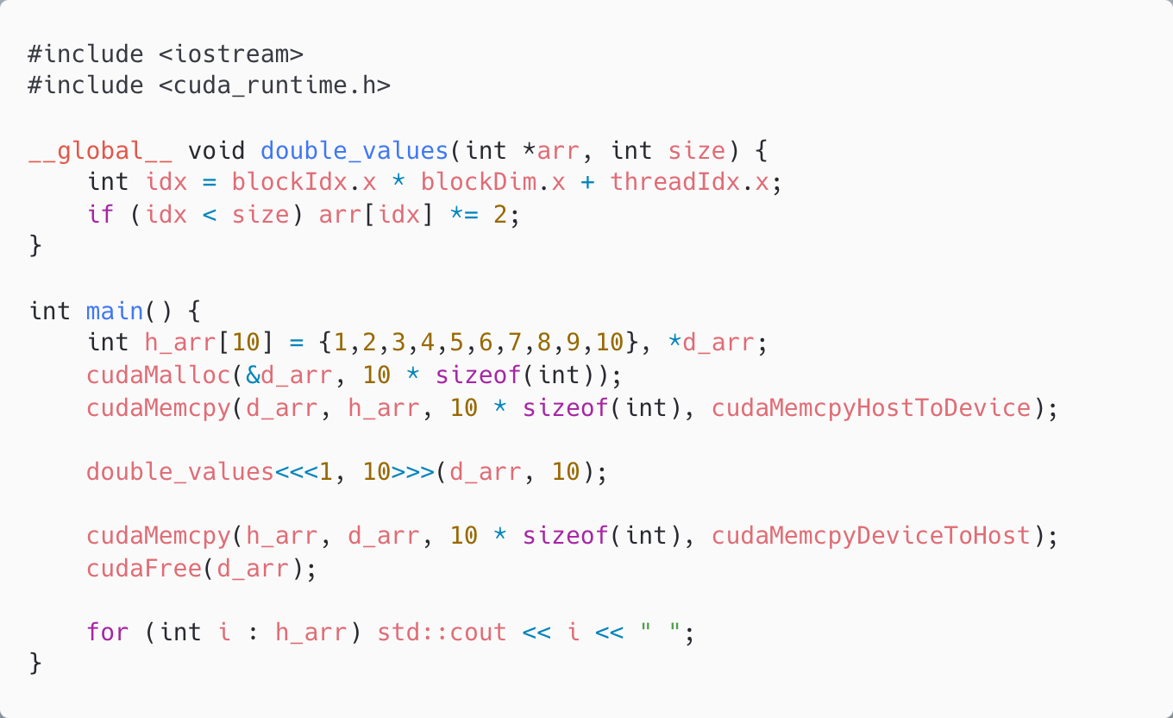
CUDA Example
CUDA is the native programming model for NVIDIA GPUs
Simple CUDA Kernel which doubles the values of a given integer list
Notes:
Parallel Execution: Each thread processes one element (idx = blockIdx.x * blockDim.x + threadIdx.x). Explicit Memory Management: Uses cudaMalloc, cudaMemcpy, and cudaFree. Thread and Block Setup: Launches 1 block with 10 threads (<<<1, 10>>>).

Slide 4
Challenges with CUDA
Problems:
Vendor lock-in (NVIDIA only)
Manual memory management
Requires explicit kernel definitions and launch configurations
Steep learning curve
Solution: Higher-level abstractions

Slide 5
SYCL
What is SYCL?
A modern C++ framework for parallel computing
Enables single-source heterogeneous programming
Portable across CPUs, GPUs, and other accelerators
Why SYCL?
High-level abstraction while still providing performance control
Open standard (Khronos Group), not vendor-locked

Slide 6
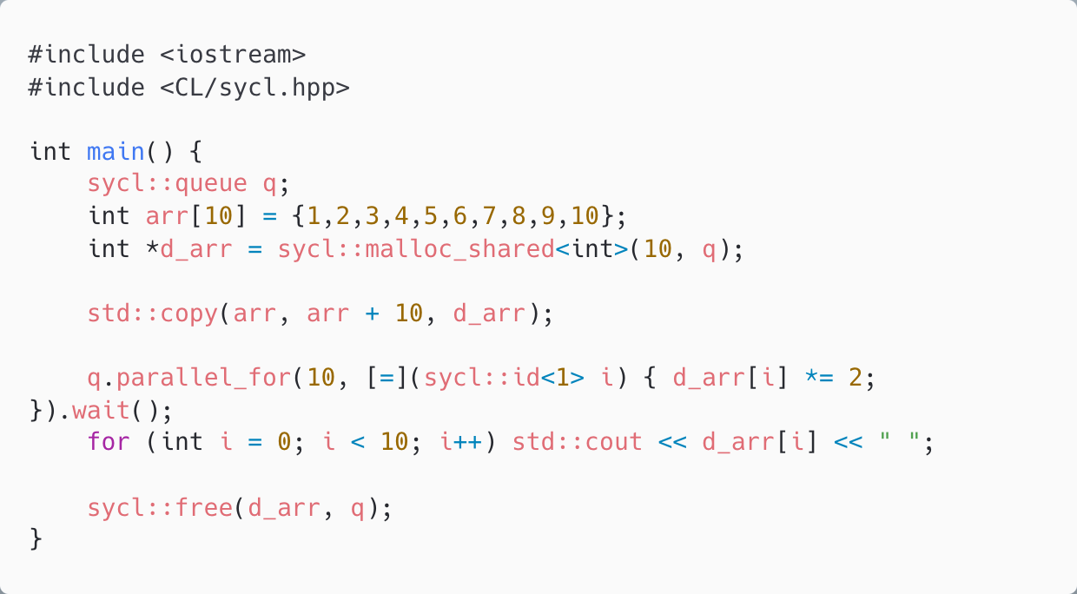
SYCL Example
Snippet shows a SYCL program that doubles the values of a given integer list

Slide 7
SYCL Memory Management
Buffers & Accessors
Unified Shared Memory (USM)
Notes:
SYCL provides two main memory models:
Buffers & Accessors: Explicit memory management with dependency tracking. Accessor = Acquisition and release of buffer
Unified Shared Memory (USM): Allows direct pointer-based memory access
USM Advantages:
Closer to standard C++ memory handling
Easier integration with existing codebases
Reduces explicit data movement overhead

Slide 8
SYCL Execution Model
Queues: Operations scheduled for execution on hardware accelerators
In-order queue / Out-of-order queue
Implicit or explicit synchronization
Notes:
Queues and Execution
SYCL uses queues to manage execution on heterogeneous devices.
Tasks are submitted to a queue, and the runtime schedules execution.
Types of Queues:
In-order queue: Tasks execute sequentially. As definied
Out-of-order queue: Tasks execute asynchronously based on dependencies. Usage of Dependency Tracking through Accesors or use Events directly
Synchronization Mechanisms:
Implicit: SYCL tracks dependencies and synchronizes automatically.
Explicit: Developers can use sycl::event to control exe

Slide 9
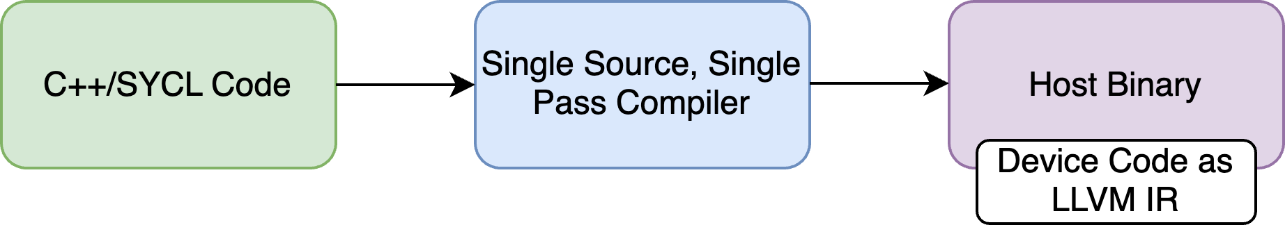
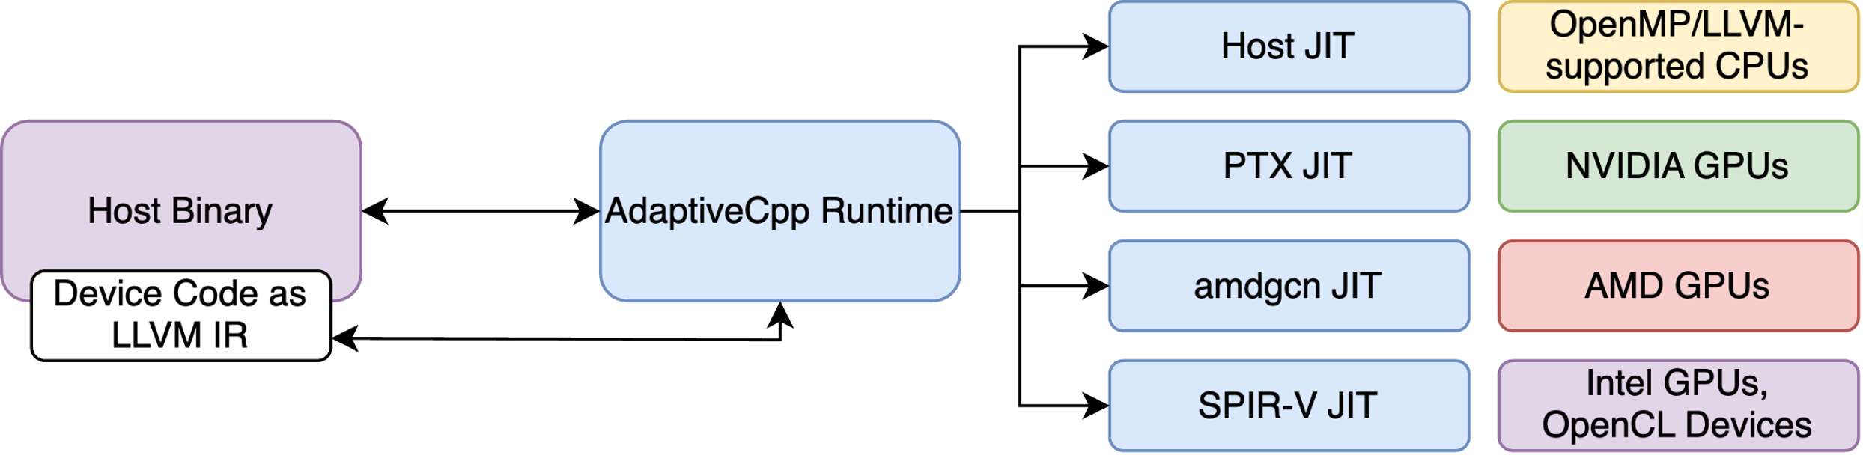
AdaptiveCpp: A SYCL implementation
Open-source SYCL implementation with support for different platforms
Single-Source, Single-Pass Compilation
Notes:
What is AdaptiveCpp?
An open-source SYCL implementation enabling stdpar execution.
Supports multiple hardware platforms (NVIDIA, AMD, Intel, CPUs).
Single-Source, Single-Pass Compilation
Unlike traditional SYCL compilers, AdaptiveCpp processes both host and device code in a single pass.
Generates a universal binary that adapts dynamically to available hardware.
How It Works:
Device code is embedded in LLVM IR during compilation.
The runtime extracts and compiles device-specific code Just-in-Time (JIT).
Advantages:
No need to recompile for different devices.
Lower compilation overhead compared to multi-pass approaches.
Seamless integration with existing SYCL and C++ applications.

Slide 10
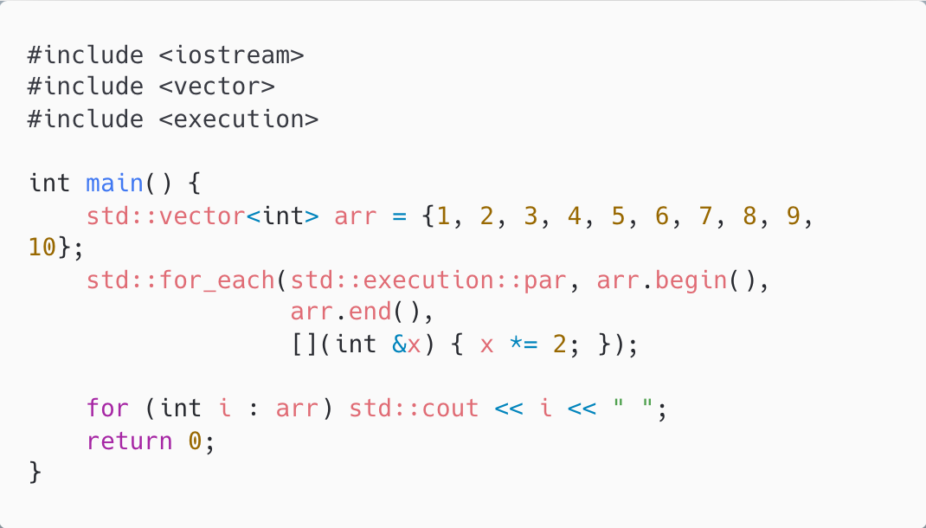
stdpar: C++ Standard Parallelism
Introduced in C++17
Proivdes execution policies to parallelize STL algorithms
std::execution::seq
std::execution::par
std::execution::par_unseq
Notes:
Key Features
Uses execution policies (seq, par, par_unseq).
Compiler decides execution model (CPU/GPU offloading).
Automatically parallelizes loops and STL algorithms.
Execution Policies:
seq: Sequential execution on a single thread.
par: Parallel execution across multiple threads.
par_unseq: Parallel execution with vectorization (SIMD).
Why stdpar?
No need for explicit thread management.
Allows for incremental parallelism in standard C++ code.
Improves maintainability and portability.

Slide 11
Challenges in integrating stdpar with SYCL
Execution Model
Memory Management
Synchronization
Device Execution Constraints
Performance Overhead
Notes:
Execution Model Differences
stdpar: Implicit parallelism via execution policies.
SYCL: Explicit task-based execution with queues & kernels.
Requires transforming high-level policies into low-level SYCL constructs.
Memory Management Mismatch
stdpar abstracts memory, while SYCL requires explicit allocation & transfers.
stdpar expects automatic data movement, but SYCL relies on buffers, accessors, or USM.
Synchronization and Task Scheduling
stdpar assumes implicit execution, while SYCL requires explicit synchronization.
Event handling & dependency tracking must be introduced efficiently.
Device Execution Constraints
stdpar is CPU-centric; SYCL enforces device-specific constraints.
SYCL restricts dynamic memory, exceptions, function pointers in kernels.
Performance Overhead
stdpar is CPU-optimized; SYCL introduces kernel launch & memory transfer overhead.
Efficient execution queue & memory management strategies are needed.

Slide 12
Challenge 1: Execution Model
Detection of parallel code by compiler
Mapping of executions to operations in sycl queues
Kernel Mapping: std_for_each to sycl::parallel_for
Notes:
Detection of Parallel Code by Compiler
AdaptiveCpp identifies parallel execution regions in stdpar code
Converts stdpar execution policies into SYCL-compatible kernel dispatch
Queue-Based Execution and Kernel Dispatch
stdpar does not expose explicit queues; AdaptiveCpp maps execution to SYCL queues
Kernel Mapping
Translates std::for_each execution to SYCL parallel_for

Slide 13
Challenge 2&3: Memory Management and Synchronization
Compiler must detect all inputs of parallel code blocks
Intercepts all memory allocations and allocates USM if necessary
USM handles data transfer transparently
Automatically insert sycl::events to to enforce execution order where needed

Slide 14
Challenge 4: Device Execution Constraints
Compiler has to limit usage of certain language features (e.g. exceptions)
Notes:
Can limit porting of code to stdpar

Slide 15
Challenge 5: Performance Overhead
Reducing kernel launch overhead
kernel fusion, batching
Memory management optimizations
buffer pooling
Minimizing synchronization overhead
dependency tracking
Conditional Offloading
Notes:
Reducing Kernel Launch Overhead
stdpar assumes implicit parallelism, but SYCL requires explicit kernel enqueuing.
AdaptiveCpp optimizes kernel fusion and batching to reduce launch overhead.
Avoids excessive kernel launches by combining multiple small parallel tasks.
Efficient Queue and Task Scheduling
Uses out-of-order queues where possible to improve execution concurrency.
Dynamically selects between CPU and GPU execution based on workload characteristics.
Memory Management Optimizations
Unified Shared Memory (USM) Integration:
Reduces explicit memory movement overhead.
Allows automatic memory migration across host and device.
Buffer Pooling:
Reuses memory allocations instead of frequent deallocations to reduce allocation overhead.
Avoiding Redundant Copies:
Tracks memory access patterns and eliminates unnecessary data transfers.
Minimizing Synchronization Overhead
Inserts only necessary synchronization points instead of global barriers.
Uses event-based dependency tracking to avoid blocking execution unnecessarily.
Workload-Specific Optimizations
Conditional Offloading:
Small workloads may execute on the CPU instead of GPU to avoid kernel launch overhead.
Load Balancing:
Dynamically adjusts workload distribution across CPU/GPU to prevent underutilization.
Vectorization and GPU-Specific Optimizations
Optimizes work-item and work-group sizes for different hardware.
Uses SIMD vectorization where applicable to improve computational throughput.

Slide 16
Conclusion: It can be this simple
acpp --acpp-targets=generic -o test test.cpp

Slide 17
References
Same is in my paper.

Slide 18
Thank you for your attention!
Now it’s time for your questions.

