Slide 1



Predicting Movie Success
USC Data Analytics Bootcamp – May 3, 2018
I've never lived in one place for more than 5 years - Saudi Arabia (0-5), India (6-12), San Francisco (13-18), East Bay (19-21), Sacramento (22-25), India (25-26), Long Beach (26-28), Culver City(29-)
I took two years of Latin in high school where I joined the Latin Club. Initiation mean wearing a white toga - earning me the nickname Casper!!
Antonio
I love to draw and have drawn at least a single doodle every day, since i was 20. It’s about 4 notebooks now.
Ahmed
Jeff

Slide 2
Our Journey…and Results!!
Business Case:
Less movies being made by the Big 6
Production costs rising faster than revenues
Problem Statement: Can existing movie prediction models be improved by at least 10%?
Results: Success, sort of!!
AMA Model Prediction Performance:
Success: Movie revenues are 2 times the production cost (inflation adjusted).
Benchmark:
Process
Data Research
EDA
Feature Engineering
Model Fit, Train, Test
Model Performance
Data Source:
OpusData provided a free dataset.
Kaggle movies data.
Score of 41% - 68% but this includes linear regression results
66% AUC – Random Forest
85% Precision Score

Slide 3
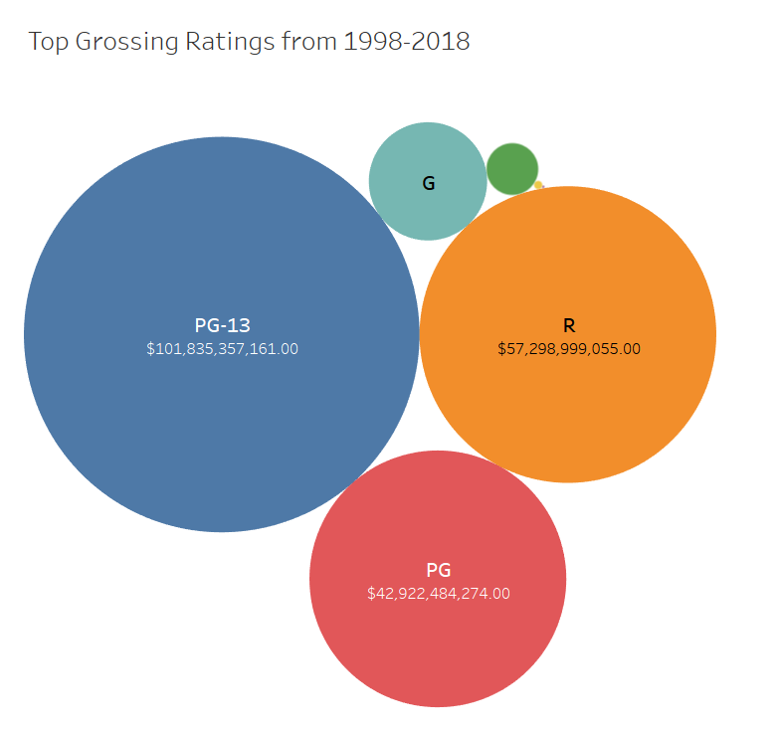
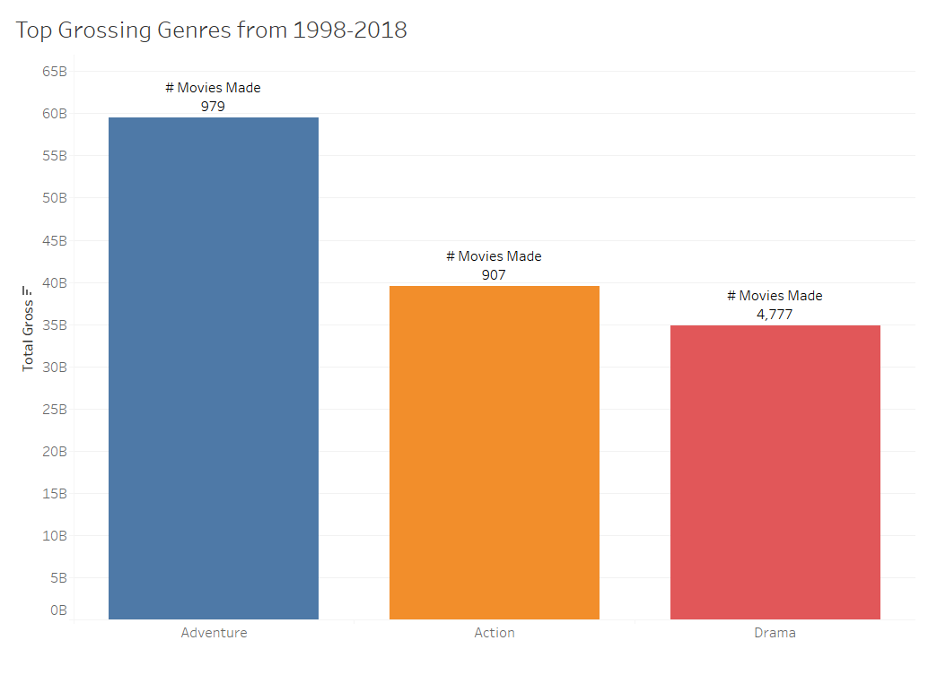
Movie Industry Fundamentals…Basic EDA!!

Slide 4
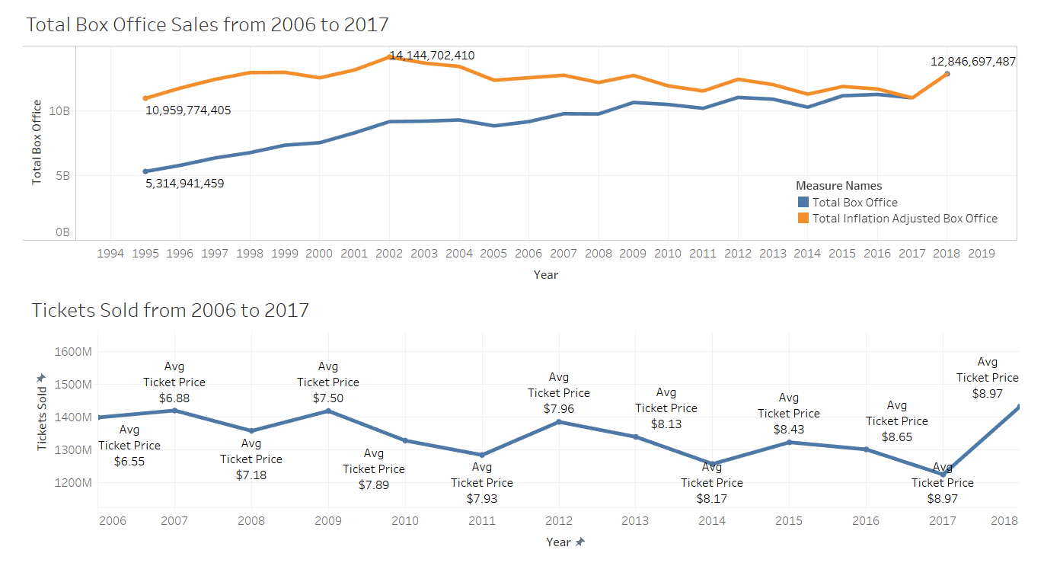
Movie Industry Fundamentals…Basic EDA!!

Slide 5
Key Assumptions
Filtered years to 2006 -2017
Data quality concerns
Social media bias
1600 movies in scope
Success means...
Ratio of 2 (revenue/cost)
Uneven production cost info
Confusion Matrix
Accuracy comparisons are difficult

Slide 6
Feature Engineering
Hyper-Tuning and Removed
N-Estimaters
Max features
Splits
Samples
Random State
Included Random State = 42 for all models
Initial model contained 4600 features. Future models contained less than 50.
Considered using GridSearch() to find optimal N-Estimaters…instead used a For Loop to find sweet spot – 175 – 250!!
Correlation analysis completed as input for feature selection

Slide 7
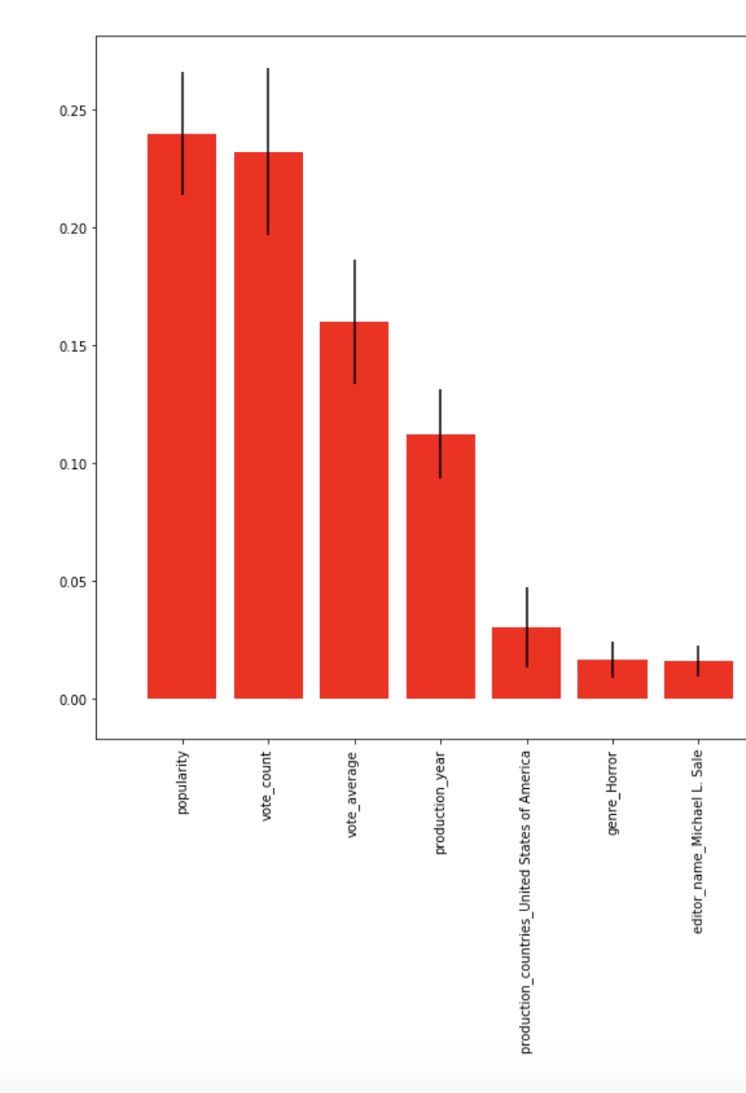
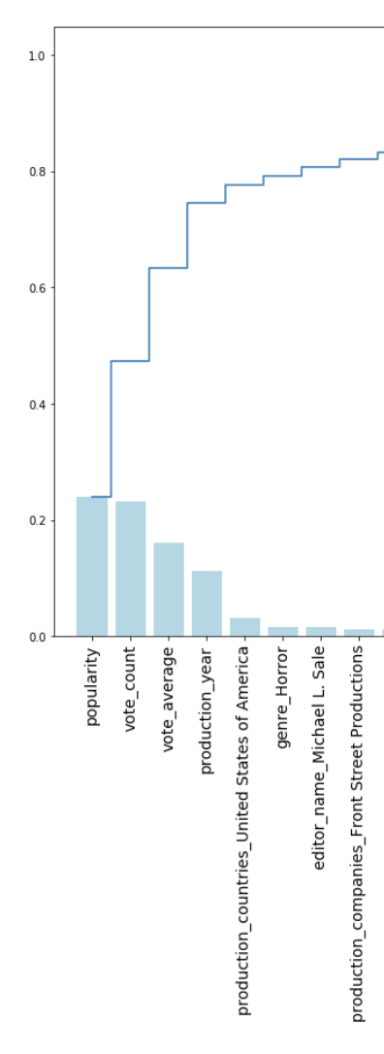
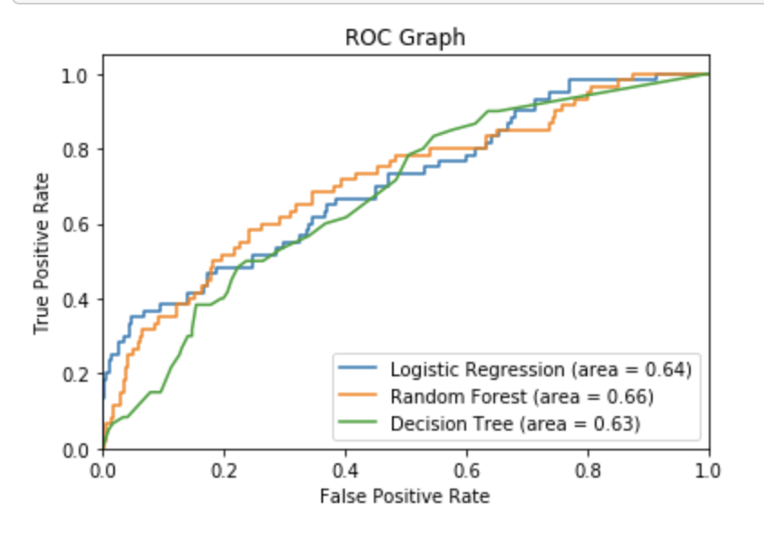
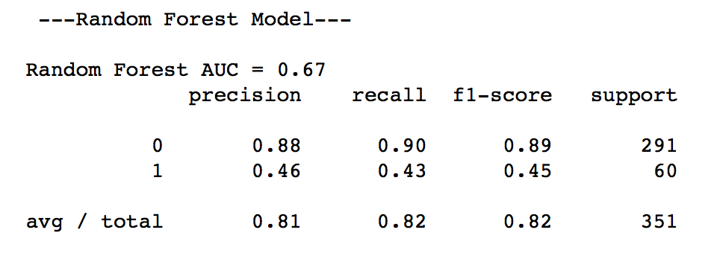
Model Performance
Feature Importance

Slide 8
Continuous Improvement
Social media impact over the past 10 years
Introducing more/less penalty – success ratios
Parameter tuning
More data – only 1600 movies in this model

