Slide 1
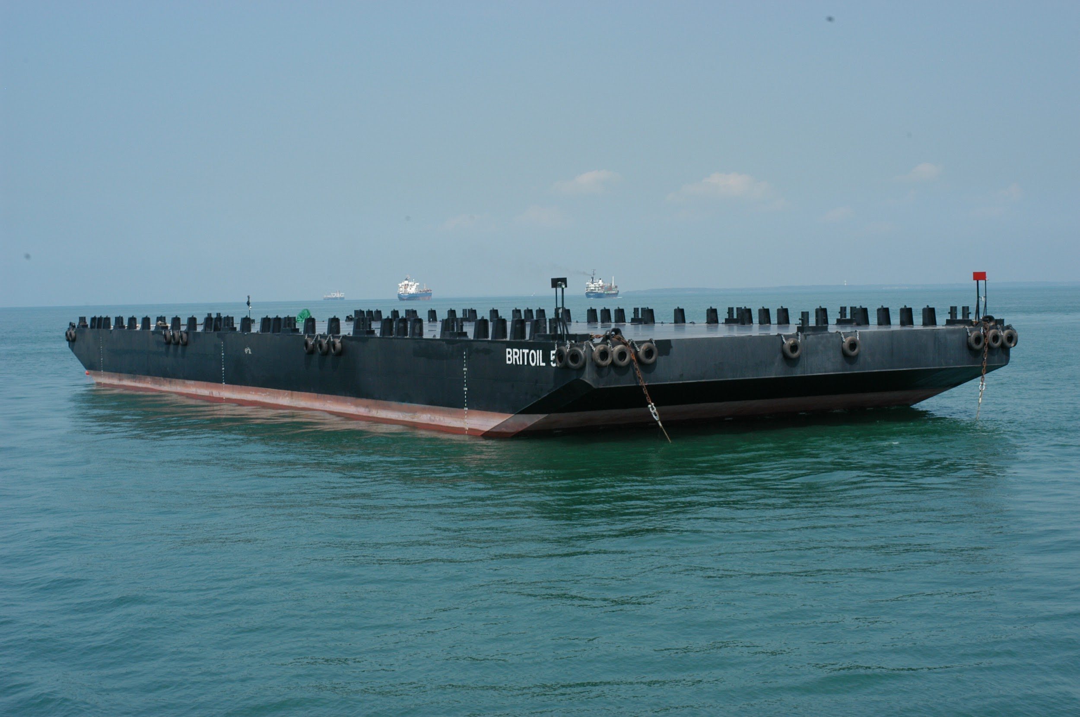
Added Mass and Damping Coefficient of a typical ship (Barge) section in Heave, Sway & Roll motion
NA18B106 Darshan Samdani
NA18B116 Subodh Wasnik

Slide 2
01
OBJECTIVE
02
THEORY
TABLE OF CONTENTS
03
PROBLEM STATEMENT
04
FEM SOLUTION
05
CALCULATIONS OF BOUNDARY CONDITIONS

Slide 3
OBJECTIVE
To determine the damping coefficient & added mass
Stiffness
Matrix
Radiation
Solution
Matrix
Hydrodynamic
Force
Pressure
Added mass
And
Damping

Slide 4
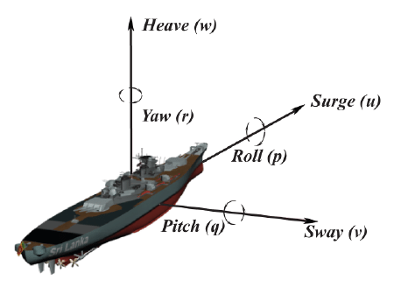
DEGREES OF FREEDOM

Slide 5
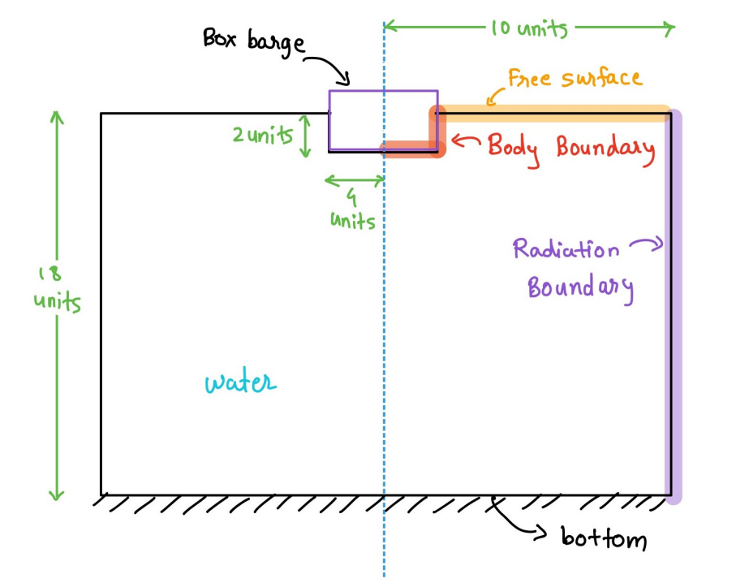
DOMAIN + BARGE SHIP

Slide 6


Problem Statement
Formulas Used
To calculate the hydrodynamic characteristics added mass coefficient and damping coefficient, in heave, sway, and roll, through FEM.
Governing Helmholtz equation
Galerkin’s form of governing equation

Slide 7
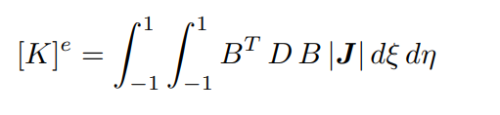
FEM Solution
The element stiffness matrix is calculated as:
Apply the boundary conditions:
Radiation Boundary Condition
Free Surface Boundary Condition
Body Boundary Condition

Slide 8



Evaluation
From the stiffness element matrix, the radiation solution matrix is derived, and hence hydrodynamic force, added mass, added mass coefficient, and damping coefficient are derived.

Slide 9
THANK YOU

