Slide 1
Introduction to Machine Learning
APril 2018
Shane Weeden
Senior Technical Staff Member, IBM Security
Notes:
Start with the Cambridge Analytica video: https://iview.abc.net.au/programs/four-corners/NC1803H010S00#playing
Play from 21:41 to 22:20
Anyone who thinks that ML isn’t relevant to what we do in this lab, think again!

Slide 2
What is Machine Learning?
Application of numerical insight obtained from existing data to make predictions on new data. - Shane Weeden, ML rookie
Notes:
To introduce some terminology, the existing data is known as a training set, and the prediction is called a hypothesis.
The hypothesis is generally expressed as an algorithm, and it is the discovery of this algorithm and it’s accuracy (according to some metric) that is the primary subject of the field of machine learning.
Note: This is really a definition for supervised machine learning, as technologies like K-means for clustering is not really about making predictions.

Slide 3
Types of Machine Learning
Supervised Machine Learning
Linear regression
Logistic regression
Neural networks
Support Vector Machines (SVM’s)
Unsupervised Machine Learning
K-means (cluster detection)
Principal Component Analysis (data compression and visualization)
Anomaly detection
Specialty applications
Recommender systems
Large scale machine learning
Notes:
Linear regression – best-fit a line or surface through a set of data points
Logistic regression – predict whether something “is” or “is not” some class (e.g. is or is not cancer). Can be multi-class, such as in optical character recognition.
Neural networks – modelled on the human brain and nervous system
Support Vector Machines – alternative form of classification algorithm than logistic regression and neural networks that can be faster and more effecting depending on number of features and training samples.
Unsupervised ML – used when there are no known outcomes to predict.
K-means - look for K “clusters” of commonality in a data set.
PCA – a way to reduce the number of dimensions of the data without largely affecting insight. Used to speed up training, and to visualize data.
Anomaly detection - look for unusual things when you have a large training set with only a very few number of positive examples.
Recommender systems - used for advertising or recommendations for when you have partial training data. E.g. movie/book ratings.
Large scale machine learning – ways of modifying training algorithms to account for when the computational expense of using all the training data is too high. Examples include Stochastic gradient descent, mini-batch gradient descent, online learning (use and throw away), and map-reduce via multiple cores or machines.

Slide 4
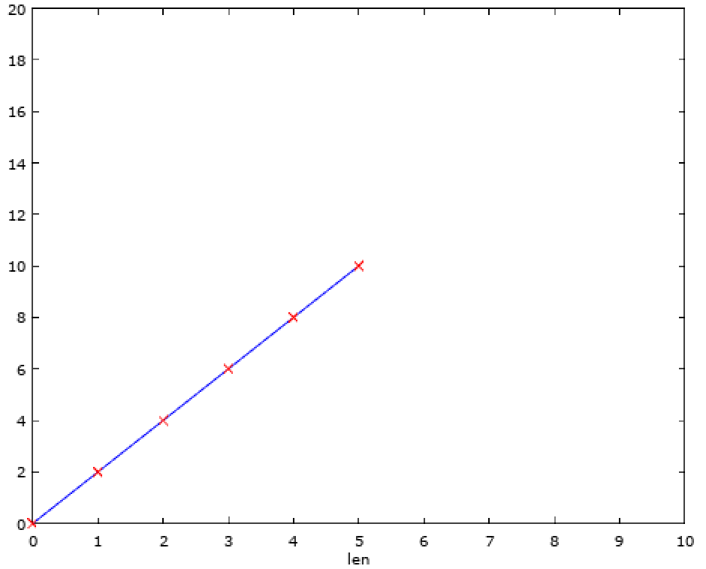
A simple regression example
Predict y when len=10?
Notes:
This is a very trivial example – the ratio of a circle’s diameter to it’s radius y = (x*2)

Slide 5
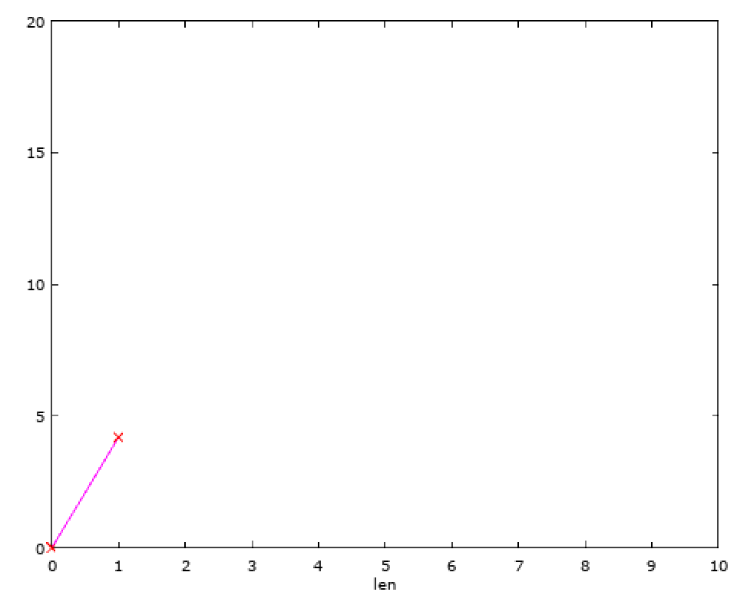
Another regression example
About 12?
Predict y when len=3?

Slide 6
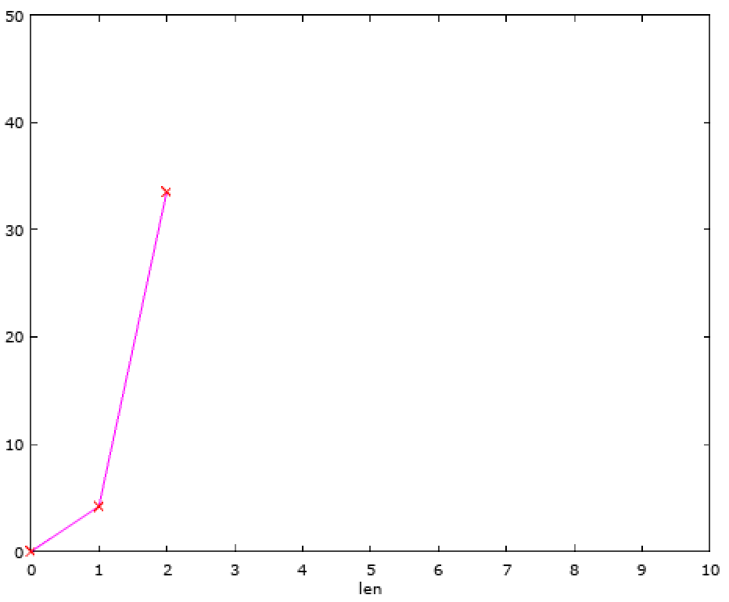
Another regression example – more training data
About 46?
Predict y when len=3?
These errors represent the difference between observed values of y and the hypothesis’ prediction. The best fit line is the line that minimises the sum of these errors. In this case the error is still quite bad…
Notes:
Now we have more training data. We can move the line, but notice there is now some error introduce, as the line does not actually “fit” any of the training data.
If you want to visualize this in Octave, use the brownbag directory and run:
X = [0;1;2];
y_volume = 4/3 * pi * (X .^ 3);
visualizeLinearReg(X, y_volume, [], 3, "Fitting linear regression to radius");

Slide 7
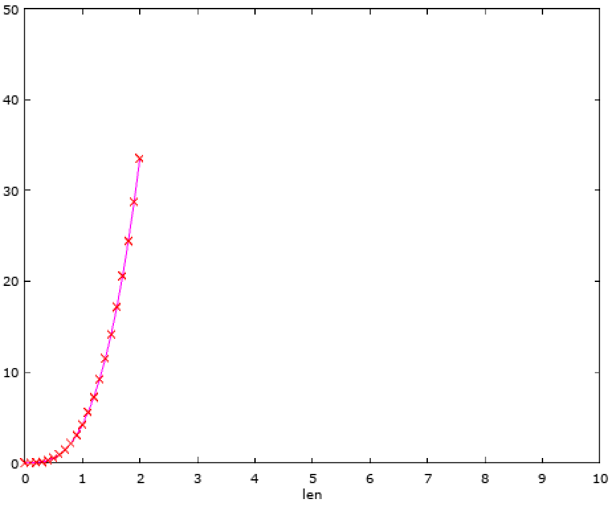
Another regression example – even more training data
Actually… it’s going to be much higher.
Predict y when len=3?
Notes:
This is actually the ratio of the radius of a sphere to it’s volume (y = 4/3 * pi * r^3)
The goal of ML in this type of scenario is to be able to predict the value of y, given x. Here there is only one “feature”, x, which is labelled “len”.
We will visualize a best-fit line to this in the demo soon.

Slide 8
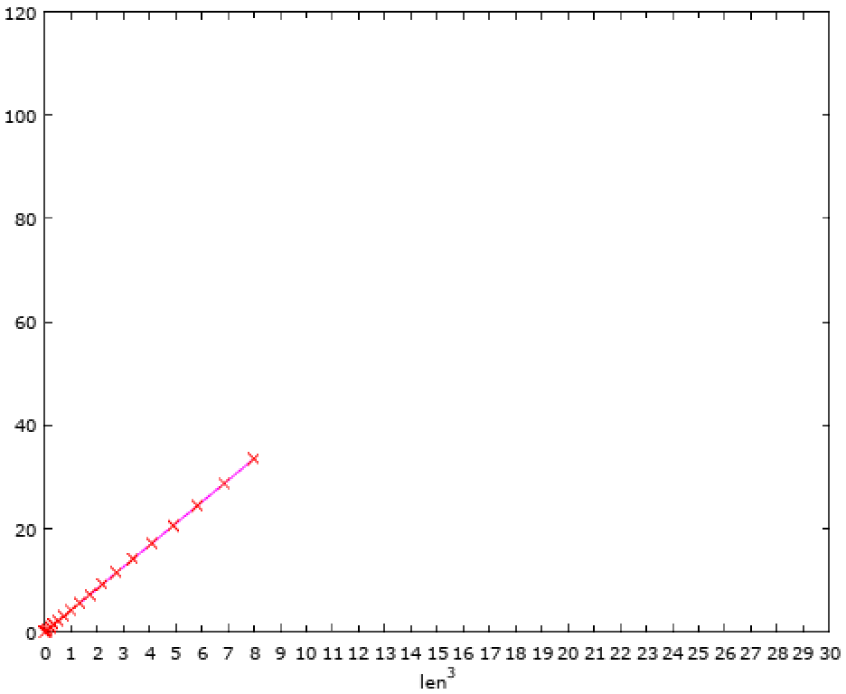
Using different features (len³) turns this into a linear problem!
About 113!
Predict y when len=3?
Equivalent to: Predict y when len^3=27.
Notes:
If we plot y as a function of len^3 we can see this is a linear problem, and it’s easy to extrapolate the data.
But it’s not always easy to see the relationships between features and an observed output….
One of the advanced skills in ML is being able to try a hypothesis, measure it’s effectiveness, and try again after changing something. Deciding what to change, and why is really what makes a skilled ML subject matter expert.

Slide 9
Basic principals and terminology
Samples – collection of known observations (and preferably their actual outcomes (training set, cross validation set, test set)).
Features – the number different of data points per sample.
Hypothesis – an algorithm representing the prediction you want to make. It is a function over the features of a sample.
Cost function – how you measure the amount of error between your hypothesis and known samples.
Gradient descent – a mathematical way of iteratively improving the hypothesis (reducing the cost) when measured against a set of samples.

Slide 10
Let’s take a look at linear regression and gradient descent in action
DEMO
Notes:
Run the sphere_lr program in the brownbag demo folder.

Slide 11
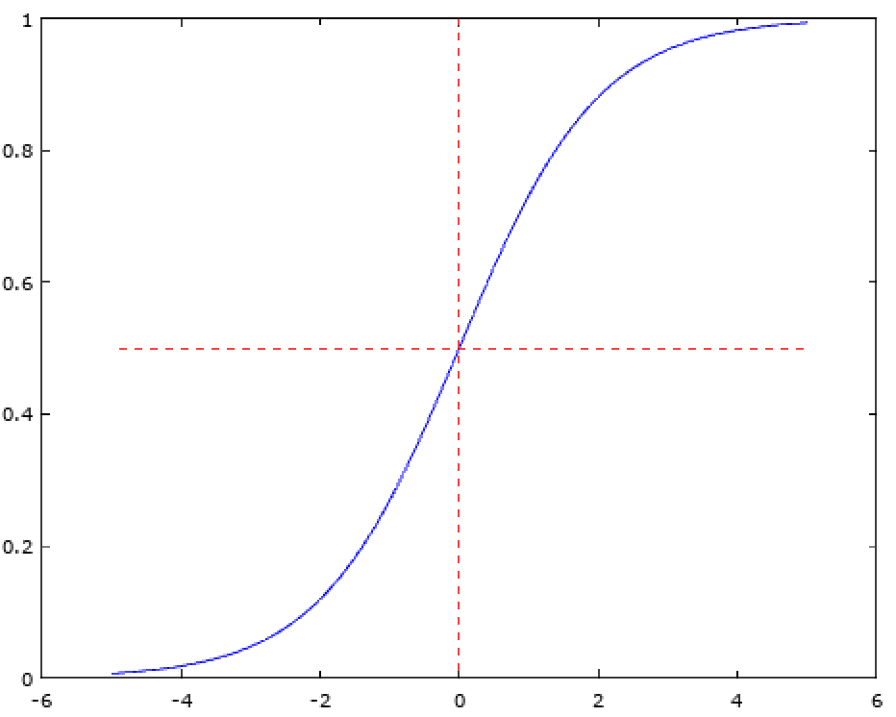
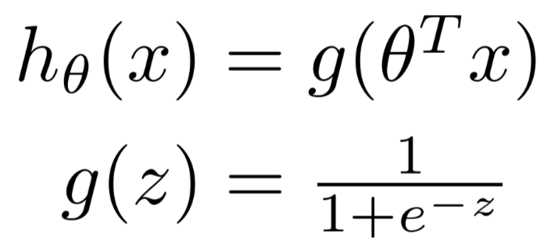
Logistic regression
The y-values of the training set “classify” a set of observations into one of a bucket of possible answers
Examples:
Predict cancer from medical observations (Y/N)
Spam filter (SPAM / NOT SPAM)
What type of cloud is this?
Uses sigmoid function to map hypothesis to range: 0 <= h(X) <= 1
Logistic regression also tries to find a set of theta values where the “cost” is minimised. In this case cost is misclassified samples.
Predict y=1 if h(X) > 0.5
Notes:
Notice that the cloud example is an example of multi-class classification rather than binary classification. What you actually do is use the One-vs-All approach, which is to train a logistic regression classifier for each class “i”. You then compute h(X) for each classifier and choose the class that maximizes h^{(i)}(X).
Here’s how I plotted sigmoid:
X=[-5:0.1:5];
figure;
hold on;
plot(X,sigmoid(X));
plot([0;0], [0;1], "r--");
plot([-5;5], [0.5;0.5], "r--");
hold off;

Slide 12
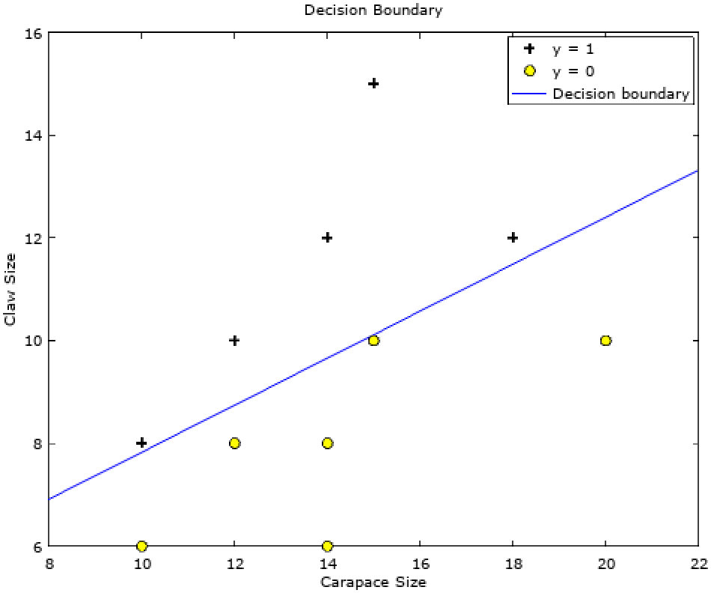
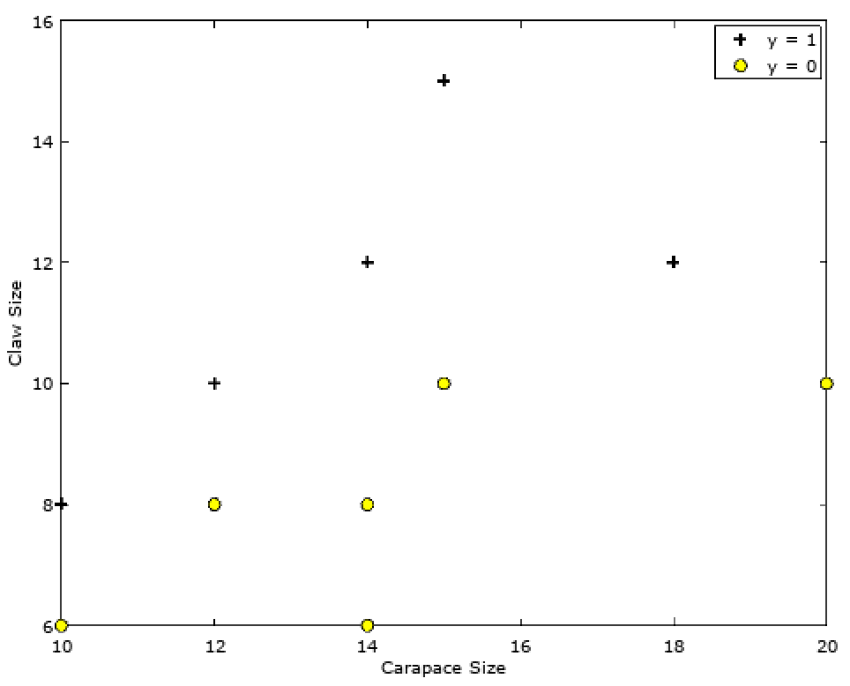
Logistic regression - Shane’s Example
Predict if a mud-crab is male or female based on the carapace size and largest claw girth
Claw girth
Carapace size
nt.gov.au

Slide 13
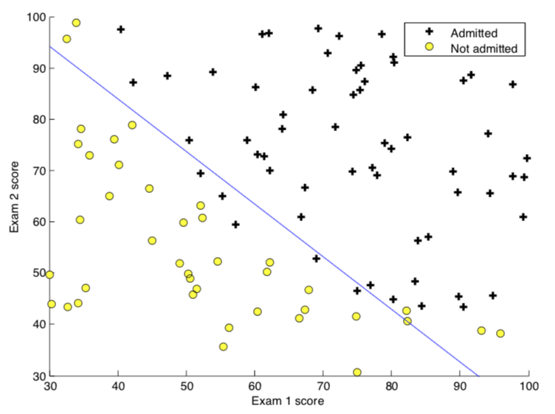
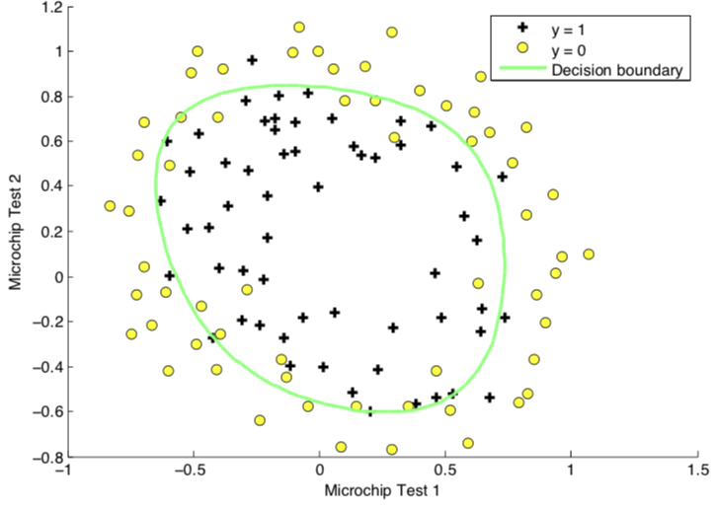
Binary Logistic Regression – More Examples

Slide 14
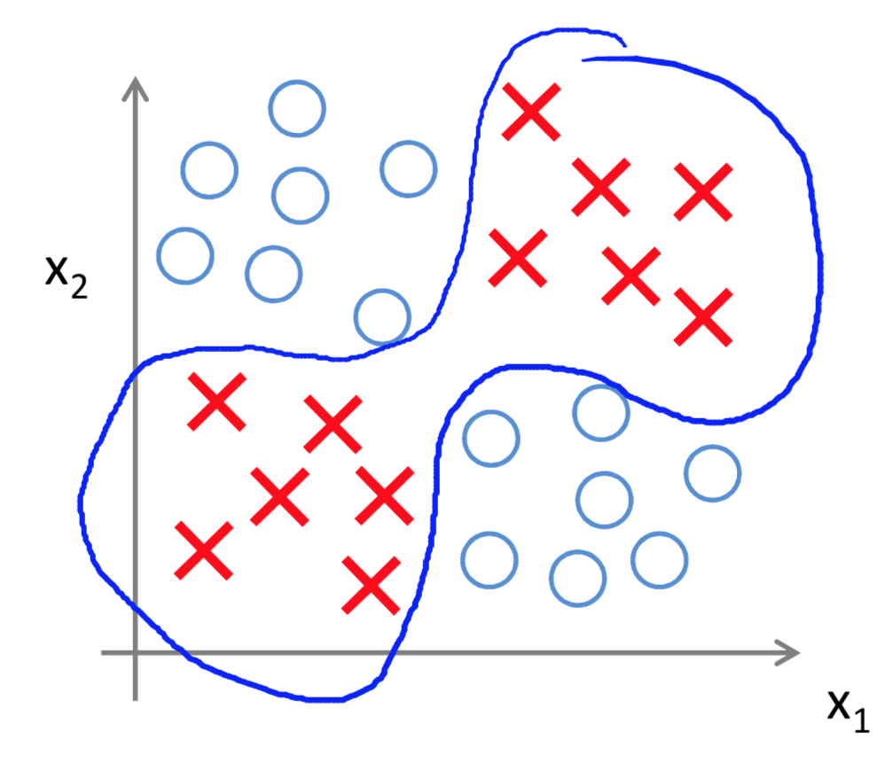
Neural Networks
Modelled on the human brain
Particularly useful for non-linear hypothesis
More efficient than complex polynomials when applied to large numbers of features.
Complex relationships between the input features can be discovered
Do you know which logical operation is represented by the diagram?
Notes:
The positive samples (X) represent XNOR
The negative samples (O) represent XOR
This is very difficult/expensive to model with logistic regression using gradient descent, but relatively easy with neural networks.

Slide 15
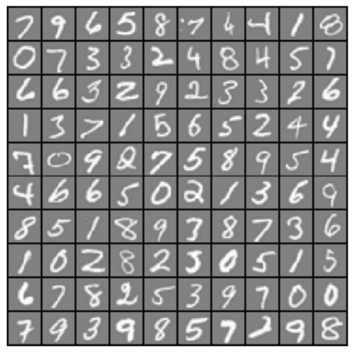

Multi-class Logistic Regression – Neural Networks
Training data – a set of images, along with the class they belong to (0-9). Each image is 20x20 pixels, so 400 data points. Each pixel is represented by a floating point number indicating the grayscale intensity at that location.
Train 10 separate logistic classifiers, measured so they perform well on the training set.
Then take a new sample
Run it through each classifier and select the one that computes the highest probability that the sample is in that class (max(sigmoid(h^{i}(X)))
https://www.coursera.org/learn/machine-learning/
Don’t expect 100% accuracy
Notes:
Is this a zero or a six?

Slide 16
Is my problem something machine learning can help with?
Could a human reasonably be expected to figure it out eventually, given the training data?
Eliminate more deterministic mathematical approaches first.
Visualize the training data, and try to understand the key features and their mathematical relationships where possible.
Consider multiple ways to formulate the problem or question you want answered, and try multiple approaches.
My advice: try it and see – you can use a range of metrics to determine if your approach is working.
Notes:
Use examples, like:
Predict if the next time I toss this coin it will be heads or tails. This is not a problem machine learning can help with.

Slide 17
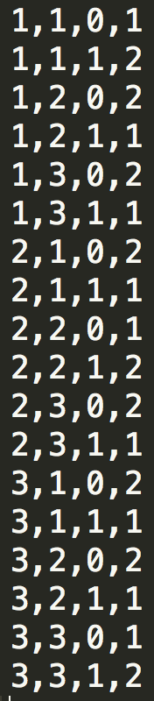
Neural Networks applied to the Monty Hall Problem
DEMO
coolmathstuff123.blogspot.com.au
Notes:
Explain the Monte Hall Problem.
Run the gameshownn program in the brownbag demo folder.
Then execute:
predictnn(Theta1, Theta2, [1 1 0])
Explain that the first number is the door the contestant chose, the second number is the door the prize is behind and the third is a binary flag to indicate whether or not they swapped.
The prediction is 1 if they win the prize, 2 if they do not.
Describe that other approaches were tried first, and failed miserably. It was only after a colleague suggested a new feature “Did they pick the prize door”, and showed that this was actually an XOR problem, that I decided to try Neural Networks.

Slide 18
What’s Next?
I’d like to generate some ideas for applying ML to data sets we have – e.g. request logs?
Be on the lookout for well-curated data, or ways to produce it in our products.
Look at lots of examples from across IBM.
Keep ML in mind the next time you’re trying to solve a problem.

