Slide 1
NOSQL with Mongo DB

Slide 2
Introduction to NOSQL:
A NoSQL (originally referring to "non SQL" or "non relational") database provides a mechanism for storage and retrieval of data that is modeled in means other than the tabular relations used in relational databases.
NoSQL databases are increasingly used in big data and real-time web applications.
These databases are used by Facebook, Google, Amazon and other big organizations which stores more of unstructured data and run analytics and Machine Learning on top of the data.
Some characteristics of databases are :
Non-relational
Flexible schema(There is no restriction or predefined columns with datatypes to store specific values)
Other or additional query languages than SQL
Distributed – horizontal scaling by using concepts of Replication
Supports big data

Slide 3
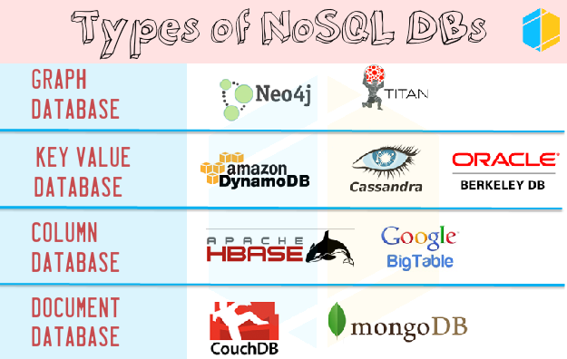

Slide 4
Introduction to JSON for doc databases.
In document type NOSQL databases we use JSON for storing the data in databases using BSON technique.
JSON stands for JavaScript object notation.
Json is based on JavaScript which is basically a standard to exchange data between client and server. Before Json , xml was used to exchange data between systems but JSON being easy to read, light and less complicated is used mostly now and becoming the standard for data exchange.
In Json there is a concept of key: value pairs. In a json object there can be number of key value pairs and again inside key there can be json objects which further can be treated as key:values or can have json array inside json object.
Documents are addressed in the database via a unique key that represents that document.

Slide 5
Examples:
JSON inside JSON object:
myObj = {
"name":"John",
"age":30,
"cars": {
"car1":"Ford",
"car2":"BMW",
"car3":"Fiat"
}
}
Array inside Json object:
{
"name":"John",
"age":30,
"cars":[ "Ford", "BMW", "Fiat" ]
}

Slide 6
Data types in JSON:
1) Numbers: No difference between integer and float
2) String: Use double quotes to represent the strings
3) Boolean: True or False
4) Arrays: Ordered list of values
5) Objects: combination of key-value pairs
6) NULL: Empty values

Slide 7
A complex JSON example:
{
_id: ObjectId("51156a1e056d6f966f268f81")
"name": "Shobhit",
"age": 26,
"address": {
"street": "MGROAD",
"city": "Gurgaon",
"state": "Haryana",
"pin": 122001
},
"organization": "ITC",
"technology": ["Mongodb", "Machine Learning", "Python", "SQL", "Informatica", "UNIX"]
}

Slide 8
Introduction to MongoDB
Mongo DB is a document based NOSQL database.
It uses BSON for storing data in database.
It is not relational database.
It's an open source database.
The data is stored in the form of collections.
The database is schema less
The data is stored in the below pattern:
1) collections vs tables
2) documents(BSON) vs rows
3) fields vs columns
The data is stored in the below pattern:
Database--> Collections--> Documents

Slide 9
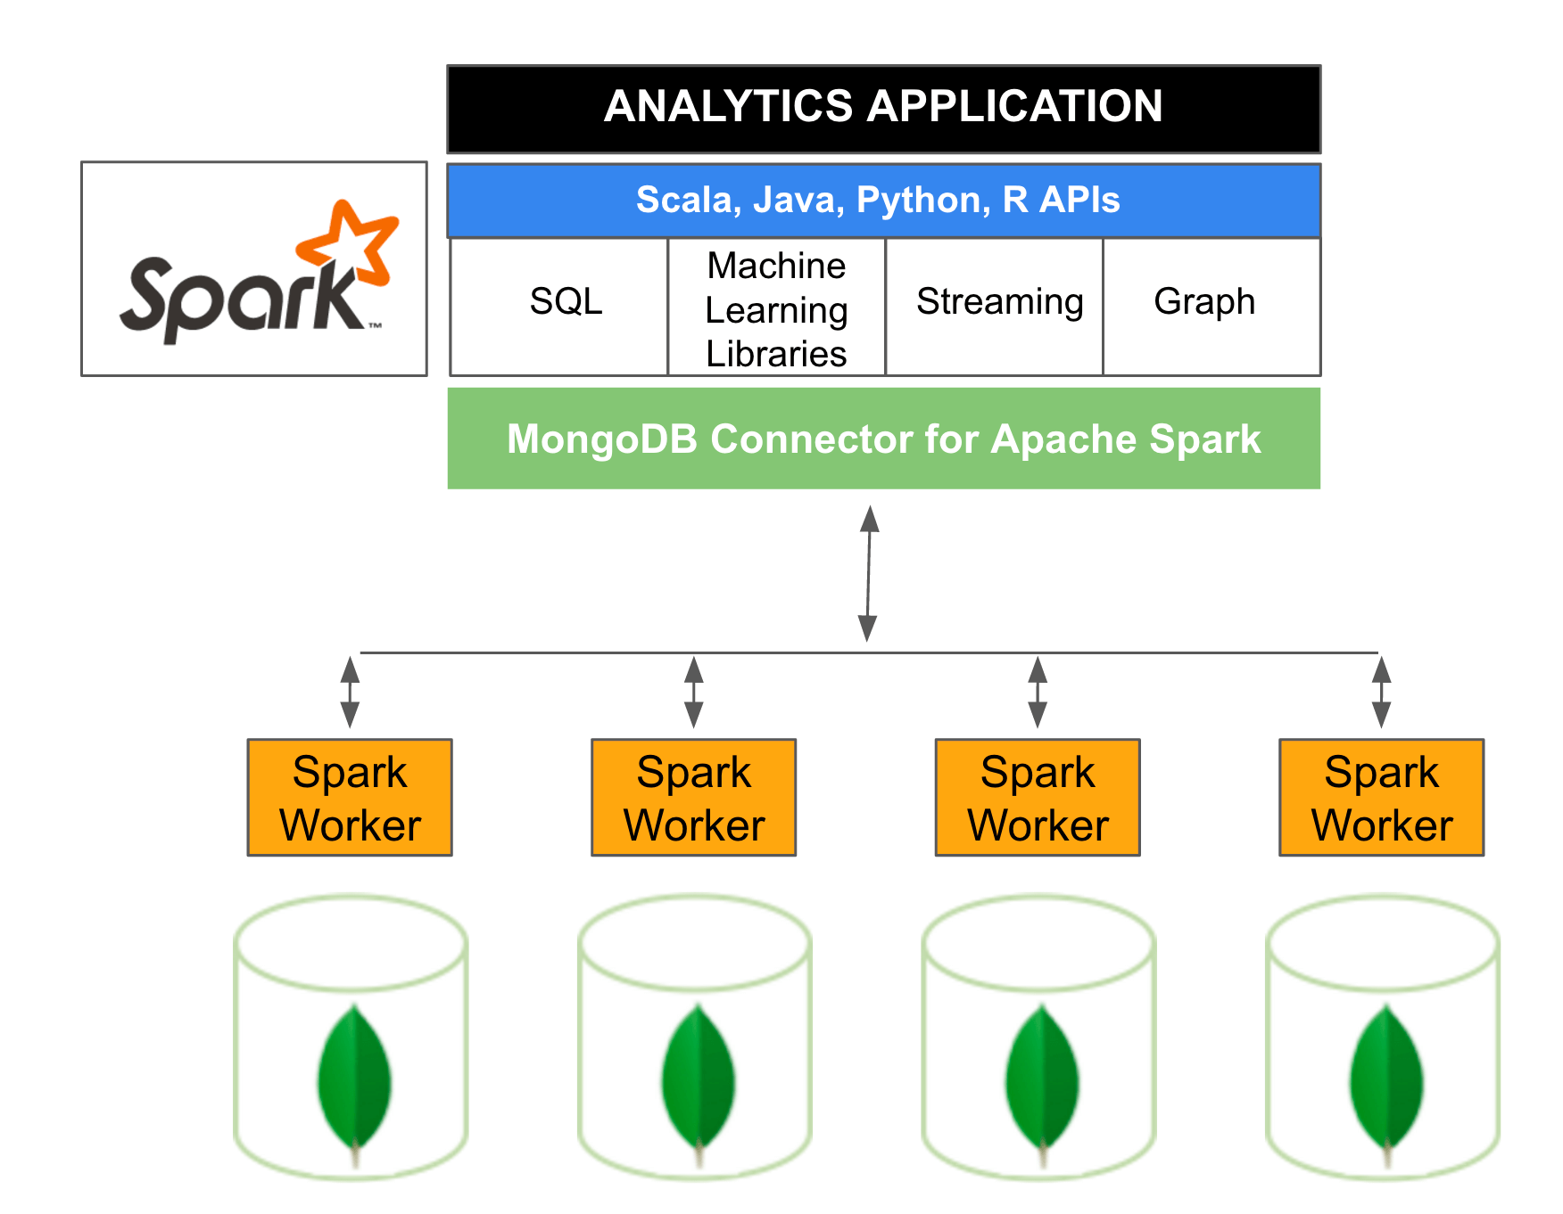
Use of MongoDB in Big data environment

Slide 10
Instructions to setup Mongodb:
In order to connect to mongodb following needs to be done.
1) install mongodb
2) set environment path
3) go to cmd and type mongod.exe which is mongodb demon.
4) open another cmd and type mongo.exe to start mongo cmd prompt.
5) instead of mongo cmd prompt we can use studio 3t which gives additional features and from there we can perform different database operations.
6) In the tool create connection and open Intellishell and start writing mongodb commands.

