Slide 1
IBM University Engagement Project Submission
“Exploring the Power of Agentic AI with IBM Granite and LangFlow”

Slide 2

Project Tile – EduQuiz AI – AI-Powered Syllabus Quiz Generator using IBM watsonx.ai and LangFlow
Domain of Project – Education
Student Name | Recent Passport Photo | Email ID | Mobile number [WhatsApp]
Sadam Bhargav |  | 24981a445c@raghuenggcollege.in | 9391484636

Slide 3
Problem Statement -
Problem Statement : EduQuiz AI
The Challenge
Students and educators spend significant time creating quizzes and assessment material.
Generating topic-wise questions, answers, and explanations manually is time-consuming.
There is a need for an AI-powered system that can automatically create learning modules and quizzes from educational topics.
The Objective
Build an AI-powered Quiz Generator that:
• Generates learning modules from a topic
• Creates MCQs automatically
• Provides answers and explanations
• Supports multiple academic subjects
• Improves learning and assessment efficiency

Slide 4
Technology Used
Tech Stack (Mandatory)
• LangFlow
• IBM watsonx.ai
• IBM Granite 4 Model
• Prompt Engineering
• Generative AI
• Python
I used LangFlow + IBM watsonx.ai + IBM Granite Models

Slide 5
Proposed Solution -
The proposed solution, EduQuiz AI, is an AI-powered educational content generator built using LangFlow, IBM watsonx.ai, and IBM Granite models. The system automatically creates structured learning modules, multiple-choice questions (MCQs), correct answers, and explanations from any educational topic provided by the user.
The workflow begins when a user enters a topic such as Machine Learning, Python Programming, or Data Science. LangFlow processes the input through a Prompt Template and sends it to IBM Granite models hosted on watsonx.ai. The model generates well-structured learning content, topic-wise MCQs, answers, and detailed explanations.
The solution reduces the time required to create assessments manually and helps students learn concepts more effectively. It supports multiple academic subjects and can be extended to generate quizzes from documents, notes, and textbooks in the future.
Overall, EduQuiz AI provides an intelligent, scalable, and automated learning assistant that improves educational content creation and assessment efficiency.

Slide 6
Langflow component Used -
1. Chat Input
Receives user topic.
2. Prompt Template
Structures quiz generation instructions.
3. IBM Watsonx AI Model
Uses IBM Granite 4 foundation model.
4. Chat Output
Displays generated quiz and explanations.

Slide 7
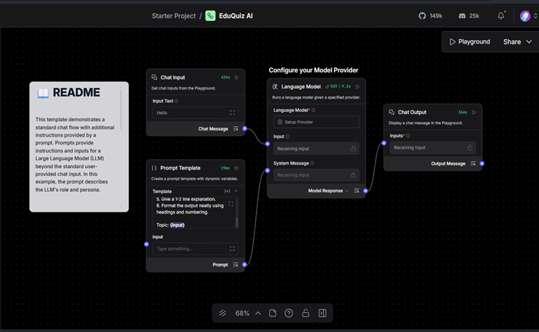
Langflow workflow -

Slide 8
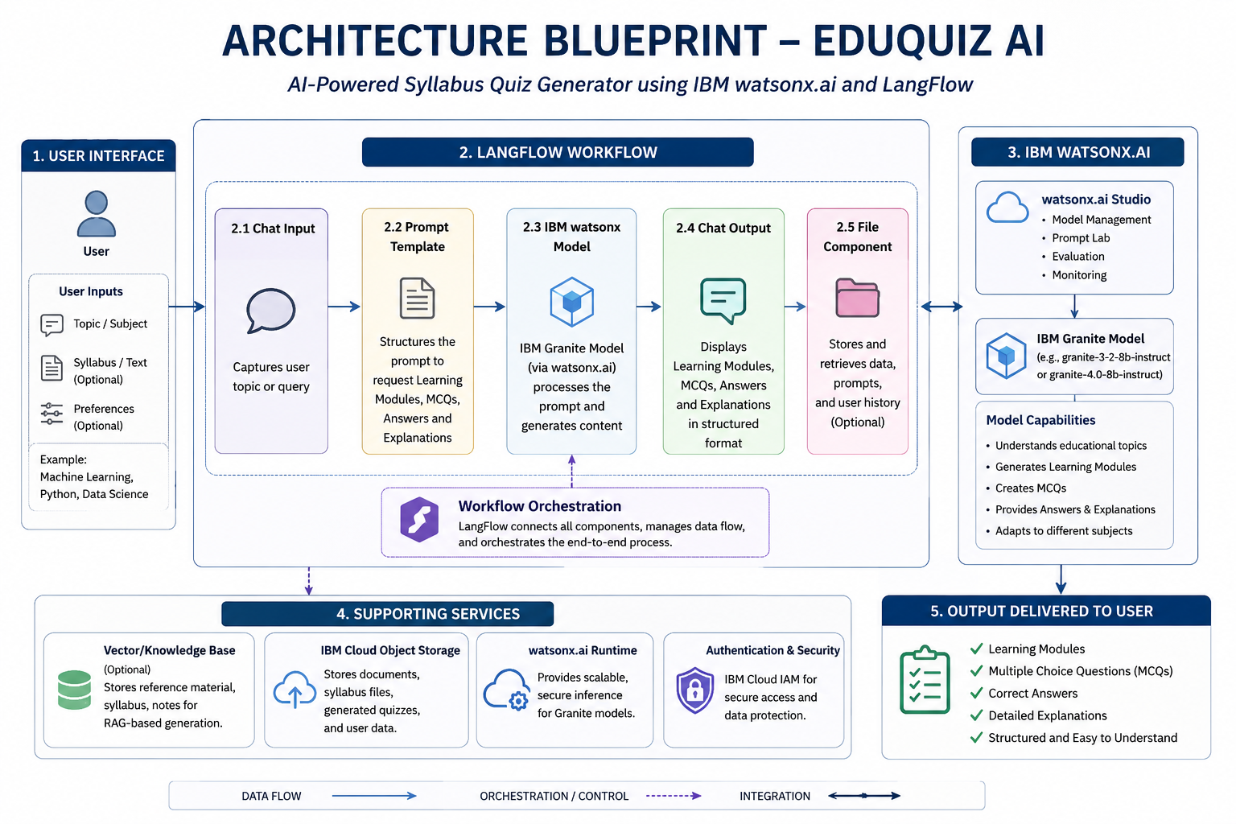
Architecture blueprint

Slide 9

Role of Agentic AI in the solution
Agentic AI enables EduQuiz AI to function as an intelligent educational assistant rather than a simple question generator. Using IBM Granite models on watsonx.ai, the system can understand user topics, reason about educational content, and generate structured learning material automatically.
The AI agent analyzes the given topic, creates learning modules, generates quiz questions, provides correct answers, and explains the reasoning behind each answer. It works autonomously to transform a simple topic into a complete educational assessment.
Agentic AI also improves personalization by adapting generated content to different subjects and educational domains. This makes the system efficient, scalable, and capable of supporting both students and educators.
Overall, Agentic AI makes EduQuiz AI a smart, autonomous, and goal-driven educational assistant that enhances learning and assessment creation.

Slide 10
Technology Used
• LangFlow – Visual workflow builder for AI applications
• IBM watsonx.ai – Platform for foundation models and AI deployment
• IBM Granite Model – Generates learning modules, quizzes, answers, and explanations
• Prompt Engineering – Structures instructions for accurate content generation
• Python – Development and integration environment
• GitHub – Version control and project hosting
• Generative AI – Powers intelligent educational content generation

Slide 11
Novelty and Uniqueness
• Automated syllabus-to-quiz generation
• Generates learning modules and MCQs simultaneously
• Provides answers with explanations
• Supports multiple educational subjects
• Built using IBM watsonx.ai and Granite models
• Visual workflow design using LangFlow
• Reduces manual effort for educators and students
• Scalable and easy to extend for future educational applications

Slide 12
Git Hub Link
GitHub Repository:
https://github.com/sbyx369/EduQuiz-AI
·
·
·

Slide 13
Future Scope
1. PDF and document upload support for automatic quiz generation.
2. Difficulty-level based question generation (Easy, Medium, Hard).
3. Multi-language educational content generation.
4. Voice-based quiz creation and interaction.
5. Student performance tracking and analytics dashboard.
6. Integration with Learning Management Systems (LMS).
7. Personalized learning recommendations using AI.
·
·
·

Slide 14


