Slide 1
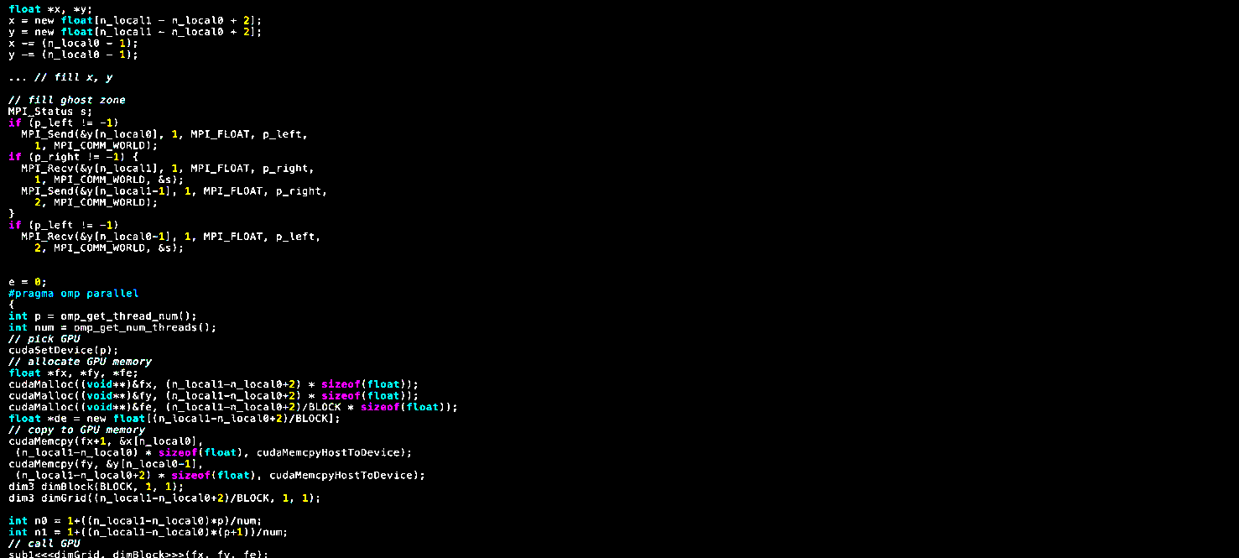

11th International SuperComputing Camp 2020 Virtual November 30th to December 11th 2020

