Slide 1
Problem under resan
Nuget-paketen återställs ej efter att ha klonat git-repot
  Lösning: Uninstall-install på berörda paket
Databasen måste regenereras, div trassel. Ännu ingen “riktig” rutin.
Har jquery och dess formulärhantering någon plats (vilken?) i ett Angular-scenario?

Slide 2
I18n och angular
Hi,
what are the pros and cons of angular-translate compared to angular-gettext?
This seems to me that the former one is way more popular, but I don't
really get the reason why - it looks like angular-gettext integrates way
more seamlessly as there is no need to extract the messages for "base" language
replacing them with made-up ID's as it is in angular-translate.
---------------
There is some relevant discussion between the authors of the two projects
here: https://github.com/rubenv/angular-gettext/issues/3.
A relevant quote from the author of gettext:
"So all in all, angular-gettext does less. In return it makes your life much simpler."
Regards,

Slide 3
Native tooling
<br><br><b>Message</b><br>
{{recipients.length, plural, offset:1
=0 {You ({{sender.name}}) gave no gifts}
=1 { {{ recipients[0].gender, select,
male {You ({{sender.name}}) gave him ({{recipients[0].name}}) a gift.}
female {You ({{sender.name}}) gave her ({{recipients[0].name}}) a gift.}
other {You ({{sender.name}}) gave them ({{recipients[0].name}}) a gift.}
}}
}
one { {{ recipients[0].gender, select,
male {You ({{sender.name}}) gave him ({{recipients[0].name}}) and one other person a gift.}
female {You ({{sender.name}}) gave her ({{recipients[0].name}}) and one other person a gift.}
other {You ({{sender.name}}) gave them ({{recipients[0].name}}) and one other person a gift.}
}}
}

Slide 4
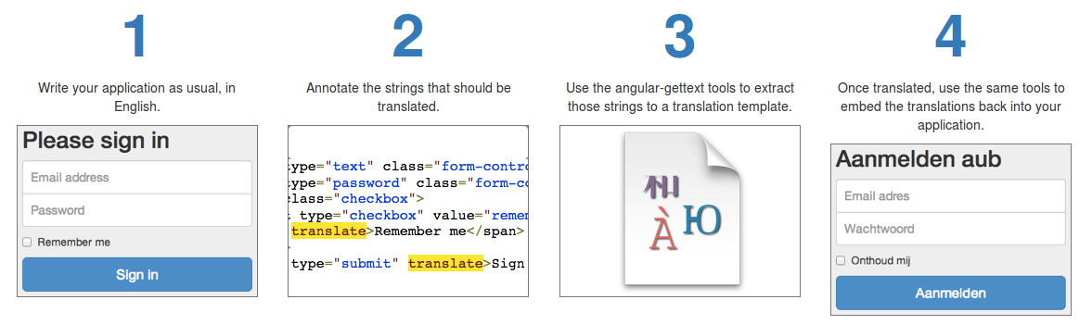
Gettext för angular...

Slide 5
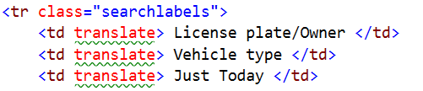
Märkning av kod

Slide 6
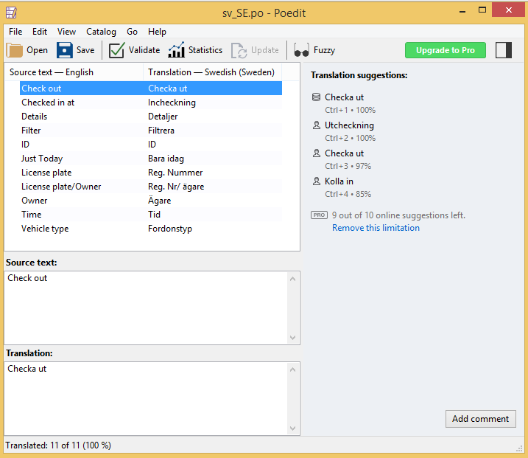
översättning

Slide 7

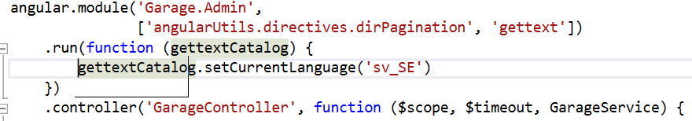
Visa det översatta

Slide 8
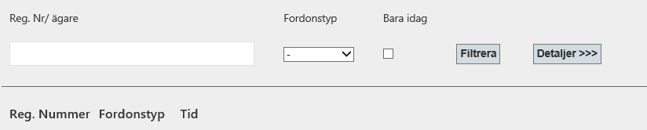
Resultat...

