Slide 1



Timesheet Data Migration and Analysis August 2026
Architecting Platforms.
Delivering Trusted Insight.
Enabling Intelligence.
Decision Intelligence, Reporting & Data Platforms
1

Slide 2


Contents
1
Introduction
3
2
Database Design
4
Data Extraction and Migration
3
5
4
Auditing and Observability
6
5
Deployment and Automation
7
6
Management Insights
8
DECISION INTELLIGENCE, REPORTING & DATA PLATFORMS

Slide 3

Introduction
Management can have a tough time dealing with timesheets at the end of the month, especially in larger corporations. To reduce the burden that it imposes we can automate at least a portion of the process and create insightful reports that can help management see the full picture. After all timesheets are just reports with data and there is nothing that a data analyst loves more that bringing insights to raw data.
Concepts Covered
Database Design
Schema layout and practices
Data Extraction and Migration
ETL package
Auditing and Observability
Logstash and Kibana dashboards for monitoring
Deployment and Automation
GitHub actions workflow
Management Insights
Power BI report

Slide 4
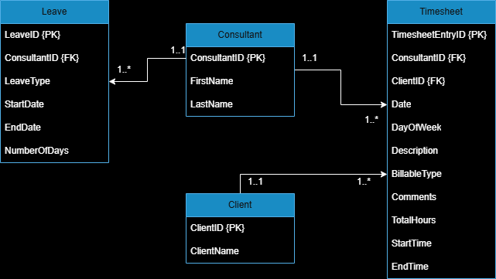
Database Design
The starting point begins with defining the ending point. The schema consists primarily of 4 tables with the consultant table being at the center of it all. It shares a relationship with a leave and timesheet. The timesheet table branches off further expose the clients. I believe this design to be a fully normalized schema reducing redundancy is mush as possible
Tables Explained
Consultant table
Contains an entry for each participating consultant
Leave table
Contains leave entries for consultants
Timesheet table
Most impactful table detailing the work and time entries for each consultant
Client table
Contains the clients for whom consultants did work for

Slide 5
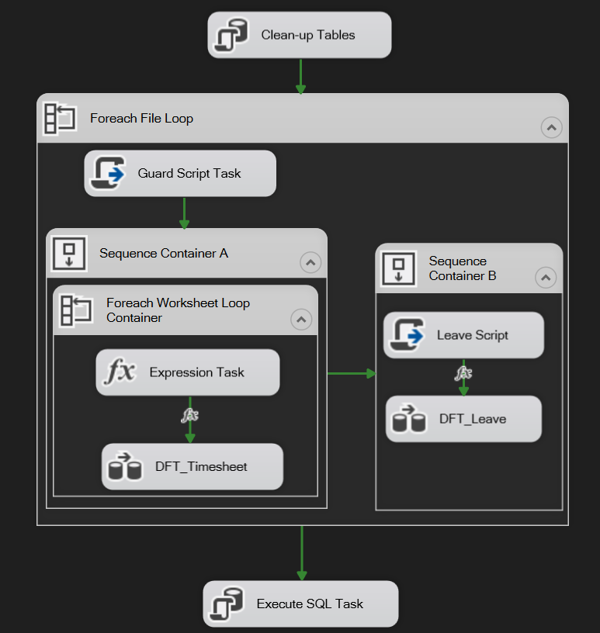
Data Extraction and Migration
Data was extracted, cleaned and migrated using an ETL package with SQL server integration. The package was designed and developed in Visual studio. Data for timesheets and leave is extracted from the excel spreadsheets using an excel connection manager, is cleaned and migrated over to a Microsoft SQL server database all within a dataflow task.
Migration Process
Clean-up Tables
Truncates staging tables
Foreach File loop
Loops through folder directory to find timesheets
Guard Script Task
Prevents crashes while extracting consultant names based on folder
Sequence Container A
Loops through individual timesheet worksheets and migrates clean data
Sequence Container B
Loops through individual leave worksheets and migrates clean data
Execute SQL Task
Executes a stored procedure that migrates staging data to master tables

Slide 6
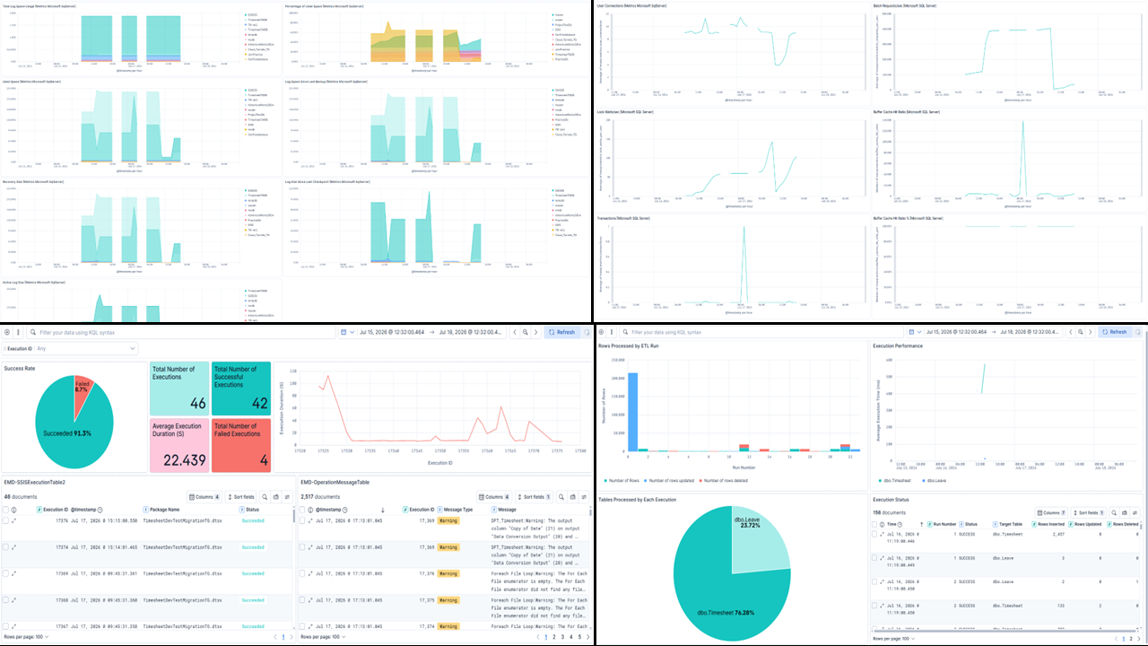
Auditing and Observability
As a data engineer, imagine waking up at 3 AM to a failed pipeline and not knowing what the issue is. To prevent this, we have inflated an audit log as a part of the ETL package to track the health of our ETL package as well as integrated SSIS auditing into Logstash and Kibana to track and monitor our system. We can also closely monitor the actual SQL server instances performance and logs.
Monitoring Dashboards
SQL Server Transaction log
logs of each database in the SQL Server instance
SQL Server Performance
SQL Server instance performance
Execution Monitor
Monitors operation and execution of ETL package
Timesheet Migration
Monitors data migration cycles

Slide 7
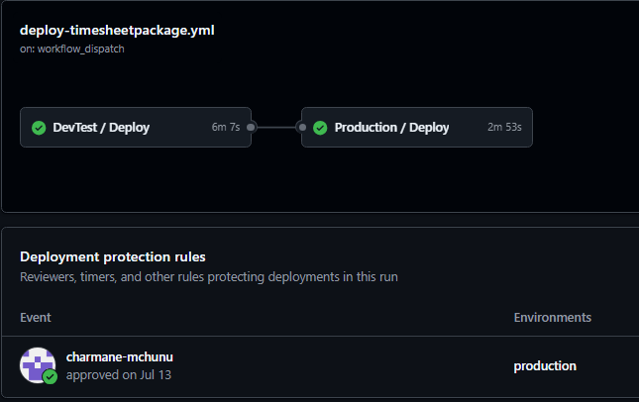
Deployment and Automation
The process of manually running the ETL package still requires a lot of manual intervention. To avoid this, we can automate the process using GitHub Actions. In addition to requiring less manual intervention, it also acts as a version control and backup point for the ETL package as well as it makes the package more dynamic allowing us to deploy and run the package on an alternative device using an exposed ngrok tunnel.
Automated Workflow
Environment Simulation
Workflow deploys to my local computer (staging)
Workflow deploys to my partners remote computer (production environment)
Database Setup
The workflow also creates the database, tables, indexes and stored procedures
Deploys the SSIS ISPAC file to SQL server
Creates a scheduled SQL server agent job.
SQL Server Agent Job
Executes SSIS ISPAC file – performs ETL migration in SQL server
Scheduled to run every 30 seconds

Slide 8
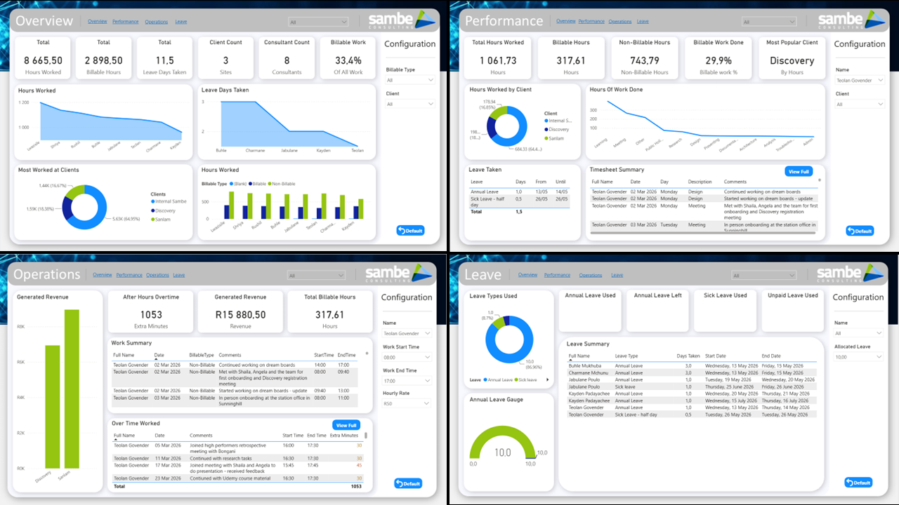
Management Insights
Up until now we have only truly moved the data from one point to another. We can make use of the transformed data by building an informative dashboard around it, give management the options to configure settings as per their requirements, perform calculations on the fly and gain insights on their staff work hours and leave that was not easily noticeable before.
Dashboard Design
Overview Dashboard
Summary of timesheet data.
Configure for client or billable type.
Performance Dashboard
Monitor consultant’s performance
Configure by consultant or client
Operations Dashboard
Perform operational tasks like calculate revenue or view overtime
Configure by consultant, work times and hourly rate
Leave Dashboard
View leave insights
Configure by consultant and allocated leave

Slide 9

Thank You
Teolan Govender Accountability Partner - Charmane Mchunu
info@sambe.co.za
www.sambe.co.za
1 Maxwell Drive, Woodmead, Sandton, 2191
Decision Intelligence, Reporting & Data Platforms
9
9

