Slide 1



E-Commerce Website
October 2026
Architecting Platforms.
Delivering Trusted Insight.
Enabling Intelligence.
Decision Intelligence, Reporting & Data Platforms
1

Slide 2

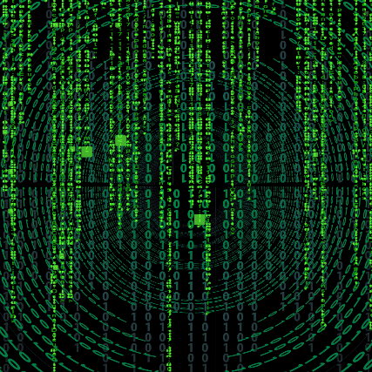
Contents
1
Introduction
3
2
Overview
4
Design
3
5
4
Database Schema
6
5
Architecture
7
6
Auditing
8
DECISION INTELLIGENCE, REPORTING & DATA PLATFORMS
7
Live Demo
9

Slide 3

Introduction
You are an ambitious individual looking to start up an e-commerce business called Tech Traders specializing in electronics and gadgets, but you don’t know how the first thing about development, so you hire me to pitch a potential solution with a demo application. Your demands are straightforward – “Just impress me”. So, this is what I would propose.
Considerations:
API based application – for modularity.
UI built on React.js framework – for modern and responsive user experience.
MVC architecture - for easy maintenance.

Slide 4




Overview
The applications core functionality involves basic e-commerce functions like user authentication, product handling like searching products, exploring products and adding products to a cart. Clicking on a product allows users to inspect the product on a dedicated product page where they can also see other items in the same category, prices from other companies and YouTube reviews. Carts will turn into orders upon ‘/checkout’ and these orders will be linked to user accounts. Users can register as either an employee or a customer through either the employee site or the customer site. After a customer has checked out, they will receive an order confirmation through e-mail. They will also be able to monitor their order status.
Key Components:
Products
Authentication
Cart
Orders
Products
Authentication
Cart
Orders

Slide 5
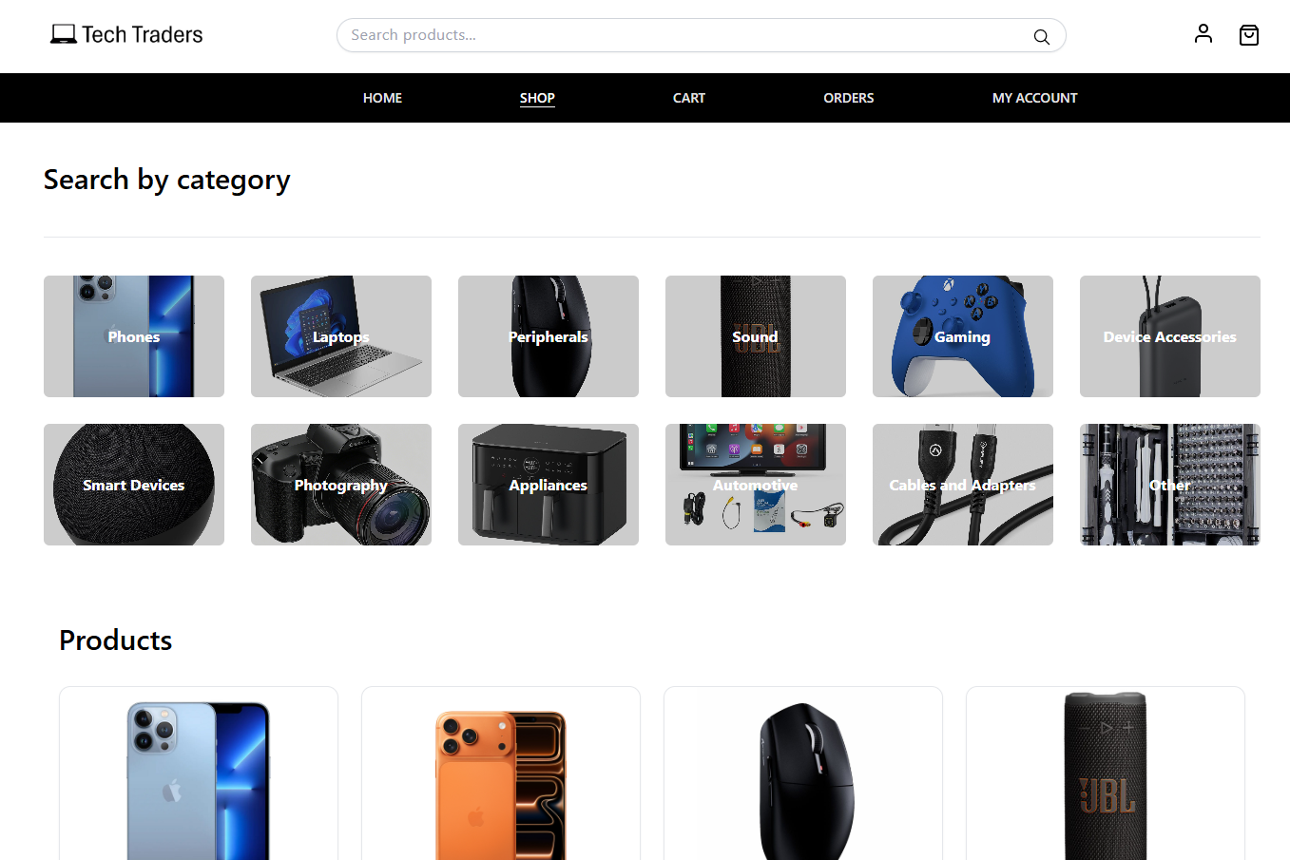
Design
I have chosen to go with a simple yet modern black and white design for the webapps frontend architecture heavily inspired by and based on a project done by Noor Mohammed. The Landing page starts on the Home component sandwiched by a header and a footer. The header contains the company watermark, a search element for finding products, a profile icon and a cart icon for corresponding pages and finally a navigation bar where users can access the sites pages.
Considerations:
Sleek Modern Design
Simple layout and ad free
Clean white and black theme

Slide 6
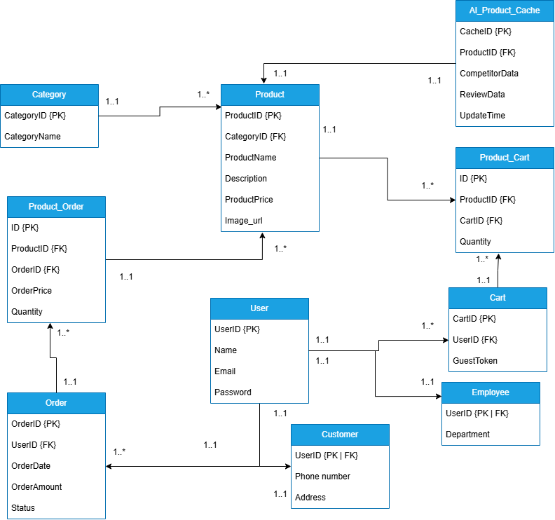
Database Schema

Slide 7




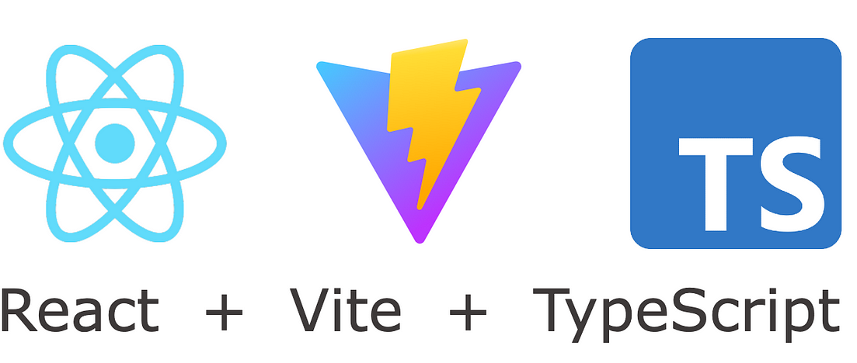





Architecture
ELK stack for monitoring and observability
Data moves between database and Flask app using SQLAlchemy
Frontend sends images to be stored as a blob on the cloud and returns a URL which gets stored in the database
Data flows between app and client through endpoint calls, but this client is used for testing endpoints with JSON body
Data flows between each app through endpoint calls
Resend for automated email passing an html body
Tivaly web-search AI agent for search results to be passed to a JSON body to the frontend
stripe API returns a payment intent to allow /checkout

Slide 8
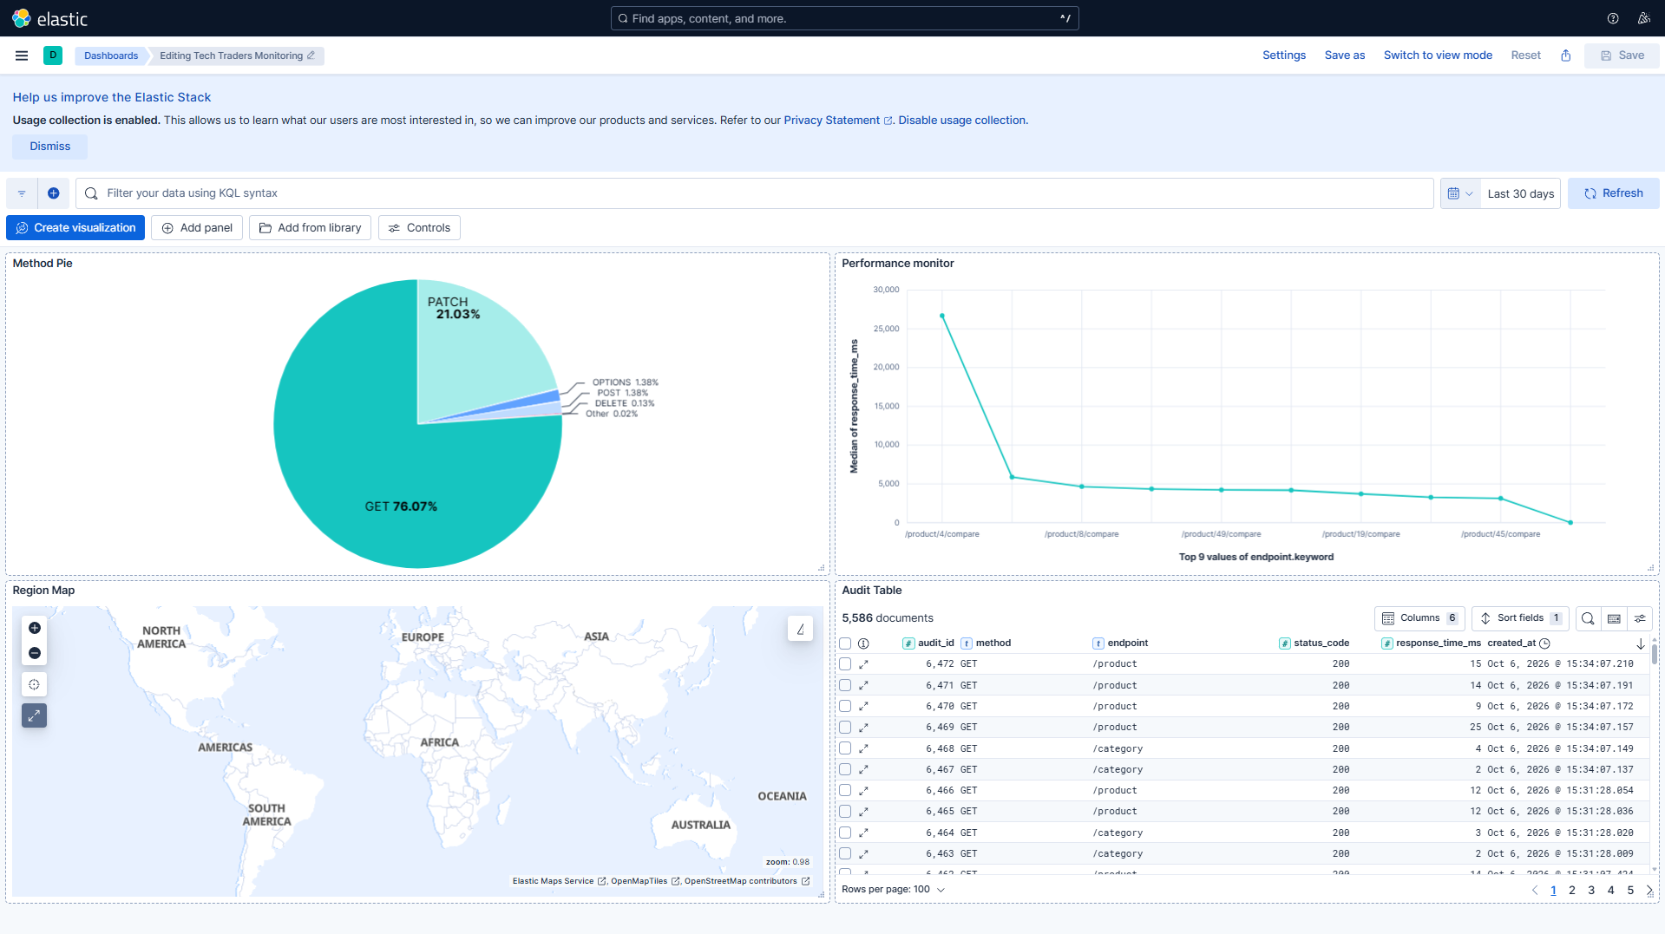
Auditing
Auditing is an essential part of maintaining production line applications. If something goes wrong, you need to be able to get to the problem as quick as possible. This is where the ELK stack (Elasticsearch, Kibana and Logstash) comes in. I have implemented a logging database table for tracking endpoint usage and health, this way if a particular endpoint fails, my ELK tools can show me the unhealthy endpoint from the ingested data.
Monitored elements:
Pie chart of endpoint methods used
Execution time of each endpoint method
IP address based region map
Endpoint health table

Slide 9
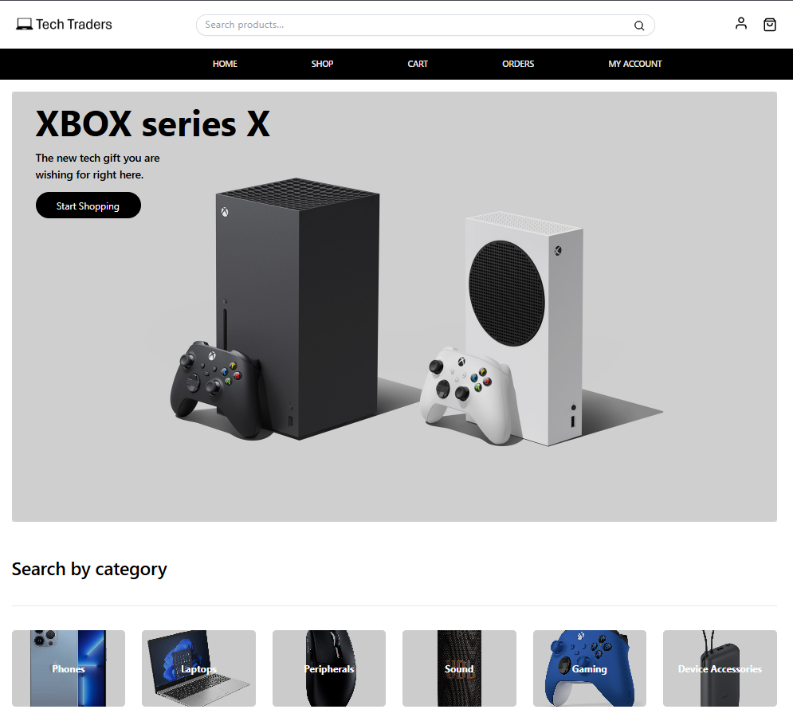
Live Demo

Slide 10

Thank You
Teolan Govender
info@sambe.co.za
www.sambe.co.za
1 Maxwell Drive, Woodmead, Sandton, 2191
Decision Intelligence, Reporting & Data Platforms
10
10

