Slide 1
Netflix (NFLX) Stocks Capstone
Ken Neal (@scooterneal)
July 20, 2018

Slide 2
Data Visualization with Python Capstone Requirements Summary
You've been hired as a data visualization developer at Yahoo Finance! Your job is to help financial analysts by creating some of the visualizations for a stock profile of Netflix.
In finance, a stock profile is a series of studies, visualizations, and analyses that dive into different aspects a publicly traded company's data.
During this project, you will analyze, prepare, and plot data. Your visualizations will help the financial analysts asses the risk of the Netflix stock.
After you complete your visualizations, you'll be creating a presentation to share the images with the rest of the Netflix Stock Profile team.
Note: This is a hypothetical educational exercise to fulfill the requirements as set forth by Codecademy. No affiliation with Yahoo Finance is implied.

Slide 3
NFLX Stock Profile 2017 - Visualizations
I have prepared the following visualizations to assist the financial analysts on the Stock Profile team with their NFLX risk evaluation:
Stock Price Distribution
Quarterly Revenue and Earnings
Estimated vs. Actual EPS
Netflix vs. Dow Jones Industrial Average

Slide 4
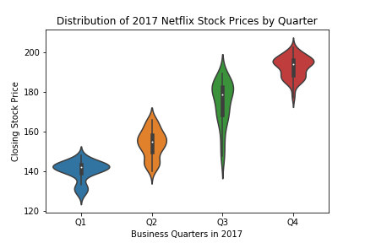
NFLX Stock Price Distribution
NFLX rose from the beginning to the end of 2017 and was most volatile in Q3
NFLX closing price range for 2017 was $127.489998 to $202.679993
NFLX Closing Price Interquartile Range in 2017
Quarter | 1st Quartile | 3rd Quartile
Q1 | $135 | $145
Q2 | $145 | $160
Q3 | $165 | $185
Q4 | $190 | $200

Slide 5
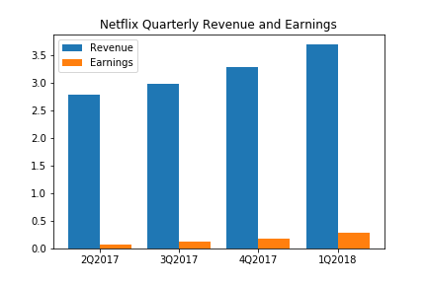
NFLX Quarterly Revenue and Earnings
Both revenue and earnings increased steadily throughout the year
The percentage of revenue that constituted earnings rose from 2.4% in Q1 to 7.8% in Q4

Slide 6
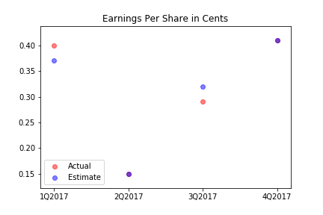
NFLX Estimated vs. Actual EPS
After dipping sharply in Q2, EPS recovered by the end of Q4 to reach Q1 levels
EPS estimates for Q2 and Q4 matched actuals

Slide 7
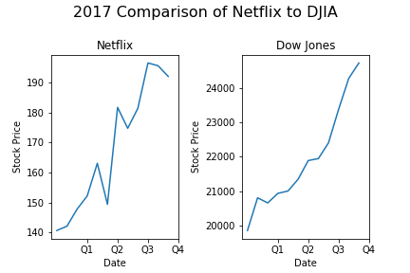
NFLX vs. DJIA
NFLX increased by 36.4% over the course of the year and outperformed the DJIA's increase of 24.4%
However, NFLX was more volatile throughout the year than the DJIA benchmark
Note: Dow Jones Industrial Average (DJIA) is 2 orders of magnitude higher than NFLX

