Slide 1

MPI-Based Heat Solver
A parallel implementation of the Jacobi method to solve heat distribution in a 1D domain
Tristan Arnuelos Burgueño
Marina Liao Colom Escolà
HPCAE - 205204
Arnau Miró Jane

Slide 2
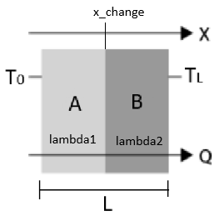
Project Overview
Problem raised:
Objective: Solve a 1D conduction heat problem of a composite wall.
Method: Iterative solver (Jacobi method) with domain decomposition. Parallelized with MPI.

Slide 3
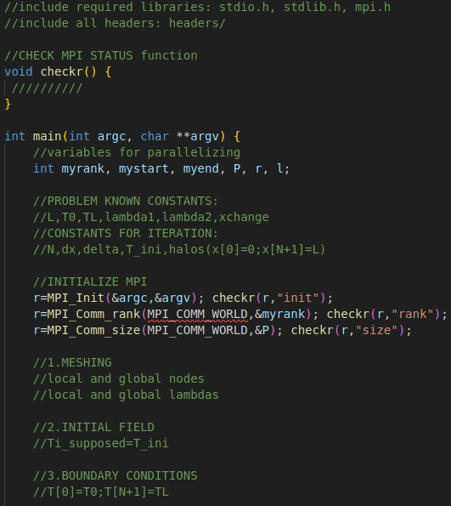
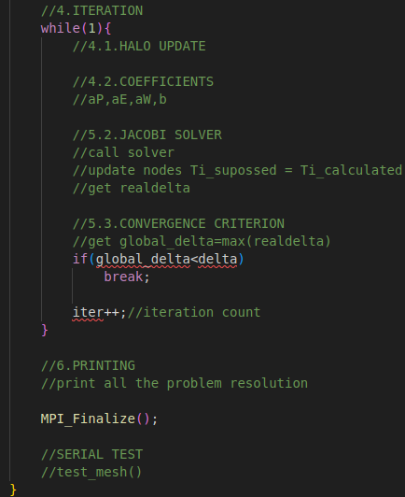
Code Structure: main.c

Slide 4

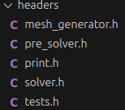
Code Structure: headers/
Code Structure: tests/
Header files with function prototypes and definitions.
Unit tests for Jacobi solver and mesh generator (serial).
Note: test_mesh.c can be called from main.c, but test_jacobi.c has to be compiled and runned separately.

Slide 5
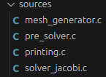
Code Structure: sources/
mesh_generator.c: for generating local and global node positions and lambdas.
solver_jacobi.c: solves the matrix equation by the Jacobi method.
printing.c: for printing the problem statement, resolution method and results.
pre_solver.c: for updating the halo and calculating the problem coefficients.

Slide 6
Memory allocation
GATHER
local variables:
global variables:
node positions xi
Ni-1
x
N-1
node lambdas lamdasi
Ni-1
lambdas
N-1
node temperatures
Ti
T[Ni]
T[Ni+1]
T
N-1
HALO
HALO
without halos

Slide 7
Parallelization with MPI
Real nodes in light yellow, halos in light blue
P0
P1
P2
T[Ni]
T[Ni+1]
T[0]
T[Ni]
T[Ni+1]
T[0]

Slide 8
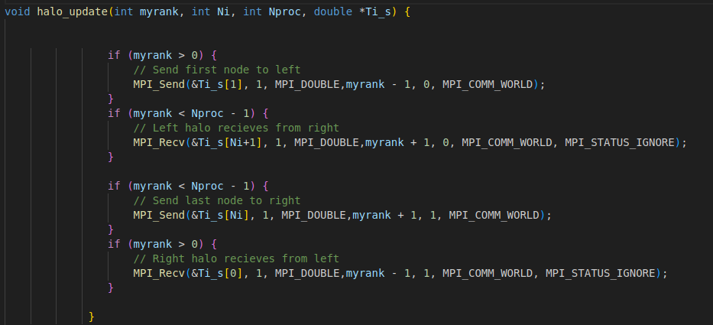
Parallelization with MPI: halo update

Slide 9
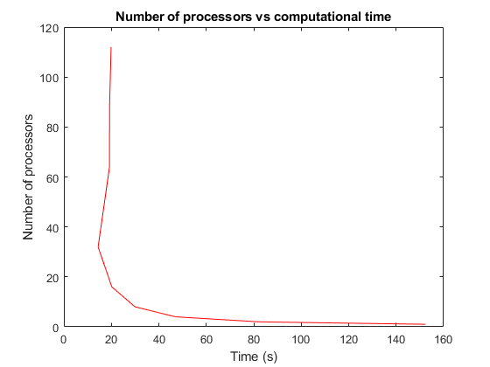
Scalability
Rapidly decrease of time with few processors
Best performance at 32 processors
Significant increase of time at 64 processors.
Slow increase of time from 64

Slide 10
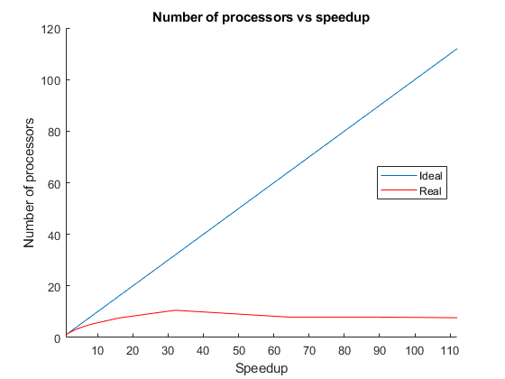
Scalability
Far from ideal behaviour with 4 processors or more
Convergence of speedup at about 80 processors
Deterioration of performance due to communications

