Slide 1

Session 9 Positive Presentations and Communications
LUBS3990 - Innovation Thinking and Practice
Tony Morgan, Associate Professor in Innovation Management Practice
Innovation Thinking and Practice
Course Code: LUBS3990

Slide 2

Positive Presentations and Communications
Improving your personal presentation skills
Hints and tips for team presentations and pitches

Slide 3

Don’t Worry!
Most people are NOT natural presenters
The good news is that there are some easy to use hints and tips which virtually everyone can use to improve their presentation skills
By the way, it’s totally natural to be nervous – in fact a level of nerves is a good thing – it means we care about we’re doing!

Slide 4


Presentation Hints and Tips Be yourself and keep it simple
Think about the audience as being your friends – they want you to succeed
Play to your strengths – do or say things which make you feel comfortable
When you speak - take your time
Keep your wording and messages simple – it’s easier for you to deliver and for the audience to understand
Pause at key points - for the audience to take in what you’ve said

Slide 5

Presentation Hints and Tips When things go wrong... (and they will!)
In general, if things go wrong, there’s no need to apologise – you can sometimes even make a joke about it
If you get your words wrong – simply correct the mistake and move on
If you forget something - don’t worry - probably nobody has even noticed or perhaps you can cover it later
If you have a blank moment and can’t remember what to say next, take a moment – perhaps your team can help you out or simply move on to the next message (We’ve all done this!)

Slide 6
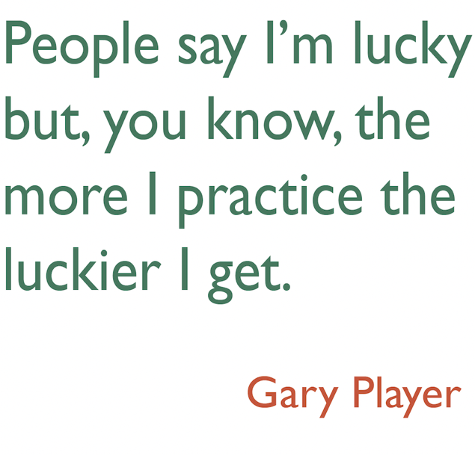
Practice Makes Better

Slide 7
Presentation Hints and Tips Practice makes better
Practice what you plan to say - on your own and with your team
You can create a script but don’t try to repeat every word – improvise around the main points (use a cue card if useful)
Practice speaking the words out loud
Identify words or phrases you stumble over - simply change them
Identify phrases which have real impact or wow factor – and practice pausing for effect when you’ve said them
The more you practice… the more comfortable and confident you’ll become

Slide 8

The “Rule of Three”

Slide 9
Team Presentations
Plan the presentation as a team
Allocate sections to play to team members’ strengths and preferences
Agree who will control the tech - and have a backup plan in case things go wrong
Practice together as a team – including hand overs, cues for next slides, managing timing, how you’ll handle questions, etc
Practice in the same room or using the same online technology which will be used for the presentation
Think through what might go wrong and be prepared...

Slide 10
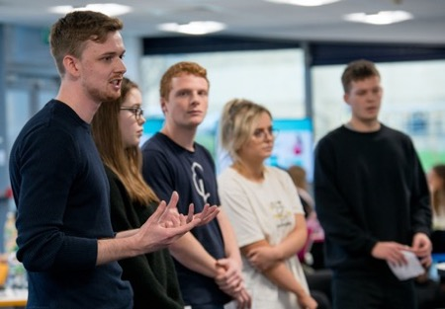
In Room Presentation Hints and Tips Checklist
Personal appearance – consider personal appearance and choice of clothing
Agree positioning of team members in room - in relation to each other, projector, screen and audience etc
Close down unnecessary apps and programmes, switch off alerts, etc
Before presenting - ensure slides are pre-loaded and set to screen show mode, ensure props etc are ready
Engage members of the audience when speaking – use eye contact and positive facial expressions and body language
Use supportive facial expressions and body language when other team members are presenting

Slide 11
Online Presentation, e.g. on Zoom Hints and Tips Checklist
Personal appearance – consider personal appearance and choice of clothing
Check room lighting and background
Set first and second name in Zoom profile
Include a good ‘head and shoulders’ Zoom profile pic for when video off
Close down unnecessary apps and programmes, switch off alerts, etc
Before sharing screen - ensure slides are pre-loaded and set to screen show mode, ensure options such as “Share computer audio” and “Optimise for video clips”, etc are selected
Audio – ensure mute and unmute selected at right times
Video – switch video on during pitch, unless connectivity or other issue
Video – if you don’t want to see yourself on screen, change setting so you don’t
Engage the audience - use positive facial expressions and body language

Slide 12

Presenting and Pitching
Structure
Clear objectives – targeted at audience
Empathy and engagement
Structure
Strong opening – to capture attention
Story telling – to keep it (Storyboarding, Hills, Prototypes, Value)
Strong close – to be remembered
Impact – value for end user and sponsor and wow factor (Hills, Business Case, Value Proposition)
Be visual – avoid wordy slides (like this one!)
Do something different – prototype demo with story, animation, video, role play, other!

Slide 13
Summary
Most people are NOT natural presenters
There are hints and tips we can all use to make presenting easier
Keep your wording and messages simple
Don’t worry if something goes wrong – be resilient and move on
The more you practice, the more comfortable and confident you’ll be
Practice on your own and with your team
Use the checklists and try to enjoy the experience – these are valuable skills and it will make another great story for interviews etc
Remember, being nervous is actually a good thing – good luck!

