Slide 1


SWAP: Effective fine-grain management of shared last-level caches with minimum hardware support
Xiaodong Wang, Shuang Chen, Jeff Setter,
and José F. Martínez
Computer Systems Lab
Cornell University

Slide 3
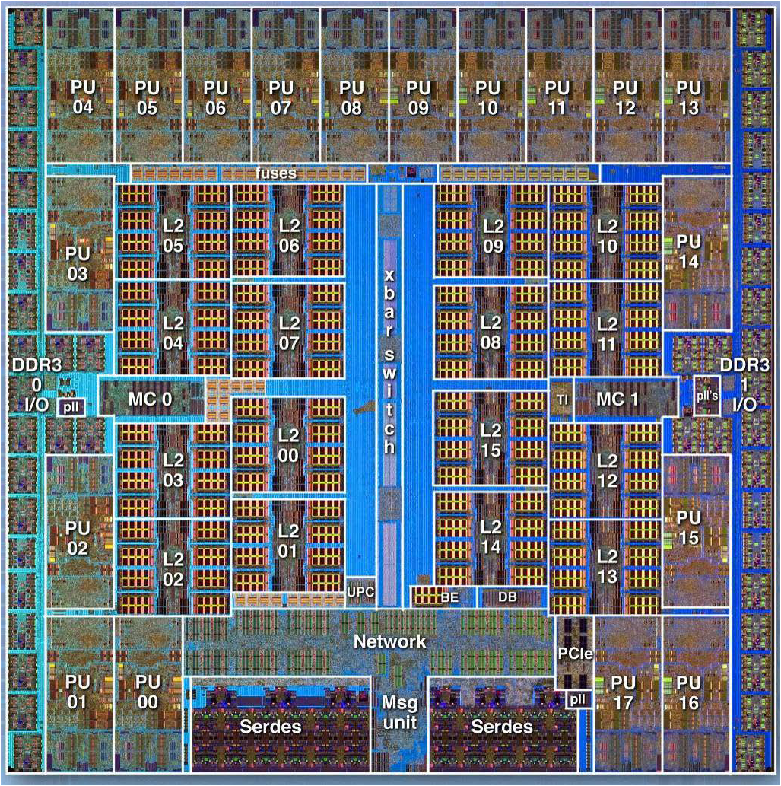
Motivation
IBM Blue Gene/Q
Shared cache
Source: IBM
Motivation • Background
Notes:
Last-level cache, which occupies almost 50% of the chip area, is an important shared resources in chip-multiprocessors. In this IBM blue gene/Q processor, there are 18 cores sharing the L2 cache, where the interferences among the cores can be high that hurt system performance. We also observed a trend that the number of cores increases, which exerts even higher pressure to the shared cache.

Slide 4
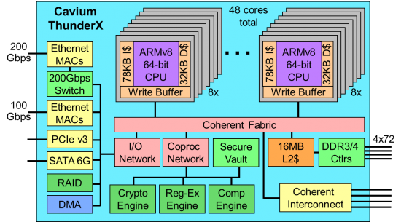
Motivation
Cavium ThunderX® 48-core CMP
Source: Cavium
Motivation • Background
Notes:
Therefore, intelligently manage the shared last-level cache is important to optimize system performance.

Slide 5
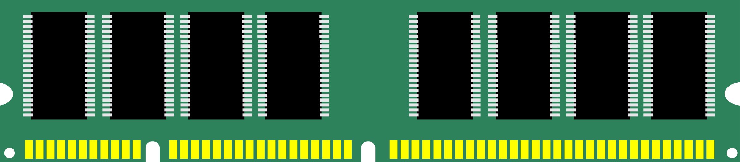
Motivation
Last-level cache is critical to system performance
~50% chip area
Performance isolation in shared cache
Improve system throughput
Guarantee QoS of latency-critical
workloads
Eliminate timing channels
Core
Core
Core
Private cache
Private cache
Private cache
Shared last-level cache
Motivation • Background
Notes:
To prevent interference among the co-running applications, is desirable xxx

Slide 6
Background
Cache way partition
Assign different cache ways to different cores
Perfect isolation
Readily available in existing CPUs
Low repartition overhead
Coarse-grained
16 cache ways in ThunderX 48-core processor
Associativity lost
Core
Core
Core
Core
Shared last-level
cache
Shared last-level cache
Motivation • Background • SWAP

Slide 7
Background
Page coloring
Assign different cache sets to different cores
Perfect isolation
OS-level software technique
Core
Core
Core
Core
Shared last-level
cache
Shared last-level
cache
Motivation • Background • SWAP

Slide 8
Background
Page coloring
Assign different cache sets to different cores
Perfect isolation
OS-level software technique
High repartition overhead
Coarse-grained: the number of page colors is limited
4 color bits, 16 colors in ThunderX 48-core processor
OS
Physical address
HW
Motivation • Background • SWAP

Slide 9
Background
Fine-grained cache partitioning [1, 2, 3, 4]
Probabilistically guarantee the size of partitions at the granularity of cache lines
Requires non-trivial hardware changes
No clear boundary across partitions: isolation is not strict
[1] Xie and Loh, ISCA’ 09
[2] Sanchez and Kozyrakis, ISCA’ 11
[3] Manikantan et al., ISCA’ 12
[4] Wang and Chen, MICRO’ 14
Motivation • Background • SWAP

Slide 10
Comparison of schemes
Way
partitioning
Page
coloring
Probabilistic
partitioning
SWAP
Perfect isolation
Yes
Yes
Probabilistic
Yes
Fine-grain
No
No
No
Yes
Yes
Hardware
overhead
Low
No
High
Low
Real system
Yes
Yes
No
Yes
Repartition
overhead
Low
High
Low
Median
Motivation • Background • SWAP
Notes:
Color blind

Slide 11
SWAP: Set and WAy Partitioning
Way partitioning vertically divides the cache
16 cache ways in ThunderX for 48 cores
Page coloring horizontally divides the cache
16 page colors in ThunderX for 48 cores
Combine way partitioning and page coloring
Background • SWAP • Evaluation

Slide 12
SWAP: Set and WAy Partitioning
Combine way partitioning and page coloring
Divide the cache in a 2-dimensional manner
Maximum 256 partitions w/ 16 cache ways and 16 page colors, fine-grained enough for 48 cores
Background • SWAP • Evaluation

Slide 13
SWAP: Set and WAy Partitioning
Contribution
Combine way partitioning and page coloring that enables fine-grain cache partition in real systems
Challenges
What’s the shape of the partition?
How are partitions placed with each other?
How to minimize repartition overhead?
Background • SWAP • Evaluation

Slide 14
SWAP: Set and WAy Partitioning
Partition shape
Given the partition size, how many cache ways and pages colors should the partition have?
Partition size = 18
# cache way
3
2
6
9
# page color
6
9
3
2
Background • SWAP • Evaluation

Slide 15
SWAP: Set and WAy Partitioning
Partition Placement
Partitions do not overlap (interference-free)
No cache space is wasted
Background • SWAP • Evaluation

Slide 16
SWAP: Set and WAy Partitioning
Partition shape
Partitions cannot simply expand to occupy unused area
Background • SWAP • Evaluation

Slide 17
SWAP: Set and WAy Partitioning
Partition shape
Given the partition size, we classify the partitions into different categories
Page colors unchanged if the partition size stays within a certain range
Partitions aligned with each other
P4
P2
P5
…
Category
P1
Partition size
P6
…
P3
…
# page color
P7
P8
Cavium ThunderX® 48-core processor:
Cache capacity = 256 (16 MB), number of page colors = 16
P9
Cache capacity = S, number of page colors = K
Background • SWAP • Evaluation

Slide 18
SWAP: Set and WAy Partitioning
Partition Placement
Start with large partitions (with more colors)
Assign the partition with page colors that have most cache ways left
8 ways
usge cntr
 | Size
P1 | 40
P2 | 12
P3 | 12
0
8
8
5
0
8
8
P2
5
0
8
8
5
0
8
8
8 page colors
P1
5
0
5
8
5
0
5
8
P3
5
0
5
8
5
0
5
8
5
Background • SWAP • Evaluation

Slide 19
SWAP: Set and WAy Partitioning
Reduce repartition overhead
Adjust cache way assignment incurs low overhead
Write way permission register
Adjust page color assignment is cumbersome
Migrate the page from the old color to the new color
Background • SWAP • Evaluation

Slide 20
SWAP: Set and WAy Partitioning
Reduce repartition overhead
Key: reduce page re-coloring
Classify the partitions as before
Same: keep the original colors
Downgrade: use partial original colors
Upgrade: may use any colors
Estimate the cache way usage before placement
Background • SWAP • Evaluation
Notes:
Transition is too fast

Slide 21
SWAP: Set and WAy Partitioning
Reduce repartition overhead
Classify the partitions as before
Estimate the cache way usage
8 ways
usge cntr
2
0
 | Before | After
P1 | 40 | 8
P2 | 12 | 8
P3 | 12 | 48
P1’
4x2
P2’
4x2
3
2
0
P3’
8x6
P2
3
Down
2
0
3
2
0
8 page colors
P1
3
0
0
1
Up
0
0
P3
1
0
0
1
0
0
1
Background • SWAP • Evaluation

Slide 22
SWAP: Set and WAy Partitioning
Reduce repartition overhead
Start with large partitions (with more colors)
Assign the partition with page colors that have most cache ways left
8 ways
usge cntr
3
9
 | Before | After
P1 | 40 | 8
P2 | 12 | 8
P3 | 12 | 48
8
3
9
P2’
8
Down
3
9
8
3
9
8 page colors
P3’
8
1
7
8
Up
1
7
P1’
8
1
7
8
1
7
8
Background • SWAP • Evaluation

Slide 23
Other issues
Cache miss-ratio curve
Profiling
Lookahead algorithm [1] decides partition sizes
Other issues
Hashed indexing
Superpage
[1] Qureshi and Patt, MICRO’ 06
Background • SWAP • Evaluation

Slide 24
Experimental setup
Cavium ThunderX Processor
48-core CMP, 1.9GHz
16MB shared last-level cache
64GB DDR4-2133, 4 channels
Ubuntu Linux 3.18
Performance analysis
Mix of SPEC2000 and SPEC2006 multi-programed workloads
Latency critical workload memcached
SWAP • Evaluations • Conclusions
Notes:
Partition L2 cache based on cache ways. Essentially, other cache allocation techniques, such as z-cache, vantage essentially mimic high associativity with limited physical cache ways. There is no fundamental reason that we cannot use it.
not really a limitation: essentially z-cache does the same thing
640W thing: IBM Power8 12 core: 200-250W @ 22nm
Intel Haswell: 155W@ 22nm
The results doesn’t depend on the absolute number.
The actual cache partition is orthogonal to our proposal.

Slide 25
Static partitioning
Running application bundle
12.5%
48-app
SWAP • Evaluations • Conclusions
Notes:
Baseline: unmanaged, shared cache

Slide 26
Dynamic partitioning
Running application sequence
The next application in the sequence replaces the finished one; cache partitions change dynamically
SWAP • Evaluations • Conclusions

Slide 27
Dynamic partitioning
Running application sequence
The next application in the sequence replaces the finished one; cache partitions change dynamically
Cores | Seq | WAY | SET | SWAP | Avg. Inj interval
 | 1 | 1.04x | 1.02x | 1.08x | 46s
 | 2 | 1.11x | 1.04x | 1.17x | 41s
 | 1 | 0.97x | 1.04x | 1.11x | 31s
 | 2 | 1.04x | 1.02x | 1.20x | 25s
 | 1 | 0.92x | 0.99x | 1.11x | 34s
 | 2 | 1.00x | 1.03x | 1.15x | 25s
16
32
48
SWAP • Evaluations • Conclusions

Slide 28
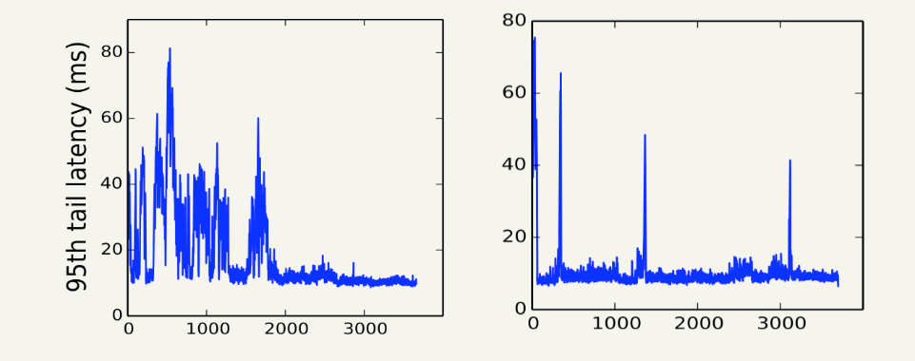
Guarantee QoS
Latency workload memcached co-located with background multi-programmed workloads
Shared cache
SWAP
SWAP • Evaluations • Conclusions
Notes:
Cache exploration or phase changes of the background workloads

Slide 29
Guarantee QoS
Latency workload memcached co-located with background multi-programmed workloads
8.1%
16-app SPEC bundle
SWAP • Evaluations • Conclusions

Slide 30
Conclusions
A real system implementation of fine-grain cache partitioning in large CMP systems
Combine cache way partitioning and page coloring
Delivers superior system throughput
Guarantee QoS of latency-critical workloads
SWAP • Evaluation • Conclusions

Slide 31
SWAP: Effective Fine-Grain Management of Shared Last-Level Caches with Minimum Hardware Support
Xiaodong Wang, Shuang Chen, Jeff Setter,
and José F. Martínez
Computer Systems Lab
Cornell University

Slide 32
Static partitioning
13.9%
14.1%
16-core
24-core
12.5%
12.5%
32-core
48-core

