Slide 1


Workshop
CMAKE
the basics

Slide 2
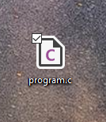
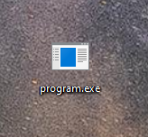
Making Programs
Text File
Binary File
compile
Configure
Compile
Link
Test
Install

Slide 3
Making Programs
Configure
Necessary to for sharing code
Compile
Necessary to organize many source code files
Link
Test
Install

Slide 4


Sharing Code
Configure
Test
Install
First step for making software from scratch
Making sure your compiled version works as intended
The actual process of installing libraries or executables
Changes:
Which features are enabled for the software
Which external libraries are used
Compiler options
Where to install the software
Configuration Software (CMAKE) automatically controls these changes
BLAS
OpenBLAS

Slide 5
CMAKE Input & Output
File paths
Makefile
Install directory
CMAKE
Build version

Slide 6



CMAKE on different OS
Makefile
Visual Studio

