Slide 1


WEB PRESENTATION TWO
ICP GROUP 8
CHENNA SRINIVAS - 16307995
MAMJALA MANISHA - 16307984

Slide 2

Introduction:
Android Studio is an open-source platform which provides an environment to build application for Android phones, tablets, Android Wear, Android TV, and Android Auto.
This is a structured code modules which allows to divide the project into units of functionality to create, build, test, and debug independently.

Slide 3
Key Features:
Creating a basic login application which contains username and password.
Fetching Github user data by performing API calls.
Converting the text into speech which is given as input by user.

Slide 4
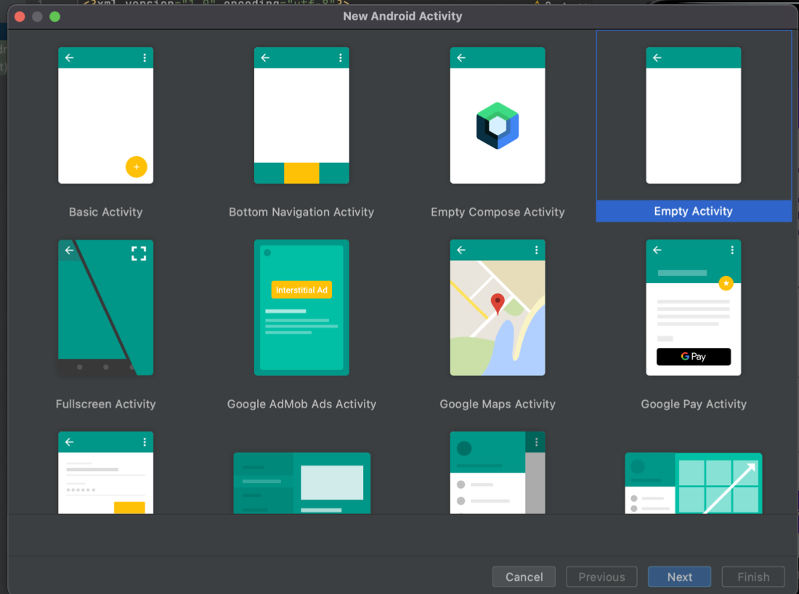
ICP8
We can create the application by selecting an empty activity as below, then give the details of our app such as name and location

Slide 5
We can insert the logo with below code:
<ImageView android:layout_width="200dp" android:layout_height="200dp" android:id="@+id/logo_main" android:src="@drawable/logo" android:layout_alignParentTop = "true" android:layout_centerHorizontal="true" android:scaleType="fitXY" />
We can include the text fields by using EditText:
<EditText android:id="@+id/username" android:layout_width="match_parent" android:layout_height="wrap_content" android:layout_below="@id/sign_in" android:layout_marginStart="20dp" android:layout_marginTop="20dp" android:layout_marginEnd="20dp" android:layout_marginBottom="20dp" android:hint="USERNAME" android:padding="20dp" />

Slide 6
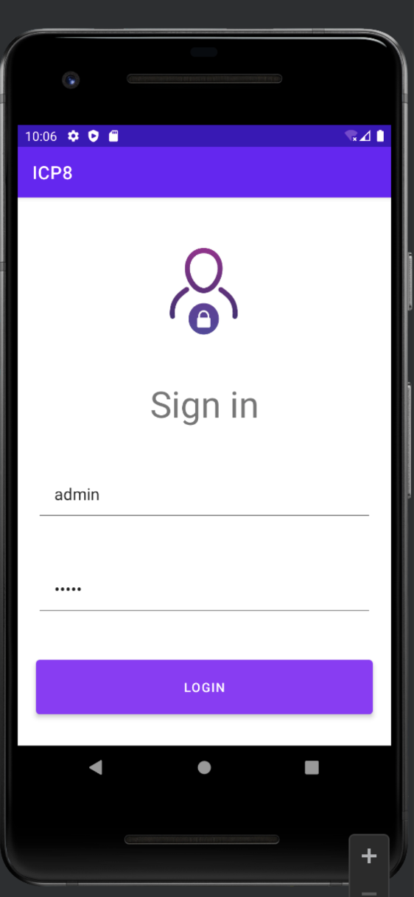
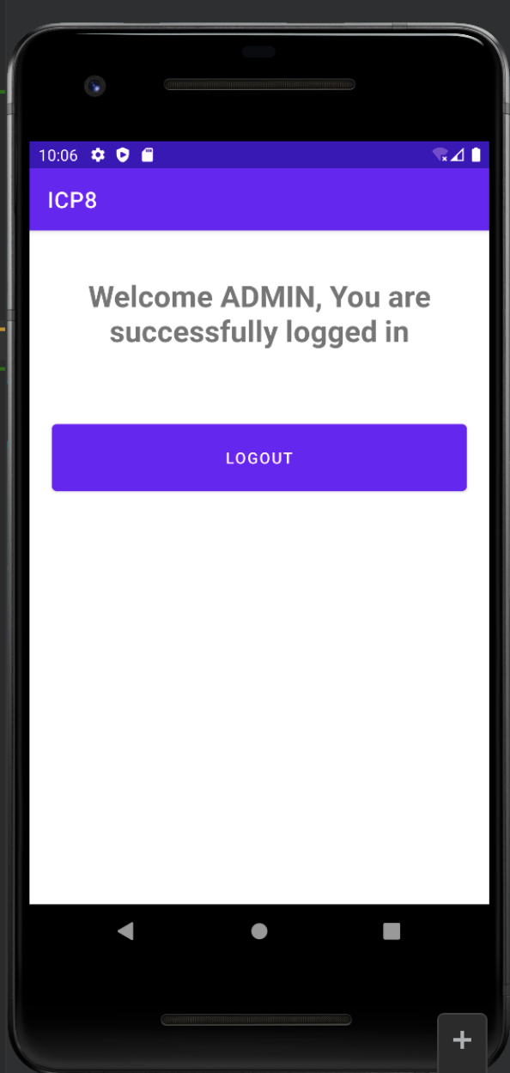

Slide 7
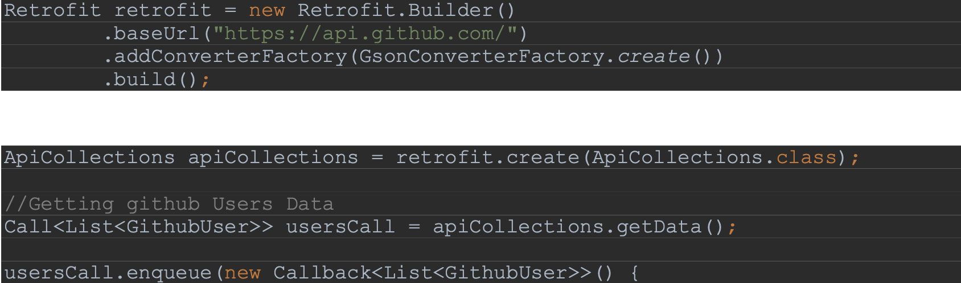
ICP10
Fetch the specific GitHub User details by performing an API call using Retrofit, then that user GitHub details will be visible on display.

Slide 8
We can use below code to give Internet permission to our application in Androidmanifest.xml :
<uses-permission android:name="android.permission.INTERNET" />
In build.gradle add below snippet for retrofit configuration, which converts API calls into objects
implementation 'com.squareup.retrofit2:retrofit:2.9.0’
implementation 'com.squareup.retrofit2:converter-gson:2.9.0'

Slide 9
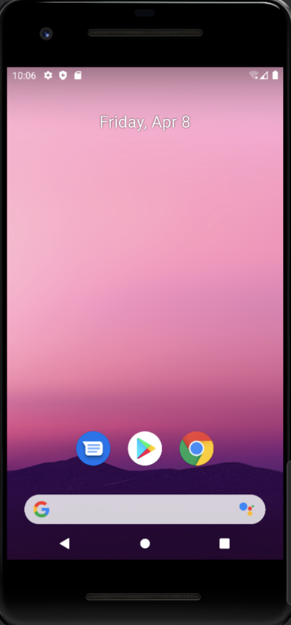
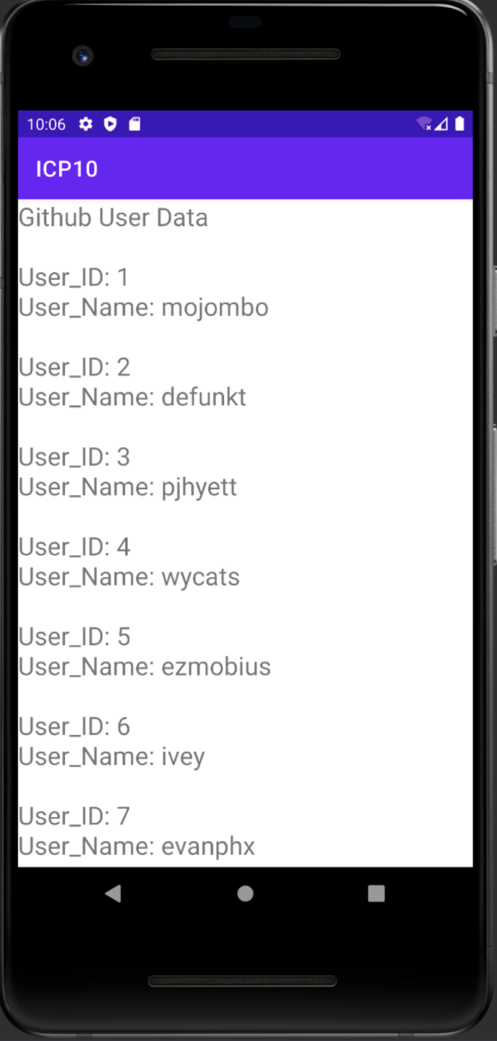

Slide 10
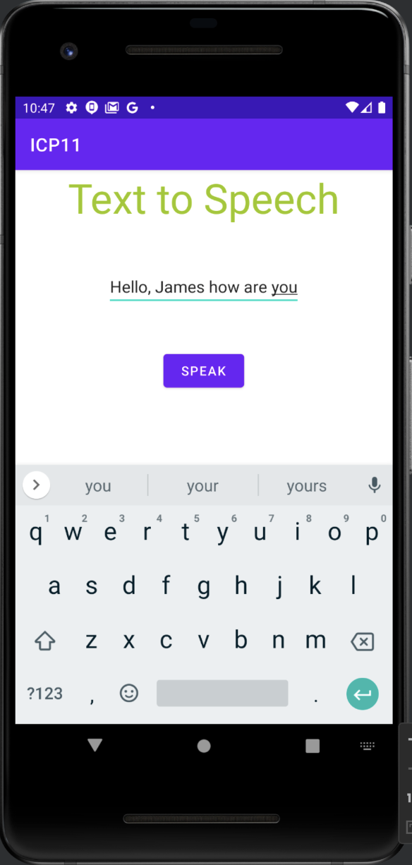
ICP11
Performing Text-to-Speech functionality to convert the text entered on the screen into speech using android studio.

Slide 11
By using below method, we can perform text to speech conversion
void speakToUser(){ // reading input
String input = text.getText().toString();
//setting speech rate
textToSpeech.setSpeechRate(0.5f);
//converting to speech
textToSpeech.speak(input, TextToSpeech.QUEUE_ADD, null); }
To check the status of successful conversion of text to speech:
if(status == TextToSpeech.SUCCESS)

Slide 12
Conclusion:
In these ICPs, we have learnt the basics of android and also learnt how to use the android studio to develop an application by including various features like user login, fetching GitHub user details and text-to-speech functionality.
GitHub link: https://github.com/sc7vc/Web_Applications/tree/main/ICP_TWO_PRESENTATION
Youtube link: https://www.youtube.com/playlist?list=PLBjU-bATcJp0MwWmN4rGk0bTtxA3HBlBl

Slide 13
Thank You

