Slide 1


WEB PRESENTATIO N
ICP GROUP 8
BY- CHENNA SRINIVAS MAMJALA MANISHA

Slide 2
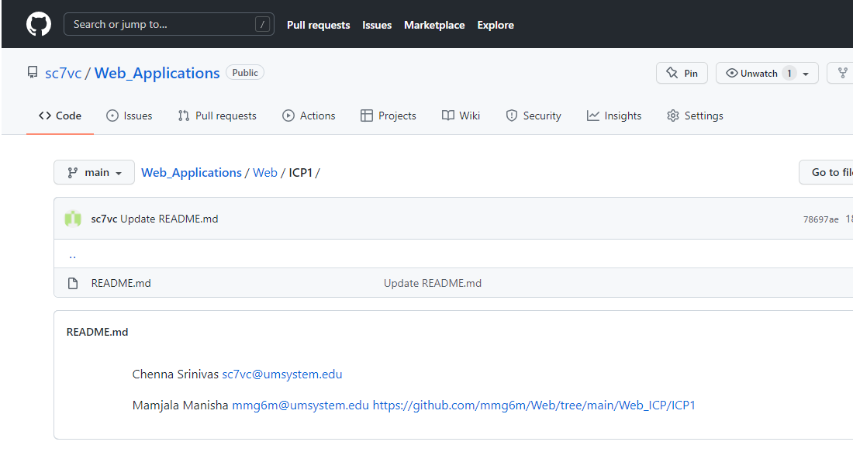
ICP1
Creation of Github Account, Cloning to Loacal Machine, Creation of document in source folder, wiki page, branch, issue. How to do pull request, how to sync local repo with remote repo.

Slide 3

ICP2
Creating HTML document in source folder with various HTML elements like paragraph, headers, unordered list, ordered list, division, span, inline and many more..

Slide 4
ICP3
Building Rock-Paper-Scissors game using JavaScript. It is a game between a person and computer. The computer generates randomly selects a choice and we can select any item. By comparing both the inputs, it will display’s who has won the game. If both selects the same, it is declared as draw.
Creating a Responsive Page, where we check how the page respond when the screen size increases or decreases in different devices like browser and mobile.

Slide 5
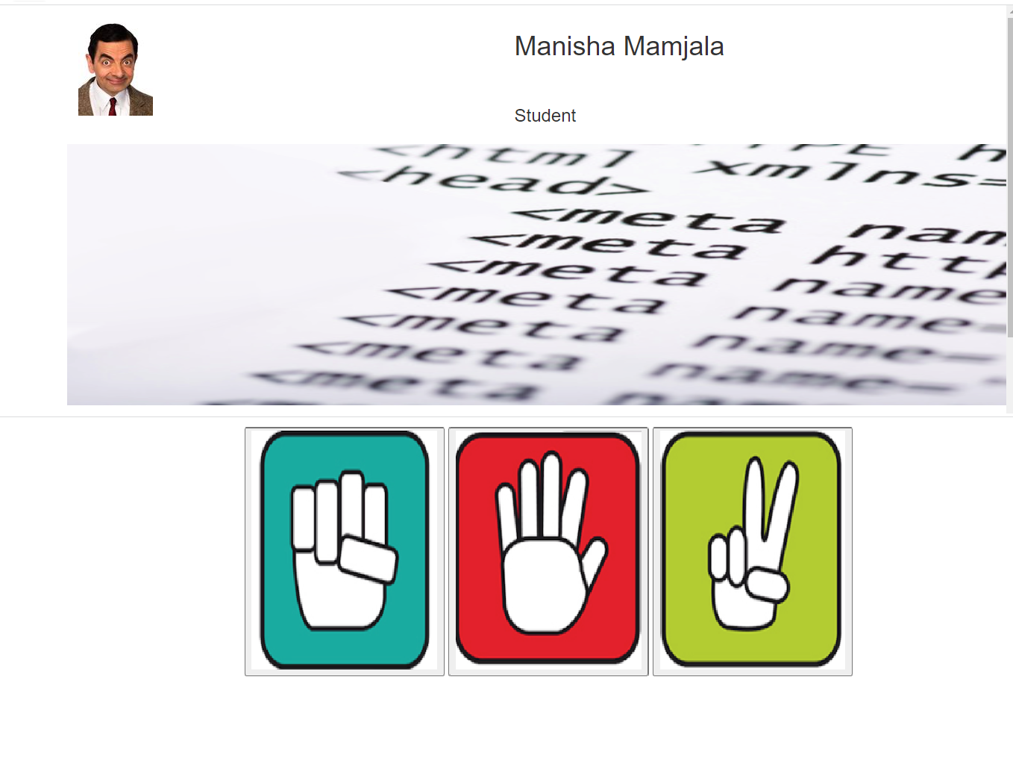

Slide 6
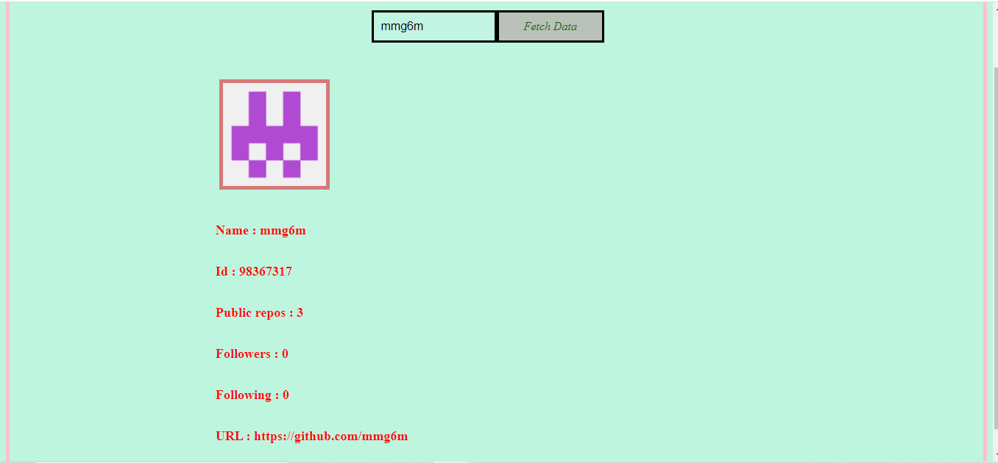
ICP 4
We will call Github API to display the Github User's account details when we search with the Username. We can retrieve all the fields which belongs to a particular user.

