Slide 2
Resilient Architecture
Building a Resilient Architecture around Dynamics 365
on-prem or cloud-based

Slide 3
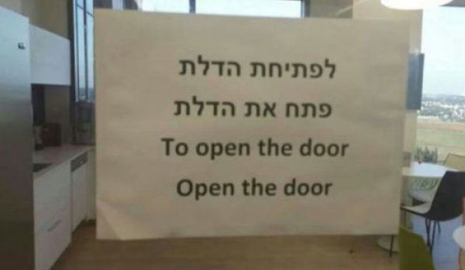
Speaker
Christian Sioui
Solution Architect
Ford Motor Company
UGCRM Technical Track coLead

Slide 4
Session Agenda
This session covers the architecture considerations and best-practices when you have a cloud-based Dynamics, some Azure cloud-based resources, and plenty of integration points with on-premises business applications and/or other SaaS peripheral components.

Slide 5
Christian Sioui
Solutions Architect
Currently helping Ford Motor Company
Previous Customers:
Blue Cross Blue Shield of Florida
Citrix
Nationwide
Disney

Slide 6
Session Objectives
What will you learn today?
How to frame your thinking around a balanced architecture
How to improve the architecture that is already in place at your company
How to keep a balance for maximum efficiency without sacrificing infrastructure robustness and/or resiliency

Slide 7
SDLC Best-Practices

Slide 8
Software Engineering 6 Best Practices
Develop Iteratively
Manage Requirements
Use Component Architectures
Model Visually
Continuously Verify Quality
Manage Change

Slide 9
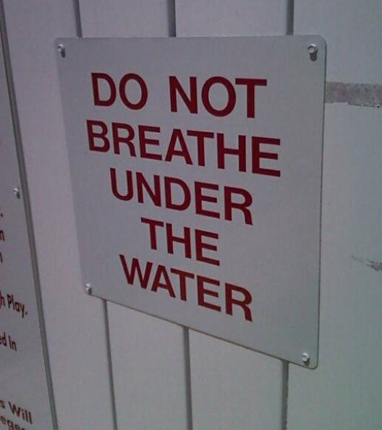
Core Concepts of Modern SDLC Methodologies
Use case or story driven
Architecture-centric
Iterative
Incremental
Service-oriented design

Slide 10
Architecture Considerations

Slide 11
Start with where your CRM is hosted
On-premises
Follow the Pacific approach
Cloud-hosted
Follow the Atlantic approach

Slide 12
The Peripheral Components
The Core
Telephony
Chat
Voice Recording / QA
Social Media Integration
Knowledge Management
Workforce Management
Data Warehouse
The Next Wave
Omni-Channel
Video Chat
Co-browsing
Gamification
Learning Management System
Dashboard
SMS Texting

Slide 13
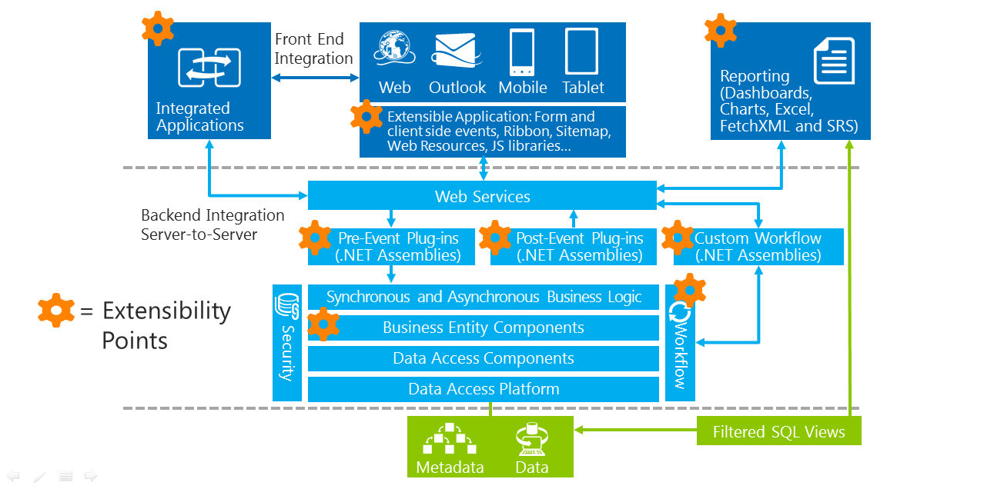
Reference Architecture

Slide 14
Telephony
On-premises
on-prem PSTN
Avaya
Cisco
SaaS / Cloud-hosted
Skype for Business
Vonage
GrassHopper
RingCentral
Jive

Slide 15
Chat
LiveAssist powered by CaféX
ZenDesk Chat
LiveChat
Slack
WhoseOn
Skype for Business

Slide 16
Exchange Integration
Exchange Mail Service
Exchange
Email messages
Contacts
Tasks
Appointments
Web mail / POP3
Gmail
Yahoo
Other email services
Sync email only

Slide 17
Integration with Other Systems
Azure Service Bus
Connecting to other systems within your organization
Connecting to other systems outside your organization
Creating an event hub for organizational change and synchronization

Slide 18
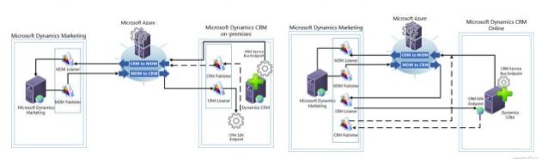
Azure Service bus

Slide 19
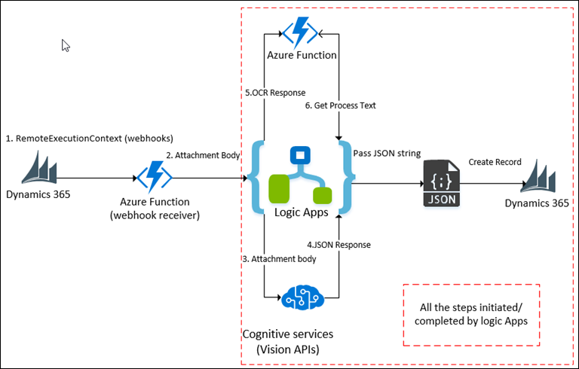
Azure Function / Logic Apps

Slide 20
Other Architectural Components
QA/ Voice Recording
Workforce Management
Bot as a deflecting agent
Bot as a pre-screening process
Knowledge Management
LMS
Gamification

Slide 21
Thank you
Christian Sioui
LinkedIn: www.linkedin.com/in/christian-sioui-a549064/
Please complete your surveys now
www.ugfocus.com/houston-survey

