Slide 1
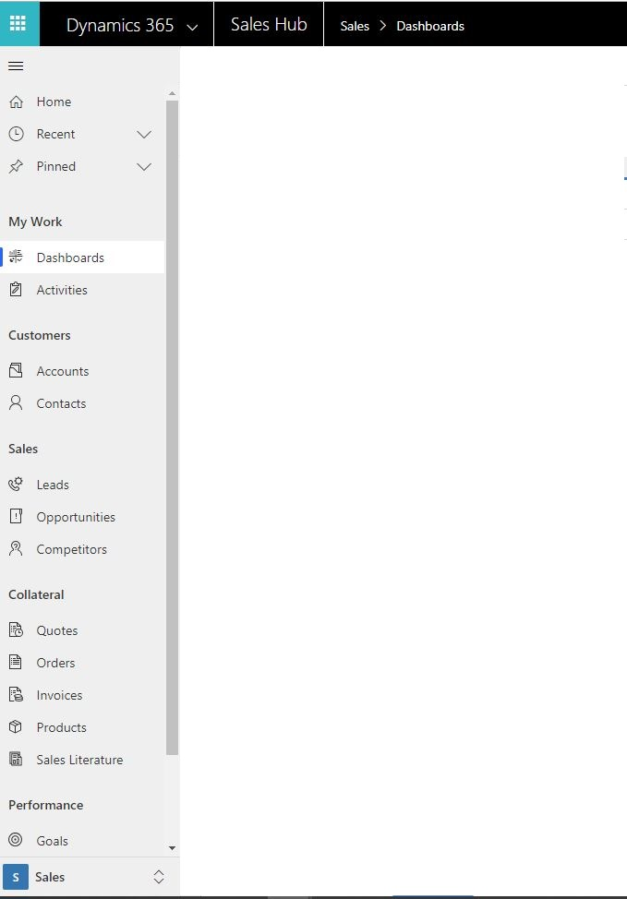
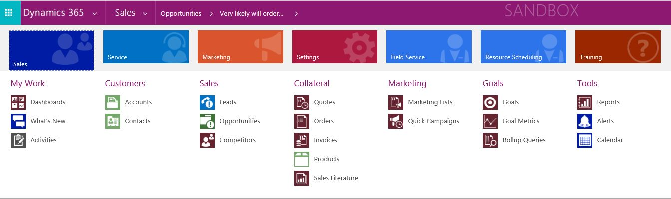
UI and Web Navigation

Slide 2
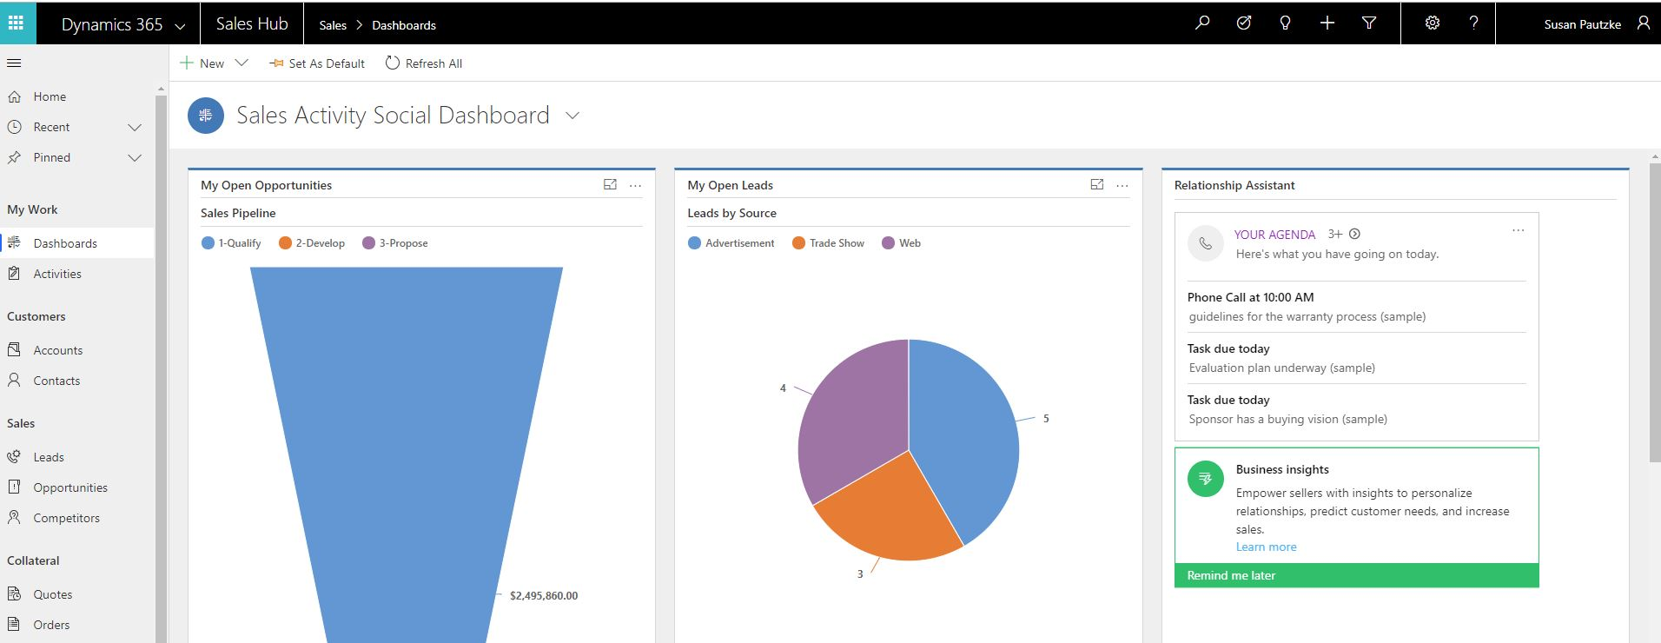
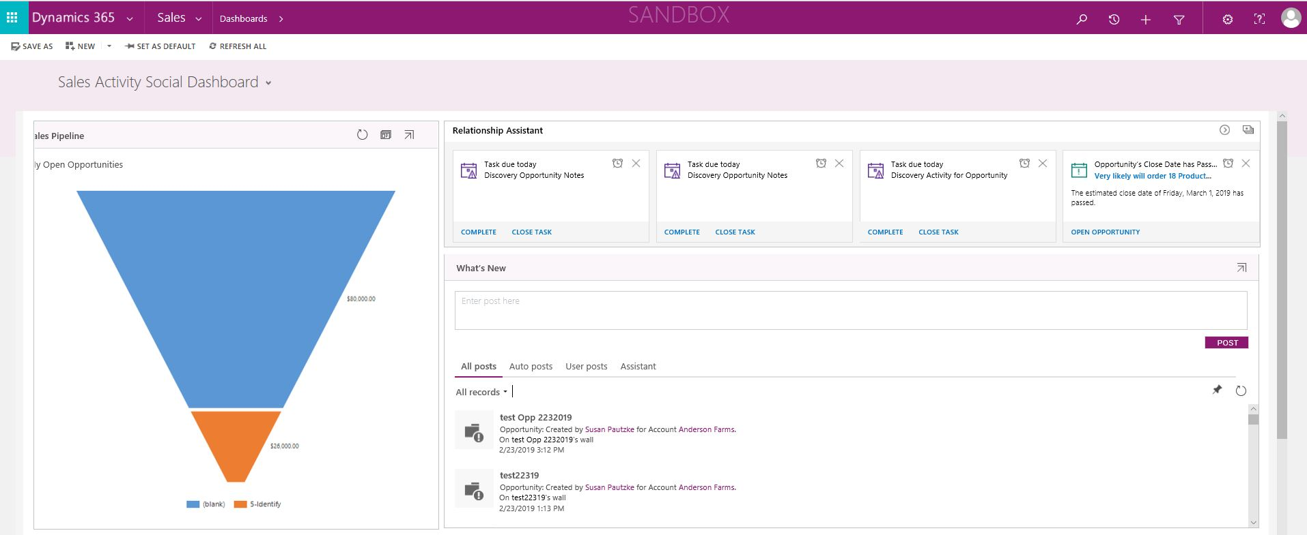
UI and Web - Dashboards

Slide 3
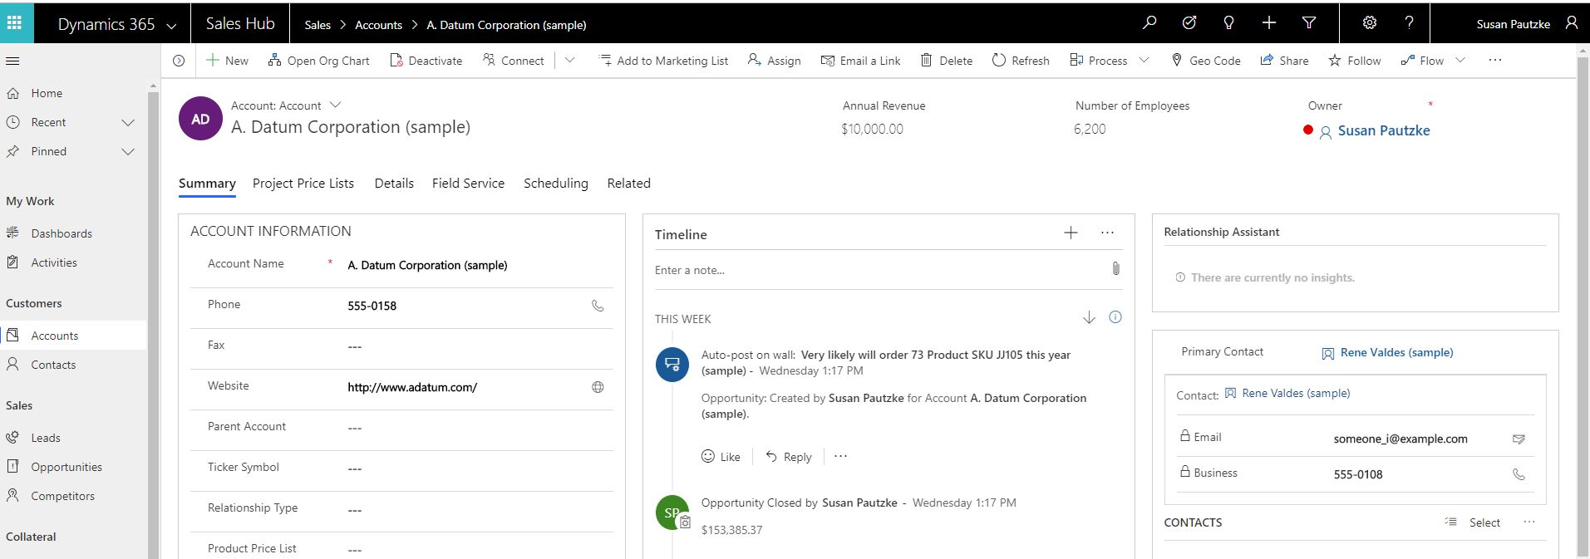
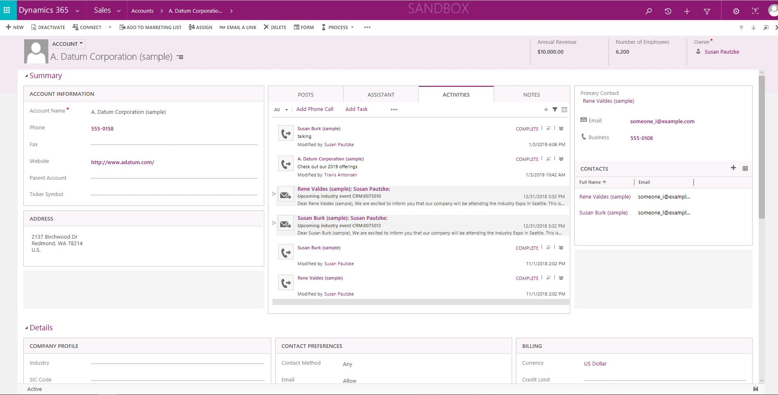
UI and Web - Account

Slide 4
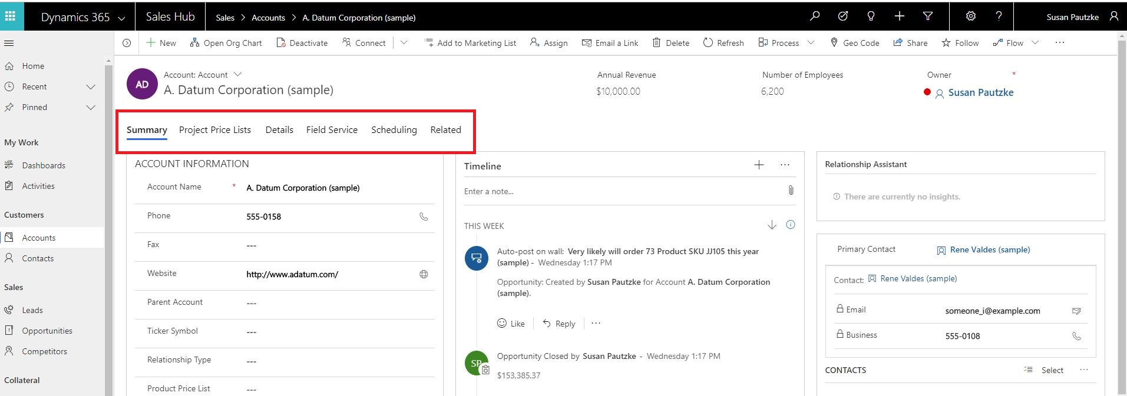
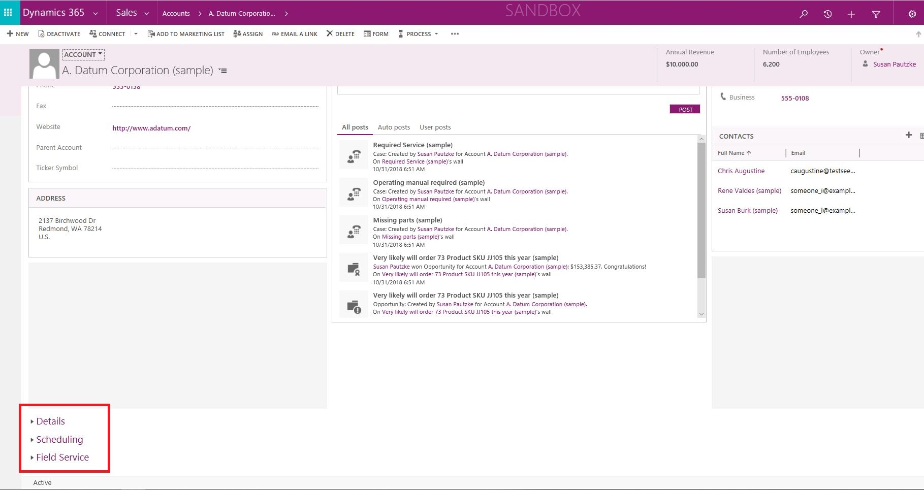
UI and Web - Tabs

Slide 5
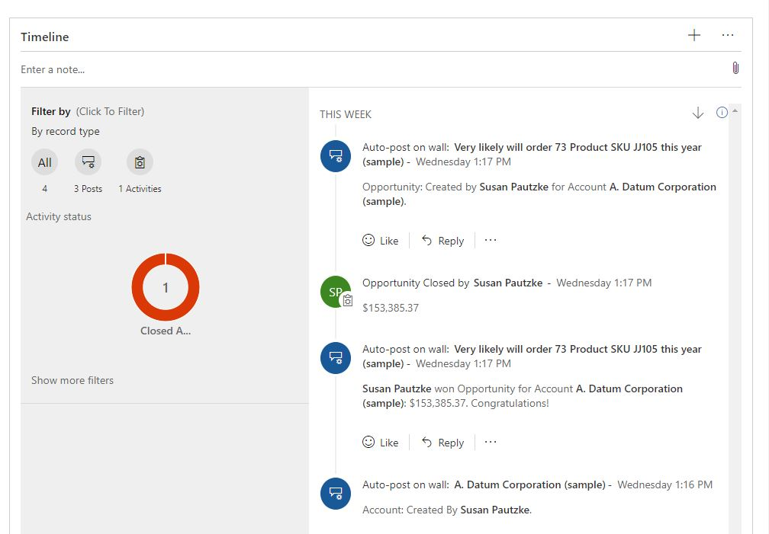
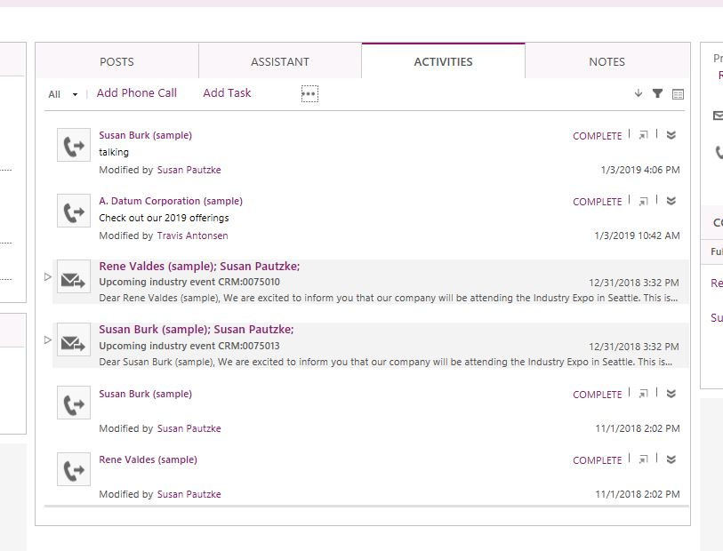
UI Timeline – Classic Activity Pane

Slide 6
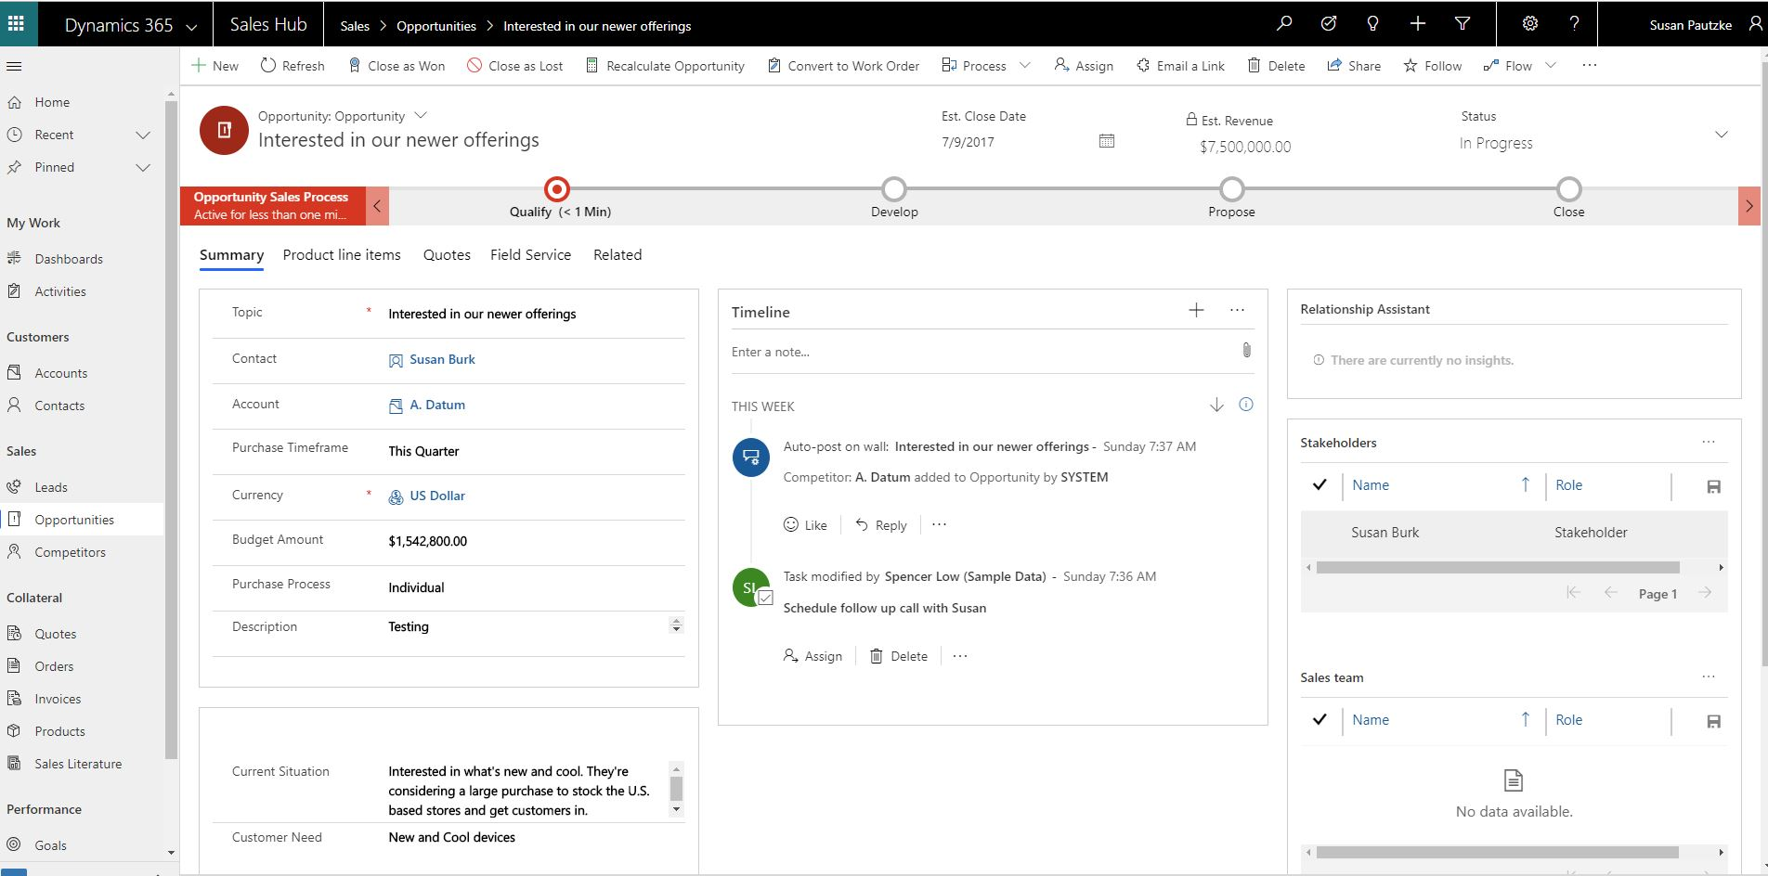
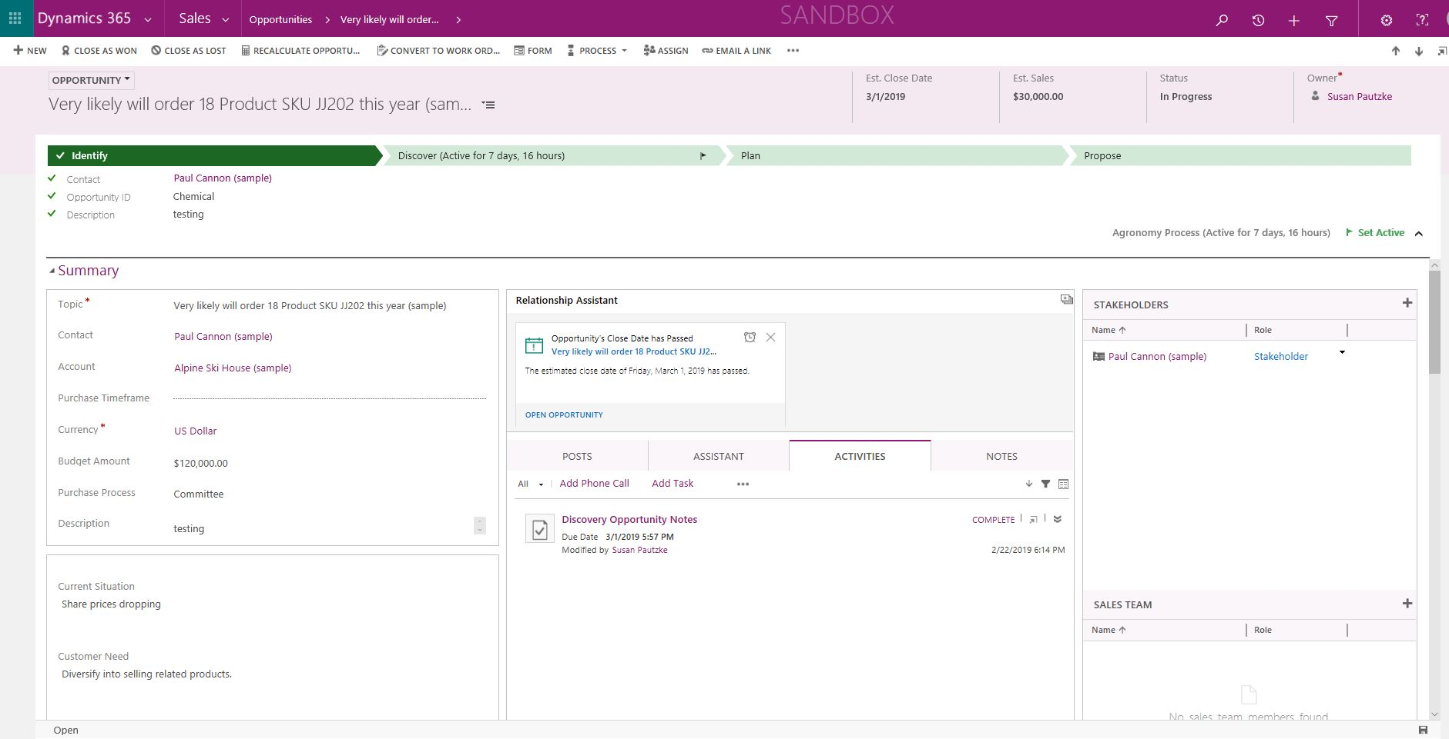
UI and Web - Opportunity

Slide 7
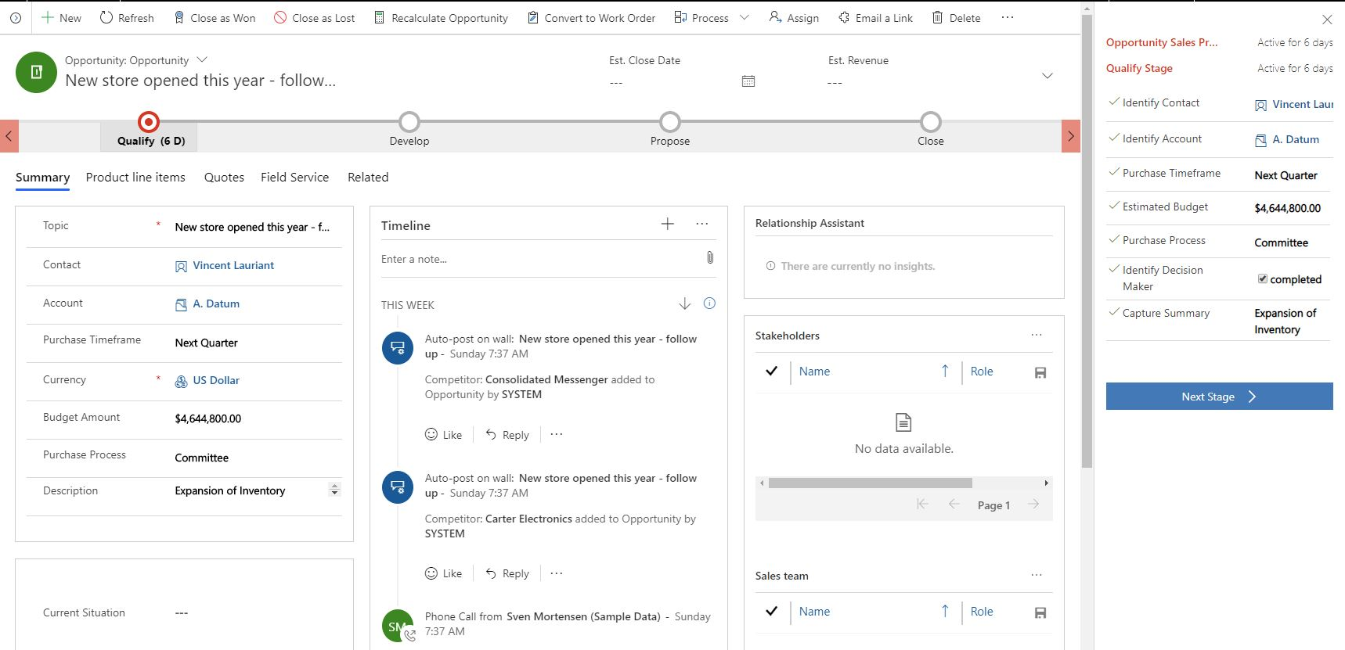
Business Process Stage Docking

Slide 8
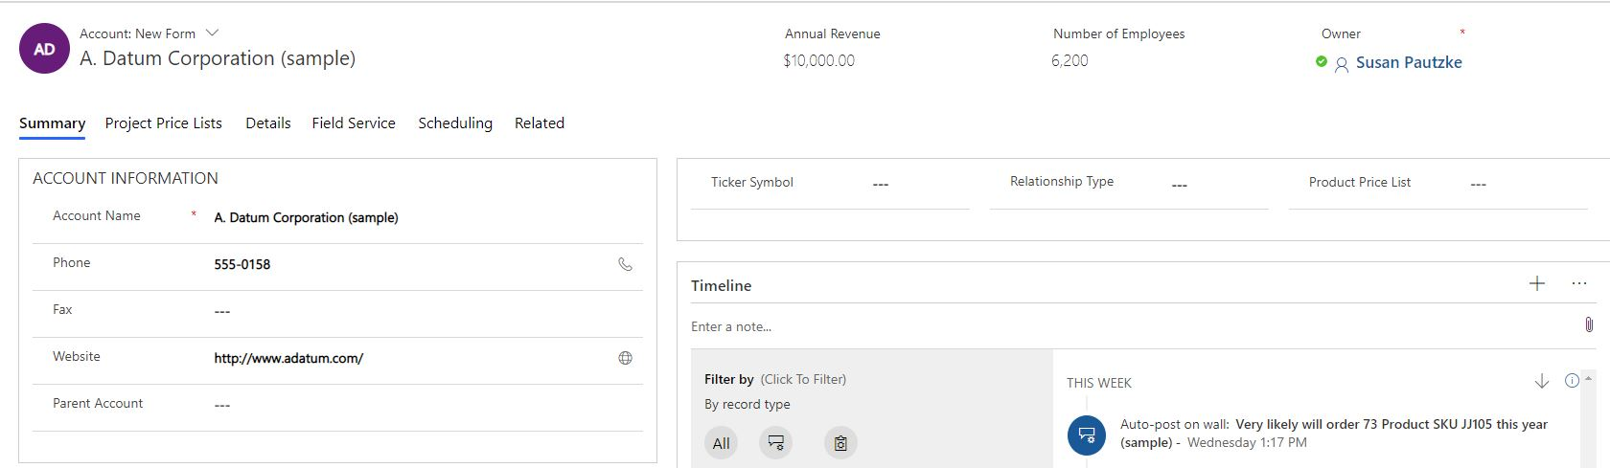
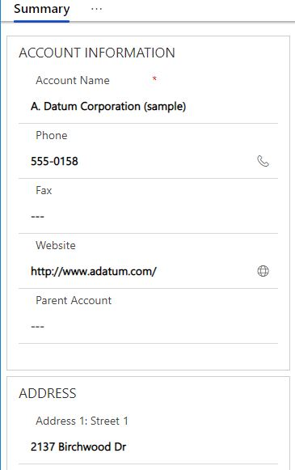
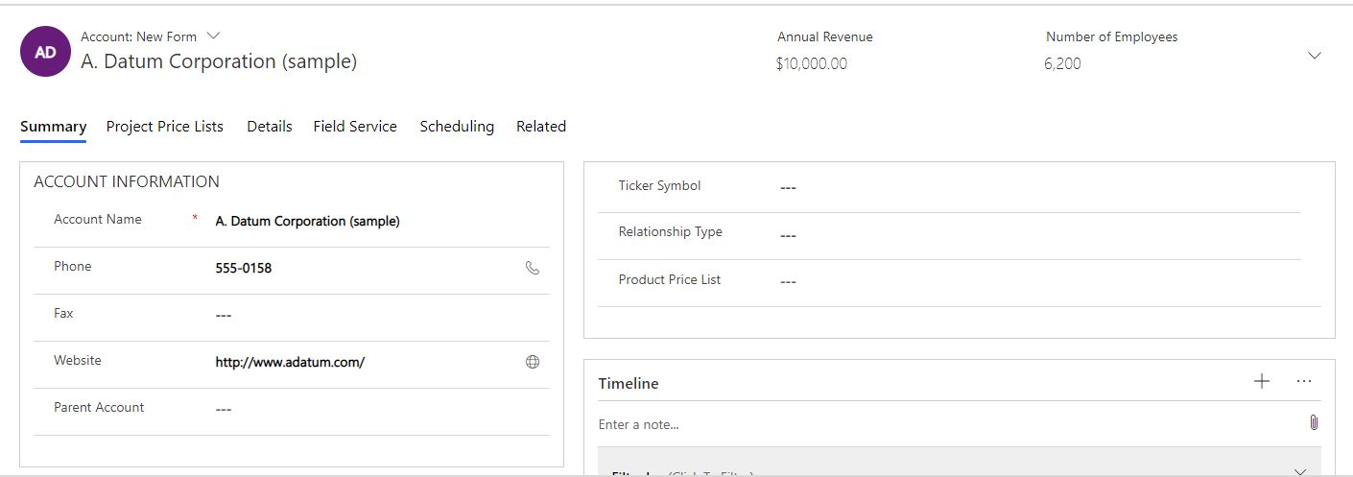
UI Reflow
Full size screen
Smaller Screen
Smallest Screen

Slide 9
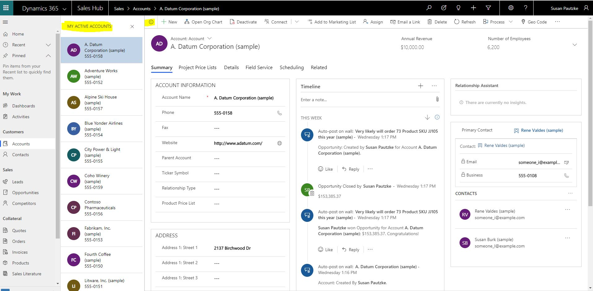
In Form Lists

Slide 10
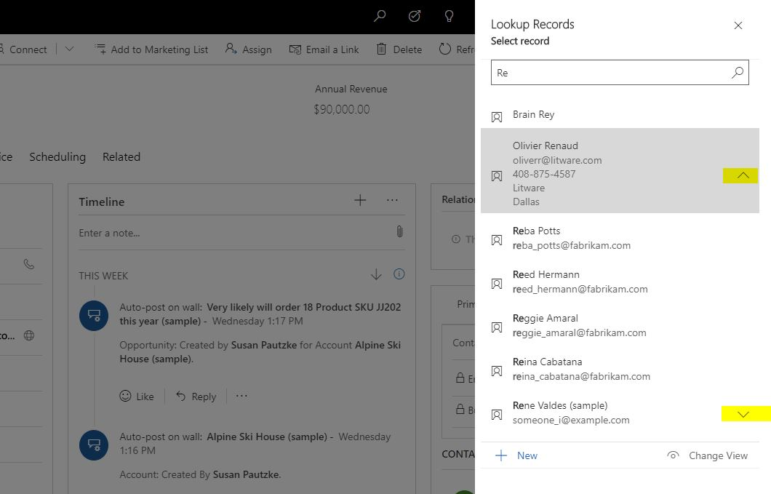
UI Lookup experience
Expanded Data Columns
Highlighted Results

Slide 11
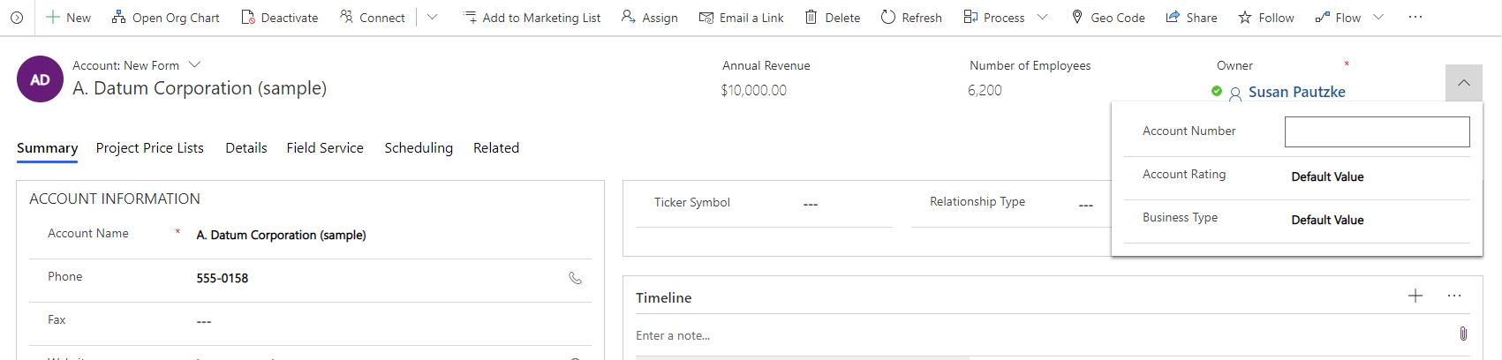
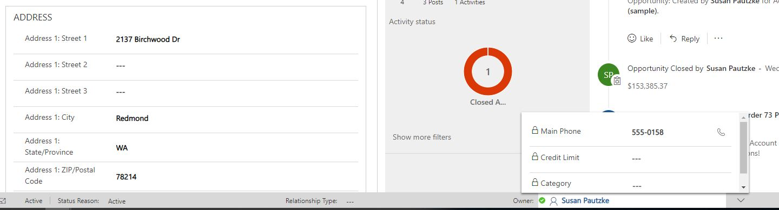
Header and Footer Flyouts

Slide 12
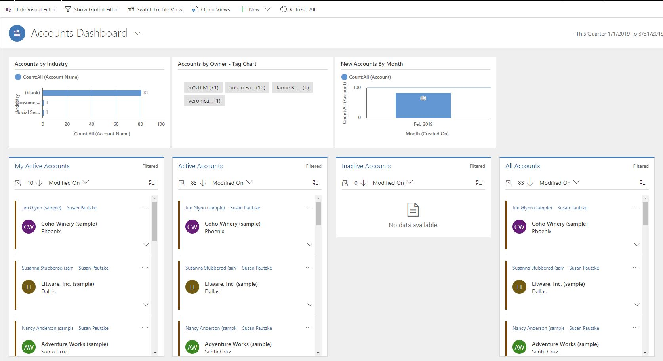
Entity Dashboards - Account

Slide 13
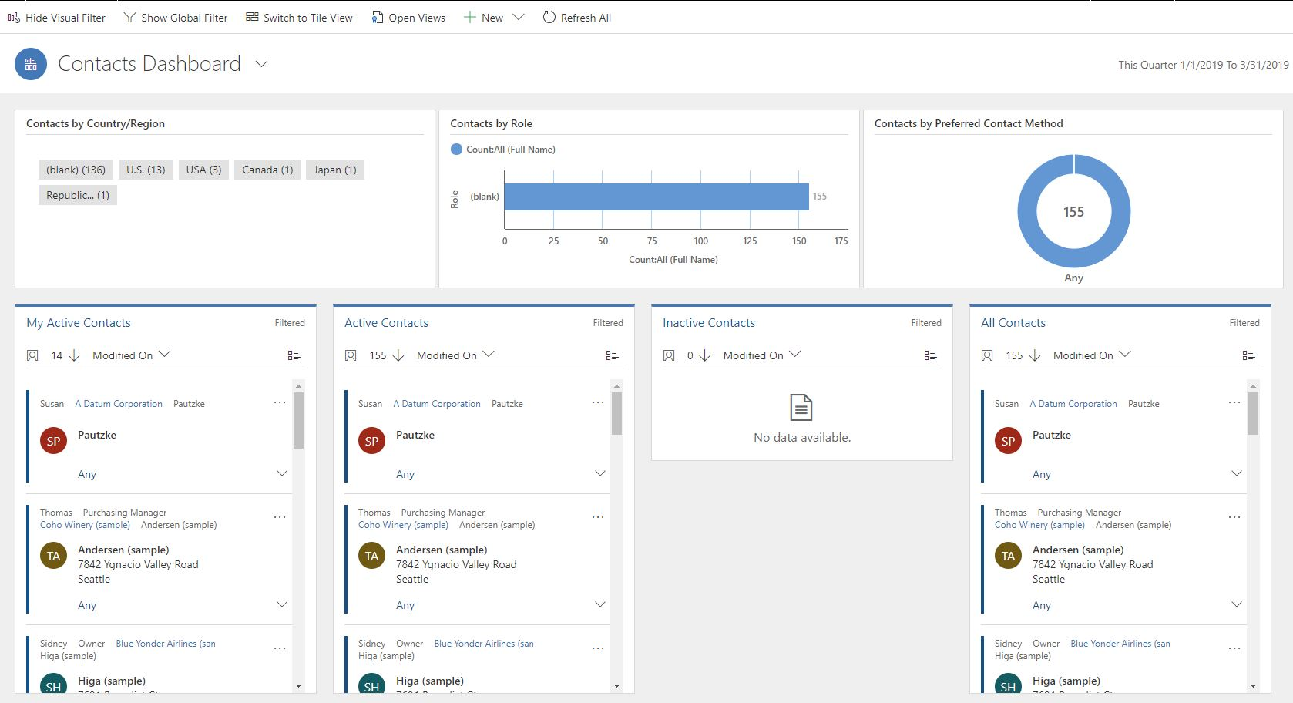
Entity Dashboards - Contact

Slide 14
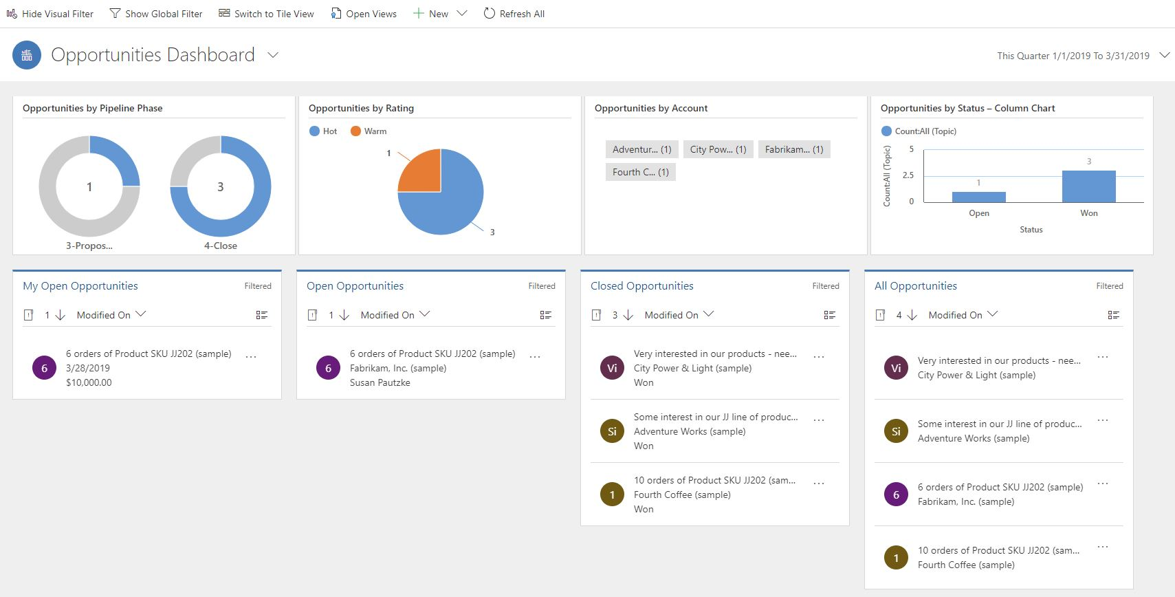
Entity Dashboards - Opportunity

Slide 15
Not in the UI, yet
Audit Trail
Custom styling of advanced chart properties (excluding colors and basic formatting)
Composite address control
Letter, Fax, Recurring Appointments
Global notifications
Admin experiences
Editable grids on phones
Learning Path

