Slide 1
PROFGAMES · ENGLISH DECK
SERVICED 27.05.2026
— SLIDE 01 / TITLE —
ProfGames
how AI changes the reproduction of professional competence
SERGEY GORDEYCHIK · #PROFGAMES · 27.05.2026
▶ #PROFGAMES

Slide 2
PROFGAMES · ENGLISH DECK
SERVICED 27.05.2026
— SLIDE 02 / SECTION —
AGENDA
00
01 · frame: four actors and three time horizons
02 · evidence base: 177 signals, 2020–2026
03 · biographies: provenance → status
04 · country parameters: US / RU / China / UAE
05 · the Russian fork
▶ #PROFGAMES

Slide 3
PROFGAMES · ENGLISH DECK
SERVICED 27.05.2026
— SLIDE 03 / STAT —
177
audited AI-era signals in A1
Events from 2020–2026 with dates, primary URLs, A/B/C/D evidence levels and a machine-readable base: profgames_ai_signals.jsonl + factcheck.json.
▶ #PROFGAMES

Slide 4
PROFGAMES · ENGLISH DECK
SERVICED 27.05.2026
— SLIDE 04 / SECTION —
THE FRAME
01
01 · professions do not simply disappear; the training channel thins
02 · AI changes the price of first tasks and status signals
03 · provenance becomes the key translator of status
04 · countries differ by parameters, not by separate theories
05 · diagnosis comes before prescriptions
▶ #PROFGAMES

Slide 5
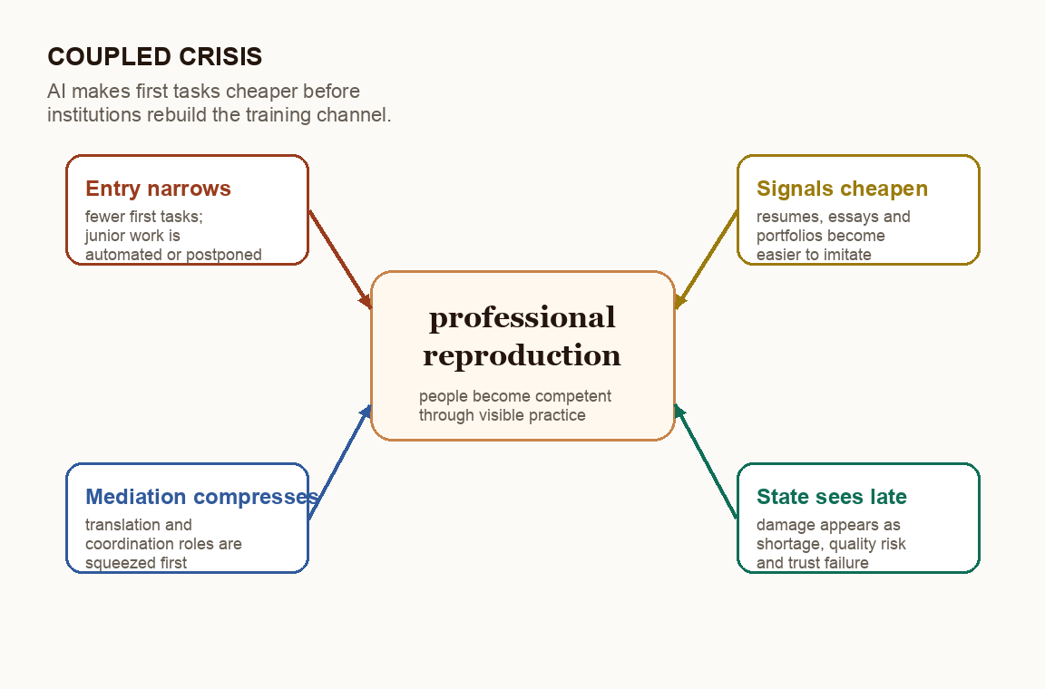
PROFGAMES · ENGLISH DECK
SERVICED 27.05.2026
— SLIDE 05 / TWO COLUMNS —
A COUPLED CRISIS
· entry into professions narrows
· signals get cheaper
· mediation compresses
· the state sees the problem late
mechanism
▶ #PROFGAMES

Slide 6
PROFGAMES · ENGLISH DECK
SERVICED 27.05.2026
— SLIDE 06 / TWO COLUMNS —
FOUR ACTORS / THREE TIMES
actors
horizons
· employer: cost of training
· worker: visible provenance
· education: competence verification
· state: rules and horizon
· mediators: registries, chambers, networks
· short: quarterly efficiency
· medium: the career ladder
· long: reproduction of the profession
· bad equilibria are often cheaper
· good ones require institutions
▶ #PROFGAMES

Slide 7
PROFGAMES · ENGLISH DECK
SERVICED 27.05.2026
— SLIDE 07 / STAT —
A/B/C/D
four evidence levels
A — administrative and causal data; B — vacancies, surveys and observational studies; C — corporate cases; D — scenarios and forecasts.
▶ #PROFGAMES

Slide 8
PROFGAMES · ENGLISH DECK
SERVICED 27.05.2026
— SLIDE 08 / STAT —
−13–16%
employment of 22–25-year-olds in AI-exposed occupations
Stanford Digital Economy Lab: relative decline for young workers in the most AI-exposed occupations; AI Index 2026 gives a related software signal of about −20%.
▶ #PROFGAMES

Slide 9
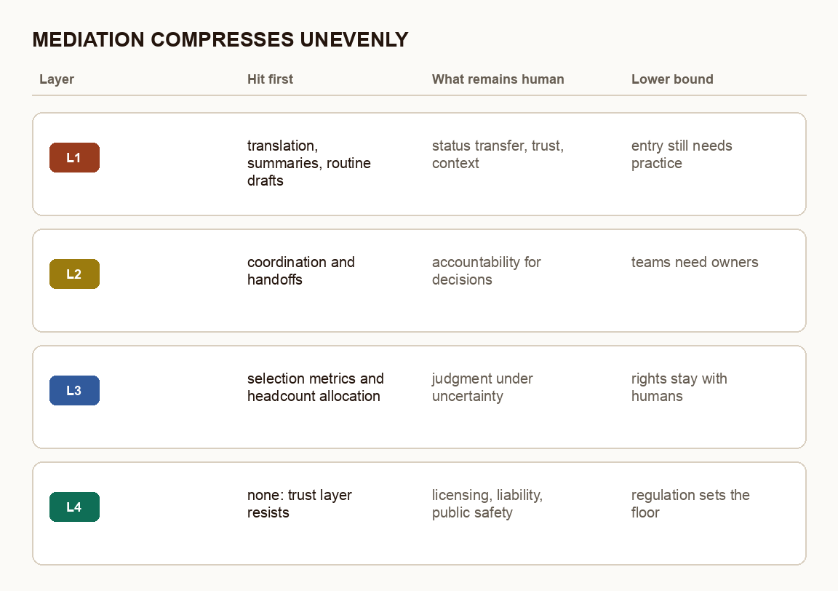
PROFGAMES · ENGLISH DECK
SERVICED 27.05.2026
— SLIDE 09 / TWO COLUMNS —
MEDIATION COMPRESSES UNEVENLY
main shift
· translation and summarization are hit first
· coordination shrinks, but does not vanish
· decision rights and trust still need humans
· regulation becomes the lower bound
▶ #PROFGAMES

Slide 10
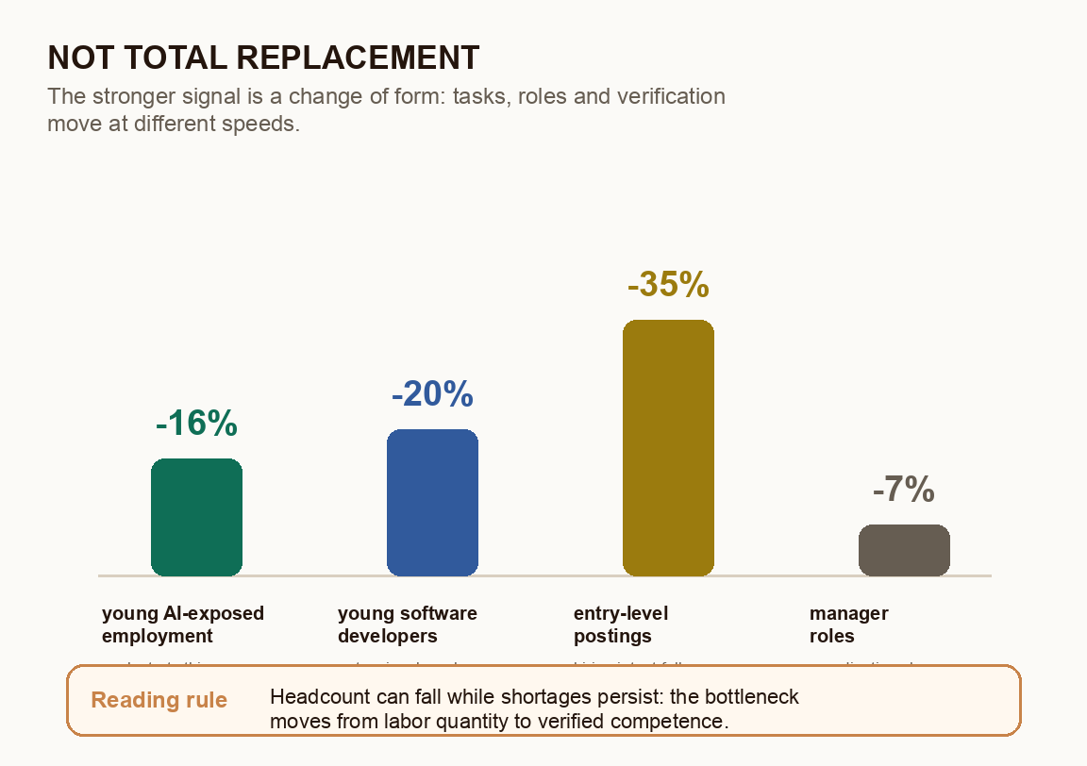
PROFGAMES · ENGLISH DECK
SERVICED 27.05.2026
— SLIDE 10 / TWO COLUMNS —
NOT TOTAL REPLACEMENT — A CHANGE OF FORM
how to read
· some tasks get cheaper
· some roles change shape
· some signals need new provenance
· shortages and layoffs can coexist
▶ #PROFGAMES

Slide 11
PROFGAMES · ENGLISH DECK
SERVICED 27.05.2026
— SLIDE 11 / SECTION —
B: BIOGRAPHIES OF PROVENANCE
02
01 · Irish teacher: registry and authorship
02 · German engineer: title, chamber, liability
03 · doctor in the UK: GMC → allocation of places
04 · Chinese returnee: state return program
05 · Russian IT: GitHub, sanctions, local market
▶ #PROFGAMES

Slide 12
PROFGAMES · ENGLISH DECK
SERVICED 27.05.2026
— SLIDE 12 / SECTION —
FIVE STATUS TRANSLATORS
B
01 · registry
02 · protected title
03 · bridge program
04 · state return machine
05 · decentralized network provenance
▶ #PROFGAMES

Slide 13
PROFGAMES · ENGLISH DECK
SERVICED 27.05.2026
— SLIDE 13 / TWO COLUMNS —
IRELAND / GERMANY
teacher
engineer
· the formal registry remains
· the new problem is authorship of student work
· verification moves to schools and assessment practice
· the registry misses the main AI shift
· the title is protected by state and chamber
· liability moves toward insurers and lawyers
· the AI Act and product liability redraw the boundary
· the chamber remains, but its function redistributes
▶ #PROFGAMES

Slide 14
PROFGAMES · ENGLISH DECK
SERVICED 27.05.2026
— SLIDE 14 / TWO COLUMNS —
UK MEDICAL / CHINA RETURN
UK medicine
return to China
· GMC works as a registry
· the bottleneck comes after recognition: Foundation / specialty
· doctor shortages and competition for places coexist
· the bridge system becomes a political filter
· YTT turns overseas provenance into a resource
· the returnee receives infrastructure
· Western systems begin reading participation as risk
· the program works asymmetrically
▶ #PROFGAMES

Slide 15
PROFGAMES · ENGLISH DECK
SERVICED 27.05.2026
— SLIDE 15 / STAT —
≈800
Softline headcount reduction from Q3 2025 to Q1 2026
A Russian analogue to the Oracle case: Q1 2026 turnover grew 5% YoY, while the company cited AI in routine development/testing, M&A integration and performance assessment.
▶ #PROFGAMES

Slide 16
PROFGAMES · ENGLISH DECK
SERVICED 27.05.2026
— SLIDE 16 / SECTION —
C: ONE THEORY, DIFFERENT PARAMETERS
03
01 · US: market underinvestment
02 · Russia: segmented market with anchor employers
03 · China: state-industrial return machine
04 · UAE: imported human-capital hub
05 · policy copy-paste breaks
▶ #PROFGAMES

Slide 17
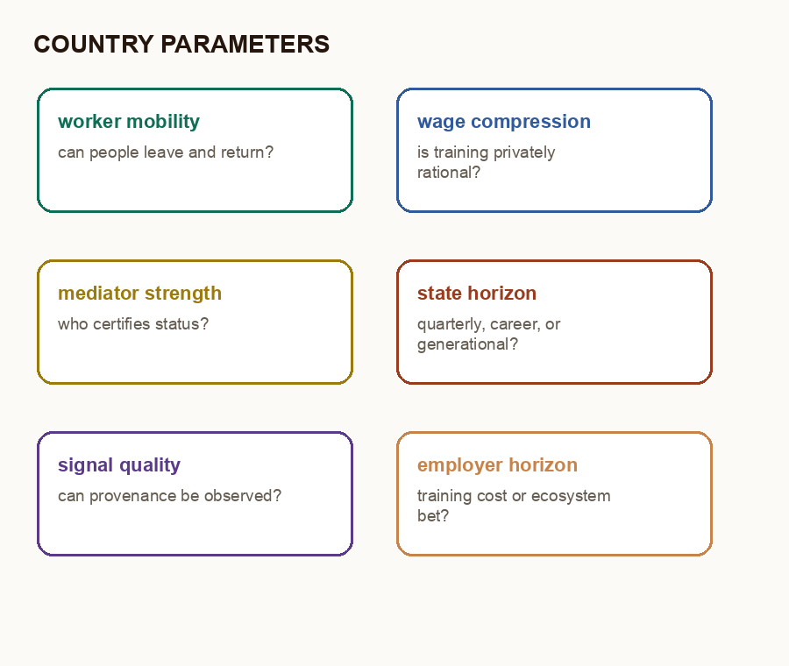
PROFGAMES · ENGLISH DECK
SERVICED 27.05.2026
— SLIDE 17 / TWO COLUMNS —
SEVEN PARAMETERS OF THE COUNTRY GAME
what changes equilibrium
· worker mobility
· wage compression
· strength of mediators
· employer horizon
· role of the state
· quality of signals
▶ #PROFGAMES

Slide 18
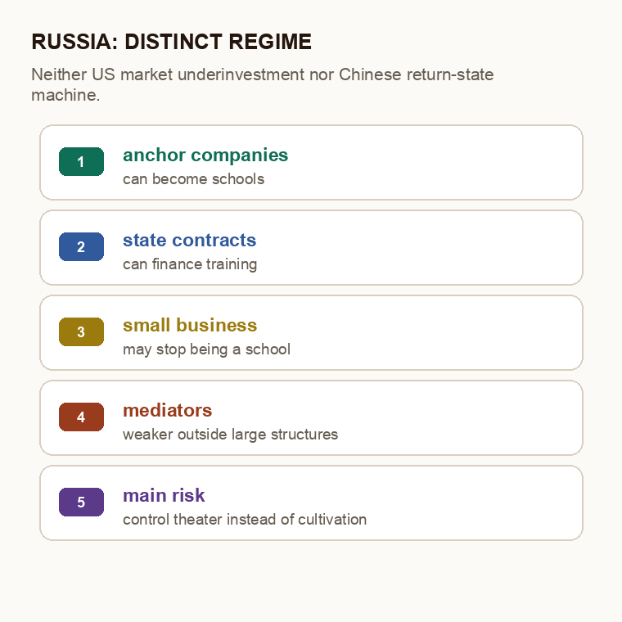
PROFGAMES · ENGLISH DECK
SERVICED 27.05.2026
— SLIDE 18 / TWO COLUMNS —
RUSSIA AS A DISTINCT REGIME
neither US nor China
· anchor companies can become schools
· the state can create long demand
· small business remains fragile
· independent mediators are weaker
· risk: control theater instead of training
▶ #PROFGAMES

Slide 19
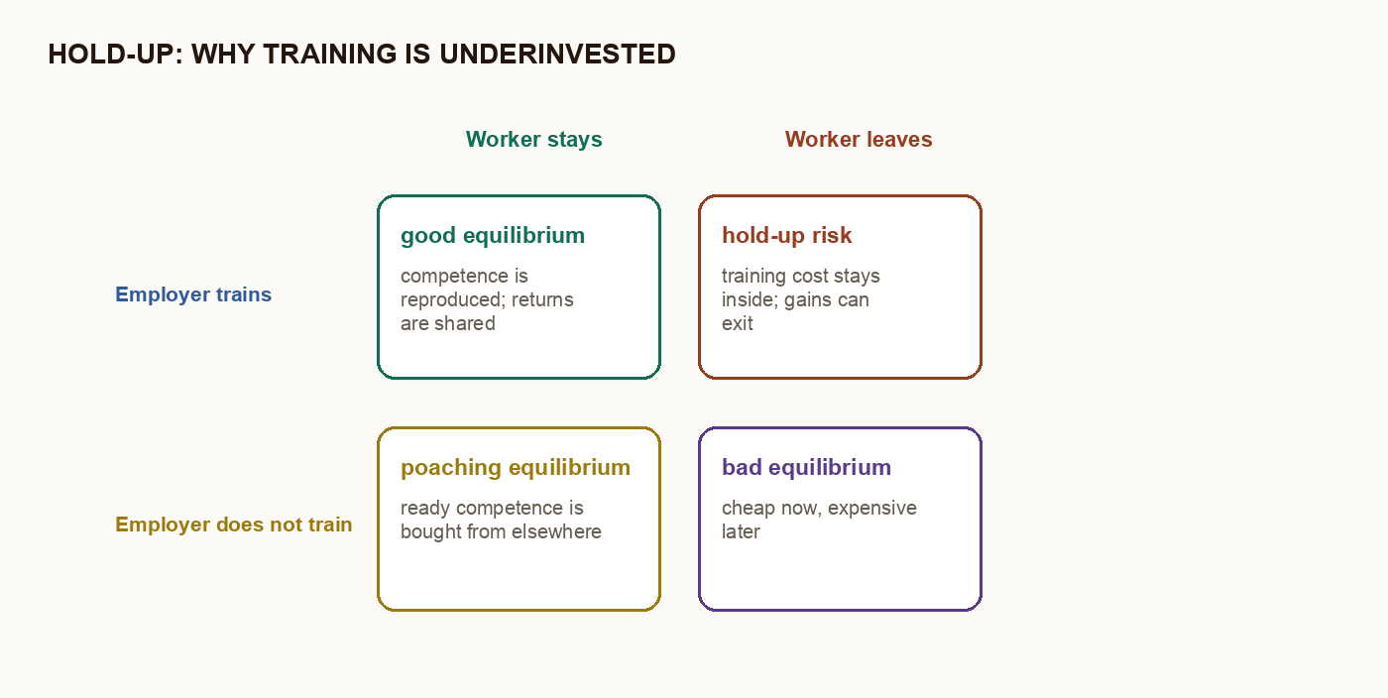
PROFGAMES · ENGLISH DECK
SERVICED 27.05.2026
— SLIDE 19 / TWO COLUMNS —
HOLD-UP: WHY TRAINING IS UNDERINVESTED
▶ #PROFGAMES

Slide 20
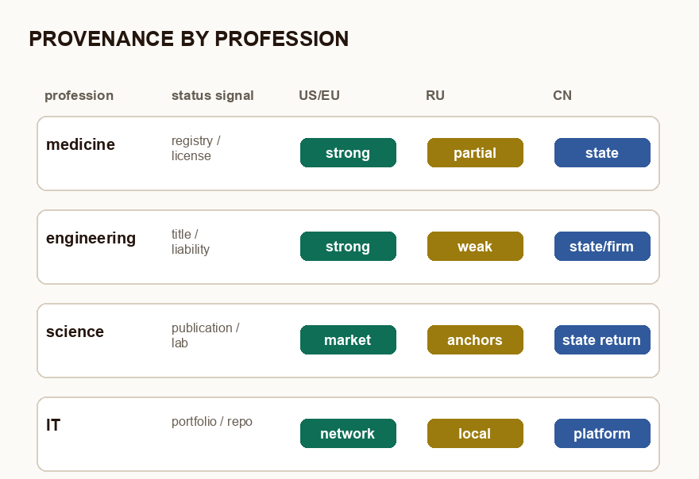
PROFGAMES · ENGLISH DECK
SERVICED 27.05.2026
— SLIDE 20 / TWO COLUMNS —
PROVENANCE BY PROFESSION AND COUNTRY
where status is visible
· medicine: registry and license
· engineering: title and liability
· science: publications and labs
· IT: portfolio, repositories, market
· Russia is weaker where the signal moved outside
▶ #PROFGAMES

Slide 21
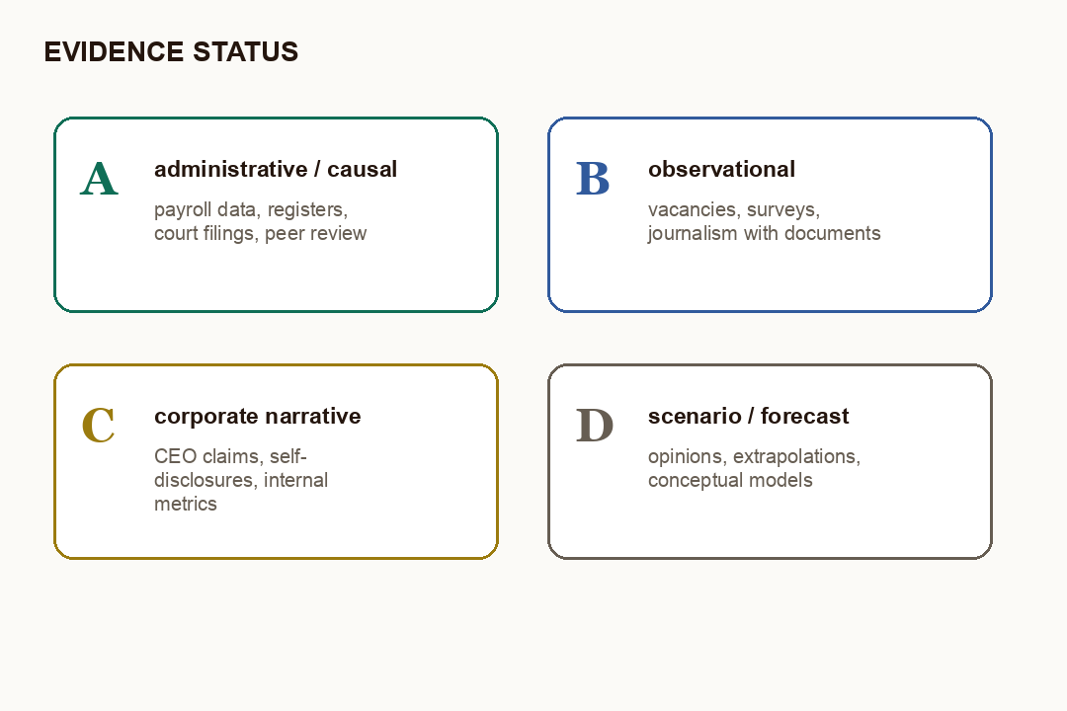
PROFGAMES · ENGLISH DECK
SERVICED 27.05.2026
— SLIDE 21 / TWO COLUMNS —
EVIDENCE STATUS: WHAT IS ALREADY SOLID
how to read the pack
· A: administrative data
· B: observations and surveys
· C: corporate cases
· D: scenarios and forecasts
· inference strength = source strength
▶ #PROFGAMES

Slide 22
PROFGAMES · ENGLISH DECK
SERVICED 27.05.2026
— SLIDE 22 / SECTION —
D: SEVEN SYMPTOMS
04
01 · entry narrows
02 · routine mediation gets cheaper
03 · work looks finished but needs checking
04 · provenance collapses
05 · detectors do not create trust
06 · layoffs and shortages move together
07 · ready competence is bought
▶ #PROFGAMES

Slide 23
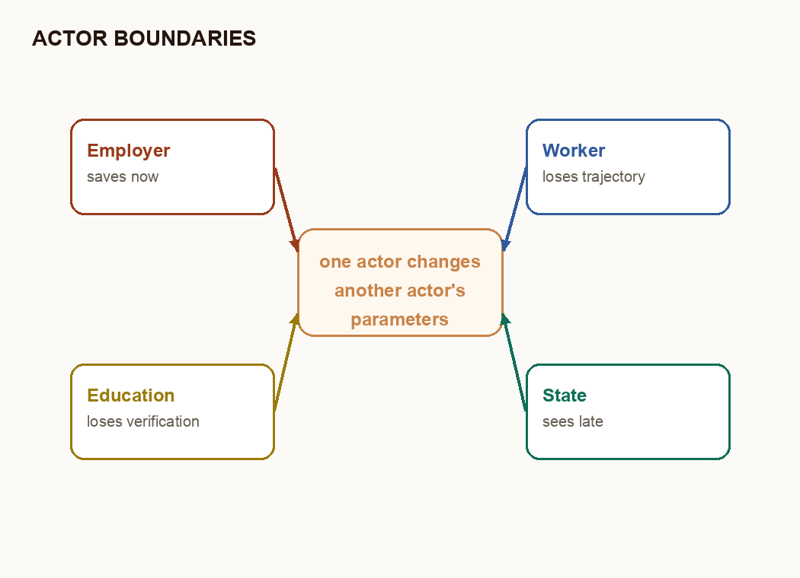
PROFGAMES · ENGLISH DECK
SERVICED 27.05.2026
— SLIDE 23 / TWO COLUMNS —
ACTOR BOUNDARIES
decision boundaries
· one actor changes another's parameters
· employer saves now
· education loses verification
· worker loses trajectory
· the state sees effects with delay
▶ #PROFGAMES

Slide 24
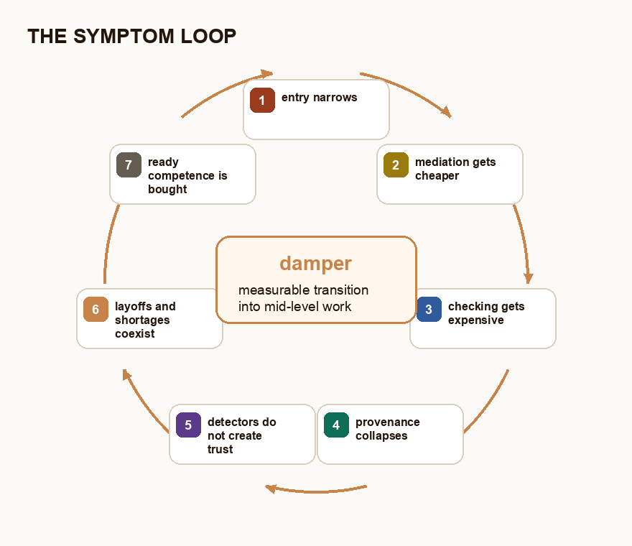
PROFGAMES · ENGLISH DECK
SERVICED 27.05.2026
— SLIDE 24 / TWO COLUMNS —
THE SYMPTOM LOOP
closure
· entry narrows
· mediation gets cheaper
· verification gets more expensive
· provenance collapses
· shortage and layoffs move together
· damper: measurable transition into mid-level work
▶ #PROFGAMES

Slide 25
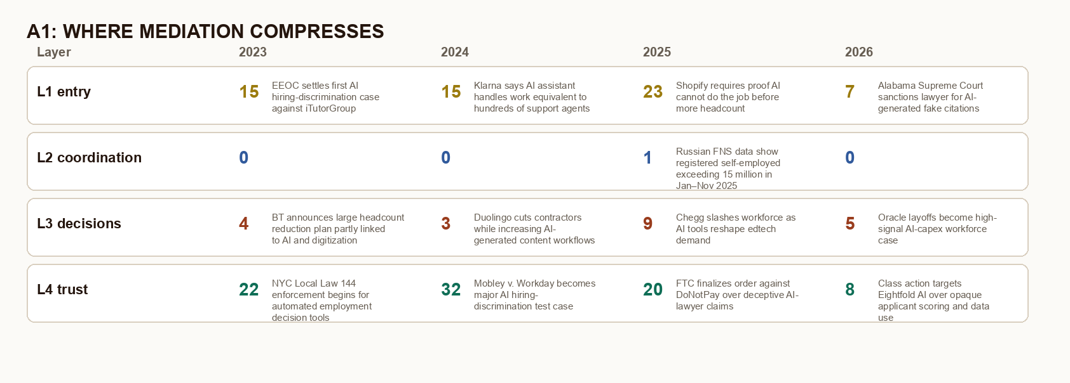
PROFGAMES · ENGLISH DECK
SERVICED 27.05.2026
— SLIDE 25 / TWO COLUMNS —
A1: WHERE MEDIATION COMPRESSES
▶ #PROFGAMES

Slide 26
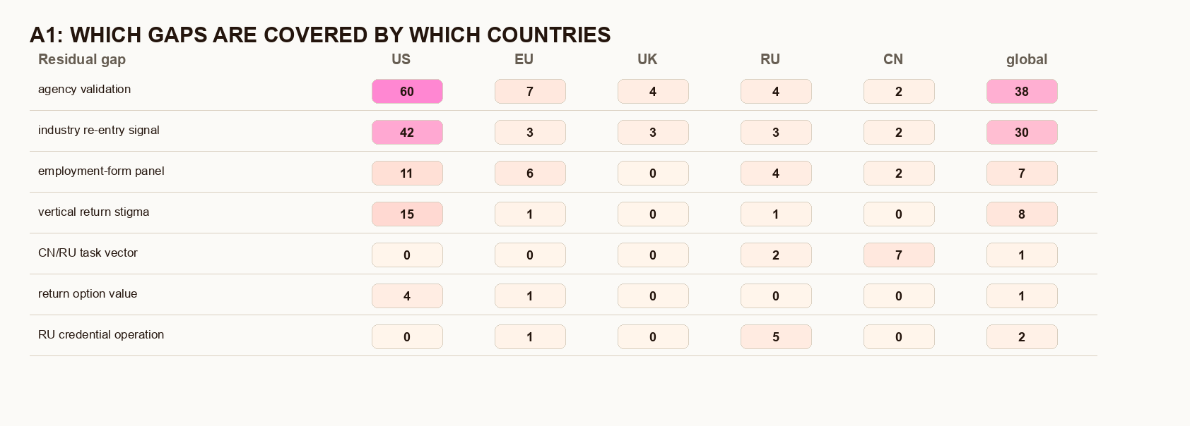
PROFGAMES · ENGLISH DECK
SERVICED 27.05.2026
— SLIDE 26 / TWO COLUMNS —
A1: WHICH GAPS ARE COVERED BY WHICH COUNTRIES
▶ #PROFGAMES

Slide 27
PROFGAMES · ENGLISH DECK
SERVICED 27.05.2026
— SLIDE 27 / SECTION —
THE RUSSIAN FORK
05
01 · the AI shock concentrates in large structures
02 · small business may stop being a school
03 · the main shortage is mentors, not only entrants
04 · procurement and contracts can finance training
05 · imported talent must not replace local cultivation
▶ #PROFGAMES

Slide 28
PROFGAMES · ENGLISH DECK
SERVICED 27.05.2026
— SLIDE 28 / STAT —
4.8→14.9
AI solutions in Russia: average adoption → large 500+ firms
HSE ISSEK: Russian AI adoption is concentrated; among AI users, 15% report staff reductions and 63% report no staffing impact. This is restructuring, not proof of mass replacement.
▶ #PROFGAMES

Slide 29
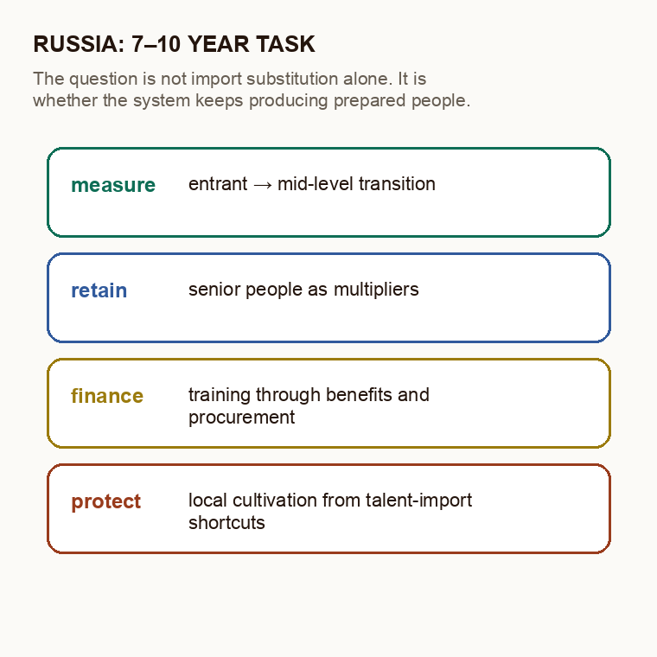
PROFGAMES · ENGLISH DECK
SERVICED 27.05.2026
— SLIDE 29 / TWO COLUMNS —
RUSSIA: THE 7–10 YEAR TASK
the bet
· close the mentorship bottleneck
· tie benefits and procurement to training
· measure entrant → mid-level transition
· retain senior people as multipliers
· do not replace training with talent import
▶ #PROFGAMES

Slide 30
PROFGAMES · ENGLISH DECK
SERVICED 27.05.2026
— SLIDE 30 / END —
?
WHAT SHOULD BE MEASURED FIRST: ENTRANT → MID-LEVEL TRANSITION
github.com/scadastrangelove/profgames · t.me/aiakyn · #profgames
▶ #PROFGAMES

