Slide 1




What counts as personal information?
Grade 4 Tech | Privacy and safety · Idea attribution: https://www.commonsense.org/education/digital-literacy/personally-identifiable-information
Mr. Fung | Grade 4 Tech

Slide 2



BIG QUESTION
Which details can point to one particular person?
Listen to made-up clues.
Thumbs up: points to a person.
Thumbs down: too general.
You may pass. Keep real details private.

Slide 3





Some clues
point to one person
One detail — or a mix of details — can identify someone.
USUALLY TOO GENERAL
CAN POINT TO
A PERSON
A favourite game by itself.
A clear photo
+ a school name.
PAUSE.
Ask a trusted adult.

Slide 4










Try It
Together
Sort each line:
Sam’s made-up team-chat request
Share
01
Full name
Pause
02
School name
Tell a trusted adult
03
Home address
Think first.
Then talk with your partner.
04
Picture in a jersey
05
Favourite colour

Slide 5









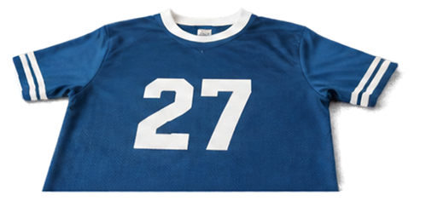
TALK ABOUT IT
Which details point to Sam?
POINTS TO A PERSON
USUALLY TOO GENERAL
SAFE NEXT MOVE
Full name
School name
Home address
Jersey photo
Favourite colour.
By itself.
Pause.
Leave the request.
Tell a trusted adult.
One general detail does not make the whole request safe.

Slide 6






EXIT CHECK
Name one safe move.
If a game asks for a home address, what is one safe move?
Ask a trusted adult.
Do not type it.
Pause.

