Slide 1


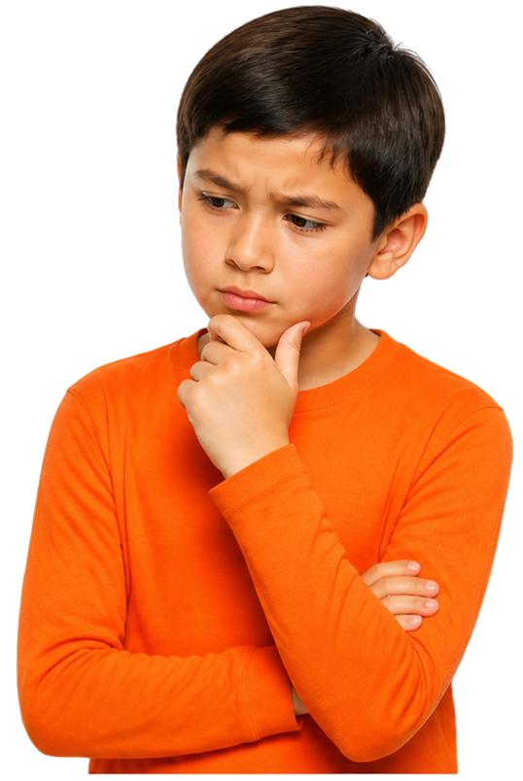


When is sharing a
Can I have
your address?
What's your
phone number?
bigger risk?
Grade 4 Tech
Privacy and safety
Teacher-led 30 minutes
Fictional examples only; pass allowed · Idea attribution: https://www.commonsense.org/education/digital-literacy/pii-whats-the-risk-factor
Mr. Fung
Grade 4 Tech

Slide 2





BIG QUESTION
When should we be more careful about
personal details?
Is it always unsafe to tell your teacher your name?
Thumbs in the middle if you are not sure.
You may pass.
Use made-up examples only.
Mr. Fung | Grade 4 Tech

Slide 3


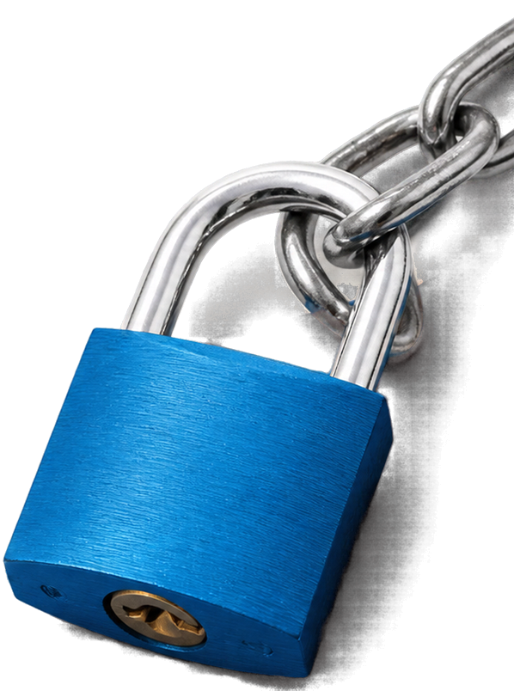






LEARN IT
Who asks and why matters
Who is asking?
Why do they need it?
What could go wrong?
Warning signs: a rush, a prize, a secret, or leave the app and talk somewhere else.
Teacher taking attendance: lower risk.
A stranger with a prize does not need a home address.
Do not add extra details nobody asked for.
Mr. Fung | Grade 4 Tech

Slide 4







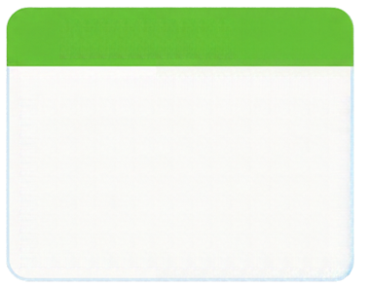
TRY IT TOGETHER
Two requests for Riley (made-up story)
REQUEST A
The teacher says, “I already have the class list. Please just open your book.”
With your partner, answer
for each request:
REQUEST B
Who is asking?
A pop-up in a game says, You won a tablet. Type your full name, home address, and password
in the next 60 seconds.
Why?
What could go wrong?
Think first.
Then talk.
Mr. Fung | Grade 4 Tech

Slide 5




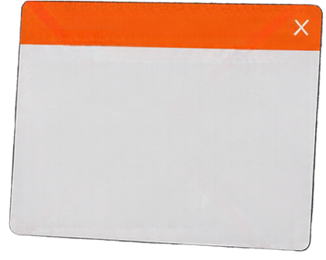

TALK ABOUT IT
Who is asking in each request?
CONGRATULATIONS!
Why would they need the detail? What could go wrong?
Claim your prize now!
Enter your name, address, and password to continue.
A: the teacher. B: an unknown pop-up.
A: for learning. B: a stranger does not need it.
A: no extra personal detail required.
B: password should not be typed.
Close it and tell a trusted adult.
A prize does not make a request safe.
Mr. Fung | Grade 4 Tech

Slide 6




EXIT CHECK
Think about
requests
carefully.
Who is asking?
Why do they need it?
What could go wrong?
Which request should Riley refuse, and what is one warning sign?
Mr. Fung | Grade 4 Tech

