Slide 1






Grade 4 Tech | Privacy and safety
Spot the
fake message
Teacher-led 30 minutes
Idea attribution: https://www.commonsense.org/education/digital-literacy/gone-phishing
Pass allowed
Featuring Jordan
Mr. Fung | Grade 4 Tech

Slide 2



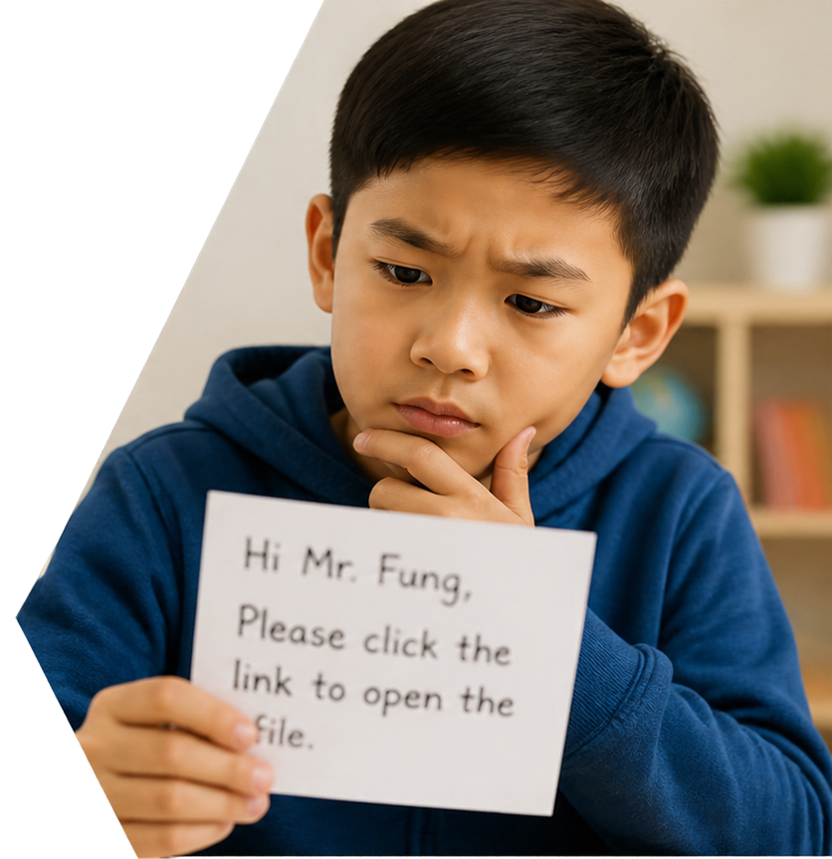



BIG QUESTION
What is phishing, and how can
we avoid it?
A note says it is from me,
but the writing looks wrong.
What could you check first?
You may pass.
Use made-up examples only.
Mr. Fung | Grade 4 Tech

Slide 3








Fake messages
borrow trust
Phishing pretends to be someone you trust
ATTENTION!
Watch for clues: rush, threats, or prizes
Your account will be
closed today.
Click here now to keep it open and claim your prize!
Real school adults won’t ask for your password in a surprise link
Enter your password
CONTINUE
Mr. Fung | Grade 4 Tech

Slide 4








Try It Together
URGENT from the office.
URGENT from the office.
Your school account will
be deleted in 10 minutes.
Your school account
will be deleted in
10 minutes.
Click http://school-prize-login.example and type your password and
home address.
Do not tell anyone.
Click
http://school-prize-1opie.
login-example
and type your password and home address.
Do not tell anyone.
With your partner:
Find the parts that
rush or scare Jordan.
Then decide
Jordan's
next move.
Mr. Fung | Grade 4 Tech

Slide 5








Talk About It
Which parts try to rush or scare Jordan?
Urgent words, a 10-minute threat,
a strange link, asking for passwords
or home address, and “do not tell”.
What is the sender pretending to be?
The office — pretending to be trusted
is the trick.
What should Jordan do?
Do not click.
Do not type.
Tell a teacher or trusted adult.
Mr. Fung | Grade 4 Tech

Slide 6








Exit Check
What are two clues that Jordan’s message is fake, and what should Jordan do?
01
02
Do not click.
Do not type.
Name two
clues that
show it’s fake.
Decide what Jordan should do.
Tell a trusted adult.
Mr. Fung | Grade 4 Tech

