Slide 1





Say what you mean
Ellis
Noor
Grade 4 Tech | Kind communication
Teacher-led 30 minutes
Idea attribution: https://www.commonsense.org/education/digital-literacy/communicating-clearly-online
Pass allowed
No devices or logins
Mr. Fung | Grade 4 Tech.

Slide 2


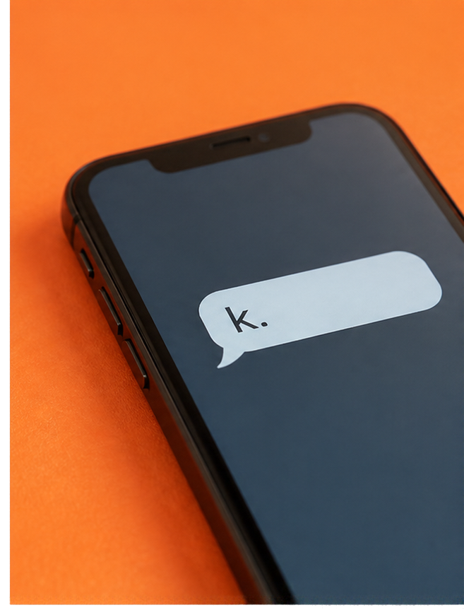


BIG QUESTION
How can our online words land differently than we intended?
“k.”
Someone replies with only
WHAT ARE TWO WAYS THAT COULD FEEL?
1
It could feel
2
It could feel
dismissive.
like no interest.
You may pass.
Mr. Fung | Grade 4 Tech.

Slide 3


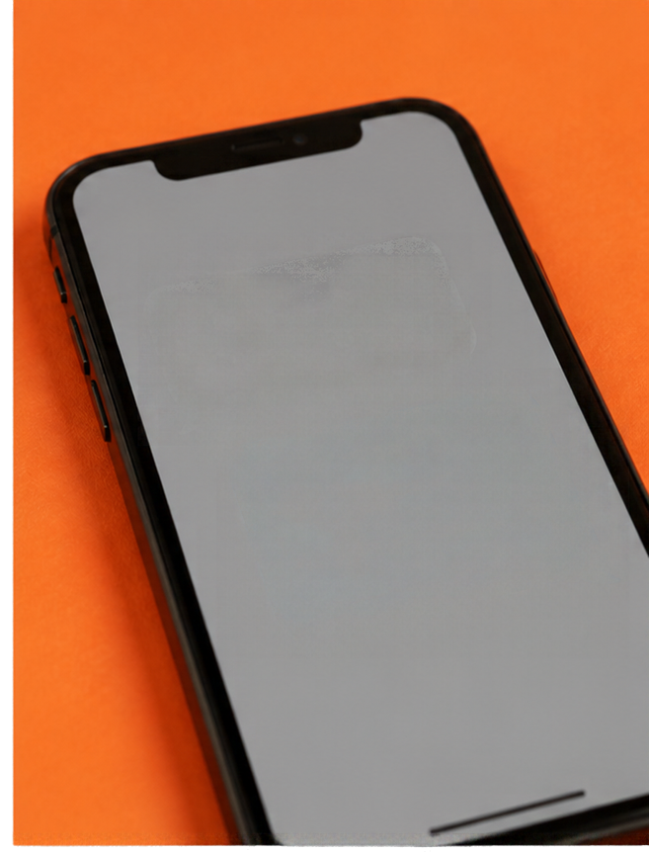









BIG QUESTION
Intent and impact
Nice goal.
For a beginner.
can differ
Nice goal.
That was
a strong shot.
INTENT
IMPACT
what you
meant
how the other
person understood it
EXAMPLE THAT MISFIRES
REVISE TO BE CLEAR AND KIND
“Nice goal. For a beginner.”
“Nice goal. That was
a strong shot.”
Read it as if you did not know the sender. If it could hurt, revise it.
Mr. Fung | Grade 4 Tech.

Slide 4

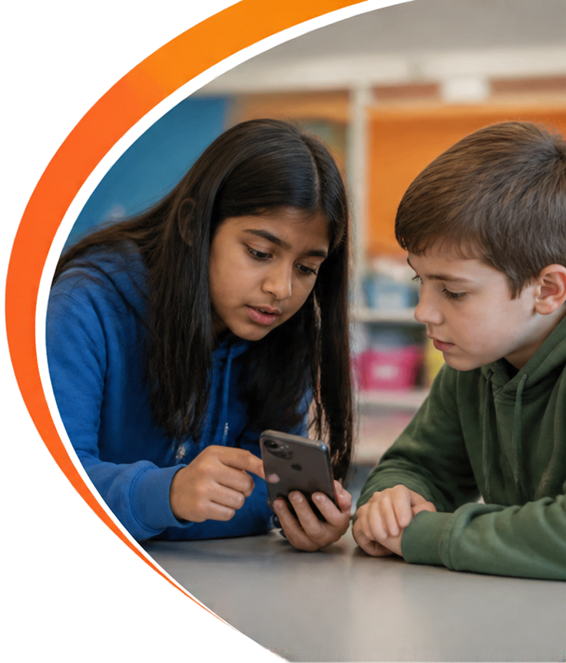





TRY IT TOGETHER
Noor sends. Ellis leaves.
Nice goal.
For a beginner.
Ellis left
the chat.
k.
After the game
Ten minutes later
1
2
3
What Noor
How Ellis
A better
meant.
felt.
message.
Think first. Then talk.
Mr. Fung | Grade 4 Tech.

Slide 5







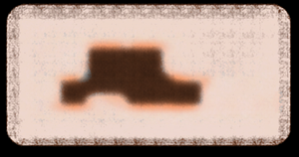





TALK ABOUT IT
How we say it
changes how it lands
1
WHAT MIGHT
NOOR HAVE MEANT?
2
HOW MIGHT
ELLIS HAVE UNDERSTOOD IT?
3
WHAT COULD
NOOR SEND
INSTEAD?
You are new
and not really good.
Then: “I do not care.”
That feels cold
and dismissive.
“Nice goal.
That shot was
strong.”
Later: “Sorry, ‘k’ sounded cold.”
A revision that still uses “beginner” as an insult is not there yet.
Mr. Fung | Grade 4 Tech.

Slide 6



EXIT CHECK
Make sure your message is kind—before you send.
Is this something I’d be happy to receive?
Impact can be different from intent.
Online, there is no face or voice.
Read it as the receiver.
If it could hurt, revise it.
Mr. Fung | Grade 4 Tech.

