Slide 1






Grade 4 Tech – Lesson 05 – A fair ...
A FAIR
GROUP
CHAT
Grade 4 Tech | Kind communication · Teacher-led 30 min · Pass allowed · Priya/Sam/Ari/Jules
Idea attribution: https://www.commonsense.org/education/digital-literacy/group-chat-dynamics
Mr. Fung | Grade 4 Tech

Slide 2






Grade 4 Tech - Lesson 05 - A fair ...
BIG
QUESTION
How can we be a good friend
when a group leaves someone out?
Can you hurt someone in a group
chat without using a mean word?
You may pass.
Use made-up examples only.
Mr. Fung | Grade 4 Tech

Slide 3

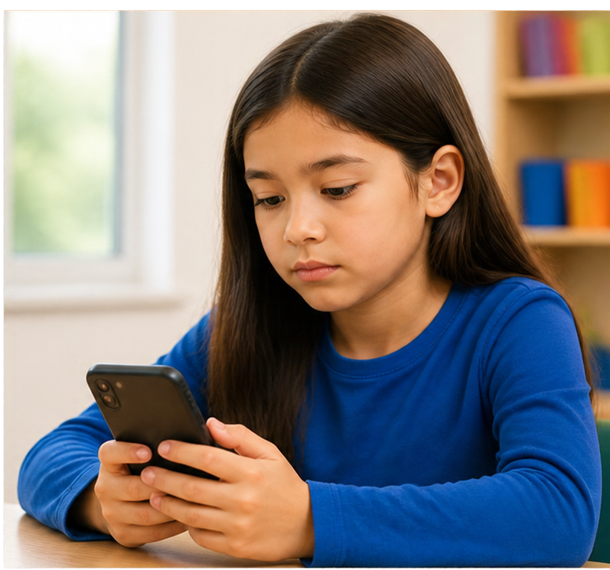




Grade 4 Tech – Lesson 05 – A fair ...
LEAVING
SOMEONE
UT
CAN HURT
Group chats feel public and fast.
Add the person. Check in face to face.
Do not pass on a private message.
Tell a trusted adult if unsure.
Mr. Fung | Grade 4 Tech

Slide 4






Grade 4 Tech – Lesson 05 – A fair ...
TRY IT
TOGETHER
How might Priya feel?
What could Sam do today?
What would make it worse?
Mr. Fung | Grade 4 Tech

Slide 5






Grade 4 Tech - Lesson 05 - A fair ...
TALK
ABOUT IT
How might Priya feel if this continues?
What can Sam do today?
What would make it worse?
Leaving someone out hurts,
even with no mean word.
Mr. Fung | Grade 4 Tech

Slide 6





Grade 4 Tech - Lesson 05 - A fair ...
EXIT
CHECK
What is one move that helps Priya,
and one move that spreads the hurt?
Add the person.
Check in face to face.
Tell a trusted adult.
Mr. Fung | Grade 4 Tech

