Slide 1





Grade 4 Tech
Kind communication
When the
group pushes
Teacher-led 30 min · Pass allowed
Idea attribution: https://www.commonsense.org/education/digital-literacy/peer-pressure-online
You may pass.
Mr. Fung | Grade 4 Tech

Slide 2



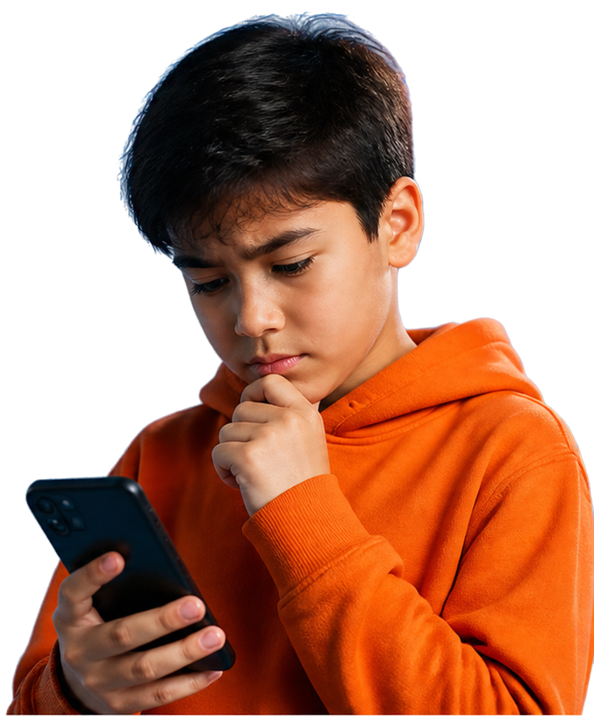


BIG QUESTION
What can we do when a group
pressures us online?
You may pass.
Use made-up examples only.
Mr. Fung | Grade 4 Tech

Slide 3















Name it, refuse it,
next step
1
Name it
Say what’s happening.
2
Refuse it
You don’t have to go along.
3
Choose a next step
Pick a safe action.
4
Tell a trusted adult if needed
Get help when it’s too much.
Mr. Fung | Grade 4 Tech

Slide 4






Try It
Together
Name the pressure
Practise a refuse line
Choose a next step
Mr. Fung | Grade 4 Tech

Slide 5


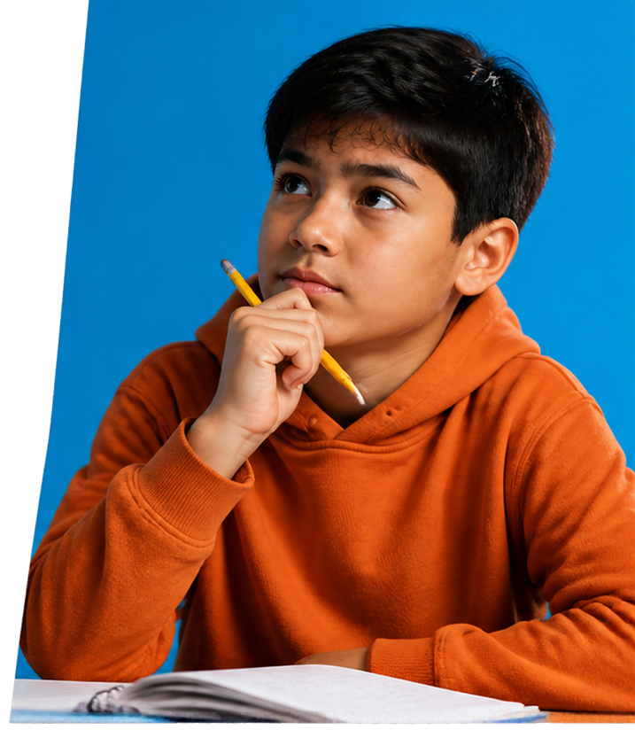







Talk About It
01
What was the pressure?
What’s a clear and kind
refuse line?
02
What next step helps
Devan stay safe?
03
Mr. Fung | Grade 4 Tech

Slide 6


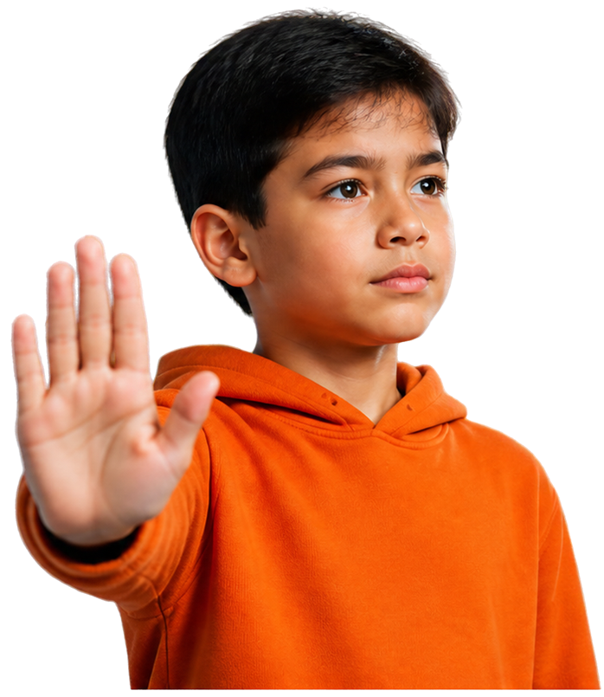



EXIT CHECK
When the group pushes, Devan can:
1
Refuse move
Say, “No, I’m not doing that.”
2
Next step
Walk away and get help
from a trusted adult.
Mr. Fung | Grade 4 Tech

