Slide 1


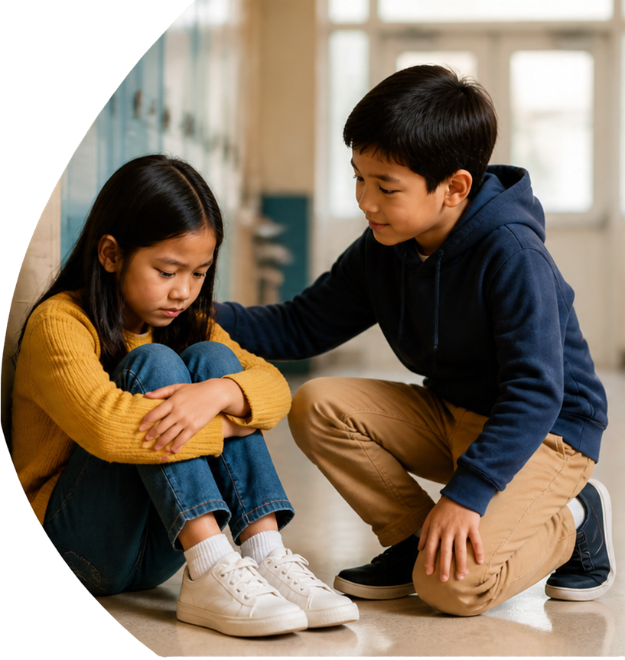




Grade 4 Tech - Lesson 07 -
Be the
person
who helps.
Standing up and repairing harm
Morgan / Ren
Teacher-led 30 minutes
Idea attribution: https://www.commonsense.org/education/digital-literacy/stand-up-to-cyberbullying
Mr. Fung
| Grade 4 Tech

Slide 2


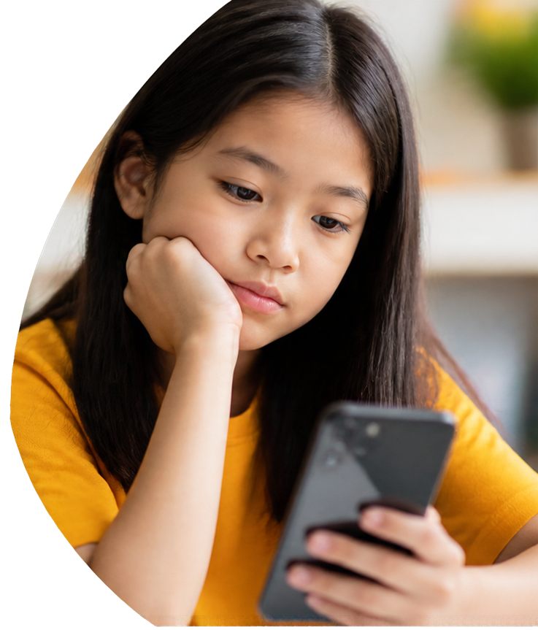




BIG QUESTION
What can a bystander do when meanness is digital?
You may pass.
Use made-up examples only.
Mr. Fung | Grade 4 Tech., Topic: Educational Grade 4 digital citizenship slides

Slide 3


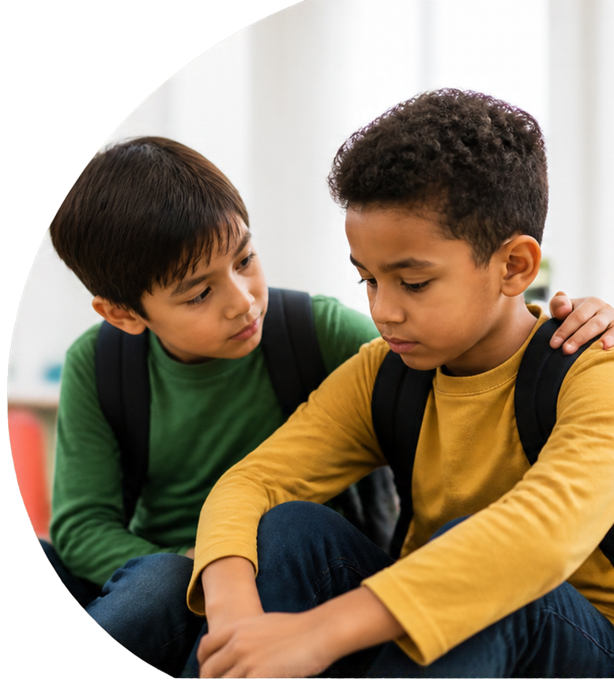








Four moves
a helper
can make
Check on the person
Refuse to join
Tell a trusted adult
Support repair
Mr. Fung | Grade 4 Tech., Topic: Educational Grade 4 digital citizenship slides

Slide 4







Try It
Together
Morgan needs help.
Ren sees what’s happening.
What could Ren do?
With your partner,
choose a helper move that fits.
Mr. Fung | Grade 4 Tech., Topic: Educational Grade 4 digital citizenship slides

Slide 5



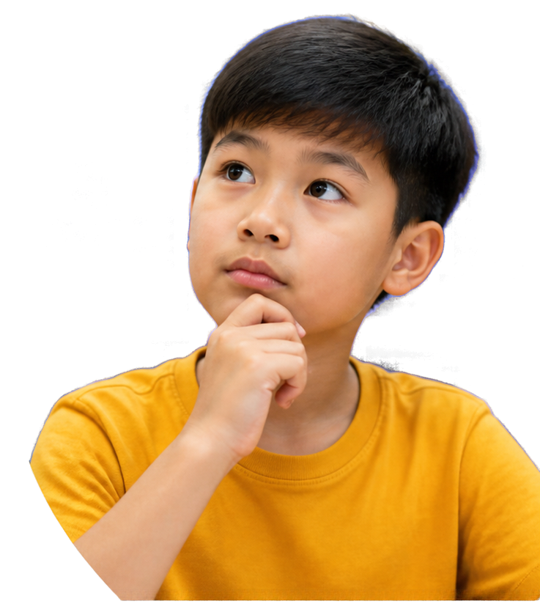










Talk
About It
Which helper move fits first?
What would make it worse?
Who is a trusted adult at school?
Mr. Fung | Grade 4 Tech., Topic: Educational Grade 4 digital citizenship slides

Slide 6










EXIT CHECK
Name one helper move
a bystander can use when meanness is digital.
Mr. Fung | Grade 4 Tech., Topic: Educational Grade 4 digital citizenship slides

