Slide 1










Grade 4 Tech
Mend the friendship
Standing up and repairing harm
Cam and Morgan
Teacher-led 30 minutes
Idea attribution: https://www.commonsense.org/education/digital-literacy/mending-friendships
Mr. Fung | Grade 4 Tech

Slide 2







BIG QUESTION
How can someone rebuild trust after hurting a friend online?
You may pass.
Use made-up examples only.
Grade 4 Tech – Lesson 09 – Mend the friendship.
Unit: Standing up and repa...
Mr. Fung | Grade 4 Tech

Slide 3



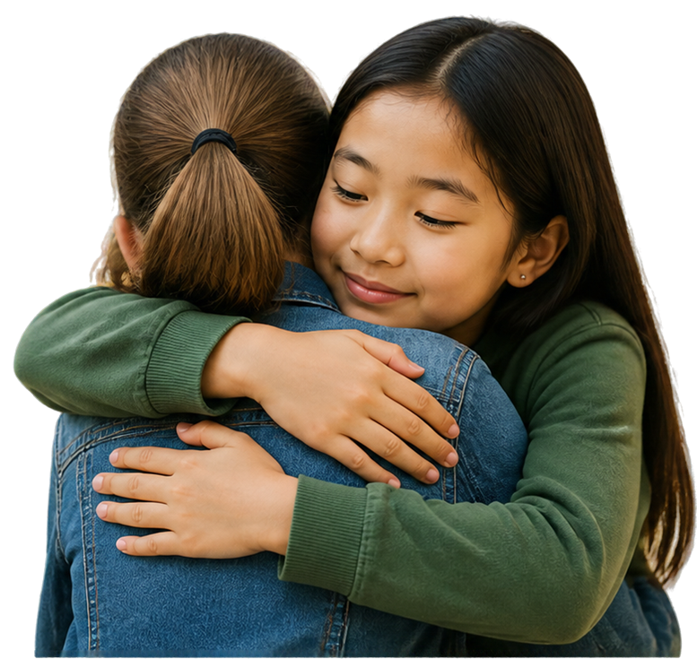




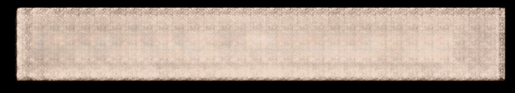









BIG IDEA
Four steps to
repair
1
Start with a sincere sorry
2
Name what you did and how it hurt
3
Make it right where you can
4
Give space and keep the change
Grade 4 Tech – Lesson 09 – Mend the friendship. Unit: Standing up and repa...
Mr. Fung | Grade 4 Tech

Slide 4







TRY IT TOGETHER
Practise a sincere repair path with your partner.
Read the scenario.
Follow the steps.
Work together to make it right.
Grade 4 Tech – Lesson 09 – Mend the friendship.
Unit: Standing up and repa...
Mr. Fung | Grade 4 Tech

Slide 5






Talk About It
Which
repair step is missing?
What
makes an apology sincere?
What
is not enough?
Grade 4 Tech – Lesson 09 – Mend the friendship.
Unit: Standing up and repa...
Mr. Fung | Grade 4 Tech

Slide 6


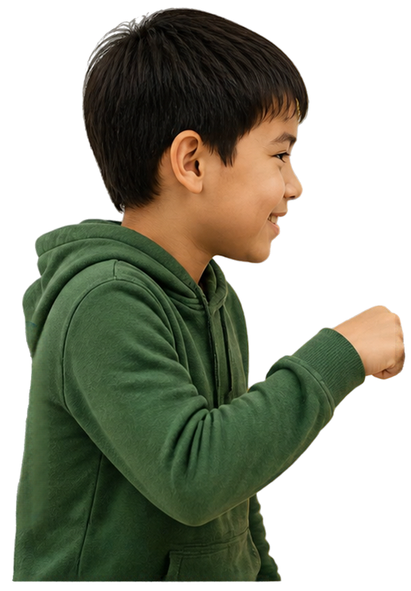
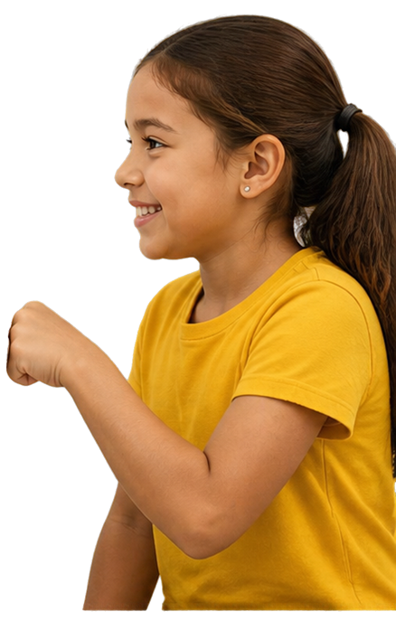




Exit Check
Two steps that help mend a friendship
after online hurt.
1
Say sorry
own what
you did
2
Make it right
show you
care and make a plan
Grade 4 Tech – Lesson 09 – Mend the friendship.
Unit: Standing up and repa...
Mr. Fung | Grade 4 Tech

