Slide 1



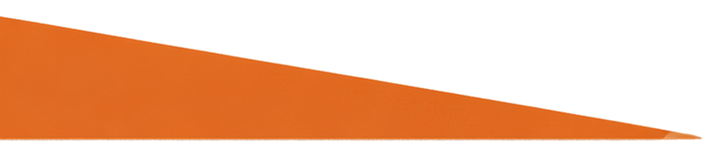
GRADE 4 TECH
Pause before you believe it.
Credible information and media
Teacher-led 30 minutes
Idea attribution: https://www.commonsense.org/education/digital-literacy/sift-for-sources
Mr. Fung | Grade 4 Tech

Slide 2





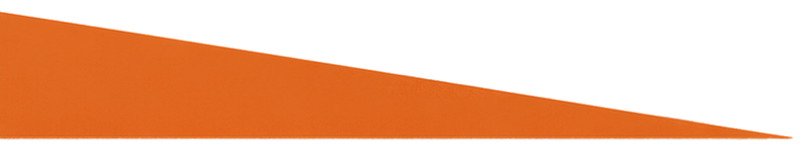
BIG QUESTION
How can we tell if an online claim is credible?
You may pass.
Use made-up examples only.
Mr. Fung | Grade 4 Tech., Presentation Locale: en-CA, Topic: Educational Grade 4 media literacy slides for Mr. Fung.

Slide 3


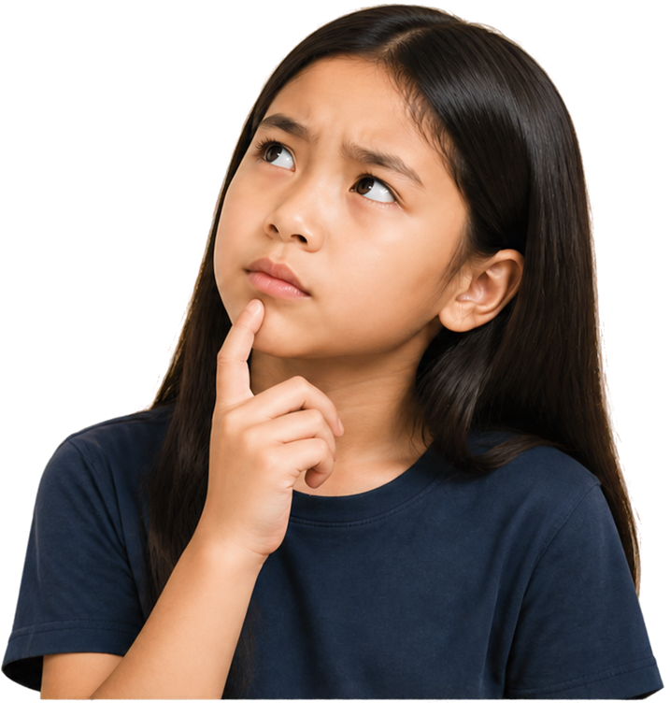







Check a claim before you
trust it
pause and think
who said it?
what proof do they give?
what does another source say?
Mr. Fung | Grade 4 Tech., Presentation Locale: en-CA, Topic: Educational Grade 4 media literacy slides for Mr. Fung.

Slide 4




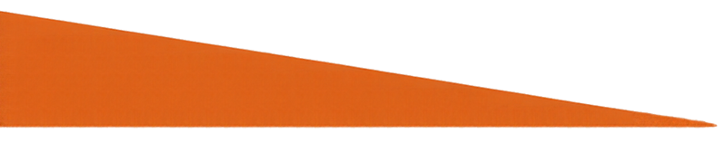
TRY IT TOGETHER
Check it together.
Avery says GameFox is the
best game ever.
What would you check before believing it?
Mr. Fung | Grade 4 Tech., Presentation Locale: en-CA, Topic: Educational Grade 4 media literacy slides for Mr. Fung.

Slide 5


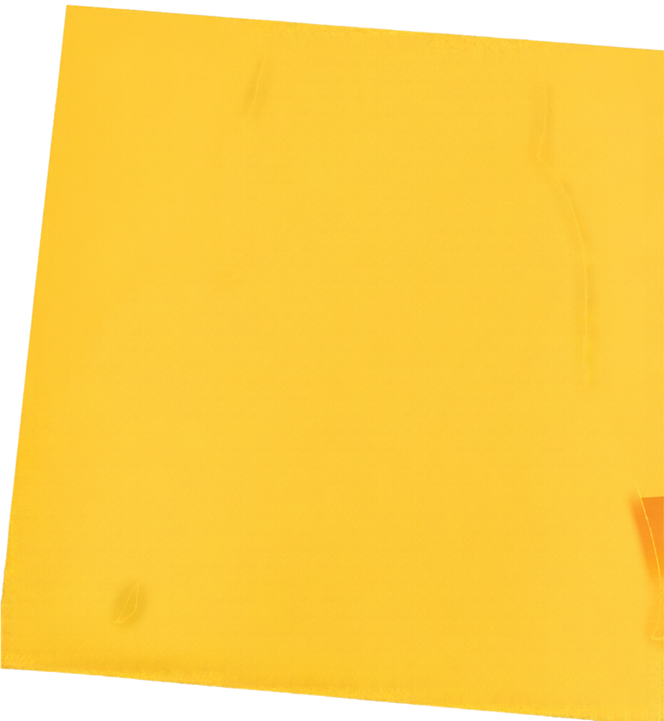

Talk About It
What makes this claim look believable?
What check would Avery try first?
What should Avery
not do yet?
Mr. Fung | Grade 4 Tech., Presentation Locale: en-CA, Topic: Educational Grade 4 media literacy slides for Mr. Fung.

Slide 6






EXIT CHECK
Avery’s check
before
believing:
Who made this claim?
Look for the author or source.
Decide if they know their topic.
Check if they have a reason you can trust.
Mr. Fung | Grade 4 Tech., Presentation Locale: en-CA, Topic: Educational Grade 4 media literacy slides for Mr. Fung.

