Slide 1


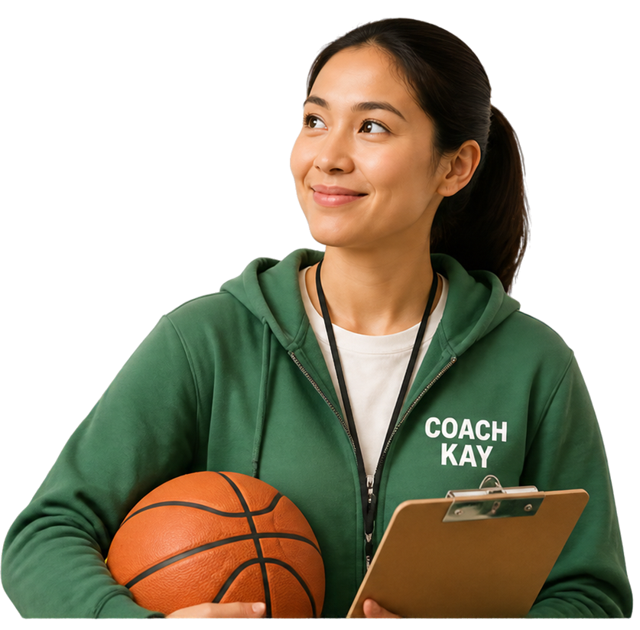

Grade 4 Tech - Lesson 13
Is this creator a role model?
Footprints and reputation · Pass allowed
Idea attribution: https://www.commonsense.org/education/digital-literacy/understanding-influencers
Mr. Fung | Grade 4 Tech

Slide 2




BIG QUESTION
Who influences us online, and are they positive role models?
It’s okay to take a pass.
Let’s think before we follow.
We’ll use made-up examples only.
Mr. Fung | Grade 4 Tech

Slide 3




Popular is
not the same as positive.
Some creators get lots of likes.
Look deeper at their choices.
Choose people who are respectful, honest, and kind to others.
Mr. Fung | Grade 4 Tech

Slide 4

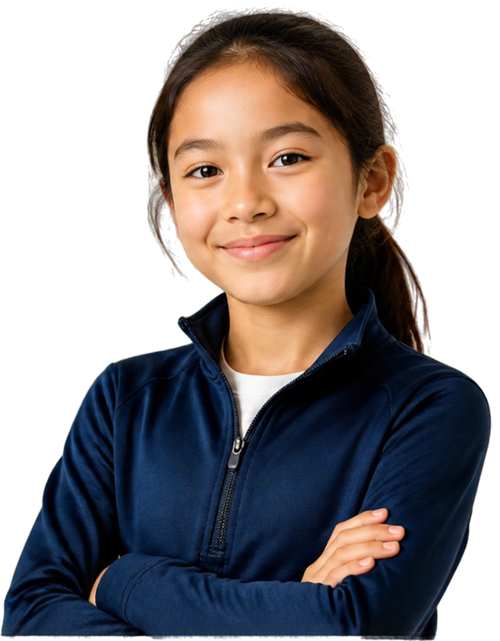



Try It Together
Look at Coach Kay.
With your partner, name:
one positive clue
one warning clue
Mr. Fung | Grade 4 Tech

Slide 5





TALK ABOUT IT
What makes Coach Kay
look like a role model?
What would make
you pause?
Who else can be a
positive influence offline?
Mr. Fung | Grade 4 Tech

Slide 6








Exit Check
Spot the difference between positive influence and popularity.
POSITIVE ROLE MODEL CLUE
POPULARITY CLUE
They encourage kindness and respect in their community.
They have a lot of followers or likes.
Mr. Fung | Grade 4 Tech

