Slide 1





GRADE 4 TECH
LESSON 15
Their reputation
is not ours to spend.
Idea attribution: https://www.commonsense.org/education/digital-literacy/online-reputations-our-responsibilities
Mr. Fung | Grade 4 Tech

Slide 2





BIG QUESTION
How can we
think about
others
when we share?
You may pass.
Use made-up examples only.
Mr. Fung | Grade 4 Tech

Slide 3




A reputation
is a
story
People talk about what they see and hear.
Ask before you share a photo or story
about someone.
Be kind. Protect someone else’s story.
Mr. Fung | Grade 4 Tech

Slide 4


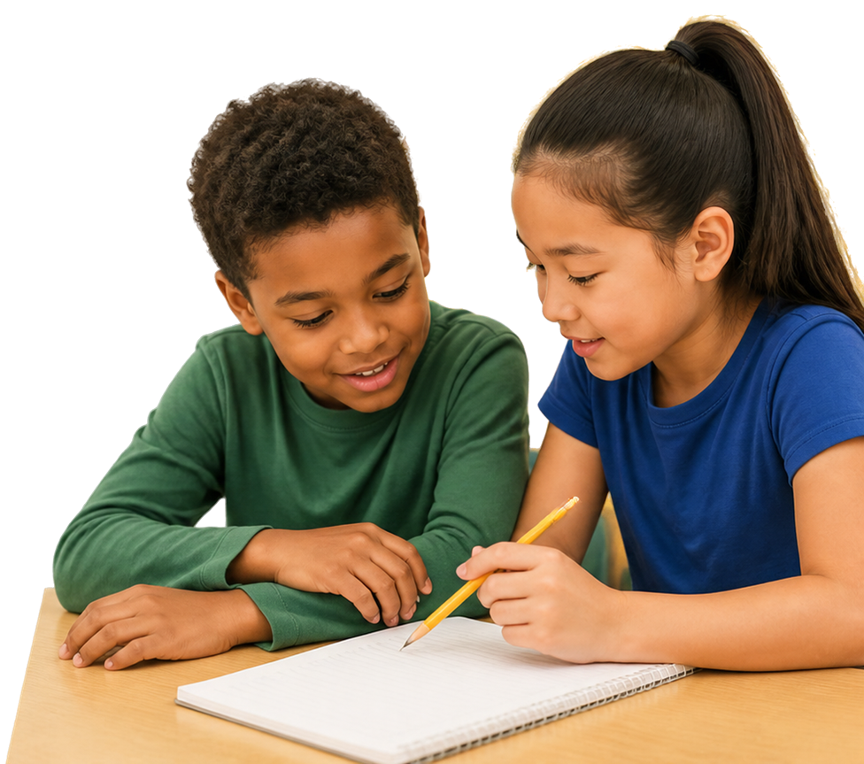


TRY IT TOGETHER
What should
Sasha do
before sharing?
Read the story about Sasha and her teammate.
Discuss what Sasha should do
first.
Mr. Fung | Grade 4 Tech

Slide 5





TALK ABOUT IT
Let’s respond with
kindness.
How might your teammate feel?
What is a kind next step?
What would make it worse?
Mr. Fung | Grade 4 Tech

Slide 6





EXIT CHECK
Name one way
to protect
someone else’s
reputation
before you share.
Mr. Fung | Grade 4 Tech

