Slide 1


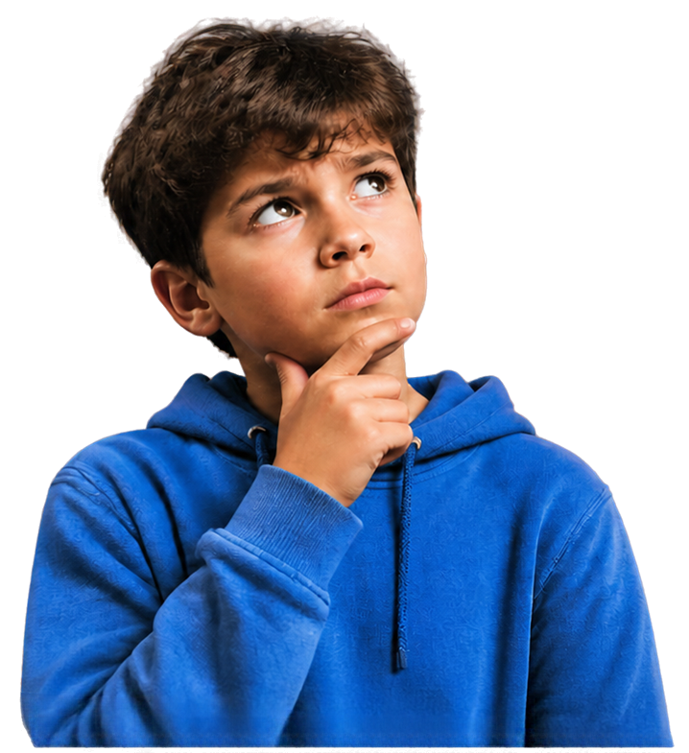

Spot the thinking trap
Grade 4 Tech | Healthy tech habits · Pass allowed
Idea attribution: https://www.commonsense.org/education/digital-literacy/spotting-thinking-traps
Fictional examples only
Mr. Fung | Grade 4 Tech

Slide 2



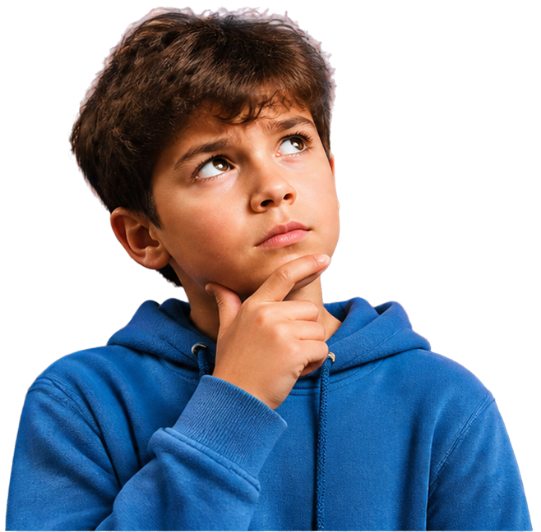
Maybe...
What if...
It must be...
Big Question
What are thinking traps?
Our brains make up answers
when we do not know.
Those guesses can make a small problem feel much bigger.
Notice the trap. Check the facts.
You may pass.
Mr. Fung | Grade 4 Tech
Topic: Educational digital citizenship lesson for a Grade 4 classroom

Slide 3


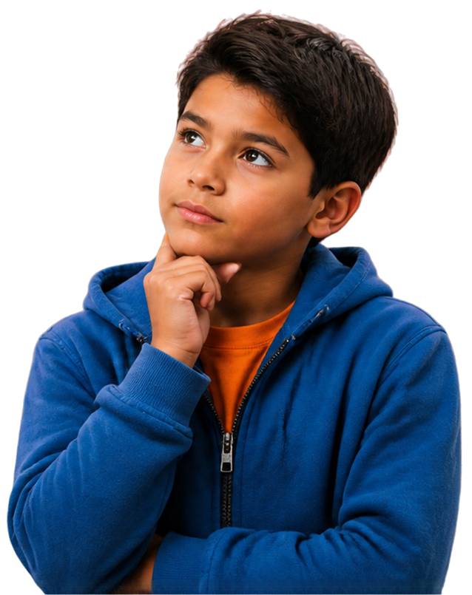





Thinking traps
feel true
A thinking trap makes a situation seem worse than the facts show.
Name the
unfair
thought
Pick a
fairer
thought
Choose one small
next step
I will be in trouble
forever.
The bus is late. I can tell an adult.
Talk to the adult when I get there.
Mr. Fung | Grade 4 Tech
Topic: Educational digital citizenship lesson for a Grade 4 classroom

Slide 4



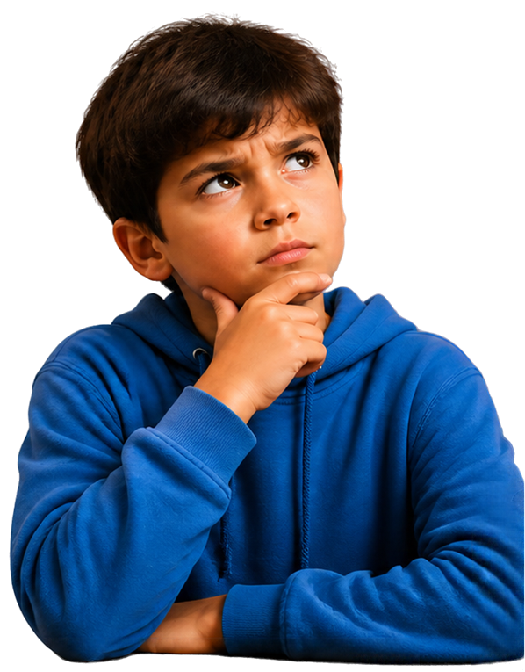
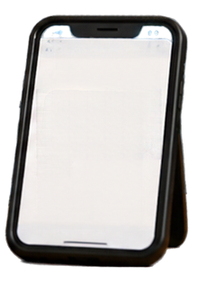

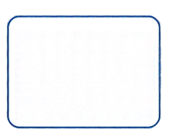




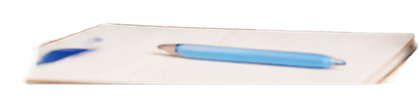
Try It Together
Did they see it?
Remy texts a friend, “Want to trade stickers tomorrow?”
Are they busy?
Ten minutes go by. No reply.
Maybe
later.
Remy thinks his friend ignored him.
But his friend is at supper.
Find the unfair thought.
Choose a fairer thought.
Pick one calm next step.
THINK
CHOOSE
ACT
Pause.
Look closer.
Pick a fairer thought.
Take one calm next step.
Want to trade stickers tomorrow?
Sent
Think first. Then talk.
Mr. Fung | Grade 4 Tech
Topic: Educational digital citizenship lesson for a Grade 4 classroom

Slide 5


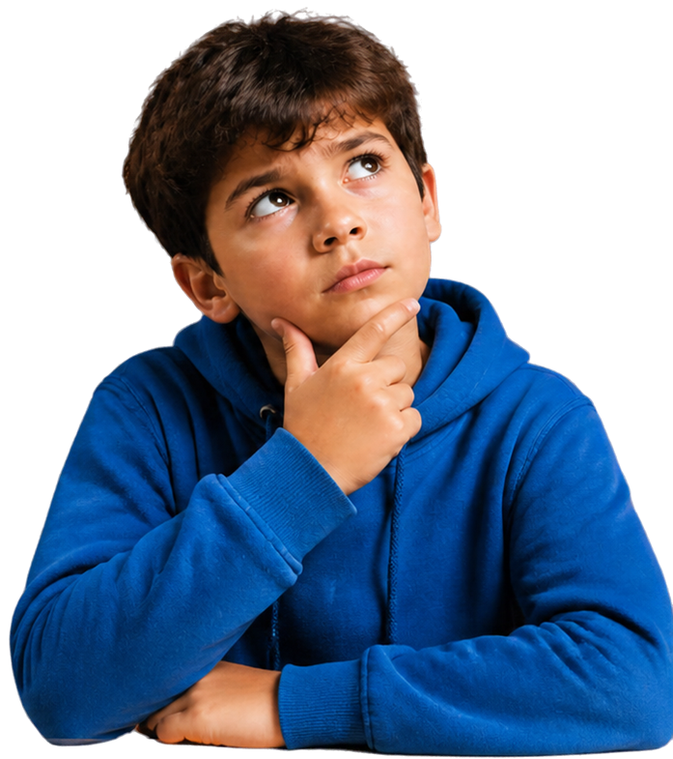








Talk About It
1
What is the unfair thought?
I think they do not care.
2
What is a fairer thought?
They might be busy.
One quiet chat is not the whole friendship.
3
What is one calm next step?
Ask at school tomorrow
or send one calm “No rush” later.
Mr. Fung | Grade 4 Tech
Topic: Educational digital citizenship lesson for a Grade 4 classroom

Slide 6








EXIT CHECK
Let’s check our thinking.
1
What is the thinking trap
in Remy’s story?
2
Name the unfair thought.
3
Pick a fairer thought.
4
Choose a small next step.
Think first. Then share aloud. You may pass.
Mr. Fung | Grade 4 Tech
Topic: Educational digital citizenship lesson for a Grade 4 classroom

