Slide 1





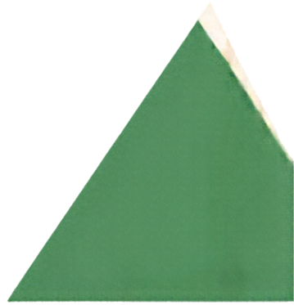
GRADE 4 TECH
Healthy tech habits
Swap
the thought
Turn unhelpful thoughts into
kinder, smarter choices.
Oral practice only. Not the Brain Battle card game.
Idea attribution: https://www.commonsense.org/education/digital-literacy/brain-battle-game
Mr. Fung | Grade 4 Tech

Slide 2




BIG QUESTION
How can we practise a
fairer thought?
It’s okay to pass.
Use made-up examples.
Think it. Say it. Check it.
Mr. Fung | Grade 4 Tech

Slide 3









Swap a trap
for a
fairer thought
A fairer thought can still
admit disappointment.
It does not jump to
always or nobody.
Practise aloud.
Mr. Fung | Grade 4 Tech

Slide 4





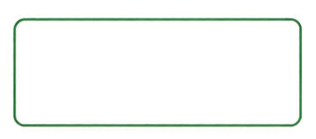


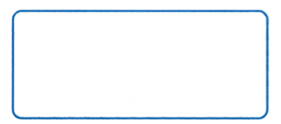



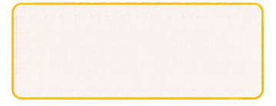

Try It Together
Swap each trap for a fairer thought.
I have to reply
right away.
I can take my time and choose.
Everyone online
is better than me.
People show highlights, not everything.
If I stop playing,
I’ll miss out.
I can step away
and still be included.
Mr. Fung | Grade 4 Tech

Slide 5




TALK ABOUT IT
Which swap feels real,
not just
perfect?
Which swap still sounds believable?
Which swap is too fake-happy?
What feeling stayed honest?
Mr. Fung | Grade 4 Tech

Slide 6

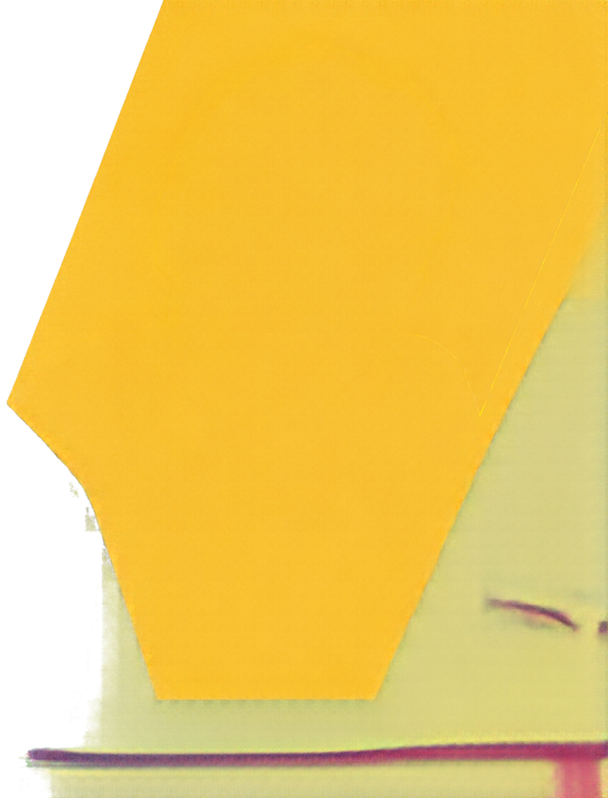



EXIT CHECK
Swap one
thinking trap
for a fairer thought you could actually
believe.
Mr. Fung | Grade 4 Tech

