Slide 1



GRADE 4 TECH
Habits that look after feelings
Idea attribution: https://www.commonsense.org/education/digital-literacy/healthy-tech-habits-our-feelings
Mr. Fung | Grade 4 Tech

Slide 2




BIG QUESTION
How can we
notice a feeling
about tech and
choose a small habit?
Pay attention to how you feel when you use tech.
Pick one small habit that supports your feelings.
You may pass.

Slide 3








Plan a pause while you are
calm
1
Notice how you feel
2
Choose a small habit
3
Practise before you need it

Slide 4








TRY IT TOGETHER
Help Luca plan
a small habit
With your partner: look at Luca’s situation.
Name the feeling and choose one small habit
he can plan.
01
What feeling might Luca
be having?
02
What is one small habit
Luca can plan?

Slide 5
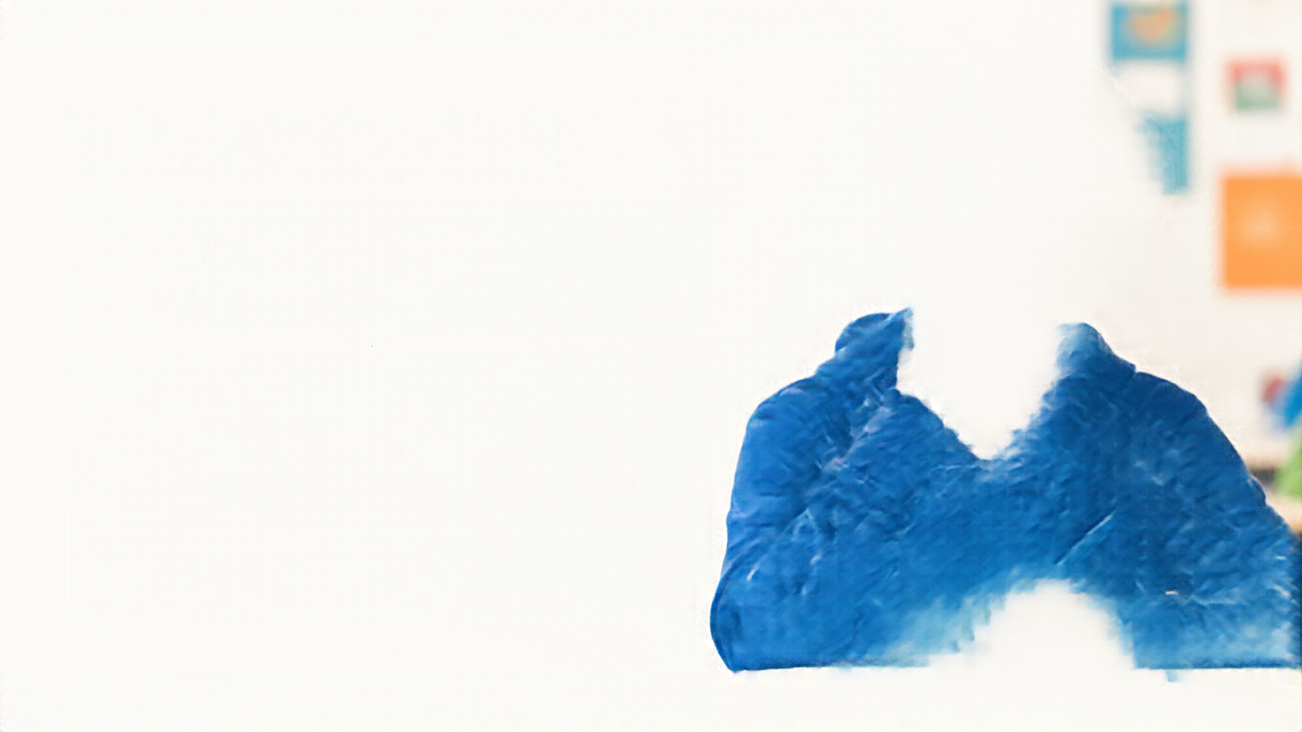










Talk About It
01
What feeling did
Luca notice?
02
Which habit fits?
03
When should Luca
practise it?

Slide 6







EXIT CHECK
Name one feeling about tech and one small habit that looks after it.
ONE FEELING
ONE HABIT
I feel
I can

