Slide 1



Reproducible Open Benchmarks
for Data Analysis Platform
Kyle Cranmer, Irina Espejo,
Sebastian Macaluso, Heiko Mueller
New York University
Shih-Chieh Hsu, Aaron Maritz,
Ajay Rawat, Cha Suaysom
University of Washington

Slide 2
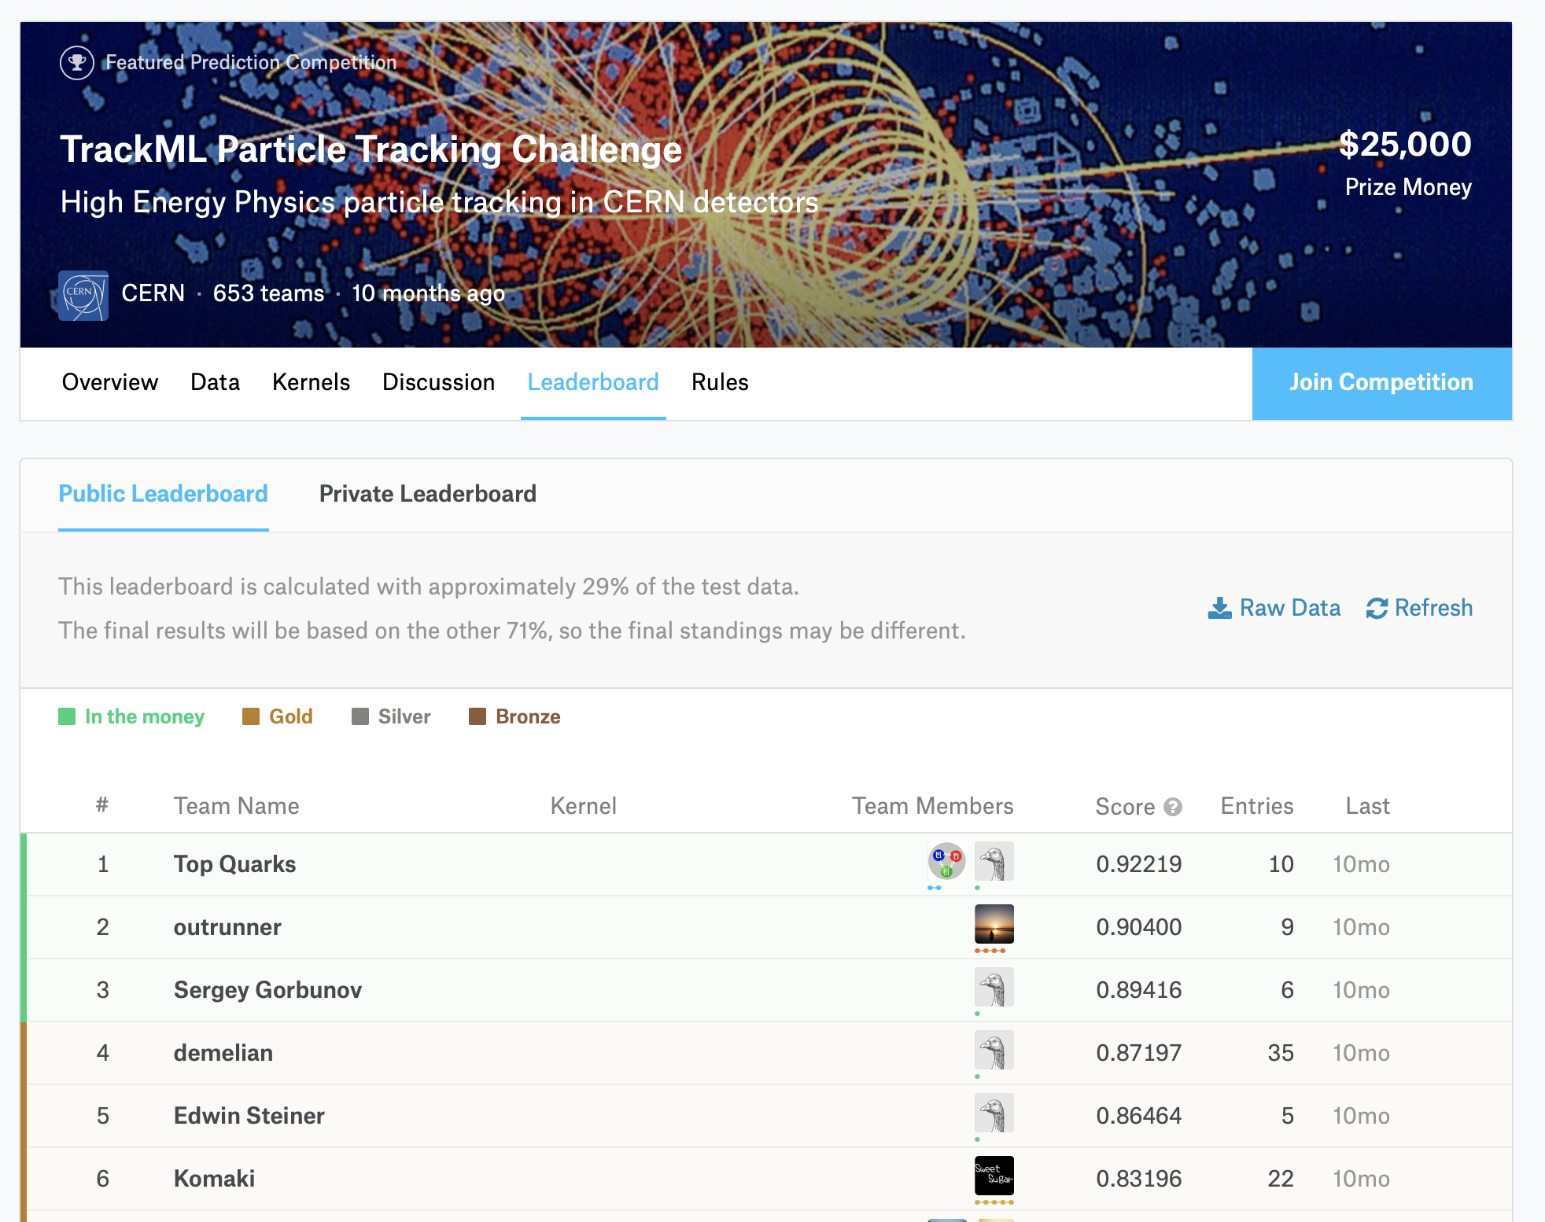
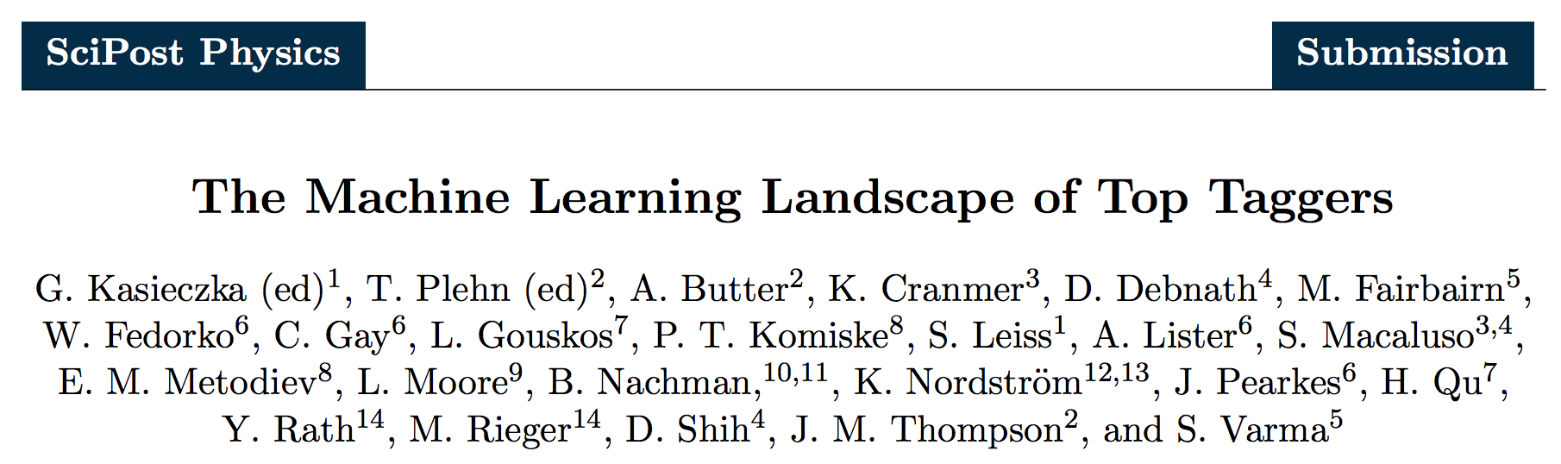
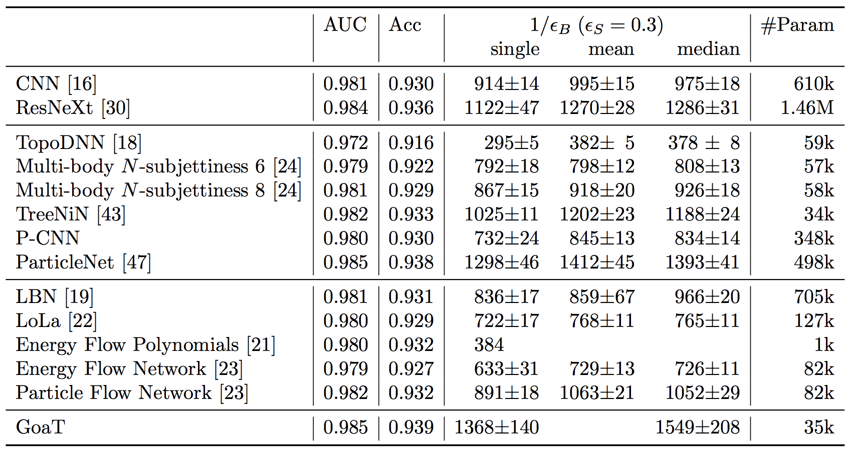
Benchmarks & Challenges

Slide 3

Reproducible Open Benchmarks Platform
Exploratory work for enabling such community benchmarks.
Components and Actors in ROB
Benchmark workflow defined by coordinator along with input data.
Users provide code (e.g. docker containers) that satisfy workflow stages, input parameters, and input data (file upload).
Back-end processes workflows and evaluates metrics (powered for example by REANA).
Front-end to collect input and display results.
Front-End
ROB
Back-End

Slide 4
Benchmark Workflow Example
Input
Data
test_jets.pkl
Workflow Templates
Coordinator defines structure of the workflow:
Static input data
User-provided input data
Intermediate output data
Implementation for static workflow stages
Default implementation for variable workflow stages
Variable (user-provided) workflow stages
Preprocessing
Stage
Default Preprocessor
processed_jets.pkl
Tagger
yProbTrue.pkl
Result
Evaluation
Task
results.json
Overall Evaluation
Task

Slide 5

Benchmark Workflow Example (cont.)
Input
Data
Input
Data
Input
Data
Benchmark Participants
Users create different instances of the workflow by providing implementation for variable workflow stages (and variable input data).
User 1
User 2
User 3
Default
Preprocessor
Default
Preprocessor
Preprocessor 1
Tagger 1
Tagger 2
Tagger 3
Result
Evaluation
Task
Result
Evaluation
Task
Result
Evaluation
Task
Overall
Evaluation
Task
Overall Evaluation
Task
Overall Evaluation
Task

Slide 6
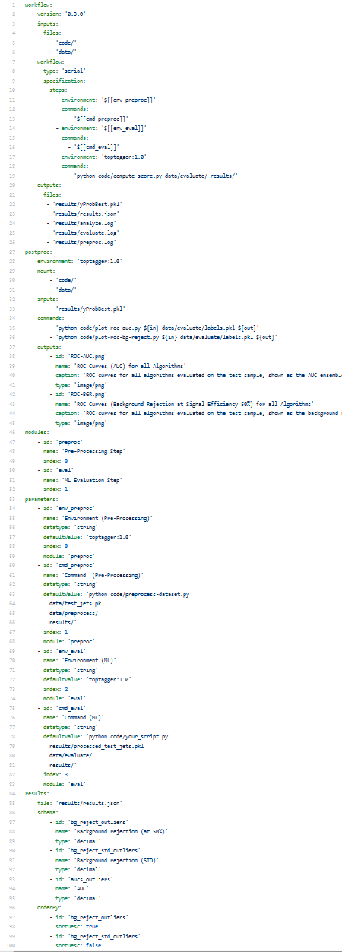
Workflow Templates
Components of Workflow Templates
Workflow specification (e.g. REANA serial workflow) with optional references to template parameters
Post-processing steps to evaluate overall performance (e.g. REANA serial workflow)
Declaration of template parameters (used by front-end for data input)
Specification of result schema to generate ‘leader board’.

Slide 7
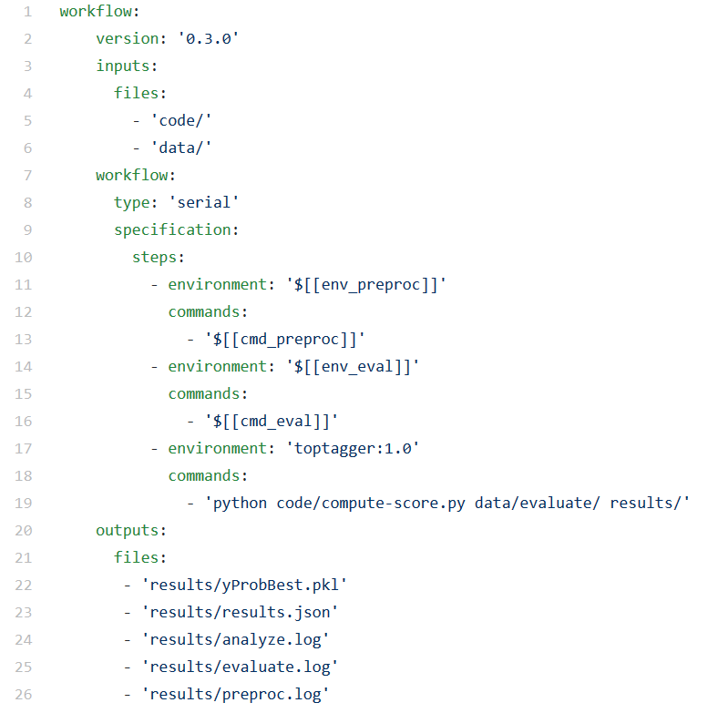
Workflow Templates (cont.)

Slide 8
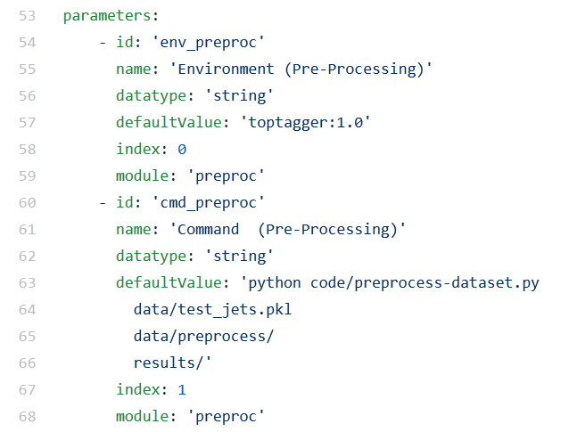
Workflow Templates (cont.)

Slide 9
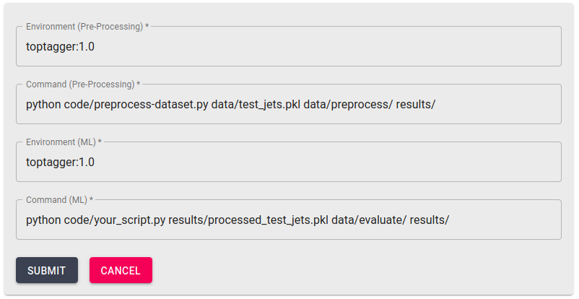
Workflow Templates (cont.)

Slide 10
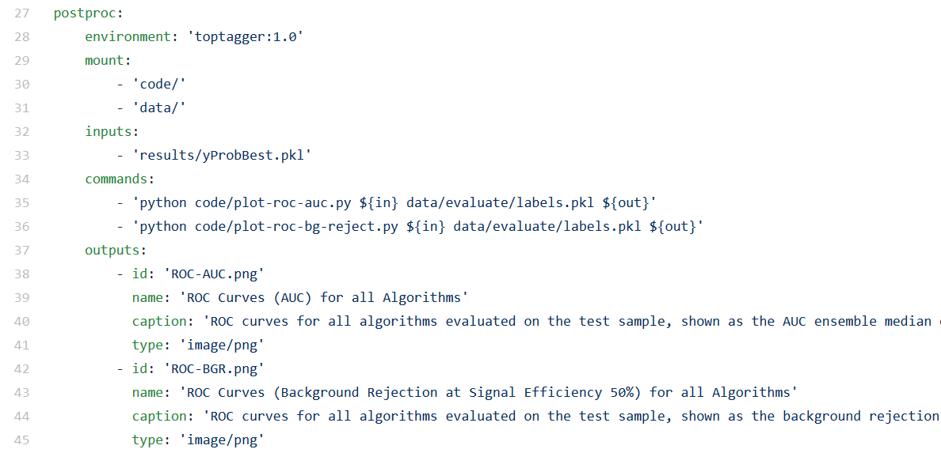
Workflow Templates (cont.)
Post-processing workflow to summarize overall results (e.g., generate plots)

Slide 11
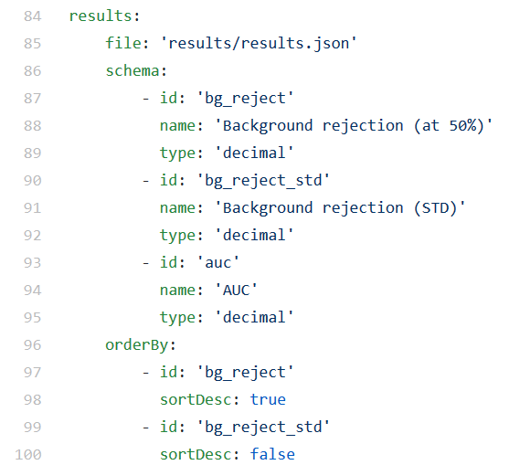
Workflow Templates (cont.)
Result schema to store benchmark results in database and to generate ranking

Slide 12
Demo

Slide 13
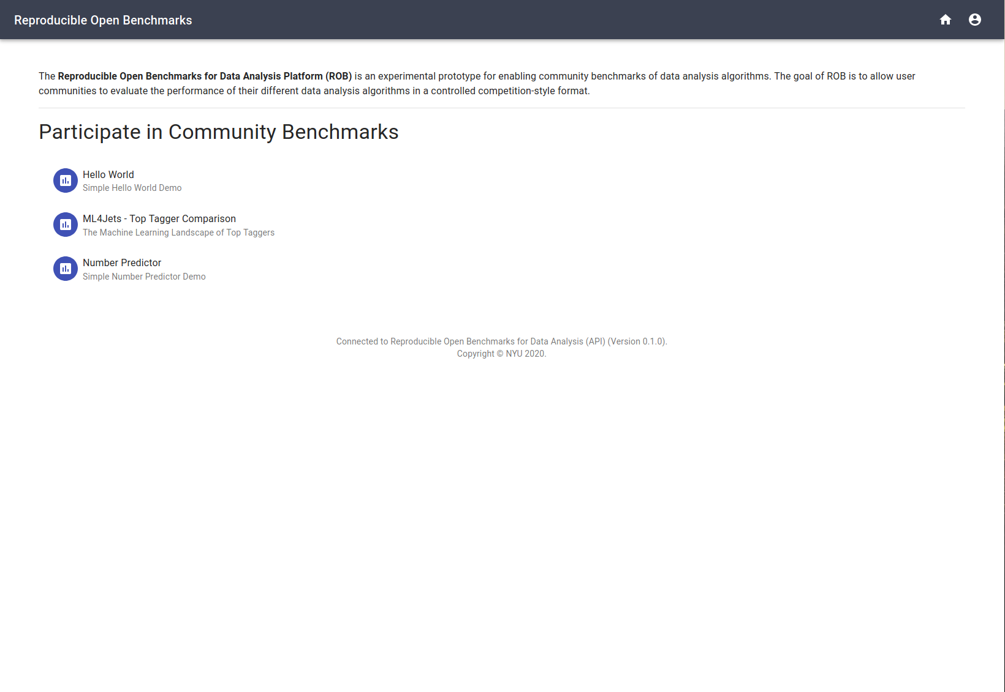

Slide 14
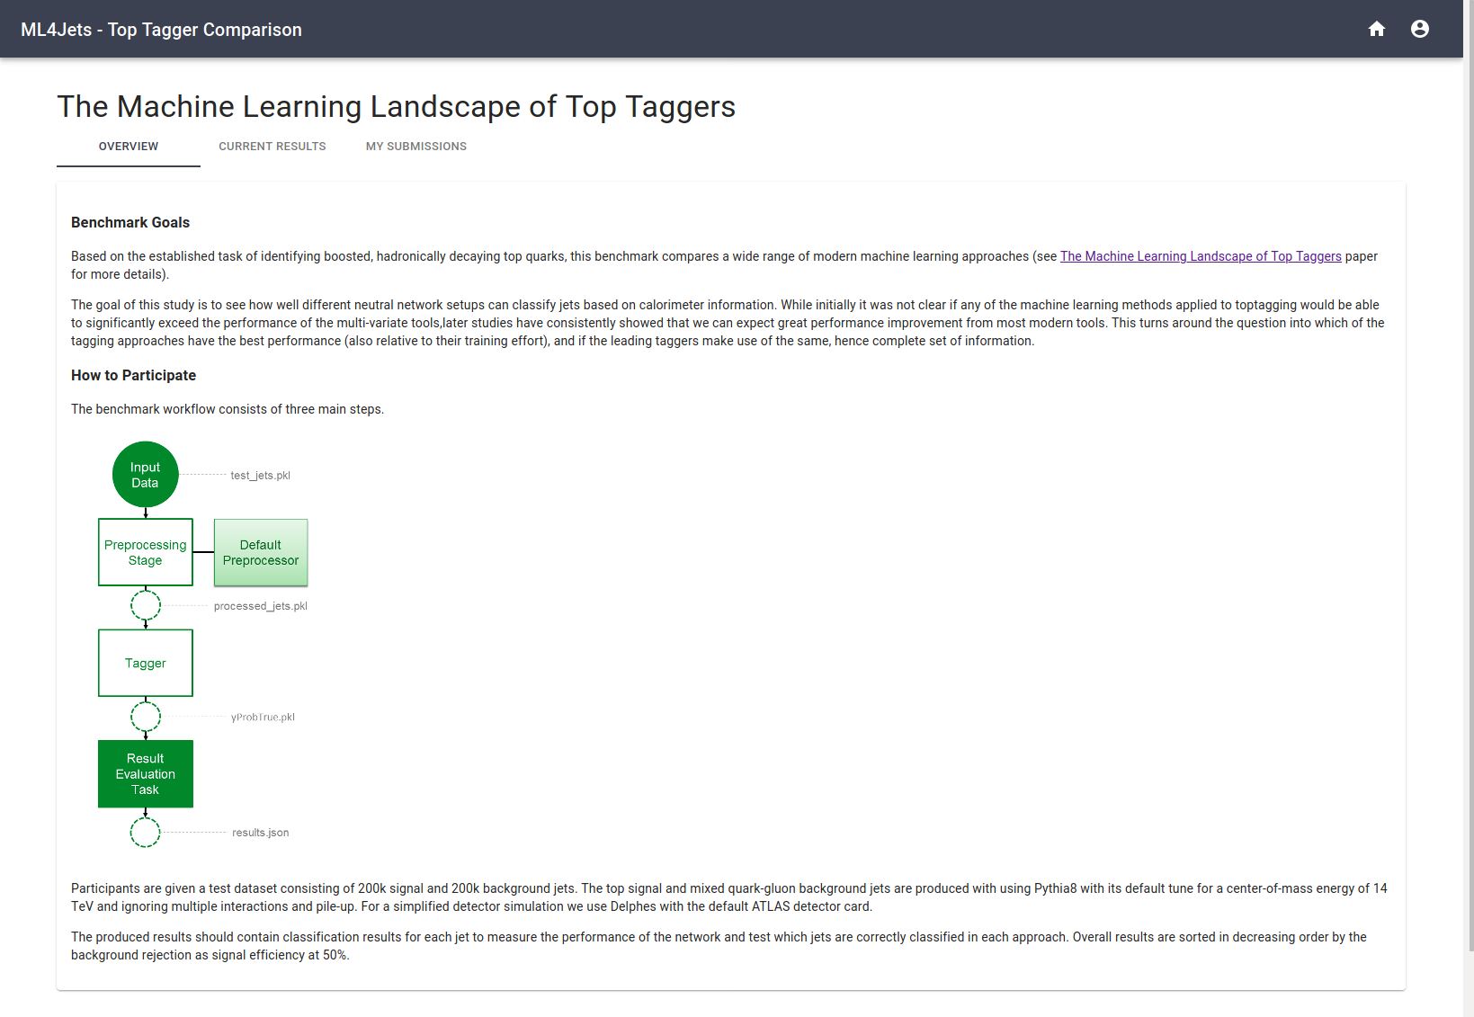

Slide 15
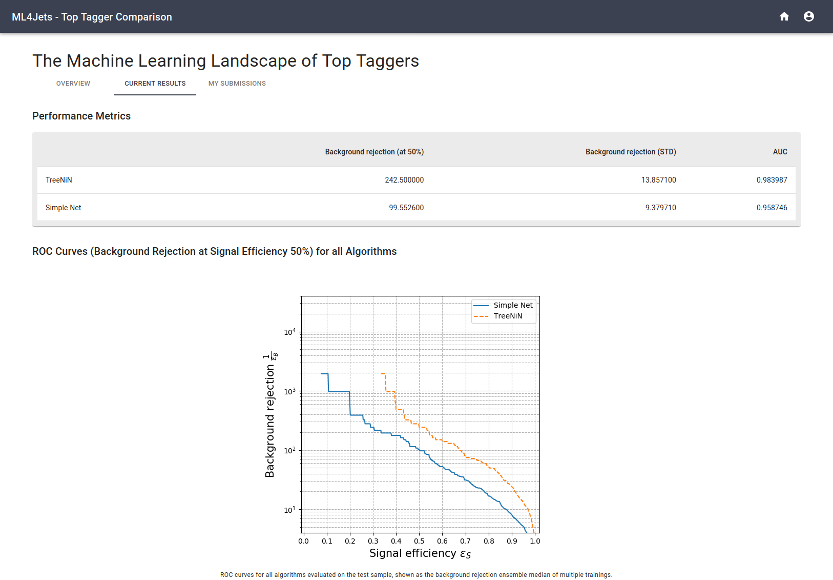

Slide 16
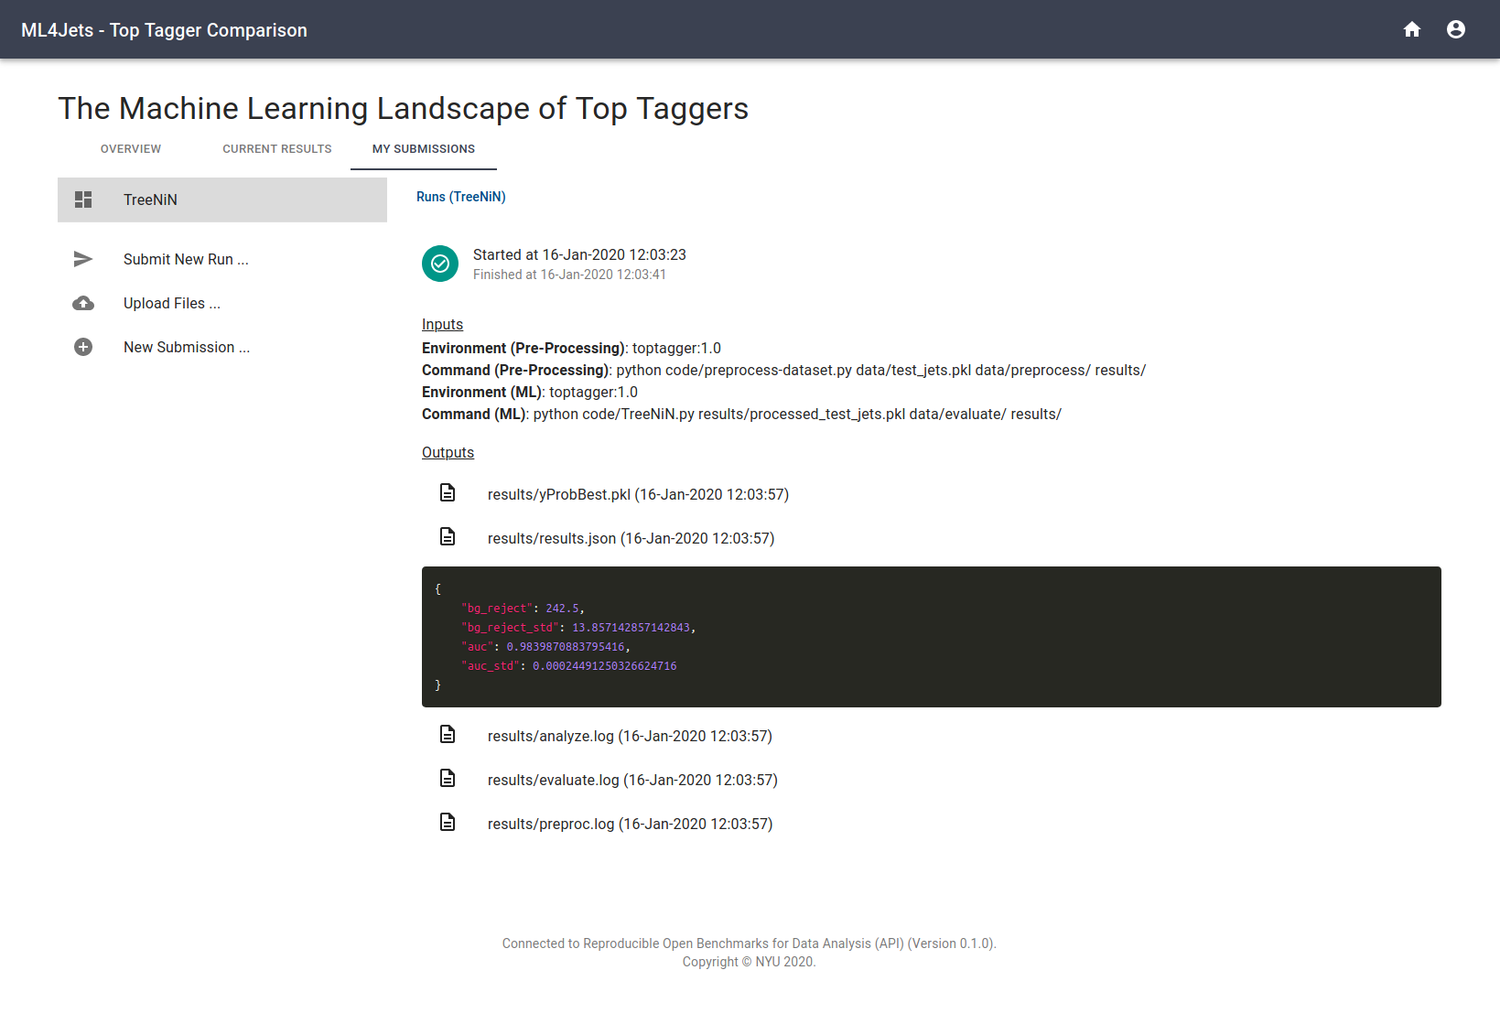

Slide 17
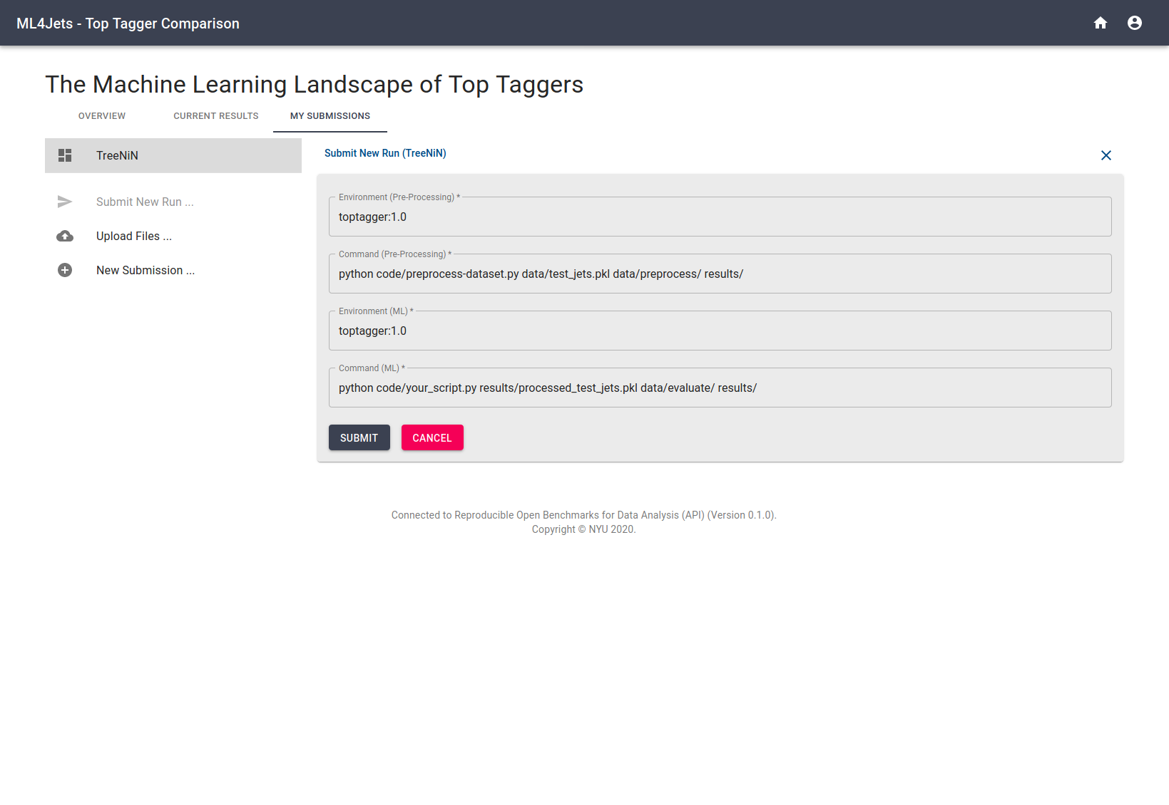

Slide 18
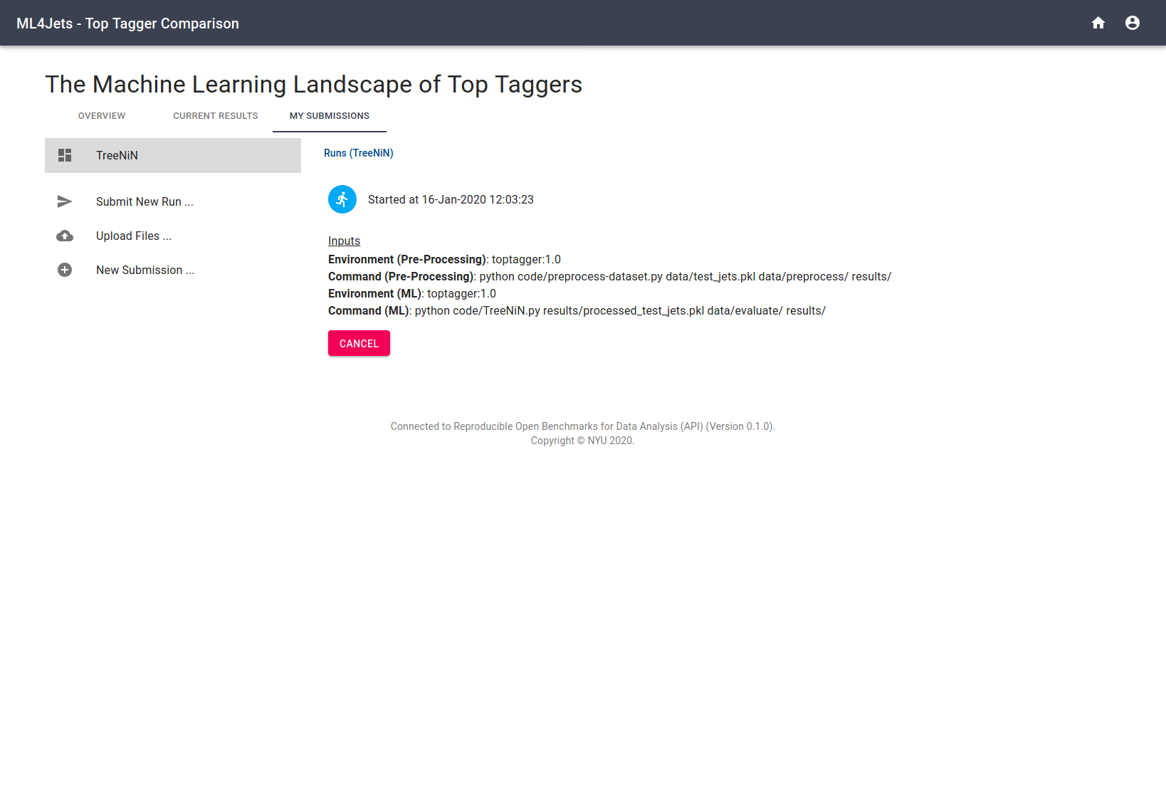

Slide 19
Continue …

Slide 20
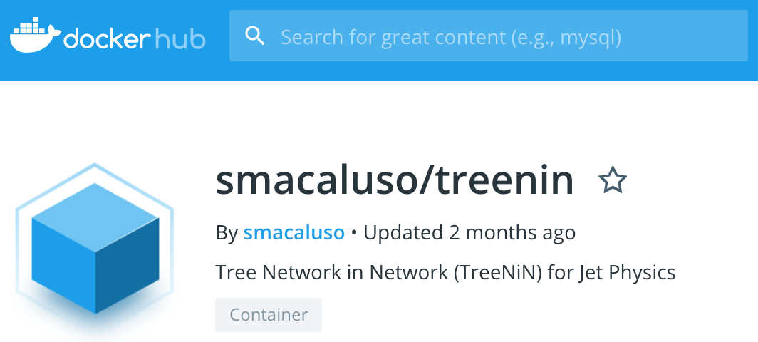
Ongoing and Future Work
(Re-)run competition using REANA as the backend
Full Yadage Workflow for TreeNiN
https://github.com/cha-suaysom/reana-demo-treenin
Docker Container
https://github.com/diana-hep/TreeNiN
https://hub.docker.com/r/smacaluso/treenin
Anyone else interested?
Code Repositories for ROB
https://github.com/scailfin/rob-core
https://github.com/scailfin/rob-webapi-flask
https://github.com/scailfin/rob-ui

Slide 21
Ongoing and Future Work (cont.)
User 3
Input
Data
New Data
Other applications …
Run provided model with different input data.
Compare different input dataset and models against each other (e.g. Standard Cortical Observer).
Apply different/additional downstream processing tasks to the model results.
User 1
User 2
Default
Preprocessor
Preprocessor 1
Tagger 1
Tagger 2
Tagger 3
Result
Evaluation
Task
Downstream
Processing
Task
Overall Evaluation
Task

