Slide 1
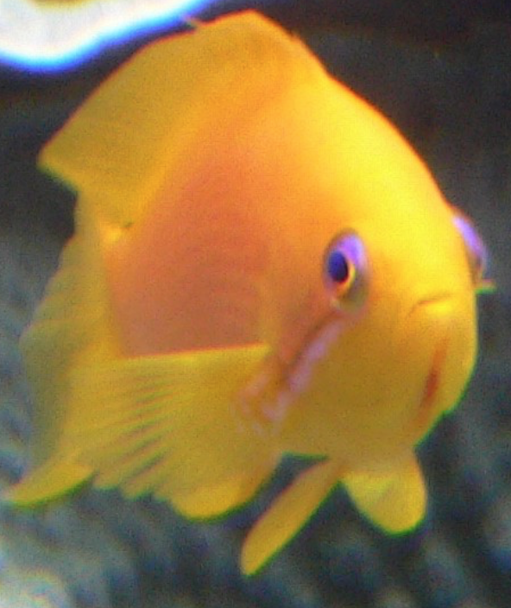

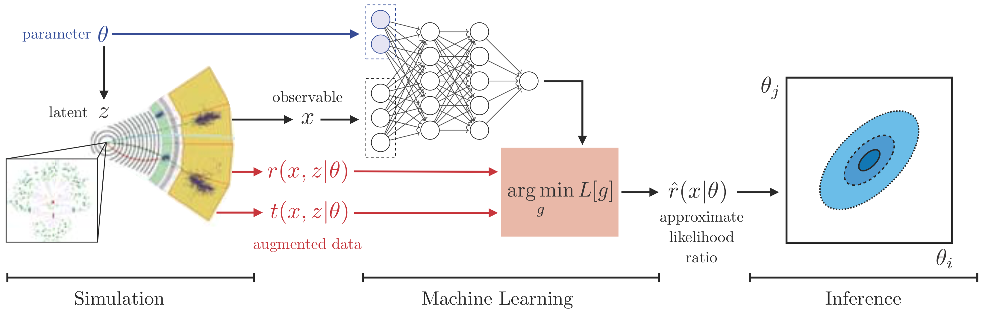
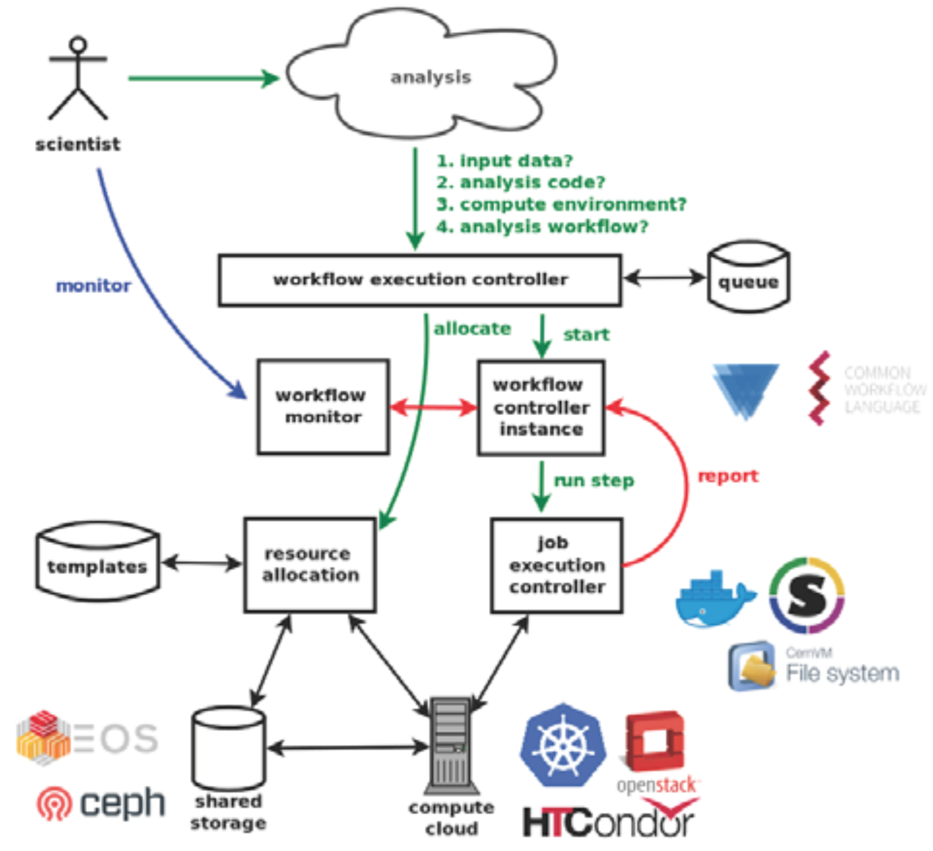



Scalable Cyberinfrastructure for Artificial Intelligence and Likelihood-Free Inference
Mark Neubauer
¹Department of Physics, University of Illinois at Urbana-Champaign, USA
²Department of Electrical and Computer Engineering, University of Illinois at Urbana-Champaign USA
³National Center for Supercomputing Applications, Urbana, IL USA
on behalf of the SCAILFIN Project Team
^{1,2,3}
scailfin.github.io
OAC-1841456
1841471
1841448
What is Artificial Intelligence?
What is Likelihood-Free Inference?
Systems that make decisions usually requiring a human level of expertise, possessing the qualities of intentionality, intelligence and adaptability (definitions vary)
Methods used to constrain parameters of a model by finding the values which yield simulated data that closely resembles the observed data (definitions vary)
Science Driver
LFI Methodology
Analysis of data from the Large Hadron Collider is the primary science driver, yet the technology is sufficiently generic to be applicable to other scientific efforts
Main Goal
Deploy AI and LFI methods and software using scalable cyberinfrastructure to be integrated into existing CI elements, such as the REANA system, to increase the discovery reach of data-intensive science
Catalyzing Convergent Research
The abstract LFI problem formulation has been demonstrated as the lingua franca for a diverse range of scientific problems
Current tools for many tasks are limited by a lack of scalability for data-intensive problems with computationally-intensive simulators
Tools will be designed to be scalable and immediately deployable on a diverse set of computing resources, including HPCs
Integrating common workflow languages to drive an optimization of ML components and to orchestrate large-scale workflows lowers the barrier-to-entry for researchers from other science domains
REANA system
The SCAILFIN Team
J. Bonham
B. Galewsky
D. Katz (co-PI)
M. Neubauer (PI)
K.-P.-H. Anampa
C. Kankel
M. Hildreth (PI)
K. Cranmer (PI)
I.-E. Morales
H. Mueller (co-PI)
NSF Large Facilities Workshop / April 2-4, 2019 / Austin, Texas, USA

