Slide 1
Reproducible Open Benchmarks
for Data Analysis
Heiko Mueller, Irina Espejo,
Kyle Cranmer and Sebastian Macaluso

Slide 2
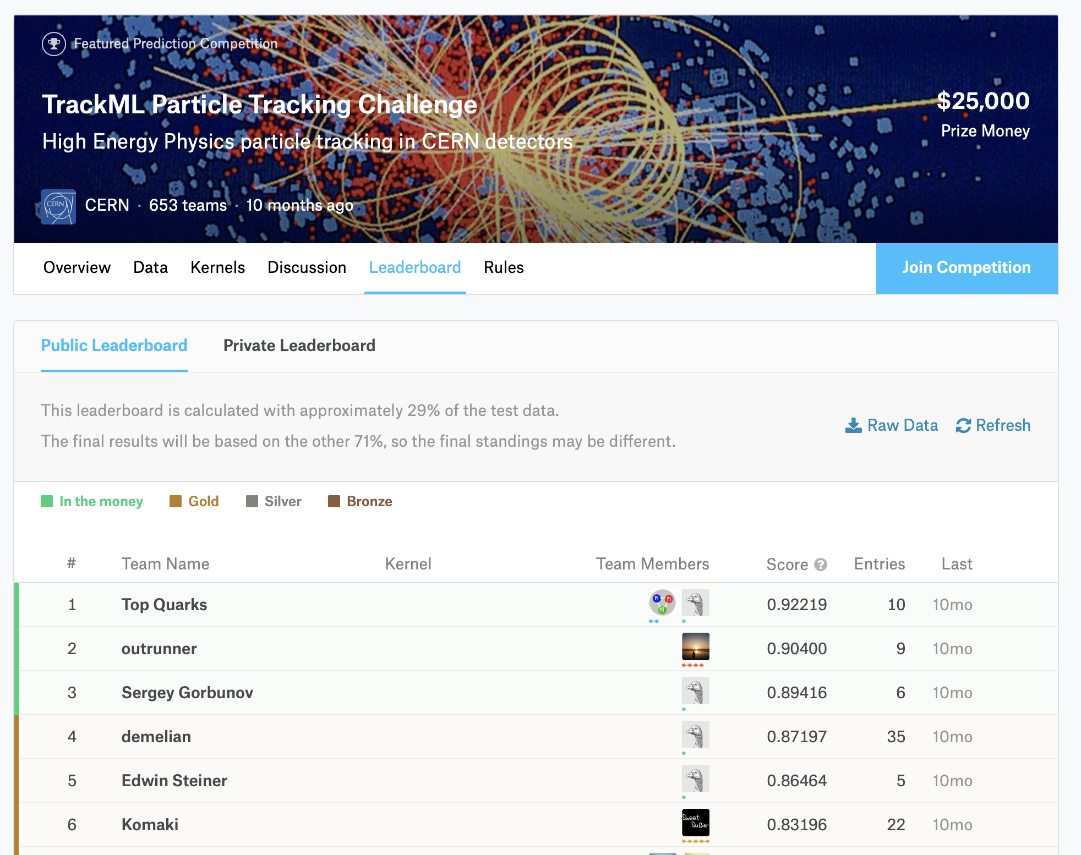
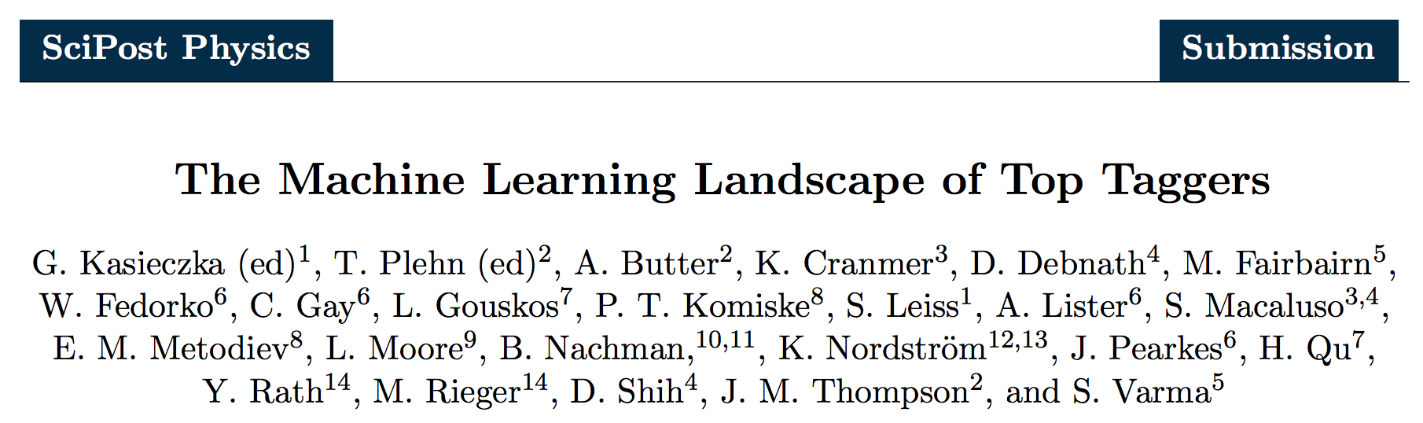
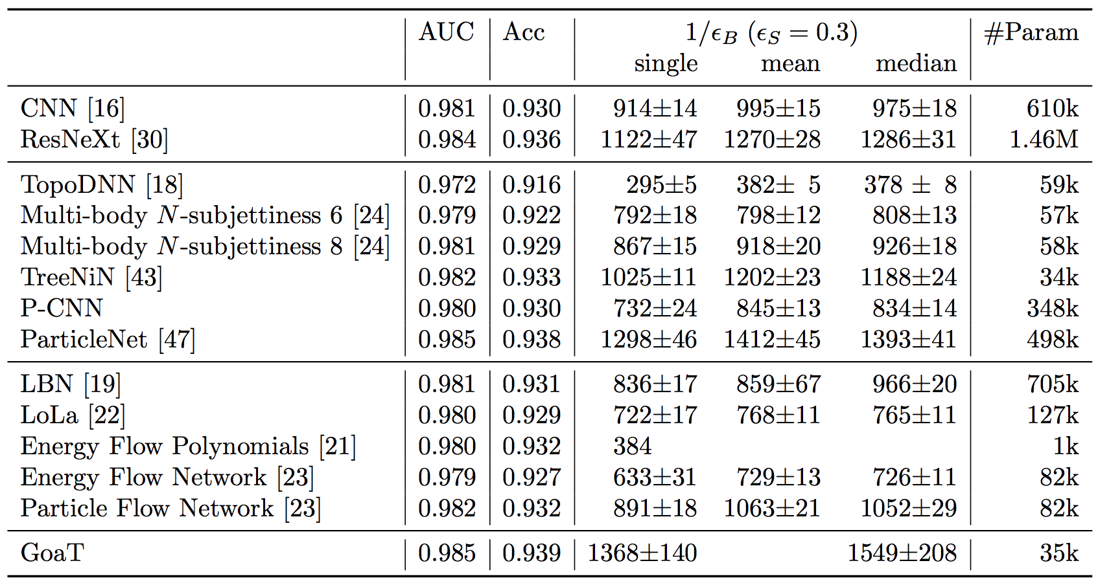
Benchmarks & Challenges

Slide 3

Reproducible Open Benchmarks Platform
Exploratory work for enabling such community benchmarks.
Components and Actors in ROB
Benchmark workflow defined by coordinator along with input data.
Users provide code (e.g. docker containers) that satisfy workflow stages, input parameters, and input data (file upload).
Back-end processes workflows and evaluates metrics (powered for example by REANA).
Front-end to collect input and display results.
Front-End
ROB
Back-End

Slide 4
Benchmark Workflow Example
Input
Data
Workflow Templates
Coordinator defines structure of the workflow:
Static input data
Implementation for static workflow stages
Default implementation for variable workflow stages
Variable (user-provided) workflow stages
User-provided input data
Preprocessing
Stage
Default Preprocessor
Tagger
Default
Tagger
Downstream
Analysis
Task
Evaluation
Task

Slide 5

Benchmark Workflow Example (cont.)
Input
Data
Input
Data
Input
Data
Benchmark Participants
Users create different instances of the workflow by providing implementation for variable workflow stages (and variable input data).
User 1
User 2
User 3
Default
Preprocessor
Default
Preprocessor
Preprocessor 1
Tagger 1
Tagger 2
Default
Tagger
Downstream
Analysis
Task 1
Downstream
Analysis
Task 2
Downstream
Analysis
Task 3
Evaluation
Task
Evaluation
Task
Evaluation
Task

Slide 6
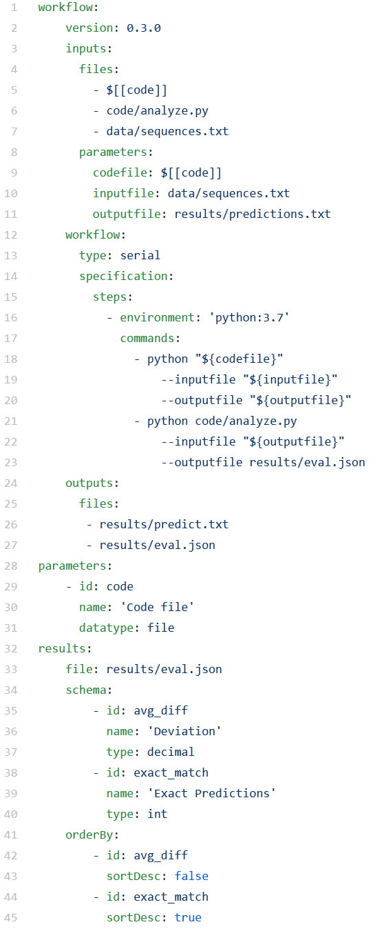
Workflow Templates
Components of Workflow Templates
Workflow specification (e.g. REANA serial workflow) with optional references to template parameters.
Declaration of template parameters (used by front-end for data input)
Specification of result schema to generate ‘leader board’.

Slide 7
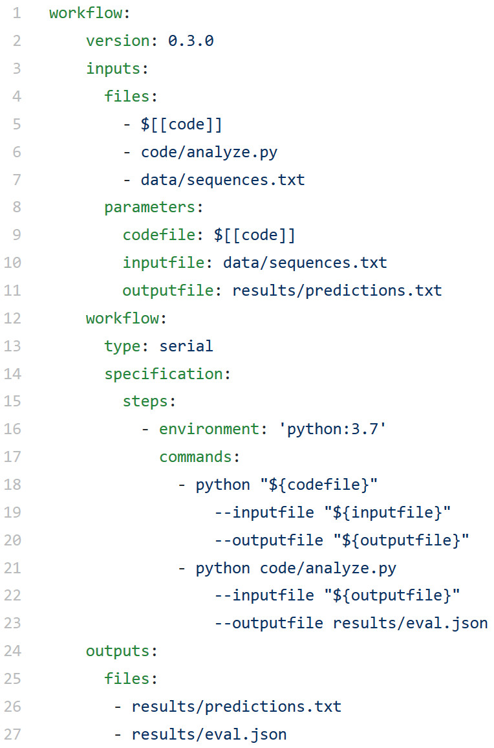
Workflow Templates (cont.)
1,3,6,4,9
3,8,1,2,4
5,6,7,8,9
1,3,5,7,9
2,4,6,8,10
sequences.txt
Predictor
11
6
10
8
12
predictions.txt
analyze.py
eval.json
{
avg_diff: 0.5,
exact_match: 2
}

Slide 8
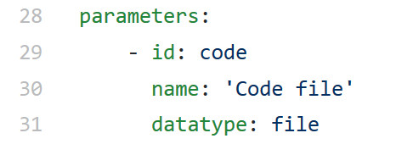
Workflow Templates (cont.)
1,3,6,4,9
3,8,1,2,4
5,6,7,8,9
1,3,5,7,9
2,4,6,8,10
Render input form from parameter declarations
sequences.txt
Predictor
11
6
10
8
12
predictions.txt
-
Run Benchmark
Code file
analyze.py
Drag file here or click to browse
eval.json
{
avg_diff: 0.5,
exact_match: 2
}
Submit
Cancel

Slide 9
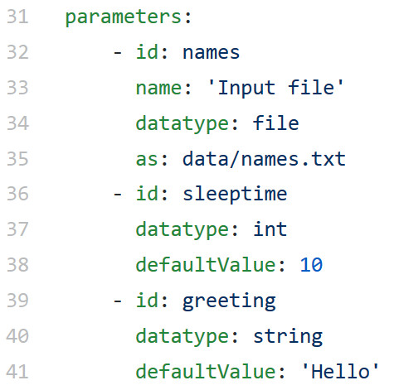
Workflow Templates (cont.)
Parameters for ‘Hello World’

Slide 10
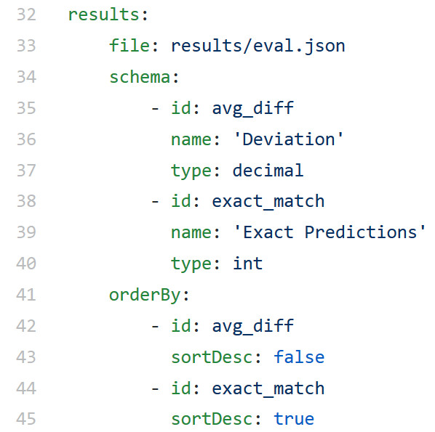
Workflow Templates (cont.)
1,3,6,4,9
3,8,1,2,4
5,6,7,8,9
1,3,5,7,9
2,4,6,8,10
Result schema to store benchmark results in database and to generate ranking
sequences.txt
Predictor
11
6
10
8
12
predictions.txt
analyze.py
eval.json
{
avg_diff: 0.5,
exact_match: 2
}

