Slide 1
ENSIME
things I'm excited about

Slide 2
ENSIME in two words
"Headless IDE"

Slide 3
Rationale
Fact: people are weird about their editors.
So: bring the IDE to the editor.

Slide 4
Getting started
git clone http://github.com/aemoncannon/ensime/master
See README

Slide 5
New stuff!

Slide 6
Lucene Indexer

Slide 7
ENSIME on ENSIME size after boot:
In-memory trie boot size: 726 MB
Lucene boot size: 315 MB
ENSIME on ENSIME boot time:
Initial: 34 seconds
Subsequent: 16 seconds

Slide 8
Sublime Text 2
Lots of improvement at github.com/sublimescala/sublime-ensime
Thanks to michaelpnash, casualjim, danielhopkins, Nuriaion, dcsobral, sjbwylbs,
Eugene Burmako

Slide 9
Sublime Text 2
Goal: get the basics working solidly.
Type checking
Goto definition
Completion

Slide 10

Debugging!

Slide 11
Debug API
:debug-start-vm
:debug-attach-vm
:debug-stop-vm
:debug-run
:debug-continue
:debug-break
:debug-clear-break
:debug-clear-all-breaks
:debug-list-breaks
:debug-next
:debug-step
:debug-step-out
:debug-value-for-name
:debug-value-for-field
:debug-value-for-stack-var
:debug-set-stack-var
:debug-value-for-id
:debug-value-for-index
:debug-backtrace
:debug-active-vm
:debug-event (:type output)
:debug-event (:type step)
:debug-event (:type breakpoint)
:debug-event (:type death)
:debug-event (:type start)
:debug-event (:type disconnect)
:debug-event (:type exception)
:debug-event (:type threadStart)
:debug-event (:type threadDeath)

Slide 12
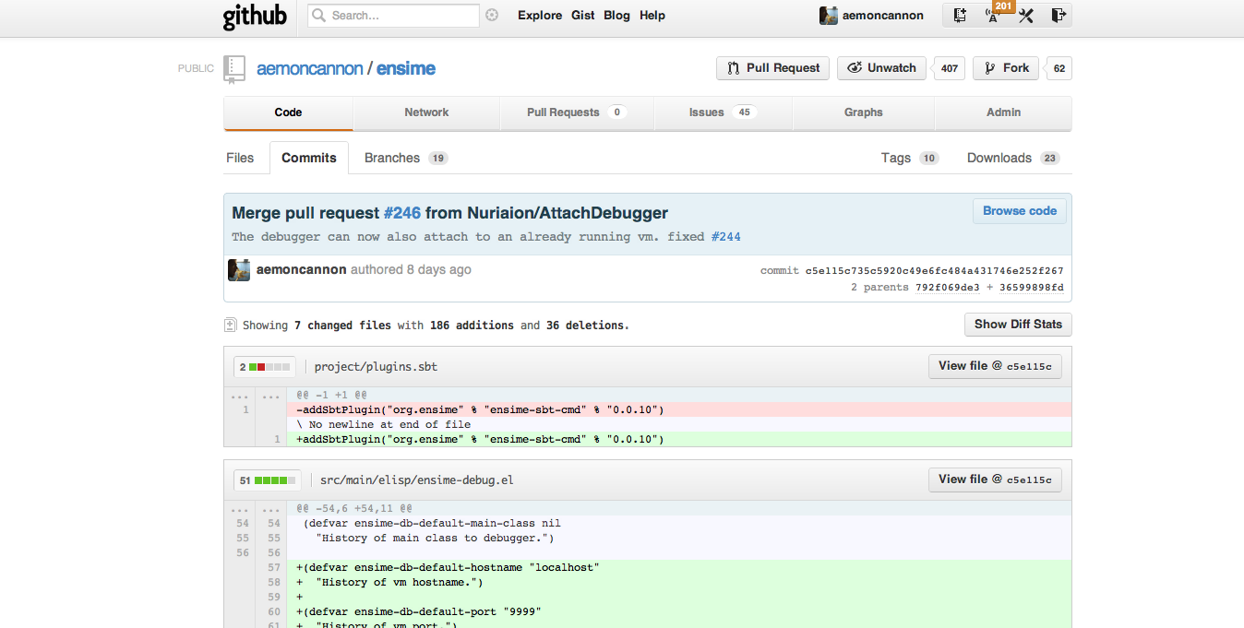
Community is Awesome

Slide 13
Finally, a quest fit for a true hero
Make scalac typecheck in the presentation compiler.

Slide 14
Thanks!

