Slide 1

Web Framework
Circumflex
introduction

Slide 2

Circumflex
Software Foundation
Web Framework
ORM Framework
Markeven
Docco
tools & integration projects

Slide 3
common goals
focus on code quality
make minimal assumptions
provide thin abstractions
make the life easier

Slide 4
Web Framework
Circumflex
architecture
Overview

Slide 5
Underlying Technologies
HTTP protocol
Java Servlet API 2.5
Standard Servlet Containers (Jetty, Tomcat, GlassFish, Resin, IBM WebSphere AS, etc...)
Scala 2.8.1 (yet)

Slide 6
Model | View | Controller
The developer’s choice: |  | Circumflex Web Framework
FreeMarker Scalate Scala XML snippets Plaintext integrate other libraries | Circumflex ORM Squeryl NoSQL solutions XML solutions other tools

Slide 7
Web Framework
Circumflex
Application Lifecycle

Slide 8

The Routing Paradigm
User Request
GET /hello/world HTTP/1.1
Main Request Router
class Main extends RequestRouter {
get("/") = <h1>Welcome!</h1>
get("/hello") = <h1>Hello world!</h1>
get("/hello/:name") =
<h1>Hello, {param("name")}!</h1>
}

Slide 9
Handling Complexity
Delegation & Prefixes
class Main extends RequestRouter {
new FooRouter
new BarRouter
}
class FooRouter extends RequestRouter(“/foo”) {
get(“/?”) = { ... } // matches `/foo` and `/foo/`
...
}
class BarRouter extends RequestRouter(“/bar”) {
...
}

Slide 10
Handling Complexity
Subroutes
any(“/users/:id/*”) = User.find(param(“id”)) map { user =>
subroute(“/users/” + user.id) {
get(“/?” = {...} // matches `/users/10` or `/users/10/`
get(“/profile”) = {...} // matches `/users/10/profile`
...
}
} getOrElse sendError(404) // if user does not exist

Slide 11
Request Dispatching
Single thread for request processing
  data sharing using ThreadLocal context
  reliable Java EE hardware scalability
  transaction-per-request pattern
Request router instance per request
  thread safety
  mutable state
Exception-driven flow
  using Scala’s ControlThrowable

Slide 12
Template Engines Integration
Template Engine
def process(template: String, data: Any): String
Data is shared using Context
get("/users/:id") = User.get(param("id")) map { user => 'user := user ftl("/users/view.ftl")} getOrElse sendError(404)
[#ftl]<h1>Hello, ${user.name}</h1>

Slide 13
Web Framework
Circumflex
API
Overview

Slide 14
Request API
accessing request parameters, headers, cookies, etc.
manipulating with Servlet sessions
parsing multi-part requests with Apache Commons FileUpload
accessing low-level HttpServletRequest

Slide 15
Response API
modifying response state: status code, cookies, content type, etc.
helpers for sending files
low-level HttpServletResponse

Slide 16
Miscellaneous
Matchers API
Routing API
Testing API
Standalone Server using Embedded Jetty

Slide 17
Web Framework
Circumflex
HOWTO

Slide 18

Before installation
Build
automation
Java 6
SDK
Revision control
Development
environment

Slide 19
Building Circumflex
Clone Circumflex repository:
Build with Maven
cd Projectsgit clone git://github.com/inca/circumflex.git
cd circumflexmvn clean install

Slide 20
Generating from Archetype
Generate new project:
Compiling:
cd Projectsmvn archetype:generate
cd wiki-slidesmvn compile jetty:run

Slide 21
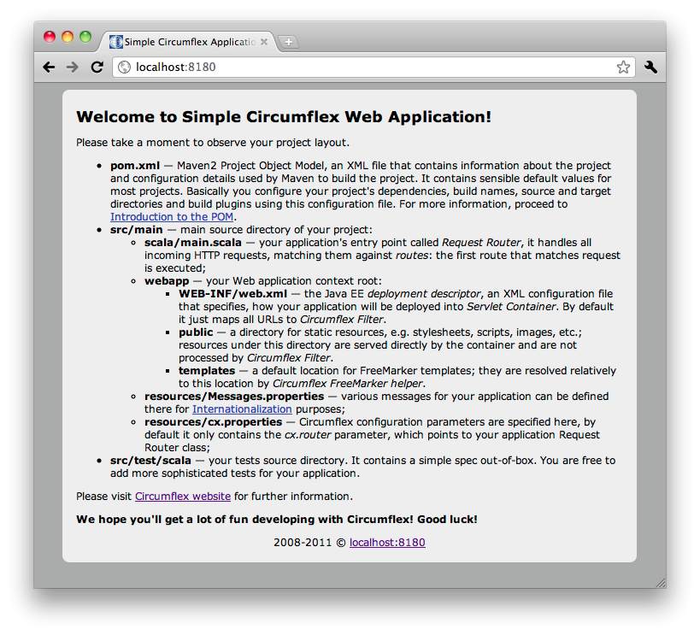

Slide 22
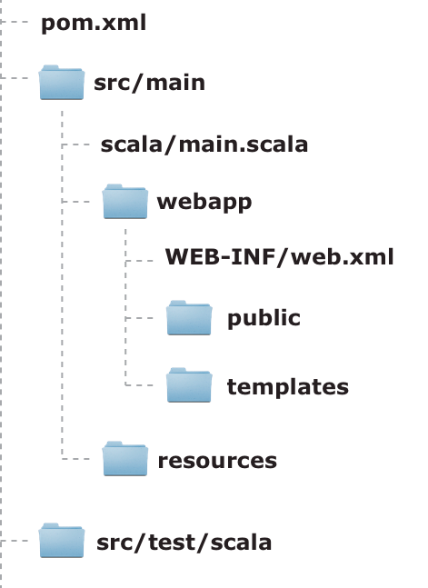
Project
layout

Slide 23
Sample Application
http://github.com/lirio/wiki-slides

Slide 24
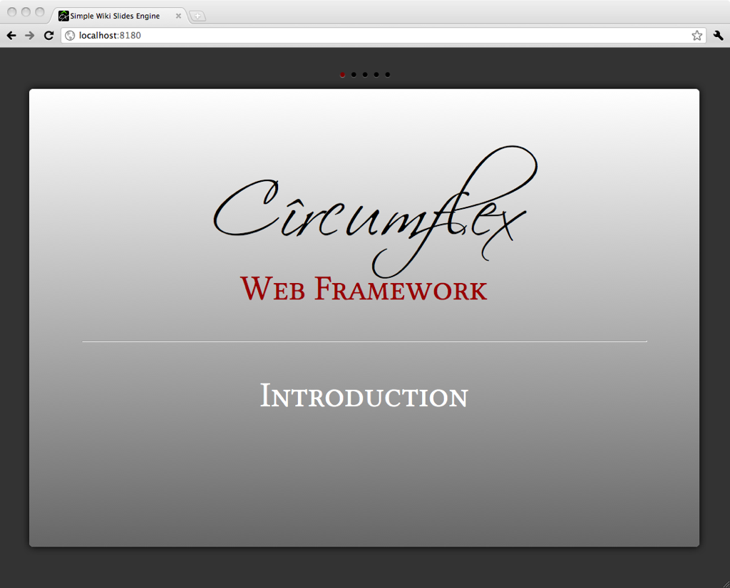

Slide 25
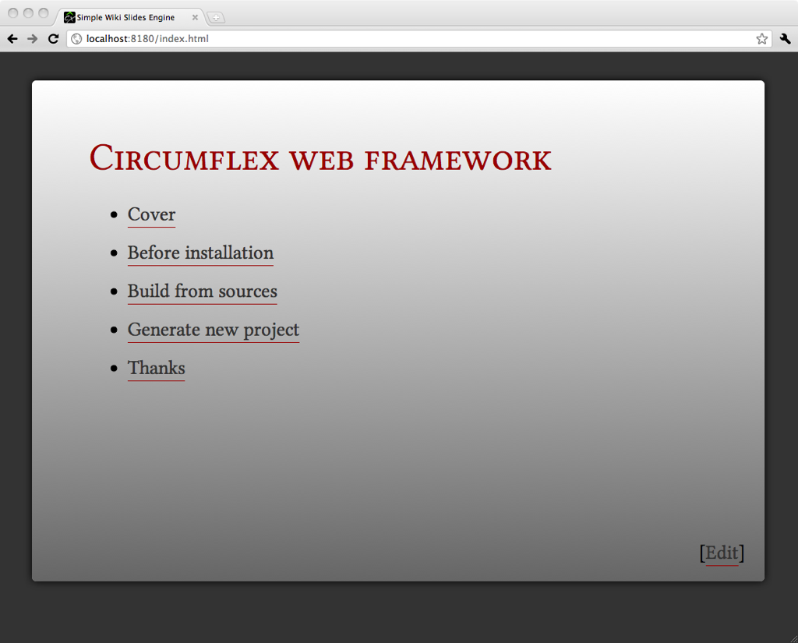

Slide 26
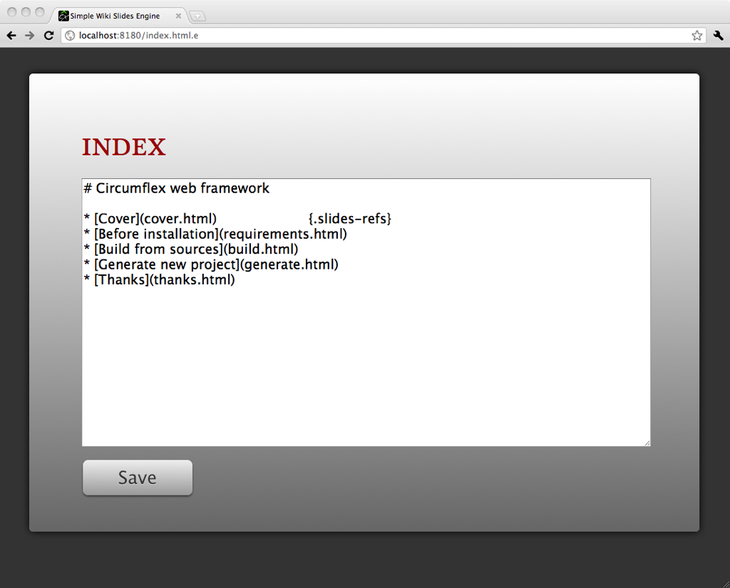

Slide 27
References
Circumflex Main Site
Circumflex Sources
FreeMarker Template Engine
http://circumflex.ru
http://github.com/inca/circumflex
http://freemarker.org

Slide 28
Thanks!

