Slide 1

Introduction to Apache Kafka
Satendra Kumar

Slide 2
Agenda
What is Kafka
Why Kafka
High level overview
Use cases
Key terminology
Partitions distribution over brokers
Replication protocol
Consumer group
Consumer Failure
Guarantees
Scala Consumer/Producer API
Java Consumer/Producer API
Keyed and Non-Keyed Messages
Auto commit enable/disable
Supported Compression type
Consumer/Producer Configuration Settings
Broker Configuration Settings

Slide 3
What is Kafka
publish-subscribe messaging system
fast
distributed by Design
fault tolerant
scalable
durable
written in Scala
free and open source

Slide 4
Building Data Pipelines

Slide 5
Building Data Pipelines

Slide 6
Building Data Pipelines

Slide 7
Building Data Pipelines

Slide 8
Building Data Pipelines

Slide 9
Building Data Pipelines

Slide 10
This is Bad data pipelining
Notes:
1) spend 10 to 20 % time for data integration
2) It is not scalable
3) push based system does not work.

Slide 11
Building Data Pipelines
Kafka decouples Data Pipelines

Slide 12
High level overview

Slide 13
High level overview

Slide 14
Use cases
Messaging
Website Activity Tracking
Metrics
Log Aggregation
Real-Time Stream Processing
Event Sourcing
Commit Log
Internet Of Things (IoT)

Slide 15
Key Terminology

Slide 18
Notes:
Topics are high level abstraction that kafka provides.
A topic is a category or feed name to which messages are published.

Slide 19
Notes:
The topics are further divided into partitions.

Slide 20
Notes:
Each partition is an ordered, immutable sequence of messages that is continually appended to—a commit log.
The messages in the partitions are each assigned a sequential id number called the offset that uniquely identifies each message within the partition.

Slide 22
Notes:
Producers publish data to the topics of their choice.
The producer is responsible for choosing which message to assign to which partition within the topic.
This can be done in a round-robin fashion simply to balance load or it can be done according to some semantic partition function (say based on some key in the message).
More on the use of partitioning in a second.

Slide 24
Notes:
1) The key abstraction in Kafka is the topic.
2) Producers publish their records to a topic, and consumers subscribe to one or more topics.
3) A Kafka topic is just a sharded write-ahead log.
4) Producers append records to these logs and consumers subscribe to changes.
5) Each record is a key/value pair. The key is used for assigning the record to a log partition (unless the publisher specifies the partition directly).

Slide 26
Notes:
Each node in the cluster is called a Kafka broker.

Slide 27
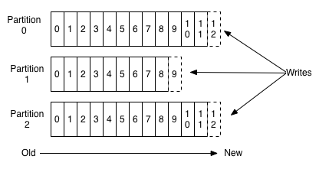
Anatomy of a Topic
For each topic, the Kafka cluster maintains a partitioned log that looks like this:
Number of partition for a Topic is configurable. In this example number of partition are three.
http://kafka.apache.org/images/log_anatomy.png
Notes:
Each partition is an ordered, immutable sequence of messages that is continually appended to—a commit log.
The messages in the partitions are each assigned a sequential id number called the offset that uniquely identifies each message within the partition.

Slide 28
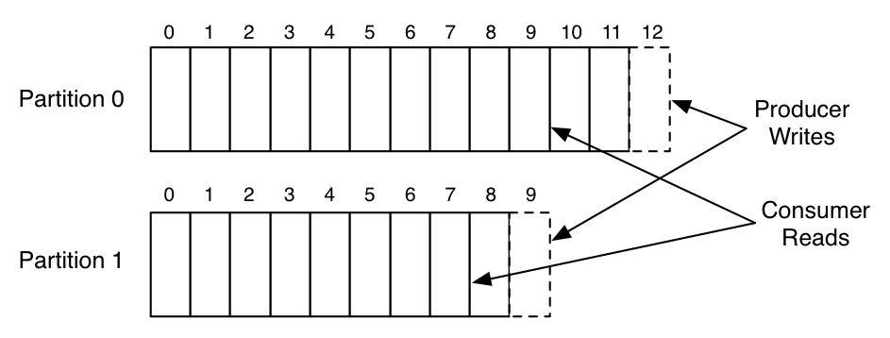
Reading & Writing From Topic
Topic with two partition:
https://content.linkedin.com/content/dam/engineering/en-us/blog/migrated/partitioned_log_0.png

Slide 29
Partitions distribution

Slide 30
Partitions distribution

Slide 31
Partitions distribution

Slide 32
Partitions distribution

Slide 33
Partitions distribution

Slide 34
Partitions distribution

Slide 35
Partitions distribution

Slide 36
Partitions Distribution
Who is responsible for these tasks ?

Slide 37
Partitions Distribution

Slide 38
Partitions Distribution

Slide 39
Partitions Distribution

Slide 40
Responsibility Of Controller
managing the states of partitions and replicas
performing administrative tasks like reassigning partitions

Slide 41
Roles For Partition
Each partition has one server which acts as the "leader" and zero or more servers which act as "followers".
The leader handles all read and write requests for the partition while the followers passively replicate the leader.
If the leader fails, one of the followers will automatically become the new leader.
Each server acts as a leader for some of its partitions and a follower for others so load is well balanced within the cluster.

Slide 42
Replication Protocol

Slide 43
Replication Protocol

Slide 44
Replication Protocol

Slide 45
Replication Protocol

Slide 46
Replication Protocol

Slide 47
Replication Protocol

Slide 48
Replication Protocol

Slide 49
Replication Protocol

Slide 50
Replication Protocol

Slide 51
Replication Protocol

Slide 52
Replication Protocol

Slide 53
Replication Protocol

Slide 54
Replication Protocol

Slide 55
Replication Protocol

Slide 56
Replication Protocol

Slide 57
Replication Protocol

Slide 58
Replication Protocol

Slide 59
Replication Protocol

Slide 60
Replication Protocol

Slide 61
Replication Protocol

Slide 62
Replication Protocol

Slide 63
Replication Protocol

Slide 64
Replication Protocol

Slide 65
Replication Protocol

Slide 66
Demo

Slide 67
Basic Operations
List all topics created:
bin/kafka-topics.sh --list --zookeeper localhost:2181
Describe a topic:
bin/kafka-topics.sh --zookeeper localhost:2181 --topic topic-name –describe

Slide 68
Basic Operations
Adding a topic:
$ bin/kafka-topics.sh --create --zookeeper localhost:2181 --replication-factor 3 --partitions 1 --topic topic_name
Modifying a topic: $ bin/kafka-topics.sh --zookeeper zk_host:localhost:2181 --alter --topic my_topic_name --partitions 4
Deleting a topic:
$bin/kafka-topics.sh --zookeeper zk_host:localhost:2181 --delete --topic my_topic_name

Slide 69
Basic Operations
Balancing Leadership:
$ bin/kafka-preferred-replica-election.sh --zookeeper zk_host:localhost:2181
Or Also configure Kafka to do this automatically by setting the following configuration :
auto.leader.rebalance.enable = true

Slide 70
Let’s try it

Slide 71
Consumer group
Messaging traditionally has two models: queuing and publish-subscribe.
Notes:
If all the consumer instances have the same consumer group, then this works just like a traditional queue balancing load over the consumers.
If all the consumer instances have different consumer groups, then this works like publish-subscribe and all messages are broadcast to all consumers.

Slide 72
Queuing

Slide 73
Queuing

Slide 74
Queuing

Slide 75
Publish-Subscribe

Slide 76
Consumer group
Messaging traditionally has two models: queuing and publish-subscribe.
Kafka offers a single consumer abstraction that generalizes both of these—the consumer group.
Notes:
If all the consumer instances have the same consumer group, then this works just like a traditional queue balancing load over the consumers.
If all the consumer instances have different consumer groups, then this works like publish-subscribe and all messages are broadcast to all consumers.

Slide 77
Consumer group
Messaging traditionally has two models: queuing and publish-subscribe.
Kafka offers a single consumer abstraction that generalizes both of these—the consumer group.
If all the consumer instances have the same consumer group, then this works just like a traditional queue balancing load over the consumers.
Notes:
If all the consumer instances have the same consumer group, then this works just like a traditional queue balancing load over the consumers.
If all the consumer instances have different consumer groups, then this works like publish-subscribe and all messages are broadcast to all consumers.

Slide 78
Consumer group
Messaging traditionally has two models: queuing and publish-subscribe.
Kafka offers a single consumer abstraction that generalizes both of these—the consumer group.
If all the consumer instances have the same consumer group, then this works just like a traditional queue balancing load over the consumers.
If all the consumer instances have different consumer groups, then this works like publish-subscribe and all messages are broadcast to all consumers.
Notes:
If all the consumer instances have the same consumer group, then this works just like a traditional queue balancing load over the consumers.
If all the consumer instances have different consumer groups, then this works like publish-subscribe and all messages are broadcast to all consumers.

Slide 87
Guarantees
At a high-level Kafka gives the following guarantees:
Messages sent by a producer to a particular topic partition will be appended in the order they are sent. That is, if a message M1 is sent by the same producer as a message M2, and M1 is sent first, then M1 will have a lower offset than M2 and appear earlier in the log.
A consumer instance sees messages in the order they are stored in the log.

Slide 88
Guarantees
At a high-level Kafka gives the following guarantees:
Messages sent by a producer to a particular topic partition will be appended in the order they are sent. That is, if a message M1 is sent by the same producer as a message M2, and M1 is sent first, then M1 will have a lower offset than M2 and appear earlier in the log.
A consumer instance sees messages in the order they are stored in the log.
For a topic with replication factor N, we will tolerate up to N-1 server failures without losing any messages committed to the log.

Slide 89
Producer Scala API
class KafkaProducer(brokerList: String) {
private val props = new Properties()
props.put("compression.codec", DefaultCompressionCodec.codec.toString)
props.put("producer.type", "sync")
props.put("metadata.broker.list", brokerList)
props.put("message.send.max.retries", "5")
props.put("request.required.acks", "-1")
props.put("serializer.class", "kafka.serializer.StringEncoder")
props.put("client.id", UUID.randomUUID().toString())
private val producer = new Producer[String, String](new ProducerConfig(props))
def send(topic: String, messages: Seq[String]): Unit =
try {
val queueMessages =
messages.map { message => new KeyedMessage[String, String](topic, message) }
producer.send(queueMessages: _*)
} catch {
case ex: Exception => ex.printStackTrace()
}
}

Slide 90
Async Producer Scala API
class KafkaProducer(brokerList: String) {
private val props = new Properties()
props.put("compression.codec", DefaultCompressionCodec.codec.toString)
props.put("producer.type", "async")
props.put("metadata.broker.list", brokerList)
props.put("batch.num.messages", "200")
props.put("message.send.max.retries", "5")
props.put("serializer.class", "kafka.serializer.StringEncoder")
props.put("client.id", UUID.randomUUID().toString())
private val producer = new Producer[String, String](new ProducerConfig(props))
def send(topic: String, messages: Seq[String]): Unit =
try {
val queueMessages =
messages.map { message => new KeyedMessage[String, String](topic, message) }
producer.send(queueMessages: _*)
} catch {
case ex: Exception => ex.printStackTrace()
}
}

Slide 91
Producer Java API
public class Producer {
private final KafkaProducer<String, String> producer;
public Producer(String servers) {
Properties props = new Properties();
props.put("bootstrap.servers", servers);
props.put("acks", "all");
props.put("retries", 5);
props.put("key.serializer", StringSerializer.class.getName());
props.put("value.serializer", StringSerializer.class.getName());
producer = new KafkaProducer<String, String>(props);
}
public Future<RecordMetadata> send(String topic, String record) {
return producer.send(new ProducerRecord<String, String>(topic, record, record));
}
}

Slide 92
Producer With Callback Java API
public class Producer {
private final KafkaProducer<String, String> producer;
public Producer(String servers) {
Properties props = new Properties();
props.put("bootstrap.servers", servers);
props.put("acks", "all");
props.put("retries", 5);
props.put("key.serializer", StringSerializer.class.getName());
props.put("value.serializer", StringSerializer.class.getName());
producer = new KafkaProducer<String, String>(props);
}
public Future<RecordMetadata> send(String topic, String record) {
ProducerRecord<String, String> message = new ProducerRecord(topic, record, record);
return producer.send(message, new CallbackHandler());
}
}
class CallbackHandler implements Callback {
public void onCompletion(RecordMetadata metadata, Exception e) {
if(e != null)
e.printStackTrace();
System.out.println("The offset of the record we just sent is: " + metadata.offset());
}
}

Slide 93
Consumer Scala API
class KafkaConsumer(topic: String, groupId: String, zookeeperConnect: String) {
private val props = new Properties()
props.put("group.id", groupId)
props.put("zookeeper.connect", zookeeperConnect)
props.put("auto.offset.reset", "smallest")
props.put("consumer.timeout.ms", "500")
props.put("auto.commit.interval.ms", "500")
private val config = new ConsumerConfig(props)
private val connector = Consumer.create(config)
private val filterSpec = new Whitelist(topic)
val numStreamsPerTopic=1
val keyDecoder=new DefaultDecoder()
val valueDecoder=new DefaultDecoder()
val streams = connector.createMessageStreamsByFilter(filterSpec, numStreamsPerTopic, keyDecoder, valueDecoder)(0)
lazy val iterator = streams.iterator()
def read():Option[String] = try {
if (hasNext) {
val message = iterator.next().message()
Some(new String(message))
} else { None }
} catch {
case ex: Throwable => None
}
private def hasNext(): Boolean =try{
iterator.hasNext()
}catch {
case timeOutEx: ConsumerTimeoutException => false
}
}

Slide 94
Consumer Java API
public class Consumer {
private final KafkaConsumer<String, String> consumer;
private final List<String> topics;
private final int id;
private final long timeout=10000;
public Consumer(int id, String groupId, String servers, List<String> topics) {
this.id = id;
this.topics = topics;
Properties props = new Properties();
props.put("bootstrap.servers", servers);
props.put("group.id", groupId);
props.put("key.deserializer", StringDeserializer.class.getName());
props.put("value.deserializer", StringDeserializer.class.getName());
consumer = new KafkaConsumer(props);
consumer.subscribe(topics);
}
public List<String> read() {
try {
ConsumerRecords<String, String> consumerRecords = consumer.poll(timeout);
List<String> records = new ArrayList();
consumerRecords.forEach( record -> records.add(record.value()));
return records;
} catch (WakeupException e) {
e.printStackTrace();
return Arrays.asList();
} finally {
consumer.close();
}
}}

Slide 95
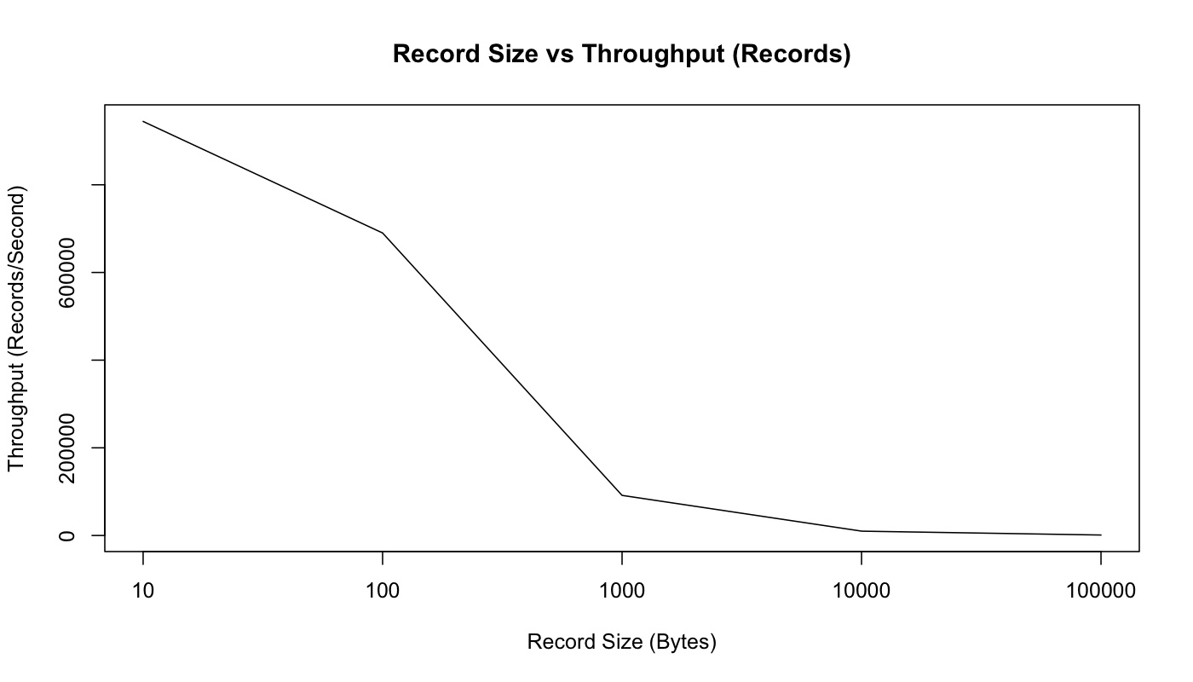
Effect of Message Size
https://engineering.linkedin.com/kafka/benchmarking-apache-kafka-2-million-writes-second-three-cheap-machines

Slide 96
Compression type
gzip
snappy
lz4
none(default)
set producer conf:
props.set(“compression.type”,”snappy”)
By default broker uses producer compression type.

Slide 97
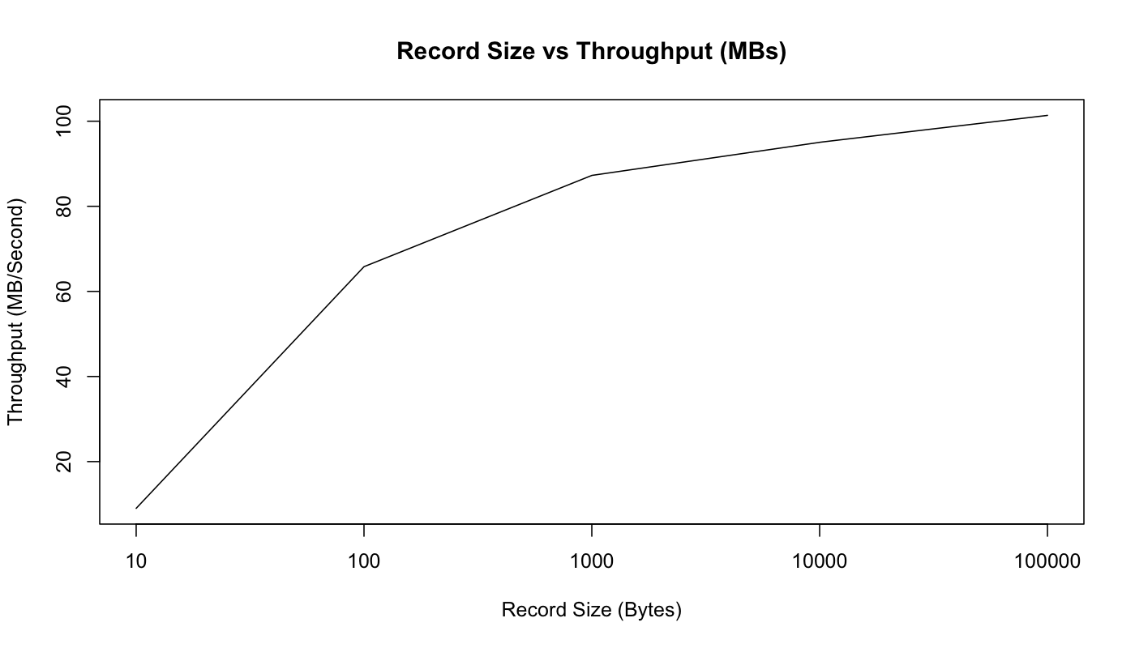
Effect of Message Size
https://engineering.linkedin.com/kafka/benchmarking-apache-kafka-2-million-writes-second-three-cheap-machines

Slide 98
Github Code URL

Slide 99
Question & Option[Answer]

Slide 100
References
http://kafka.apache.org/documentation.html
https://engineering.linkedin.com/kafka/benchmarking-apache-kafka-2-million-writes-second-three-cheap-machines
http://www.confluent.io/blog/tutorial-getting-started-with-the-new-apache-kafka-0.9-consumer-client
http://kafka-summit.org
http://www.confluent.io/blog/hands-free-kafka-replication-a-lesson-in-operational-simplicity

Slide 101

Thanks
@_satendrakumar

