Slide 1
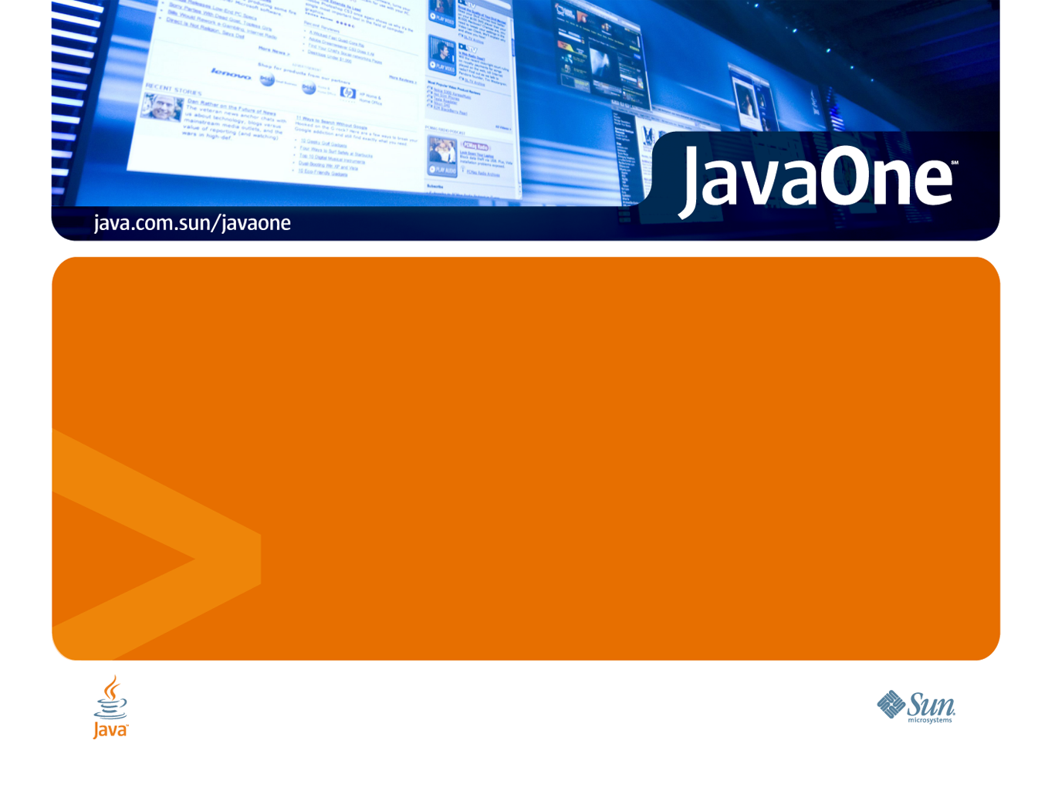
Scala - a scalable language
Martin Odersky
EPFL

Slide 2
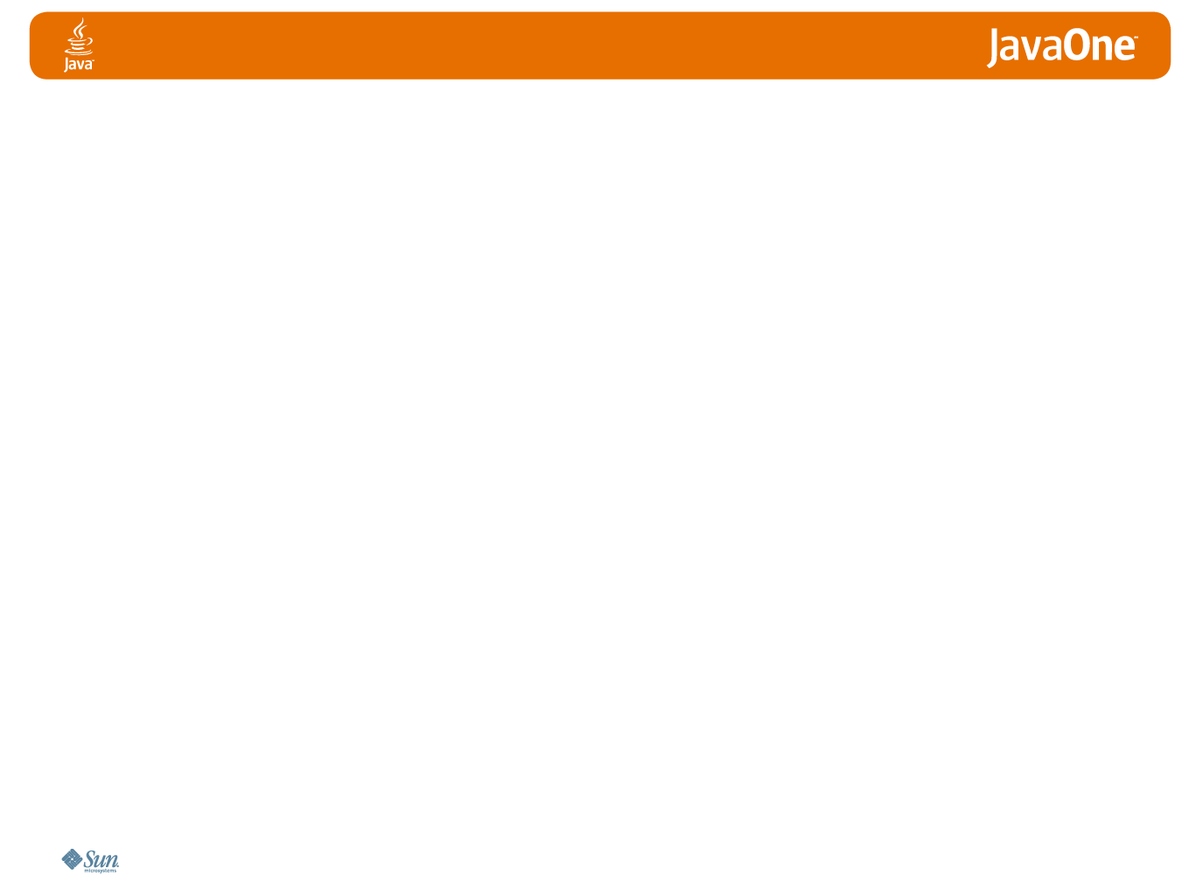
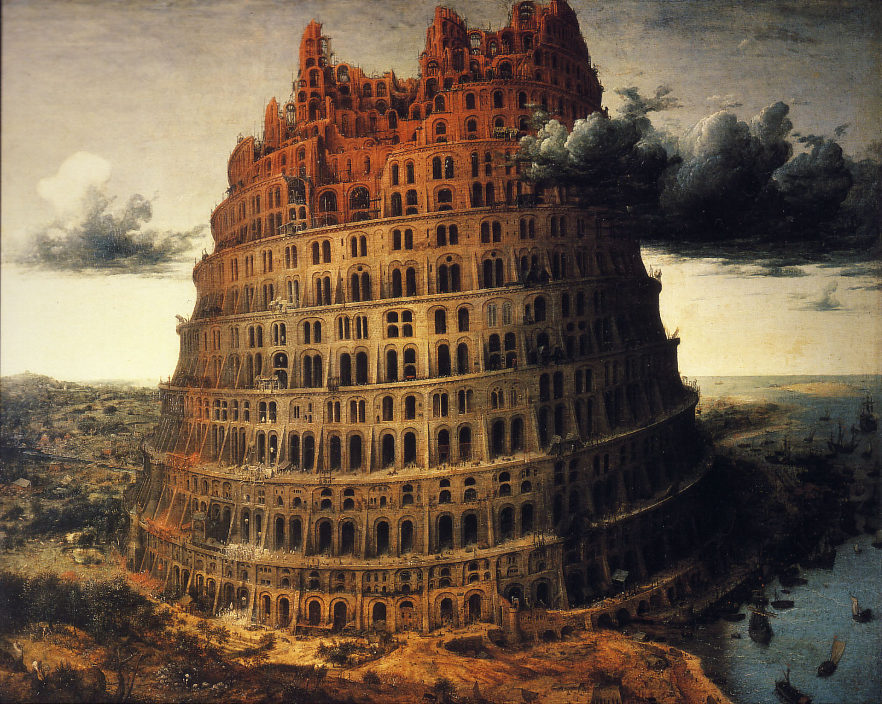

The software landscape today …
… resembles a tower of Babel with many little (or not so little) languages playing together.
E.g.
  JavaScript on the client
  Perl/Python/Ruby/Groovy for server side scripting
  JavaFX for the UI
  Java for the business logic
  SQL for database access
  all cobbled together with a
  generous helping of XML.

Slide 3
This is both good and bad
Good: Every language can concentrate on what it’s best at.
Bad: Cross language communication
  complicates deployment,
  makes systems more fragile,
  is a source of misunderstandings.
Problematic: Cross language communication is not subject to a common type system (neither static nor dynamic).
It's based instead on low-level representations such as XML trees or (worse) strings (as in JDBC database queries).

Slide 4
Alternative: Scalable languages
A language is scalable if it is suitable for very small as well as very large programs.
A single language for extension scripts and the heavy lifting.
Application-specific needs are handled through libraries and embedded DSL's instead of external languages.
Scala shows that this is possible.

Slide 5
Scala is a scripting language
It has an interactive read-eval-print-loop (REPL).
Types can be inferred.
Boilerplate is scrapped.
scala> var capital = Map("US" -> "Washington", "France" -> "Paris")
capital: Map[String, String] = Map(US -> Washington, France -> Paris)
scala> capital += ("Japan" -> "Tokio")
scala> capital("France")
res7: String = Paris

Slide 6

Scala is the Java of the future
It has basically everything Java has now.
(sometimes in different form)
It has closures.
(proposed for Java 7)
It has traits and pattern matching.
(I would not be surprised to see them in Java 8, 9 or 10)
It's compiles to .class files, is completely interoperable and runs about as fast as Java
object App {
def main(args: Array[String]) {
if (args exists (_.toLowerCase == "-help"))
printUsage()
else
process(args)
}
}

Slide 7
Interoperability
Scala fits seamlessly into a Java environment
Can call Java methods, select Java fields, inherit Java classes, implement Java interfaces, etc.
None of this requires glue code or interface descrptions
Java code can also easily call into Scala code
Performance is usually on a par with Java.

Slide 8
Scala is a composition language
New approach to module systems:
  component = class or trait
  composition via mixins
Abstraction through
  parameters,
  abstract members (both types and values),
  self types
gives dependency injection for free
trait Analyzer { this: Backend =>
…
}
trait Backend extends Analyzer
with Optimization
with Generation {
val global: Main
import global._
type OutputMedium <: Writable
}

Slide 9
Is Scala a “kitchen-sink language”?
In German: eine “Eierlegende Wollmilchsau”?
Not really. In terms of feature count, Scala is roughly comparable to today’s Java and smaller than C# or C++.
But Scala concentrates on the glue, whereas other languages concentrate on individual features.
Two principles:
1. Focus on abstraction and composition, so that users can implement their own specialized features as needed.
2. Have the same sort of constructs work for very small as well as very large programs.

Slide 10
Scala compared to Java
Scala adds | Scala removes
+ a pure object system | - static members
+ operator overloading | - primitive types
+ closures | - break, continue
+ mixin composition with traits | - special treatment of interfaces
+ existential types | - wildcards
+ abstract types | raw types
+ pattern matching | enums
Modeled in libraries:
assert, enums, properties, events, actors,
using, queries, …

Slide 11
Scala cheat sheet (1): Definitions
Scala method definitions:
def fun(x: Int): Int = {
result
}
def fun = result
Scala variable definitions:
var x: Int = expression
val x: String = expression
Java method definition:
int fun(int x) {
return result
}
(no parameterless methods)
Java variable definitions:
int x = expression
final String x = expression

Slide 12
Scala cheat sheet (2): Expressions
Scala method calls:
obj.meth(arg)
obj meth arg
Scala choice expressions:
if (cond) expr1 else expr2
expr match {
case pat₁ => expr₁
....
case pat_{n} => expr_{n}
}
Java method call:
obj.meth(arg)
(no operator overloading)
Java choice expressions, stmts:
cond ? expr1 : expr2
if (cond) return expr1;
else return expr2;
switch (expr) {
case pat₁ : return expr₁;
...
case pat_{n} : return expr_{n} ;
} // statement only

Slide 13
Scala cheat sheet (3): Objects and Classes
Scala Class and Object
class Sample(x: Int, val p: Int) {
def instMeth(y: Int) = x + y
}
object Sample {
def staticMeth(x: Int, y: Int) =
x * y
}
Java Class with statics
class Sample {
private final int x;
public final int p;
Sample(int x, int p) {
this.x = x;
this.p = p;
}
int instMeth(int y) {
return x + y;
}
static
int staticMeth(int x, int y) {
return x * y;
}
}

Slide 14
Scala cheat sheet (4): Traits
Scala Trait
trait T {
def abstractMth(x: String): Int
def concreteMth(x: String) =
x+field
var field = “!”
}
Scala mixin composition:
class C extends Super with T
Java Interface
interface T {
int abstractMth(String x)
}
(no concrete methods)
(no fields)
Java extension + implementation:
class C extends Super
implements T

Slide 15
Scalability demands extensibility
Take numeric data types
Today's languages support int, long, float, double.
Should they also support BigInt, BigDecimal, Complex, Rational, Interval, Polynomial?
There are good reasons for each of these types
But a language combining them all would be too complex.
Better alternative: Let users grow their language according to their needs.

Slide 16
Adding new datatypes - seamlessly
For instance type BigInt:
def factorial(x: BigInt): BigInt =
if (x == 0) 1 else x * factorial(x - 1)
Compare with using Java's class:
import java.math.BigInteger
def factorial(x: BigInteger): BigInteger =
if (x == BigInteger.ZERO)
BigInteger.ONE
else
x.multiply(factorial(x.subtract(BigInteger.ONE)))
}

Slide 17
Implementing new datatypes - seamlessly
Infix operations are method calls:
a + b is the same as a.+(b)
a add b is the same as a.add(b)
Here's how BigInt is implemented
+ is an identifier; can be used as a method name
import java.math.BigInteger
class BigInt(val bigInteger: BigInteger)
extends java.lang.Number {
def + (that: BigInt) =
new BigInt(this.bigInteger add that.bigInteger)
def - (that: BigInt) =
new BigInt(this.bigInteger subtract that.bigInteger)
… // other methods implemented analogously
}

Slide 18
Adding new control structures
For instance using for resource control
(proposed for Java 7)
Instead of:
using (new BufferedReader(new FileReader(path))) {
f => println(f.readLine())
}
val f = new BufferedReader(new FileReader(path))
try {
println(f.readLine())
} finally {
if (f != null) f.close()
}

Slide 19
Implementing new control structures:
Here's how one would go about implementing using:
T is a type parameter...
… supporting a close method
def using[T <: { def close() }]
(resource: T)
(block: T => Unit) {
try {
block(resource)
} finally {
if (resource != null) resource.close()
}
}
A closure that takes a T parameter

Slide 20
What makes Scala scalable?
Many factors: strong typing, inference, little boilerplate,…
But mainly, its tight integration of functional and object-oriented programming
Functional programming:
Makes it easy to build interesting
things from simple parts, using
  higher-order functions,
  algebraic types and
  pattern matching,
  parametric polymorphism.
Object-oriented programming:
Makes it easy to adapt and extend
complex systems, using
  subtyping and inheritance,
  dynamic configurations,
  classes as partial abstractions.

Slide 21
Scala is object-oriented
Every value is an object
Every operation is a method call
Exceptions to these rules in Java (such as primitive types, statics) are eliminated.
scala> (1).hashCode
res8: Int = 1
scala> (1).+(2)
res10: Int = 3

Slide 22
Scala is functional
Scala is a functional language, in the sense that every function is a value.
Functions can be anonymous, curried, nested.
Many useful higher-order functions are implemented as methods of Scala classes. E.g:
scala> val matrix = Array(Array(1, 0, 0),
| Array(0, 1, 0),
| Array(0, 0, 1))
matrix: Array[Array[Int]] = Array([I@164da25,…
scala> matrix.exists(row => row.forall(0 ==))
res13: Boolean = false

Slide 23
Functions are objects
If functions are values, and values are objects, it follows that functions themselves are objects.
The function type S => T is equivalent to scala.Function1[S, T] where Function1 is defined as follows :
So functions are interpreted as objects with apply methods.
For example, the anonymous successor function
(x: Int ) => x + 1
is expanded to:
trait Function1[-S, +T] {
def apply(x: S): T
}
new Function1[Int, Int] {
def apply(x: Int) =
x + 1
}

Slide 24
Why should I care?
Since (=>) is a class, it can be subclassed.
So one can specialize the concept of a function.
An obvious use is for arrays, which are mutable functions over integer ranges.
A bit of syntactic sugaring lets one write:
  a(i) = a(i) + 2 for
  a.update(i, a.apply(i) + 2)
class Array [T] (l: Int)
extends (Int => T) {
def length: Int = l
def apply(i: Int): T = …
def update(i: Int, x: T): Unit …
def elements: Iterator[T]
def exists(p: T => Boolean)
…
}

Slide 25
Partial functions
Another useful abstraction are partial functions.
These are functions that are defined only in some part of their domain.
What's more, one can inquire with the isDefinedAt method whether a partial function is defined for a given value.
trait PartialFunction[-A, +B]
extends (A => B) {
def isDefinedAt(x: A):Boolean
}
Scala treats blocks of pattern matching cases as instances of partial functions.
This lets one write control structures that are not easily expressible otherwise.

Slide 26
Developing new paradigms
Scala's flexibility makes it possible for users to grow the language into completely new paradigms.
Case in point: concurrent programming
Since Scala is interoperable, Java threads and concurrent libraries are available.
But it's also possible to explore completely new paradigms.

Slide 27
Erlang-style actors
Two principal constructs (adopted from Erlang):
Send (!) is asynchronous; messages are buffered in an actor's mailbox.
receive picks the first message in the mailbox which matches any of the patterns msgpat_{i}.
If no pattern matches, the actor suspends.
// asynchronous message send
actor ! message
// message receive
receive {
case msgpat₁ => action₁
…
case msgpat_{n} => action_{n}
}
A pattern matching block of type
PartialFunction[MessageType, ActionType]

Slide 28
A simple actor
case class Data(bytes: Array[Byte])
case class Sum(receiver: Actor)
val checkSumCalculator =
actor {
var sum = 0
loop {
receive {
case Data(bs) => sum += hash(bs)
case Sum(receiver) => receiver ! sum
}
}
}
}
Spawn a new actor
repeatedly receive messages

Slide 29
Implementing receive
Using partial functions, it is straightforward to implement receive:
Here,
  self designates the currently executing actor,
  mailBox is its queue of pending messages, and
  extractFirst extracts first queue element matching given predicate.
def receive [T] (f: PartialFunction[Message, T]): T = {
self.mailBox.extractFirst(f.isDefinedAt)
match {
case Some(msg) =>
f(msg)
case None =>
self.wait(messageSent)
}
}

Slide 30
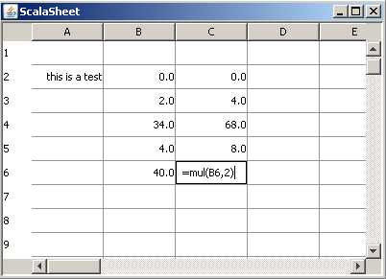
Scala in serious use
I now show how Scala's constructs play together in a realistic application.
Task: Write a spreadsheet
Start from scratch, don't use any parts which are not in the standard libraries
You'll see that this can be done in about 200 lines of code.

Slide 31
Step 1: The main function
package scells
import swing._
object Main extends SimpleGUIApplication {
def top = new MainFrame {
title = "ScalaSheet"
contents += new SpreadSheet(100, 26)
}
}
Advantage of objects over statics: objects can inherit.
Hence, can hide low-level fiddling necessary to set up a swing application.

Slide 32
Step 2: The SpreadSheet class - view
Property syntax; expands to method call
rowHeight_=(25)
This calls in turn jtable.setRowHeight(25)
class SpreadSheet(val height: Int, val width: Int) extends ScrollPane {
val cellModel = new Model(height, width)
import cellModel.{cells, valueChanged}
val table = new Table(height, width) {
rowHeight = 25
autoResizeMode = Table.AutoResizeMode.Off
showGrid = true
gridColor = Color(150, 150, 150)
def userData(row: Int, column: Int): String = {
val v = this(row, column)
if (v == null) "" else v.toString
}
override def render(isSelected: Boolean, hasFocus: Boolean, row: Int, column: Int) =
if (hasFocus) new TextField(userData(row, column))
else new Label(cells(row)(column).toString) { halign = Orientation.right }
reactions += {
case event.TableChanged(table, firstRow, lastRow, column) =>
for (row <- firstRow to lastRow)
cells(row)(column).formula =
FormulaParsers.parse(userData(row, column))
case ValueChanged(cell) =>
markUpdated(cell.row, cell.column)
}
for (row <- cells; cell <- row) listenTo(cell)
}
val rowHeader = new ComponentList((0 until height) map (_.toString)) {
fixedCellWidth = 30
fixedCellHeight = table.rowHeight
}
viewportView = table; owHeaderView = rowHeader
}

Slide 33
Step 3: The SpreadSheet class - controller
class SpreadSheet(val height: Int, val width: Int) extends ScrollPane {
val cellModel = new Model(height, width)
import cellModel.{cells, valueChanged}
val table = new Table(height, width) {
rowHeight = 25
autoResizeMode = Table.AutoResizeMode.Off
showGrid = true
gridColor = Color(150, 150, 150)
def userData(row: Int, column: Int): String = {
val v = this(row, column)
if (v == null) "" else v.toString
}
override def render(isSelected: Boolean, hasFocus: Boolean, row: Int, column: Int) =
if (hasFocus) new TextField(userData(row, column))
else new Label(cells(row)(column).toString) { halign = Orientation.right }
reactions += {
case event.TableChanged(table, firstRow, lastRow, column) =>
for (row <- firstRow to lastRow)
cells(row)(column).formula = FormulaParsers.parse(userData(row, column))
case ValueChanged(cell) =>
markUpdated(cell.row, cell.column)
}
for (row <- cells; cell <- row) listenTo(cell)
}
val rowHeader = new ComponentList((0 until height) map (_.toString)) {
fixedCellWidth = 30
fixedCellHeight = table.rowHeight
}
viewportView = table; owHeaderView = rowHeader
}
reactions property defines component behavior with closures.
Import can be used anywhere,
not just at top-level
Events are objects,
can pattern match on them.

Slide 34
Spreadsheet formulas
We consider:
  -12.34 Number
  text Text label
  =expr Formulas, consisting of
  B12 Cell
  B12:C18 Range of cells
  add(A7,A4) Binary operation
  sum(A12:A14,A16) Vararg operation
  (no infix operations such as X+Y)
Formula expressions can nest, as in:
  =sum(mul(A4, 2.0), B7:B15))

Slide 35
Step 4: Representing formulas internally
Case classes enable pattern matching
B12 → Coord(12, 1)
B0:B9 → Range(Coord(0, 1), Coord(9, 1)
-12.34 → Number(-12.34d)
trait Formula {}
case class Coord(row: Int, column: Int) extends Formula {
override def toString = ('A' + column).toChar.toString + row
}
case class Range(c1: Coord, c2: Coord) extends Formula {
override def toString = c1.toString+":"+c2.toString
}
case class Number(value: Double) extends Formula {
override def toString = value.toString
}
case class Textual(value: String) extends Formula {
override def toString = value.toString
}
case class Application(function: String, arguments: List[Formula])
extends Formula {
override def toString = function+arguments.mkString("(", ", ", ")")
}
object Empty extends Textual("")
Sales forecast → Textual("Sales forcast")
add(A7, 1) → Application(Coord(7, 0), Number(1))

Slide 36
A grammar for formulas
number = -?\d+(\.\d*)
ident = [A-Za-z_]\w*
cell = [A-Za-Z]\d+
range = cell : cell
application = ident
( expr (, expr)* )
expr = number
| cell
| range
| application
formula = = expr
textual = [^=].*

Slide 37
A grammar for formulas and their parsers
number = -?\d+(\.\d*) """-?\d+(\.\d*)?""".r
ident = [A-Za-z_]\w* """[a-zA-Z_]\w*""".r
cell = [A-Za-Z]\d+ """ [A-Za-z]\d\d*""".r
range = cell : cell cell~":"~cell
application = ident ident~ ( expr (, expr)* ) "("~repsep(expr, ",")~")"
expr = number number | cell | range |
| cell application
| range
| application
formula = = expr "=" ~> expr
textual = [^=].* """[^=].*""".r

Slide 38
Step 5: Parsing formulas
object FormulaParsers
extends RegexParsers {
def ident: Parser[String] =
"""[a-zA-Z_]\w*""".r
def decimal: Parser[String] =
"""-?\d+(\.\d*)?""".r
def cell: Parser[Coord] =
"""[A-Za-z]\d+""".r ^^ { s =>
val column = s.charAt(0) - 'A'
val row = s.substring(1).toInt
Coord(row, column)
}
def range: Parser[Range] =
cell~":"~cell ^^ {
case c1~":"~c2 => Range(c1, c2)
}
def number: Parser[Number] =
decimal ^^ (s => Number(s.toDouble))
def application: Parser[Application] =
ident~"("~repsep(expr, ",")~")" ^^ {
case f~"("~ps~")" =>
Application(f, ps)
}
def expr: Parser[Formula] =
application | range | cell | number
def textual: Parser[Textual] =
"""[^=].*""".r ^^ Textual
def formula: Parser[Formula] =
number | textual | "=" ~> expr
def parse(input: String): Formula =
parseAll(formula, input) match {
case Success(e, _) => e
case f: NoSuccess =>
Textual("["+f.msg+"]")
}
}
This makes use of an internal DSL, much like the external Lex and Yacc.

Slide 39
Step 6: Evaluating formulas
Evaluate by pattern matching
on the kind of formula
trait Evaluator { this: Model =>
val operations = new collection.mutable.HashMap[String, List[Double] => Double]
def evaluate(e: Formula): Double = e match {
case Number(v) => v
case Textual(_) => 0
case Coord(row, column) => cells(row)(column).value
case Application(function, arguments) =>
val argvals = arguments flatMap evalList
operations(function)(argvals)
}
private def evalList(e: Formula): List[Double] = e match {
case Range(_, _) => references(e) map (_.value)
case _ => List(evaluate(e))
}
def references(e: Formula): List[Cell] = e match {
case Coord(row, column) => List(cells(row)(column))
case Range(Coord(r1, c1), Coord(r2, c2)) =>
for (row <- (r1 to r2).toList; column <- c1 to c2)
yield cells(row)(column)
case Application(function, arguments) => arguments flatMap references
case => List()
}
Scala's Self-type feature lets us assume the type of this in Evaluator is Model
That's
dependency
injection!
But how does Evaluator know abaout cells?

Slide 40
Step 7: The spreadsheet Model class
class Model(val height: Int, val width: int) extends Evaluator with functions.Arithmetic {
class Cell(row: Int, column: Int) extends Publisher {
private var v: Double = 0
def value: Double = v
def value_=(w: Double) {
if (!(v == w || v.isNaN && w.isNaN)) {
v = w
publish(ValueChanged(this))
}
}
private var e: Formula = Empty
def formula: Formula = e
def formula_=(e: Formula) {
for (c <- references(formula)) deafTo(c)
this.e = e
for (c <- references(formula)) listenTo(c)
value = evaluate(e)
}
reactions += {
case ValueChanged(_) => value = evaluate(formula)
}
}
case class ValueChanged(cell: Cell) extends event.Event
val cells = new Array[Array[Cell]](height, width)
for (i <- 0 until height; j <- 0 until width)
cells(i)(j) = new Cell(i, j)
}

Slide 41
Lessons learned
DSL's can help: Parser combinators, swing components and reactions.
Internal DSLs have advantages over external ones.
Mixin composition + self types let you write fully re-entrant complex systems without any statics.
Application complexity can be reduced by the right language constructs.
To ensure you always have the right constructs, you need a language that's extensible and scalable.

Slide 42
The Scala community
5000 downloads a month
240 trak contributors
20-30 messages/day on the mailing lists
Many companies and individuals.
lift web framework
Scala LiftOff conference:
  www.scalaliftoff.com
  Sat May 10th, 2008 from 9am
  301 Battery Street, San Francisco

Slide 43
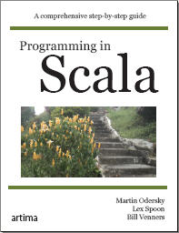
Publicity break
This talk has taken you from Scala's design principles and motivations to all the fiddly details of a concrete application.
There's a book almost finished which covers on 600+ pages the missing stuff in-between.
It's available as a rough cut from artima.com.

Slide 44
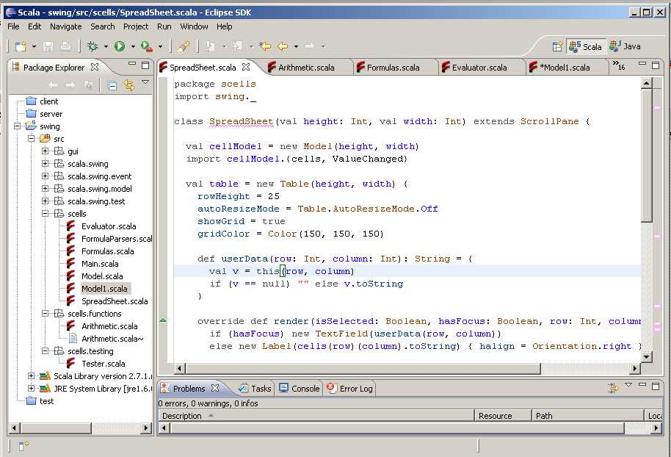
Try it out: scala-lang.org
Thanks to the (past and present) members of the Scala team:
Philippe Altherr, Vincent Cremet, Iulian Dragos, Gilles Dubochet, Burak Emir, Sebastian Hack, Philipp Haller, Sean McDermid, Ingo Meier, Adriaan Moors, Stéphane Micheloud, Nikolay Mihaylov, Likas Rytz, Michel Schinz, Lex Spoon, Erik Stenman, Geoffrey Washburn, Matthias Zenger.

Slide 45
Summing Up
Scala blends functional and object-oriented programming.
This has worked well in the past: for instance in Smalltalk, Python, or Ruby.
However, Scala is goes farthest in unifying FP and OOP in a statically typed language.
This leads to pleasant and concise programs.
Scala feels similar to a modern scripting language, but without giving up static typing.

Slide 46
Relationship between Scala and other languages
Main influences on the Scala design: Java, C# for their syntax, basic types, and class libraries,
Smalltalk for its uniform object model,
Eiffel for its uniform access principle,
Beta for systematic nesting,
ML, Haskell for many of the functional aspects.
OCaml, OHaskel, PLT-Scheme, as other (less tightly integrated) combinations of FP and OOP.
Pizza, Multi Java, Nice as other extensions of the Java platform with functional ideas.
(Too many influences in details to list them all)
Scala also seems to influence other new language designs, see for instance the closures and comprehensions in LINQ/C# 3.0.

